Slide 1
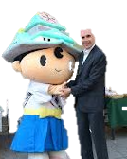
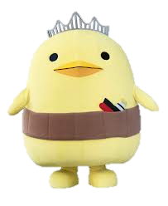
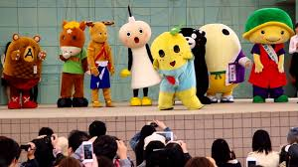
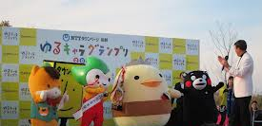
ゆるキャラ
Background of ゆるキャラ
Research links toゆるキャラ
Language functions relating to comparisons and explanations

Slide 2
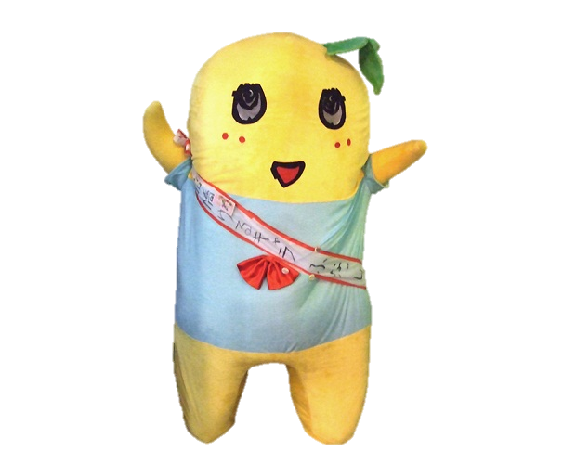
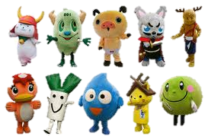
What is "Yuru-kyara"?
"Yuru-kyara(ゆるキャラ)"(loose characters) are cute, friendly and a little bizarre mascots owned by national government organizations, local governments, companies, individuals for the purpose of public relations. In recent years in Japan, more and more local governments(prefectures and municipalities) compete to create their own ゆるキャラ. It is commonly called "ゆるキャラ” boom.

Slide 3
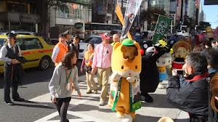
Popularity of ゆるキャラ The Wall Street Journal: Isn't That Cute? In Japan, Cuddly Characters Compete Tuesday, December 25, 2012 As of 10:30 PM EST
TOKYO—Japan's new prime minister won election this month promising a more muscular military, and campaigning with a trademark clenched fist in TV commercials vowing to "take back Japan."
But soon after taking office Wednesday, Shinzo Abe will get an image makeover. Next month, his Liberal Democratic Party will unveil the design of a soft, cuddly mascot modeled after him—based on a proposal deemed most "widely lovable and cute," said an official when announcing the contest in November.
In the past, backers of Mr. Abe had promoted his looks. But now, "we thought Mr. Abe would be accepted more widely by being cute versus being handsome," said Taizo Toyoda, an LDP spokesman.

Slide 4
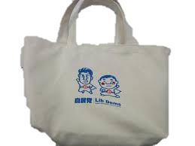
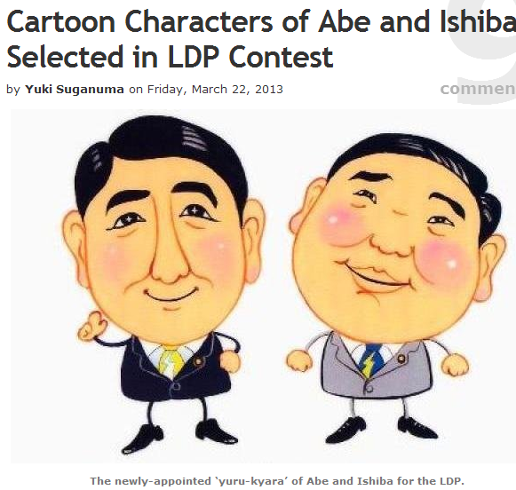
http://www.japancrush.com/2013/stories/3931.html
The Liberal Democratic Party of Japan held an award ceremony for an illustration competition based on illustrations of the Prime Minister Abe Shinzo and Secretary-General, Ishiba Shigeru for the party convention on March 17. It’s part of media strategies toward the House of Councilors election in the summer and attendees at the party convention received plastic folders and eco-friendly reusable shopping bags with the Abe and Ishiba ‘yuru-kyara’ printed on them.
The acrylic painter, Ms Takahashi Reika (age 47, Sapporo) won the top prize. She drew both in suits and lightning patterned ties. The Prime Minister praised her drawing, calling it ‘well drawn, very cute’. Ms Takahashi said: ‘Please get ahead with your work with lightning speed’.

Slide 5
例：くまモン
Kumamon standing
One of the most popular yuru-kyara in Japan is "Kumamon(くまモン)", which is a mascot of Kumamoto Prefecture. "Kumamon" is a combination of two words: "Kuma" is short for Kumamoto and "Mon" represents the local dialect that uses that word for the standard Japanese word for "things," or "mono (物)."

Slide 6
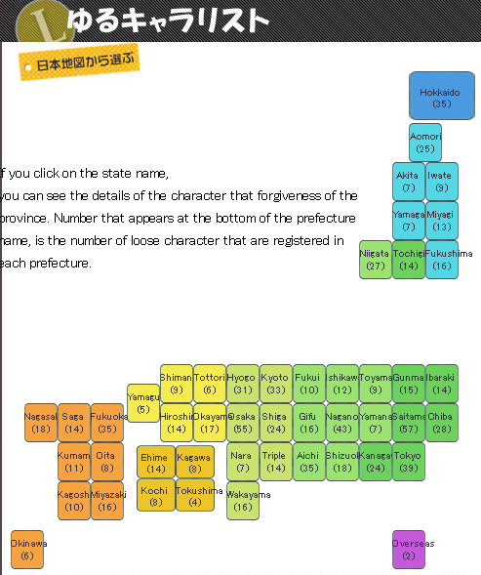
けんきゅう：Research ゆるキャラ
A list of the ゆるキャラ and their places of origin can be found at http://www.yurugp.jp/

Slide 7
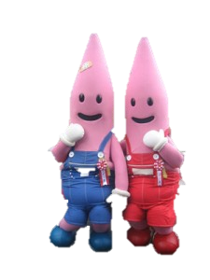
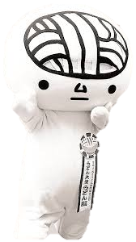
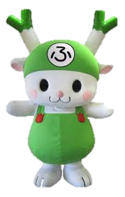
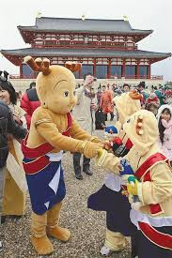
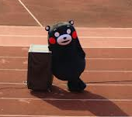
いちばん 好きな ゆるキャラ は 何 です か？ どうして？
ゆるキャラの名前 (name?) | とくちょう (characteristics) | 何をすすめていますか？ (promote?)
1.
2.
3.
4.
5.
くまもん
うどんのう
せんとくん
のっぽん
ふっかちゃん

Slide 8
例：
名前 は うどんのう と 言います。
一番好きなゆるキャラだと思います。ちょっと へんな のです。
香川町「かがわまち」から 来ました。
頭「あたま」は うどん の よう です。長くて白いです。そして うどん は にんきな 食べ物 んです。
毎日「まいにち」食べていたので、あさおきたら白くて長い「ながい」食べ物の頭「あたま」になりました！でも今は、この食べ物で有名「ゆうめい」な町「まち」のＰＲたいし(ambassador)です！

Slide 9
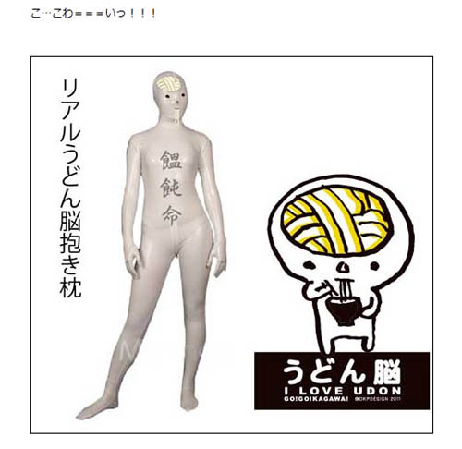
うどん のう
Udon Nou means “Udon (noodle) Brain.” As you can see, he’s not kidding about his name. The official story is that he used to be a normal human being once, but because he loved eating udon so much, one day when he woke up he found himself looking like this. Kagawa is well-known for its delicious udon noodle, but if it has such side-effect I’ll think about it before I eat.
On Udon Nou official blog（http://udonnoww.jugem.jp/?eid=33), he once posted a realistic image of himself, which is even more nightmarish.

Slide 10
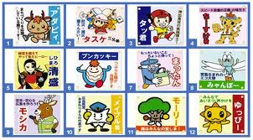
Language Functions for class discussion on ゆるキャラ
most 一番好きなゆるキャラは＿＿です。
comparing (A is not as __as B) AはＢほどかわくないです。
comparing (A is more __than B) Ａの方がＢより＿＿です。
opinions (I think __) ～だと思います。
Explaining and giving reasons ～んです・～んだ

Slide 11
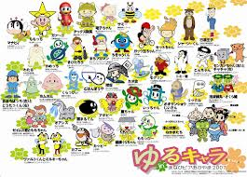
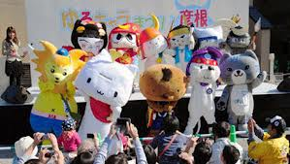
How to create a ゆるキャラ！
A growing army of yuru-kyara is inundating Japan with hundreds of soft, plush mascots representing municipalities, government organizations and companies with a uniquely Japanese mix of cute and bizarre.
1. グルプで、オリジナル「ゆるキャラ」をかんがえる。(Brainstorm the ゆるキャラin groups)
2. デザイン、名前、好きな物、すむところを かんがえる。(think about design, name, favourite things, where it comes from)

Slide 12
3. Choose a name linked to the area/product you wish to promote. （Their name often provides some clues to "what" they are—because it may not be clear visually.)
4. ぎじんか：Personalize your ゆるキャラ by adding ~ちゃん or ～くん
5. List the main features of the ゆるキャラ
6. ミッションを かんがえて、アピール・ポスタをかんがえる。Think about the mission and the reason for creating this ゆるキャラ. What is it going to promote?
7. Complete the スクリプト(script on next slide/handout)
8. Now your ゆるキャラis ready to compete in the annual grand prix … present your ゆるキャラ!
がんばってください！

Slide 13
スクリプト
ゆるキャラ の 名前は ___です。
とくちょ(physical features)は ＿＿ です。
好きな物「すきなもの」は ＿＿ です。
(mission) ＿＿＿＿ように それが ミッション です。
(reasons why this ゆるキャラ was made) ____________ から、私たちは、この ゆるキャラ を かんがえました。
ポスターのスローガン(slogan)は、＿＿＿＿＿＿＿です。

Slide 14
ゆるキャラ グランプリ！ http://www.yurugp.jp/
In 2012, there were 865 ゆるキャラentered in the Grand Prix!

Slide 15
Bibliography
Cartoon Characters of Abe and Ishiba Selected in LDP Contest by Yuki Suganuma on Friday, March 22, 2013 http://www.japancrush.com/2013/stories/3931.html
Creepy yuru kyara http://blog.rinkya.com/creepiest-town-mascots-of-japan-that-would-make-kids-cry/
Cathy Jonak: Japan Foundation Sydney, Professional Development Session “yurukyara” http://www.jpf.org.au/pd/sessions/pdsession_anz.html
Kumamon http://topics-on-japan.blogspot.com.au/2013/03/what-is-yuru-kyara.html
Kumamon's official website http://kumamon-official.jp/
Wall Street Journal, Isn't That Cute? In Japan, Cuddly Characters Compete http://online.wsj.com/article/SB10001424127887323717004578156610405635572.html
Yurukyara Grand Prix http://www.yurugp.jp/

