Slide 1
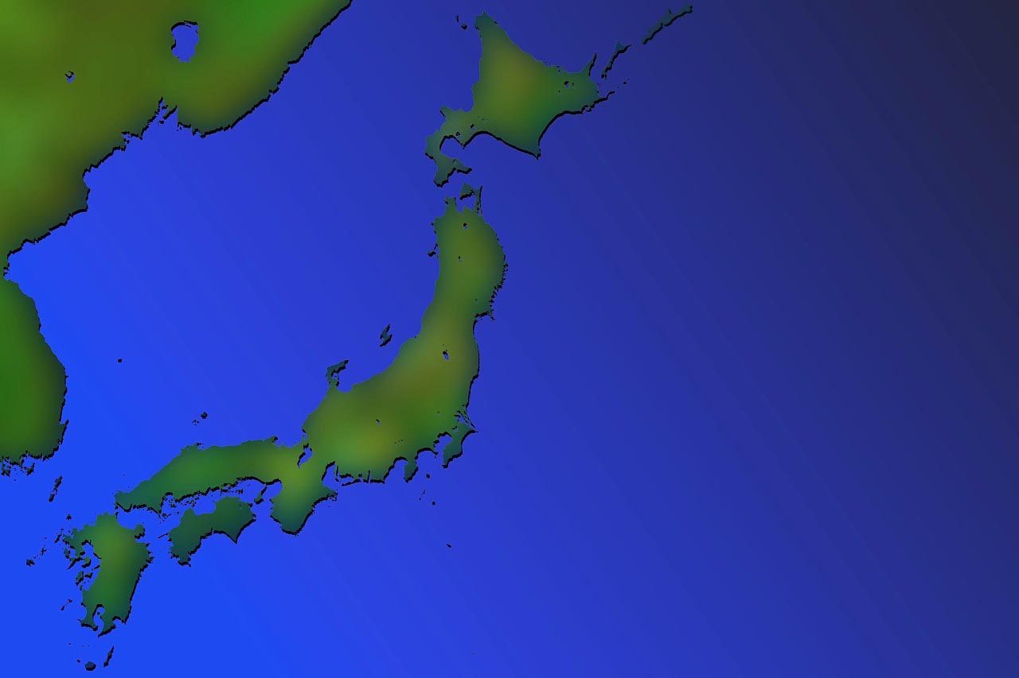
い
日本の どこに 行きたい ですか。
Where do you want to go in Japan?

Slide 2
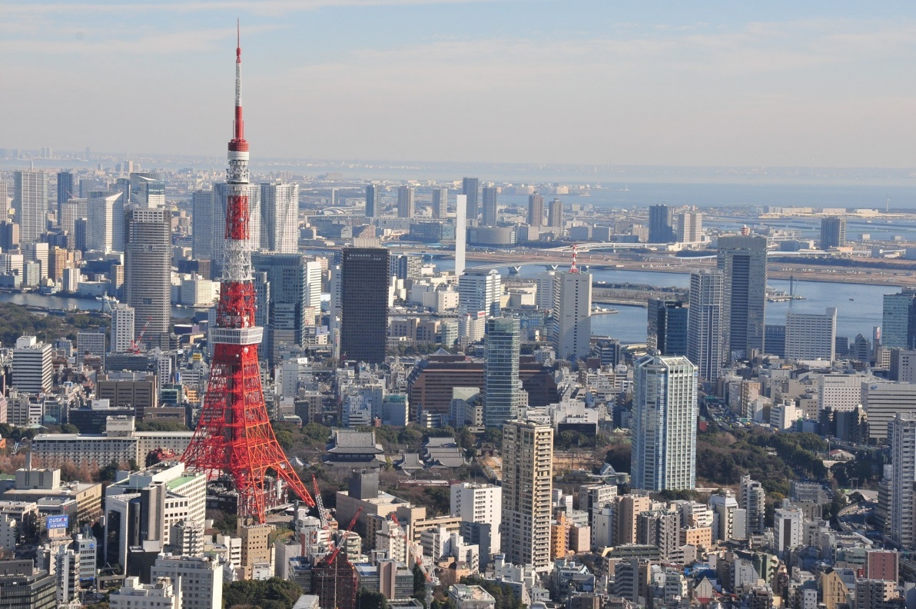
とうきょう い
東京に 行きたい です。
I want to go to Tokyo

Slide 3
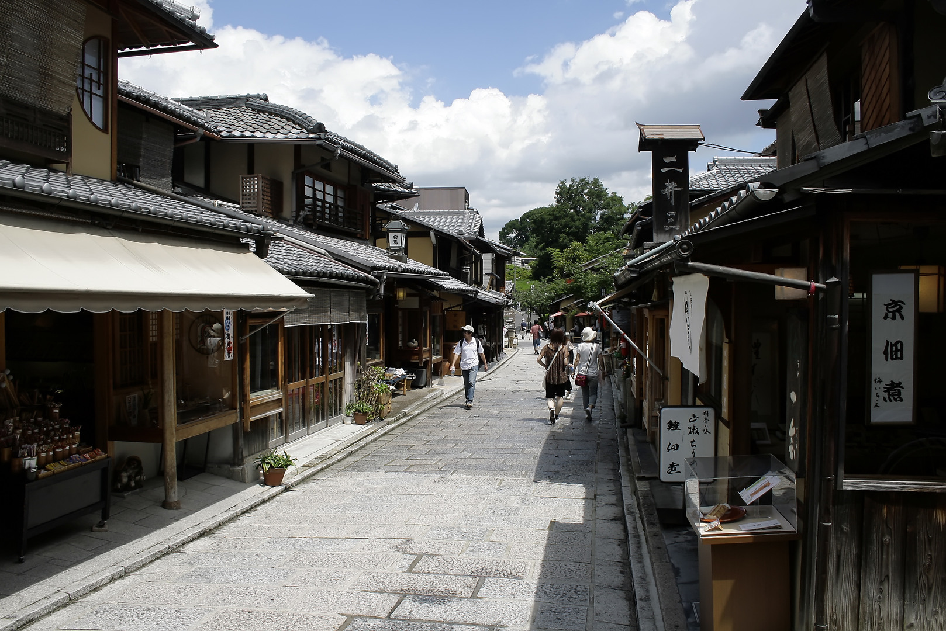
い
きょうと に 行きたい です。
I want to go to Kyoto.

Slide 4
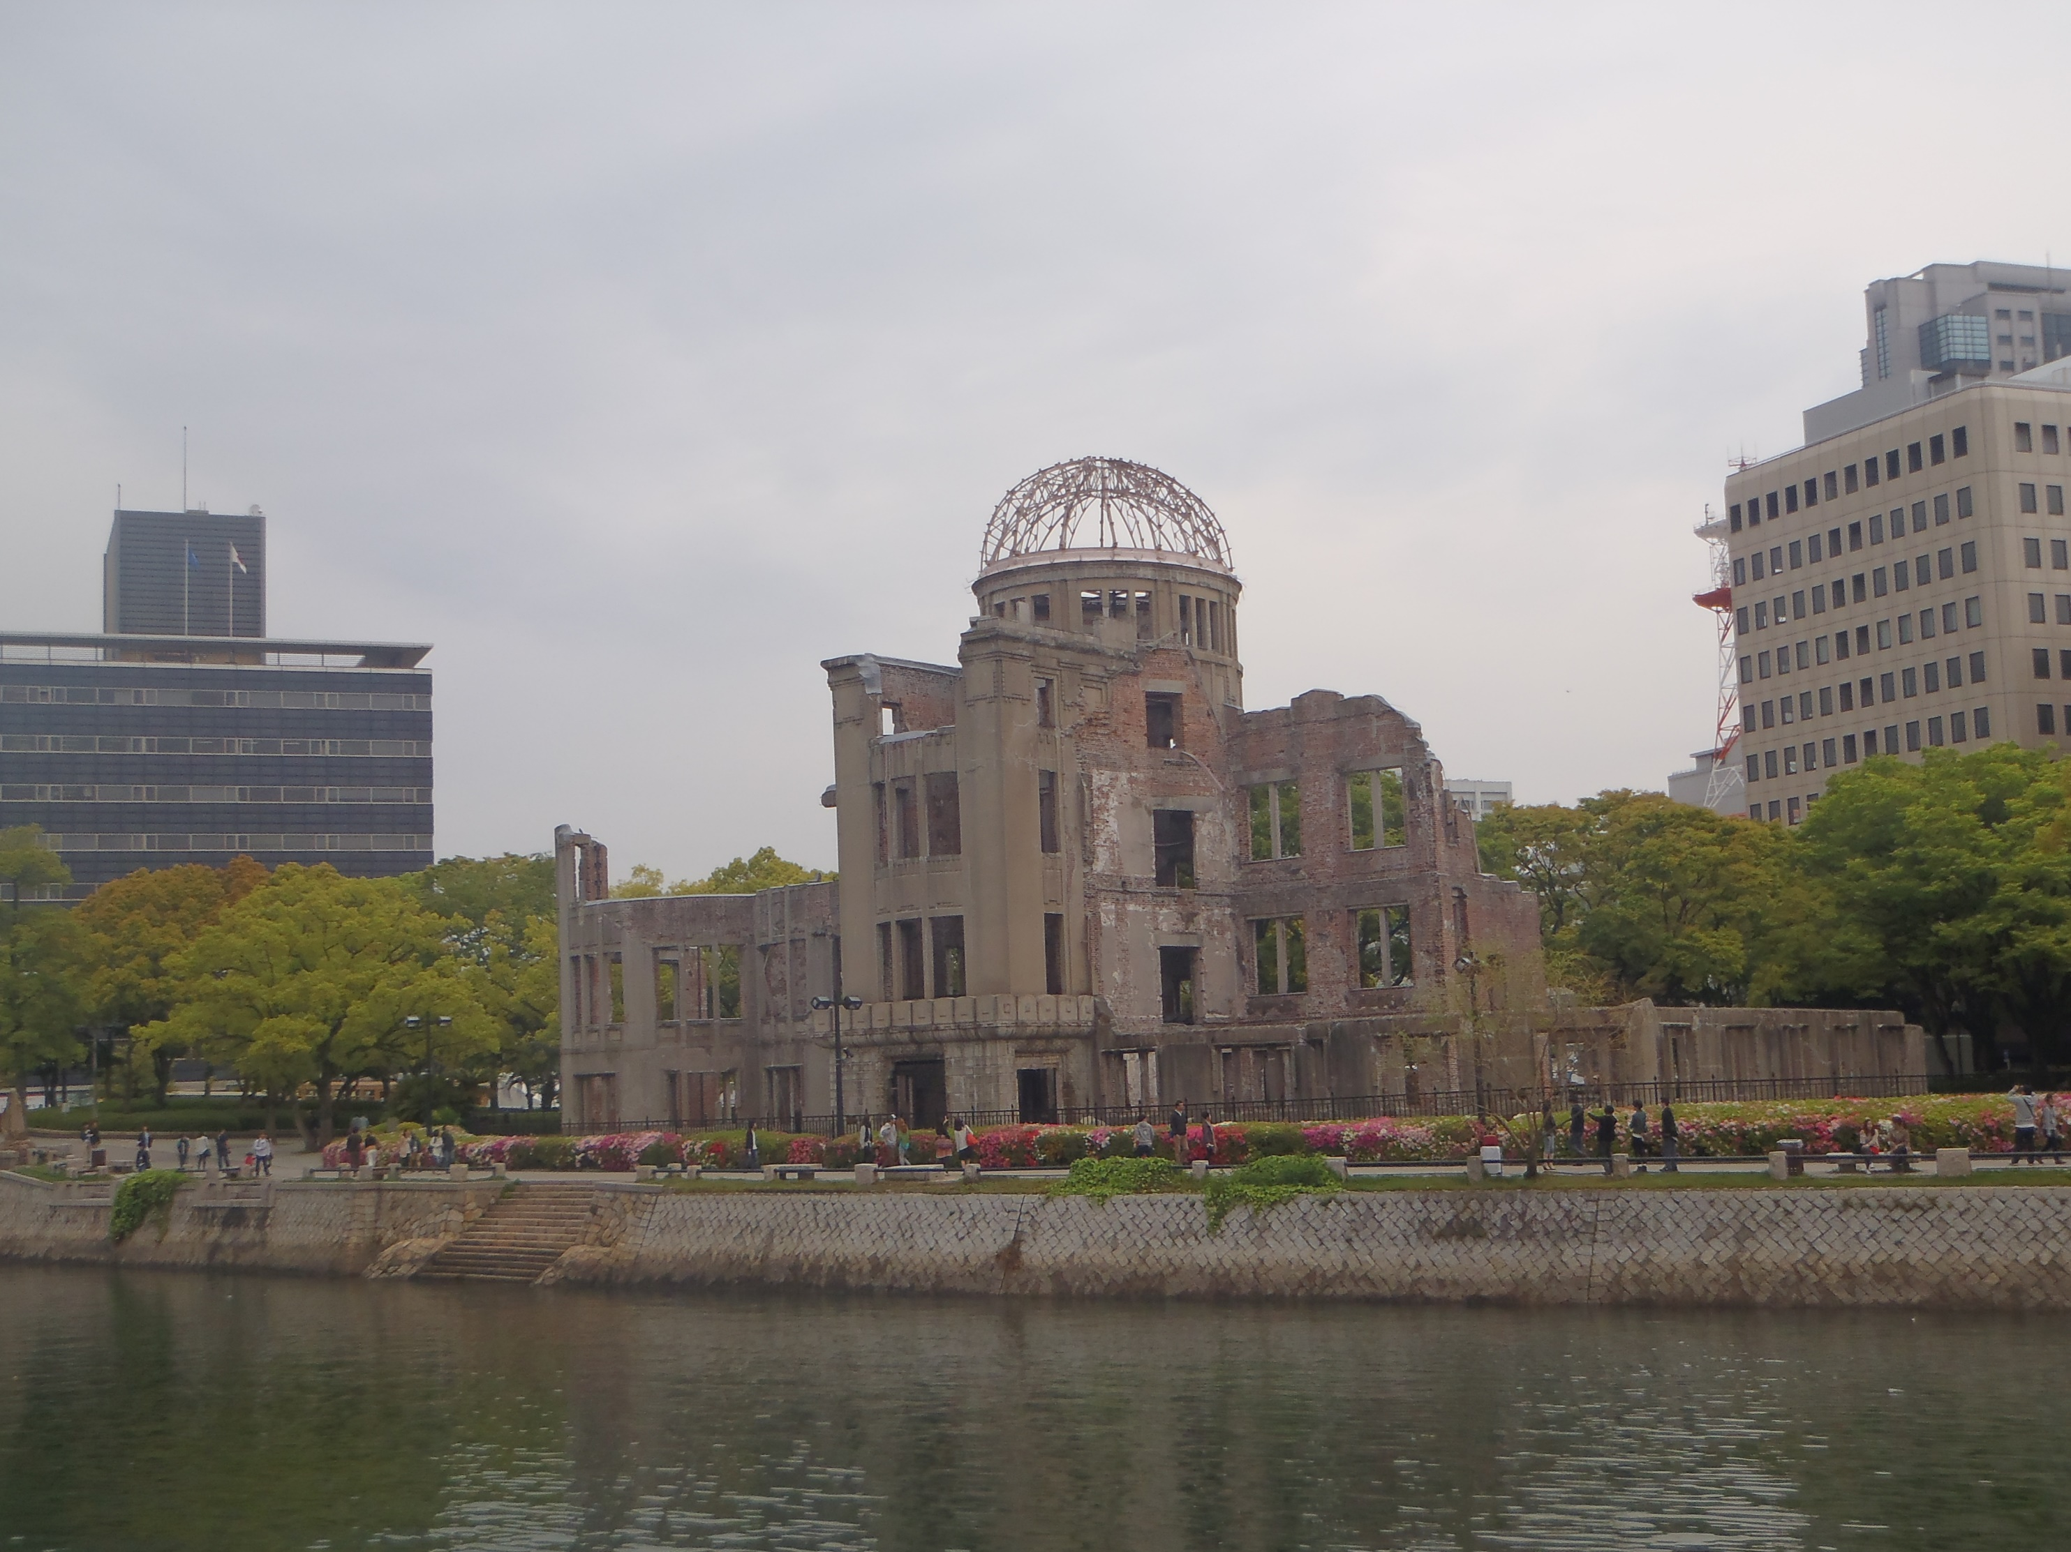
い
ひろしま に 行きたい です。
I want to go to Hiroshima.

Slide 5
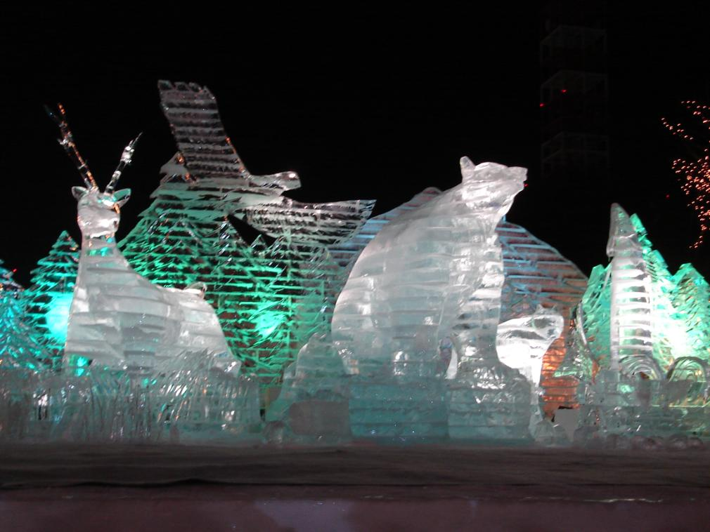
い
さっぽろ に 行きたい です。
I want to go to Sapporo.

Slide 6
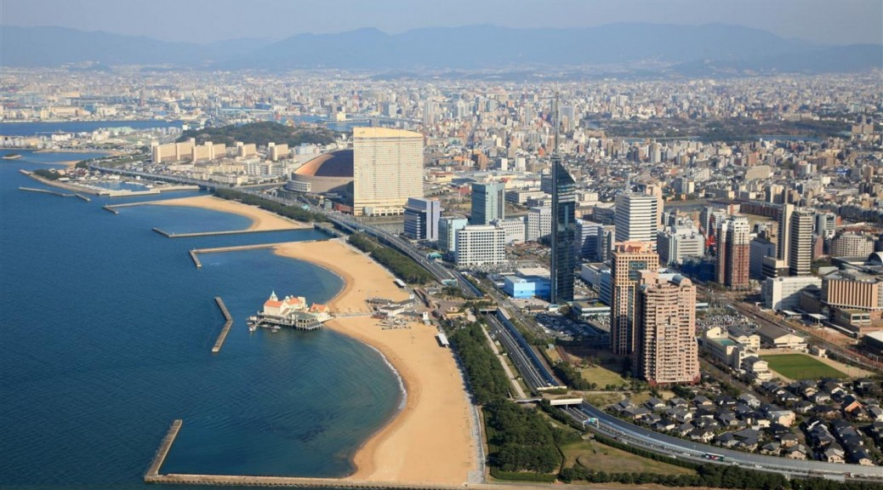
い
ふくおか に 行きたい です。
I want to go to Fukuoka.

Slide 7
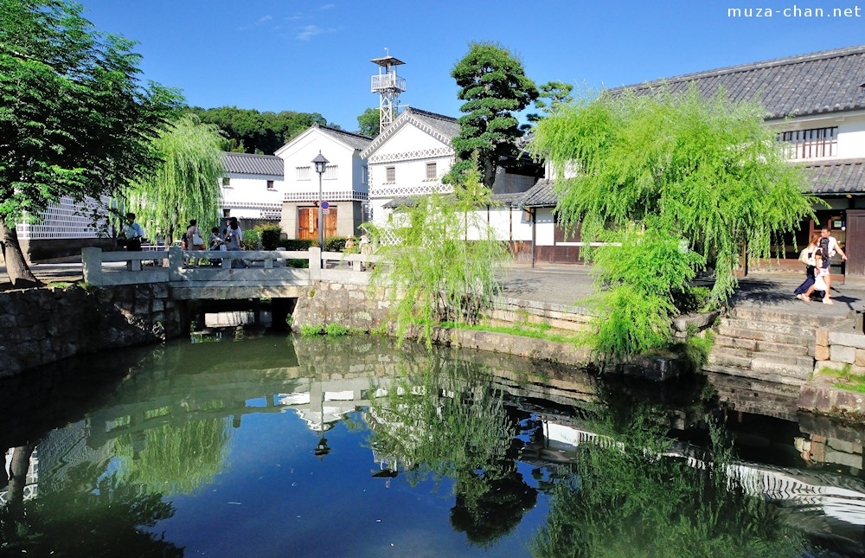
い
くらしきに 行きたい です
I want to go to Kurashiki.

Slide 8
Question:
い
日本の どこ に 行きたい ですか。
Where do you want to go in Japan?
Reply:
い
＿＿＿＿ に 行きたい です。
I want to go to ________
Responses:
そう ですか。 Really?
わたしも me too
わたしは ＿＿＿ に 行きたいです。I want to go to ____

Slide 9
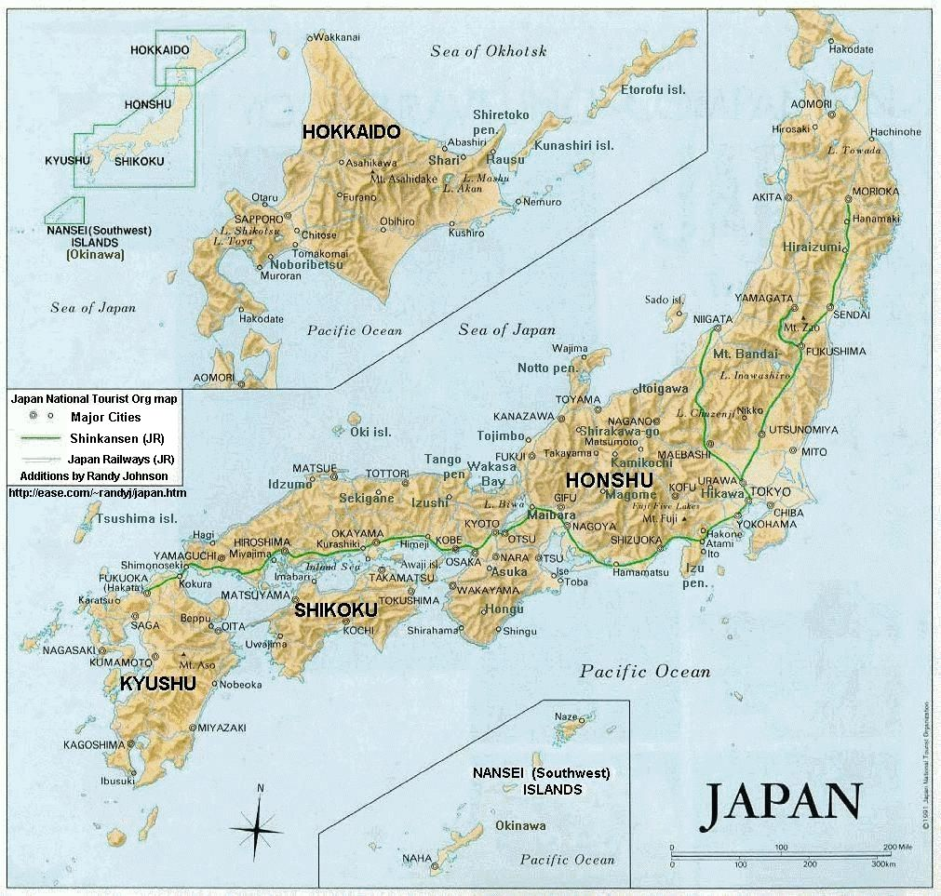

Slide 10
Let’s look at this language a little more closely
So….. what is this TAI form helping us to say?
I want to ………………
How do we make the TAI form?
Remove the masu
Add tai desu

Slide 11


れんしゅう しましょう
Look, see
みます
I want to see
みたい です。
eat
たべます
I want to eat
たべたい です

Slide 12
Group survey
Each member of your team has a card with the things you want to do in your city.
Take turns asking each other what you want to do while you are in your city.
Fill in the answers in English on the survey sheet.
Don’t forget to use:
そう ですか really? たのしそう sounds fun
そう ですね I agree おいしい ですね it’s delicious, isn’t it
いい ですね that’s nice わたしも me too
なるほど of course, I see わかりました I see, I understand

Slide 13
What if there are things you don’t want to do??
Formation:
おすし が たべたい です
おすし が たべたく ない です
I want to eat sushi
I don’t want to eat sushi
Remember:
Remove the i add ku nai

Slide 14



Group Activity:
Use the support material provided.
Think of things you don’t want to do while you are in Japan.
How many sentences can your group create??
Write them down on the whiteboards.
Challenge: Which group can make the most?

Slide 15
What if there are things you wanted to do or didn’t want to do in the past??
PAST TENSE:
Formation:
おすし が たべたい です
おすし が たべたかった です
I want to eat sushi
I wanted to eat sushi
おすし が たべたく ない です
おすし が たべたく なかった です
I don’t want to eat sushi
I didn’t want to eat sushi
Remember:
Remove the i, add katta

Slide 16
Group Activity:
You have returned to NZ from your Japanese city.
Report back to your class what you wanted to do and
didn’t want to do while you were there.
Use your group survey activity and the ‘don’t want to’ sentences you created to help you do this task.
For example:
ジョンさんは おすし が たべたかった ですが、
マックドナルドが たべたくなかった です。
John wanted to eat sushi but
he didn’t want to eat MacDonalds
Write a sentence like the example for each group member on your own paper.

Slide 17

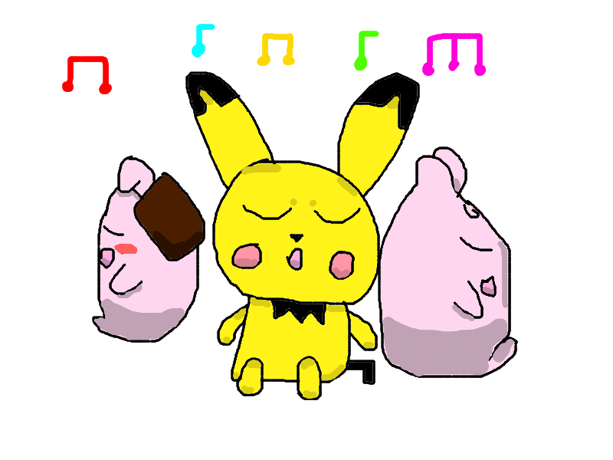

Listening Game
1) Listen to the statements I will read about your trip to Japan.
2) Each group should use the game card provided.
3) Place your piece of coloured card on to the box which is the best match
for the sentence you hear.
4) How quickly can you do it?

Slide 18

おわり です。
べんきょう に なったら よかった ですね

