Slide 1
Tenki てんき

Slide 2
いい ii

Slide 3
いやな iya-na

Slide 4
ひどい hidoi

Slide 5
あつい atsui

Slide 6
むしあつい mushiatsui

Slide 7
さむい samui

Slide 8
きょう は ＿＿＿ てんき です ね。
Kyō wa ____ tenki desu ne.
The word “tenki” can be omitted
ii
hidoi
atsui
1
2
3
iya-na
mushi-atsui
samui
4
5
6

Slide 9
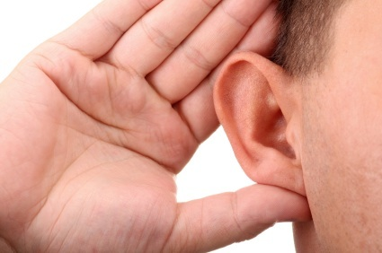
Listening!
Page 24 - #3

Slide 10
Kaiwa o shimashō!
Imagine you are in Japan and you see an old friend. Ask the friend how they are and start some small talk about the weather.
A: PERSON-san? Konnichi wa.
B: O-genki desu ka?
A: Hai, FEELING desu. O-genki desu ka?
B: Hai, FEELING desu. Kyō wa WEATHER tenki desu ne.
B: Sō desu ne.
Level 1
A: PERSON-san? *Shibaraku desu ne!
B: Ee, sō desu ne. O-genki desu ka?
A: Hai, FEELING desu. Kyō wa WEATHER tenki desu ne.
B: Ee, WEATHER desu ne.
*Hisashiburi
Level 2

