Slide 1
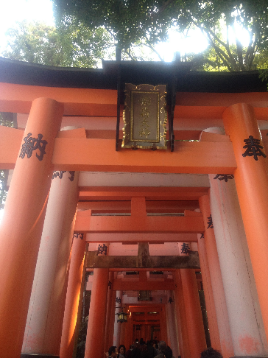
Visiting a temple or shrine
in Japan

Slide 2
Usually when you enter a sacred Buddhist (Otera) temple ground, some ritual cleansing takes place.

Slide 3
This is either done by washing the hands, drinking sacred water, or burning incense and blowing smoke towards the head and hands.

Slide 4
Shinto is a religion where believers worship gods of nature or their ancestors.

Slide 5
Visitors to a Shinto shrine pass through a Torii gate, and approach the central area where the gods are housed.

Slide 6
They must ring the bell and clap their hands loudly to attract the attention of the gods.

Slide 7
Then a short prayer is offered, a wish is made, and coins are tossed into the donation box.

Slide 8
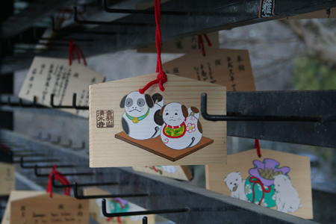
In the grounds there are usually shops selling good luck tokens and charms.

Slide 9
As with any religion, there are particular customs you must follow.

Slide 10
Be sure to be respectful when going to either a temple or a shrine.

