Slide 1
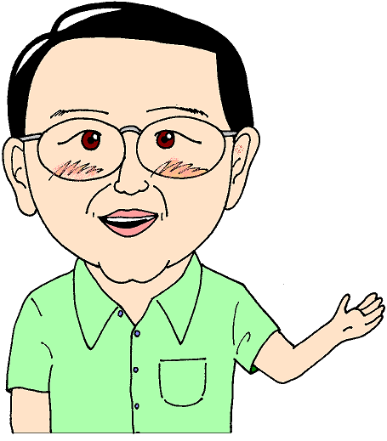
Useful daily expressions

Slide 2
おはようございます
Ohayōgozaimasu

Slide 3
こんにちは
Konnichiwa

Slide 4
こんばんは
Konbanwa

Slide 5
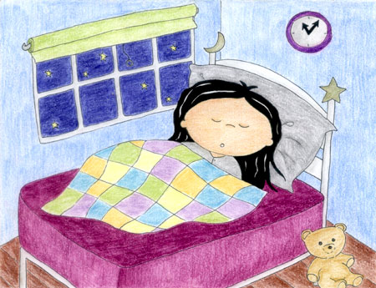
おやすみなさい
Oyasuminasai

Slide 6
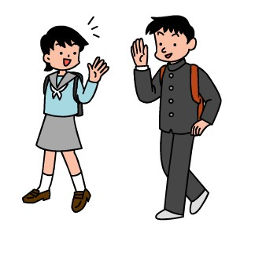
では、また OR じゃ、また
Dewa mata
Ja mata

Slide 7
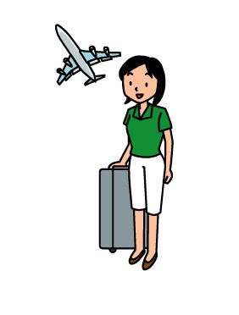
さようなら
Sayōnara

Slide 8
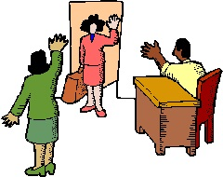
おさきに しつれいします
おつかれさまでした
Osaki ni shitsurei shimasu
Otsukaresama deshita

Slide 9
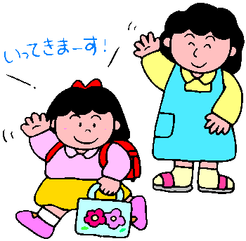
いってきます
いってらっしゃい
Ittekimasu
Itterasshai

Slide 10
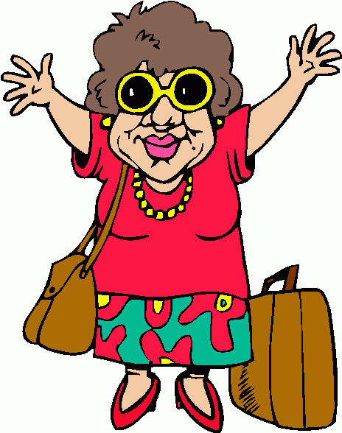
ただいま
おかりなさい
Tadaima
Okarinasai

Slide 11
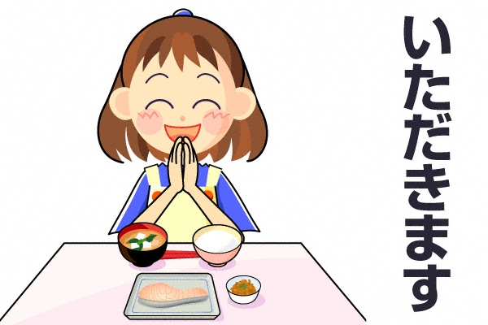
いただきます
Itadakimasu

Slide 12
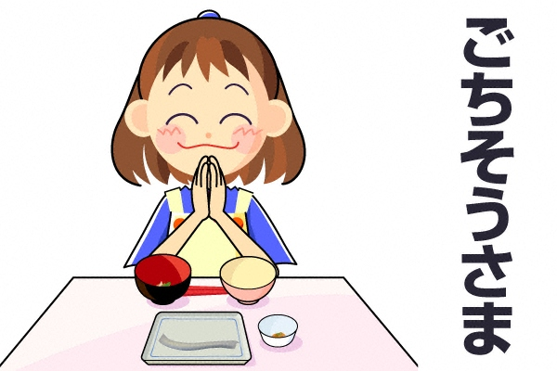
ごちそうさまでした
Gochisōsama deshita

Slide 13
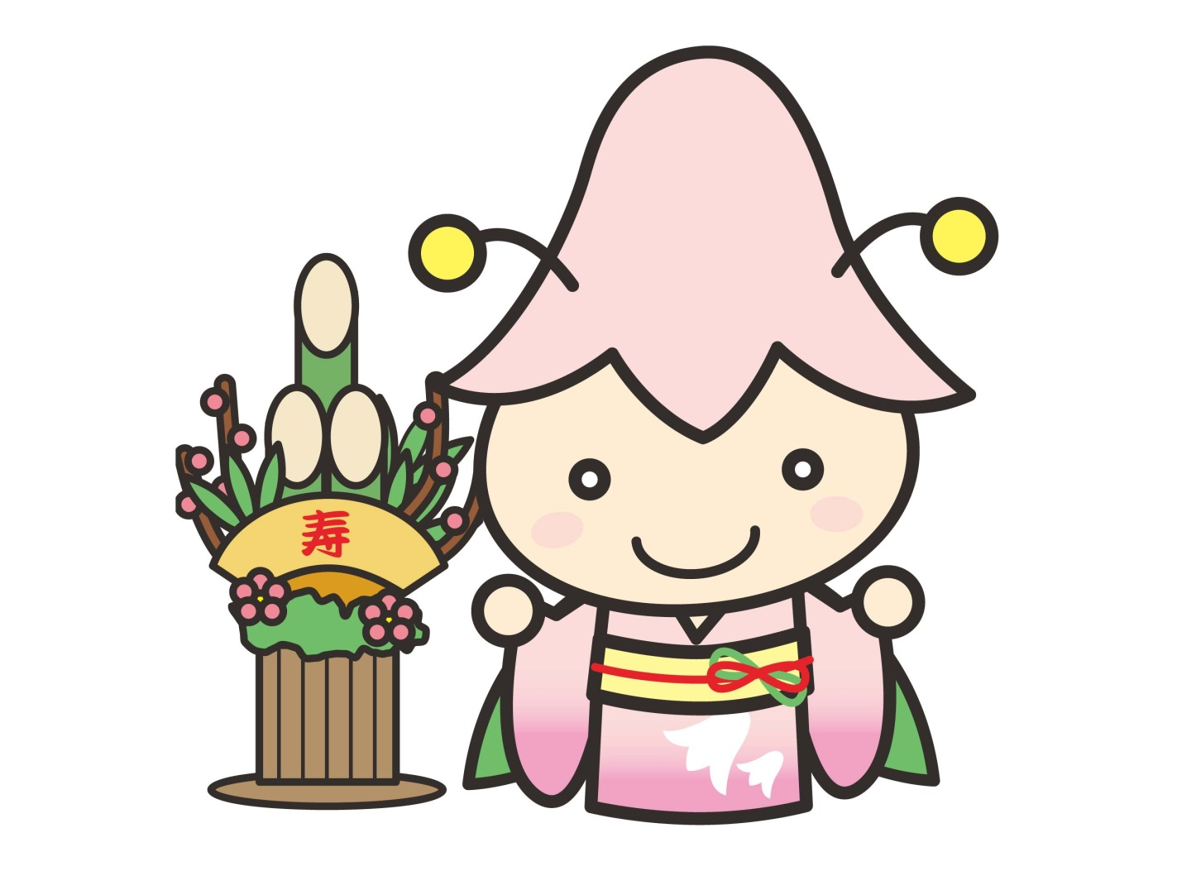
おめでとう ございます
Omedetō gozaimasu

Slide 14
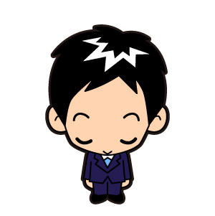
どうも ありがとう ございます
Dōmo arigatō gozaimasu

Slide 15
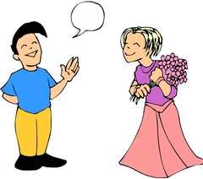
どういたしまして
Dōitashimashite

Slide 16
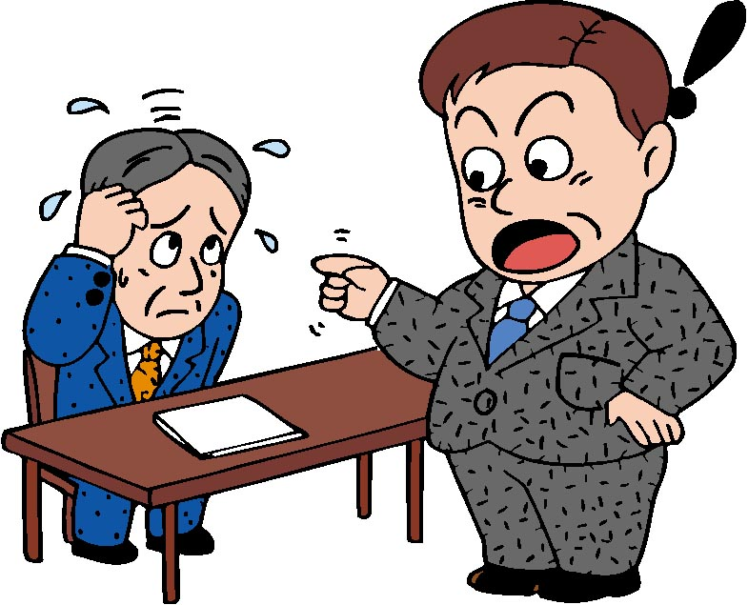
すみません
Sumimasen

Slide 17
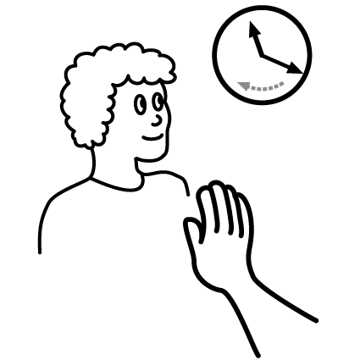
ちょっと まって ください
Chotto matte kudasai

Slide 18
もう いちど おねがいします
Mō ichido onegaishimasu

Slide 19
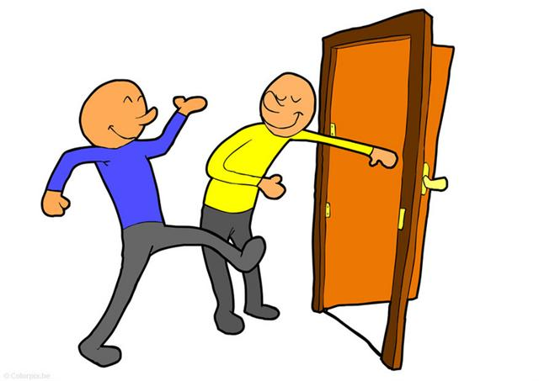
どうぞ おさきに
Dōzo osakini

Slide 20
き を つけて
Ki o tsukete

Slide 21
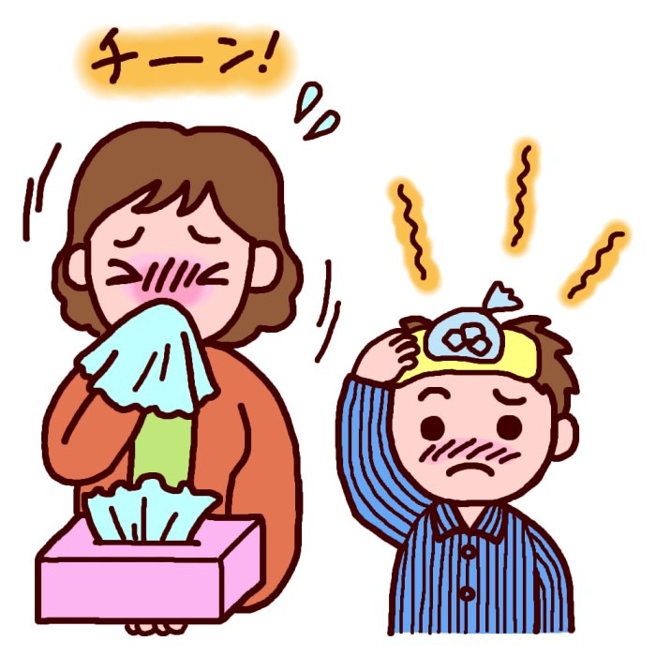
おだいじに
Odaijini

Slide 22
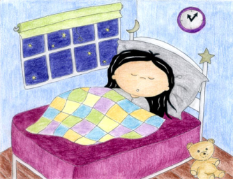
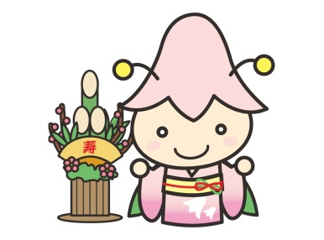
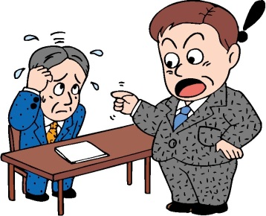
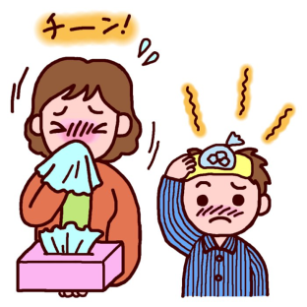

Slide 23
Imagine you are staying in a hotel in Japan
and you are meeting some of your friends for lunch.
What useful expression could you use in each situation?
In the morning you go to your hotel reception
The receptionist gives you directions, you leave
You meet your Japanese friend at lunchtime
Your other Japanese friend calls to cancel and says he is sick
You open the restaurant door for your friend.
You are about to eat in a restaurant
You find out your friend graduated from university
Your friend is going snowboarding this weekend
Your friend says a difficult Japanese word very quickly
You spill your drink on your waiter
You finished eating, you call the waiter to pay
Your friend thanks you for paying for the meal
The next time you will meet your friend is in a few weeks
You return to the hotel and greet the hotel receptionist

