Slide 1
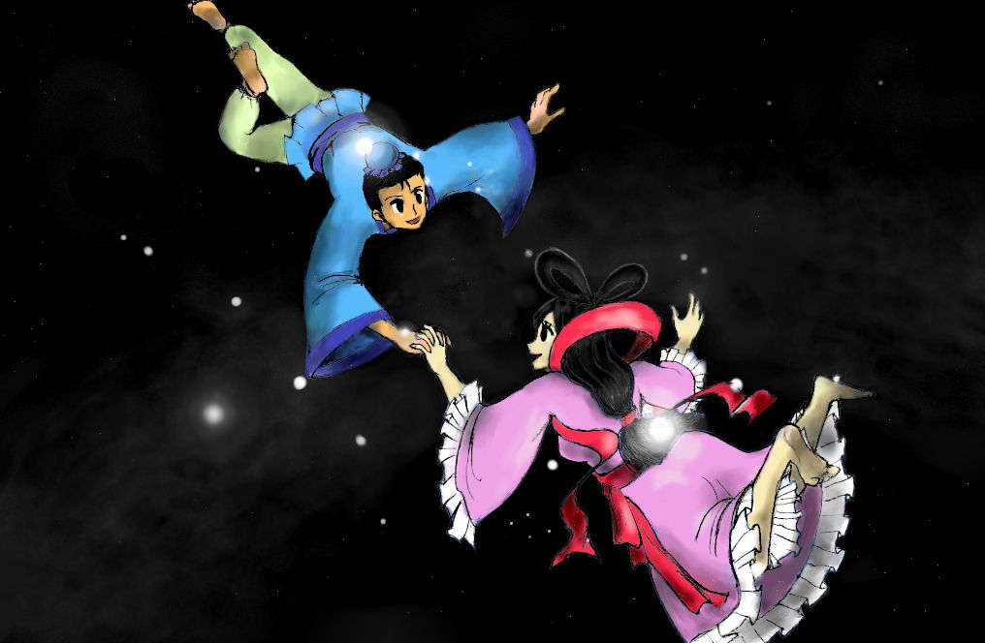
Tanabata
Star Festival

Slide 2
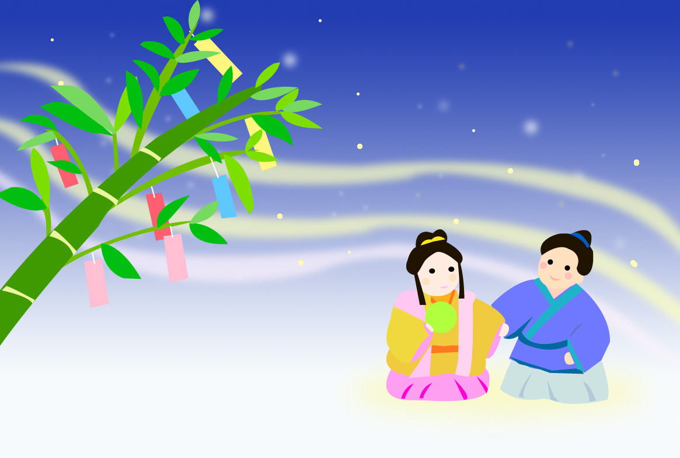
What’s Tanabata?
Tanabata (Star Festival) is held on July 7.
Its story is based on a romantic Chinese legend about two stars, Orihime(Vega, the star of the weaver princess) and Hikoboshi(Altair, the star of the cowherd).

Slide 3
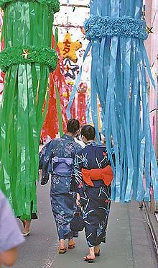
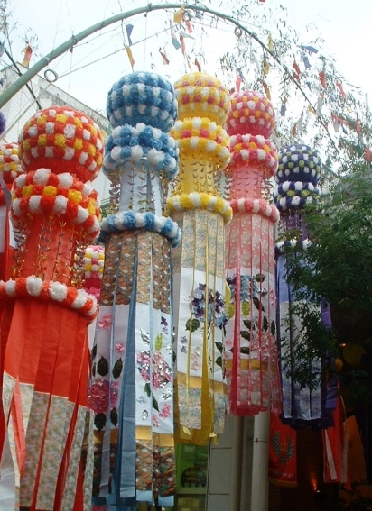
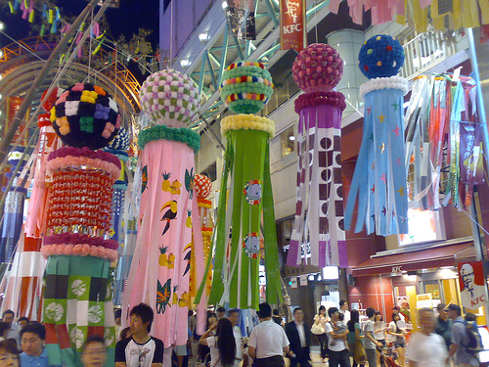
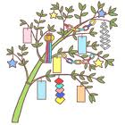
What do we do on Tanabata?
People make offerings of food.
Women dress in yukata.
School children decorate their classrooms and sing the “Tanabata” song.
Some cities and shopping centres decorate their streets and shops with large and attractive ornaments.

Slide 4
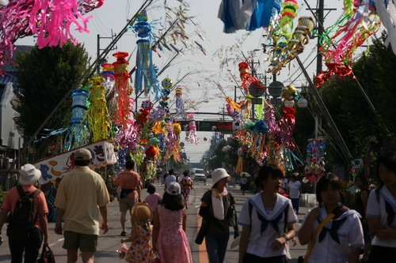
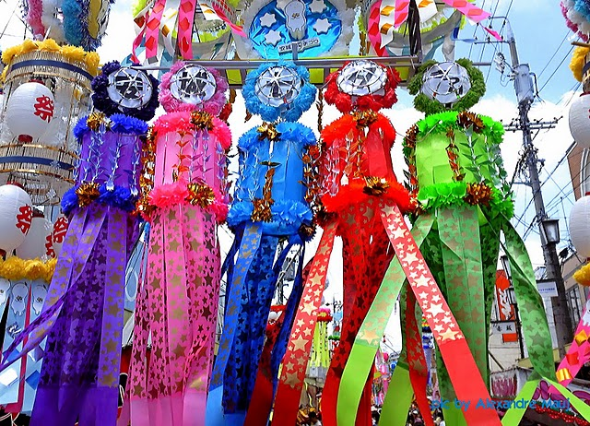
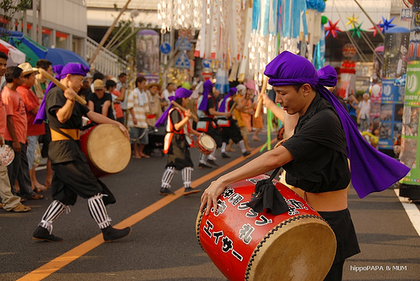
Anjo Tanabata Festival
Anjo is famous for the Tanabata Festival and it is one of the three biggest Tanabata Festival’s in Japan.

Slide 5
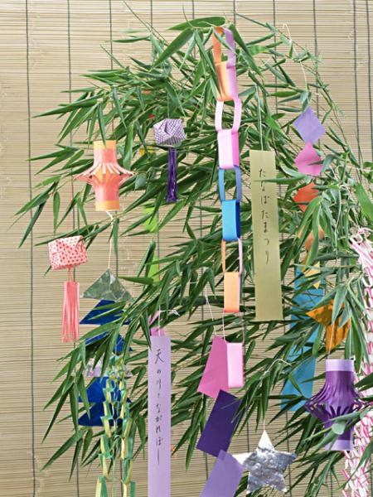
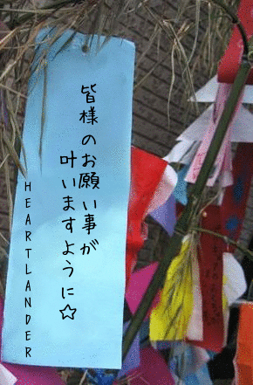
Write your wishes on Tanzaku
Children and adults write their wishes on colourful and narrow stripes of paper, Tanzaku and hang them, along with other paper ornaments, on bamboo branches.

Slide 6
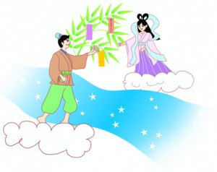
Let’s sing “Tanabata” song
Tanabata sama
1.Sasa no ha sarasara
Nokiba ni yureru
Ohosisama kirakira
Kingin sunago
2.Gosioki no tanzaku
Watasi ga kaita
Ohosisama kirakira
Sora kara miteru
(English translation)
The bamboo leaves rustle,
Shaking away in the eaves.
The stars twinkle;
Gold and silver grains of sand.
The five colored Tanzaku
I wrote.
The stars twinkle,
And see us from the sky.

