Slide 1
Talking about your pet
NAMES & AGES

Slide 2
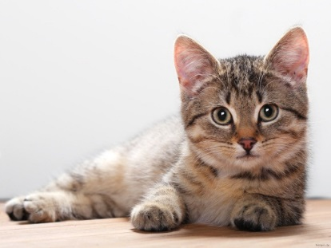
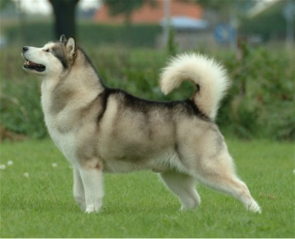
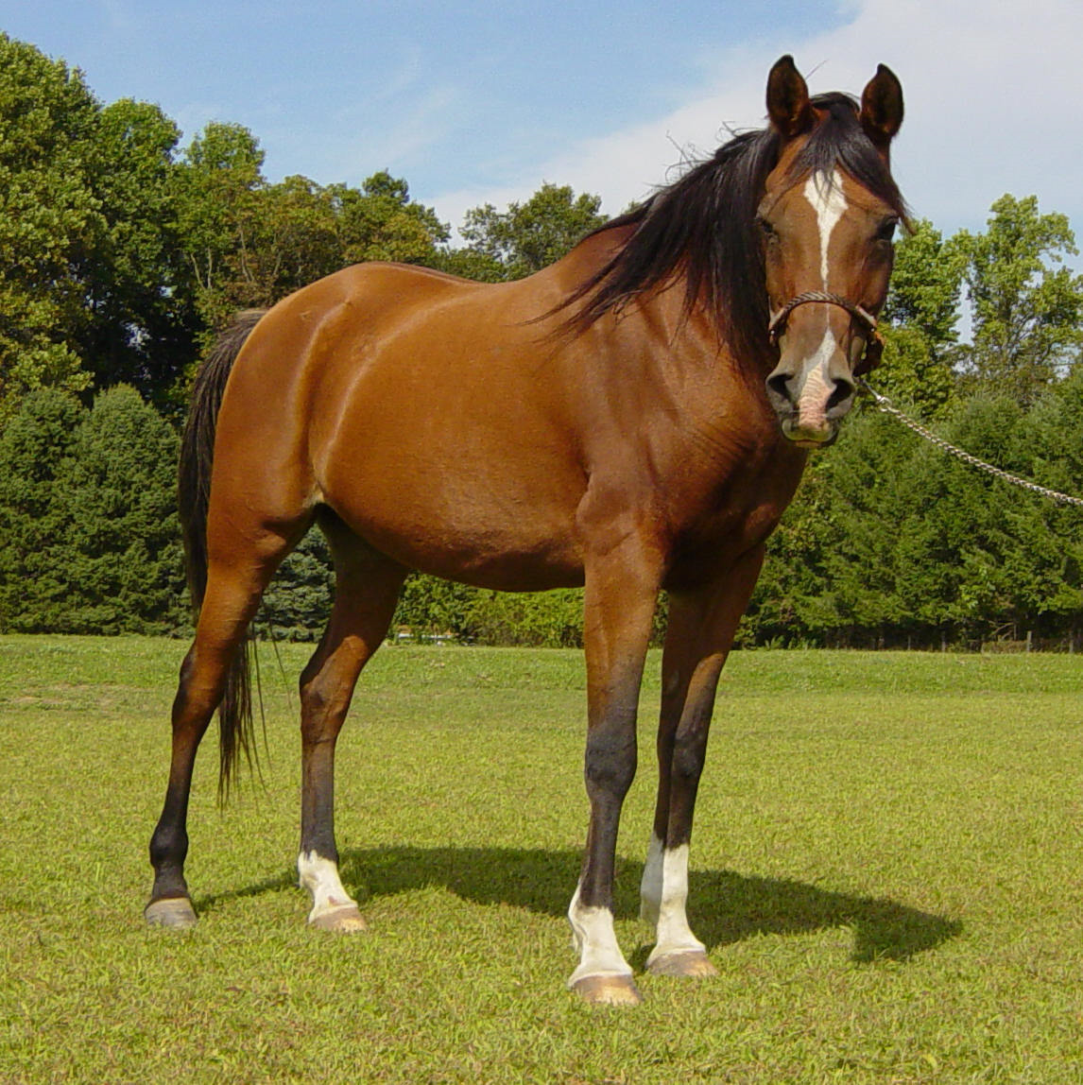
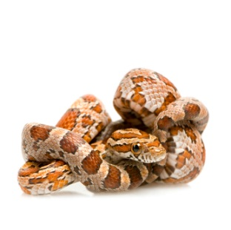
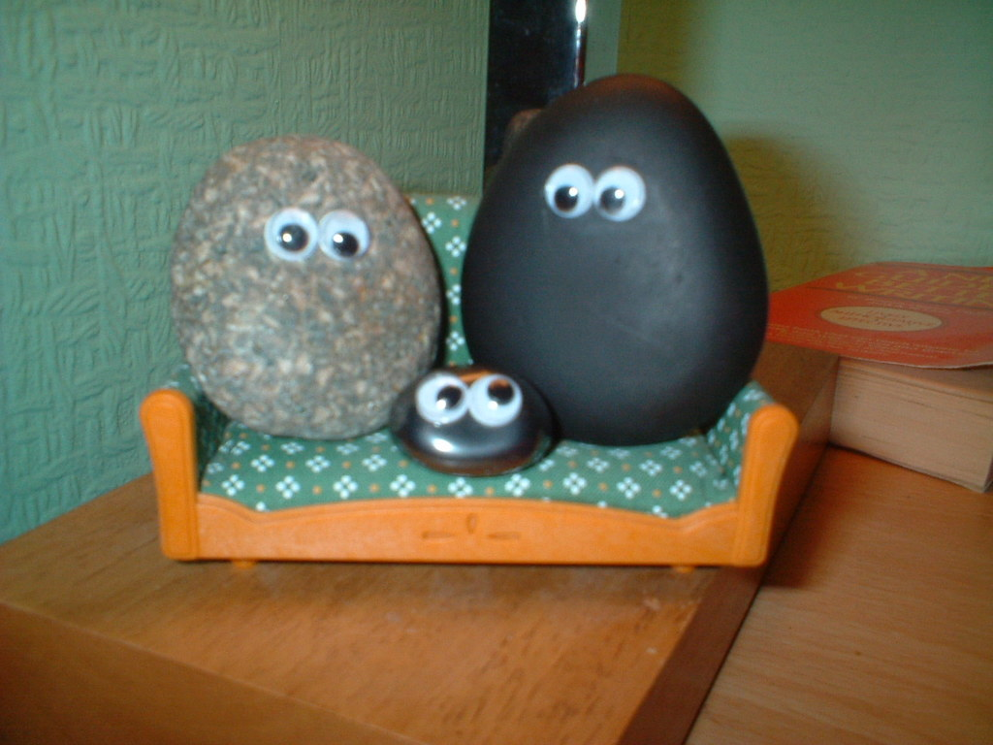
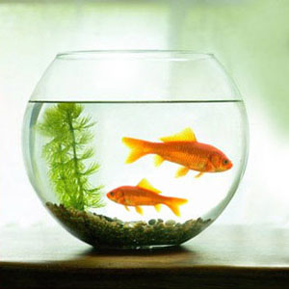
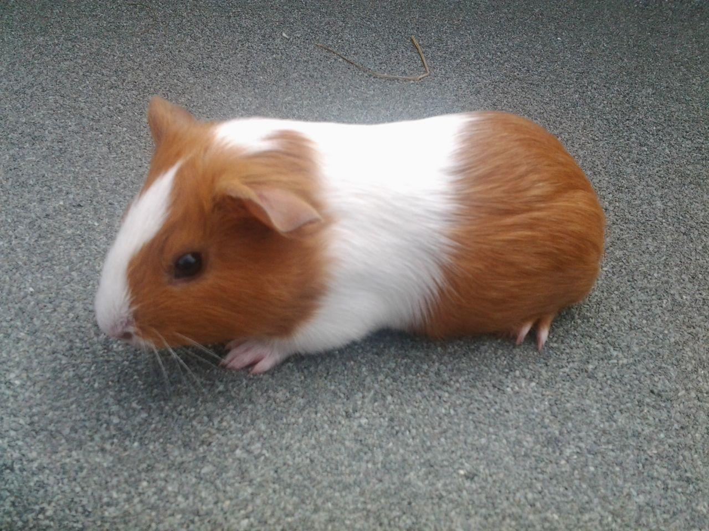
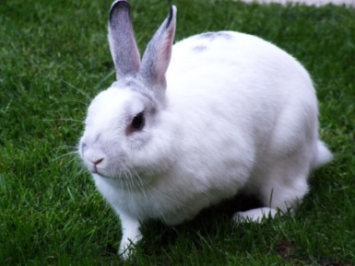
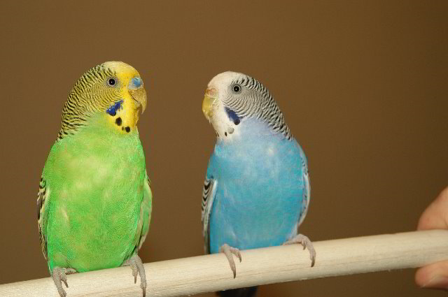
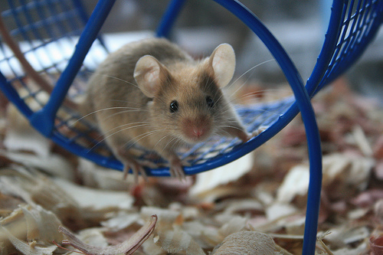
Can you remember how to say these pets in Japanese?

Slide 3
Asking and saying your pet’s name?
Q | Onamae wa? What’s its name?
A1 | NAME desu. Its name is NAME.
A2 | Petto no namae wa NAME desu. My pet’s name is NAME.
Sam
(Samu)
サム

Slide 4
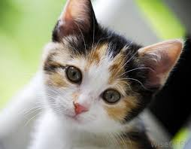
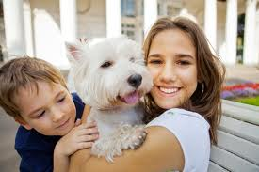
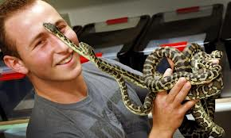
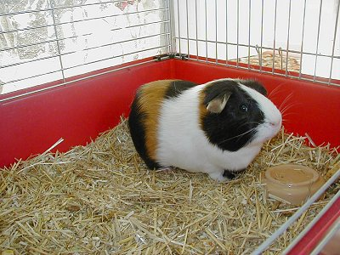
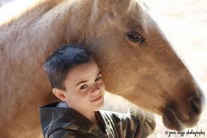
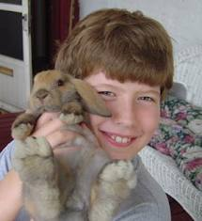
Harry
(Harii)
ハリー
George
(Jiooji)
ジオージ
Hana
(Hana)
はな
Lucky
(Rukkii)
ラッキー
Nibbles
(Nibaruzu)
二バルズ
Peter
(Piitaa)
ピーター

Slide 5
Talking about your pet…
Q1 | Petto wa nan desu ka? What pet do you have?
A1 | PET desu. I have a PET.
Q2 | Onamae wa? What’s its name?
A1 | NAME desu. Its name is NAME.
Sam
(Samu)
サム

Slide 6
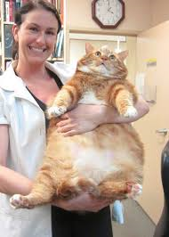
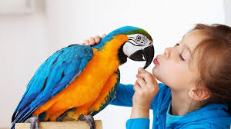
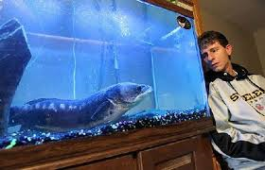
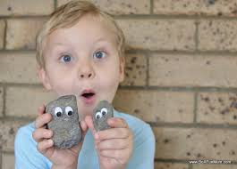
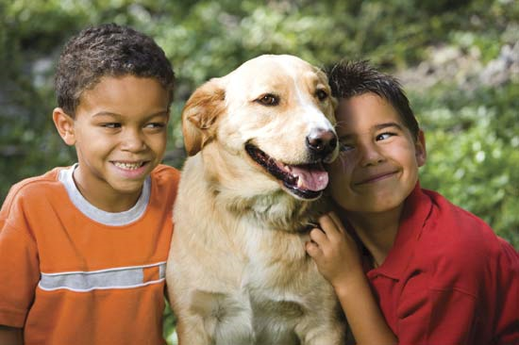
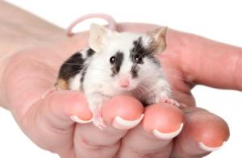
Polly
(Porii)
ポリー
Sharkie
(Shaakii)
シャーキー
Mr Biggles
(Misutaa Biguruzu)
ミスタービグルズ
Goldie
(Gorudii)
ゴルディー
Spot
(Supotto)
スポット
Rocky and Jimbo
(Rokkii/Jimboo)
ロッキー／ジンボー

Slide 7
Asking and saying your pet’s age?
Q | Nan sai desu ka? How old is it?
A1 | AGE desu. It is AGE.
A2 | PET wa AGE desu. PET is AGE.
2 years old
ni-sai

Slide 8
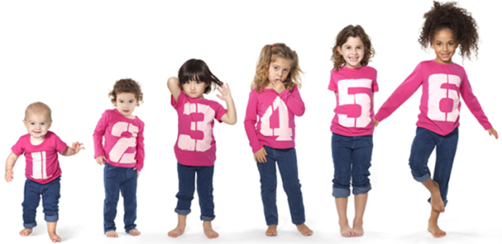
English | Romaji
1 year old | is-sai
2 years old | ni-sai
3 years old | san-sai
4 years old | yon-sai
5 years old | go-sai
6 years old | roku-sai
7 years old | nana-sai
8 years old | has-sai
9 years old | kyuu-sai
10 years old | jus-sai
11 years old | juu is-sai
12 years old | juu ni-sai
13 years old | juu san-sai
Can you remember how to say AGE in Japanese?
NUMBER + sai

Slide 9
3 years old
10 years old
5 years old
1 year old
2 years old
7 years old

Slide 10
Talking about your pet…
Q1 | Petto wa nan desu ka? What pet do you have?
A1 | PET desu. I have a PET.
Q2 | Onamae wa? What’s its name?
A2 | NAME desu. Its name is NAME.
Q3 | Nan sai desu ka? How old is it?
A3 | AGE desu. Its AGE.
Sam
(Samu)
サム
2 years old

Slide 11
Polly
(Porii)
ポリー
5 years old
Sharkie
(Shaakii)
シャーキー
13 years old
Mr Biggles
(Misutaa Biguruzu)
ミスタービグルズ
10 years old
Goldie
(Gorudii)
ゴルディー
3 years old
Spot
(Supotto)
スポット
1 year old
Rocky and Jimbo
(Rokkii/Jimboo)
ロッキー／ジンボー
11 and 12 years old

Slide 12
Mingle activity
MINGLE CARDS
Ask questions about each other’s pets and stand in age order

Slide 13
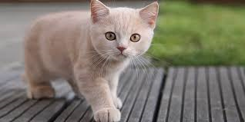
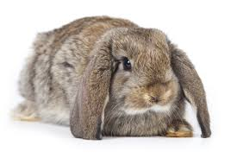
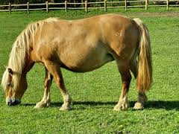
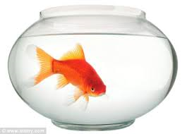
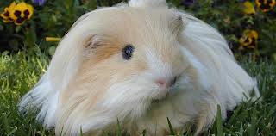
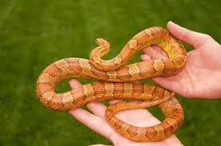
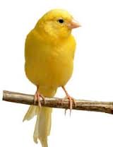
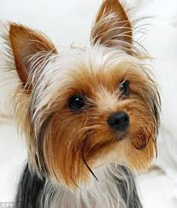
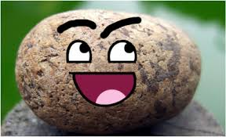
Tom
1 year old
Hop
2 year olds
Brownie
3 years old
Goldie
4 years old
Fluffy
5 years old
Slither
6 years old
Sunny boy
7 years old
Ruby
8 years old
Jack
9 years old

Slide 14
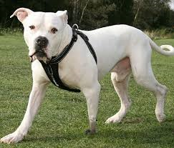
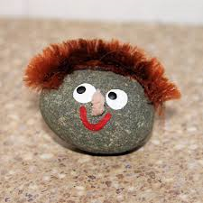
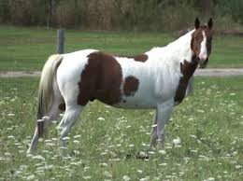
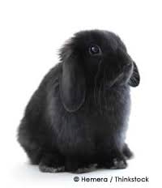
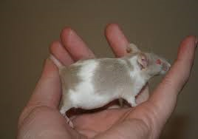
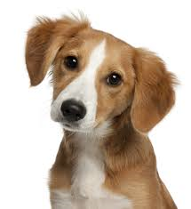
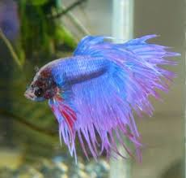
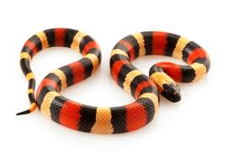
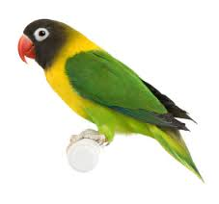
Snowy
10 years old
Spike
11 year olds
Princess
12 years old
Smokey
13 years old
Patch
1 year old
Charlie
2 years old
Bubbles
3 years old
Rainbow
4 years old
Roxy
5 years old

