Slide 1
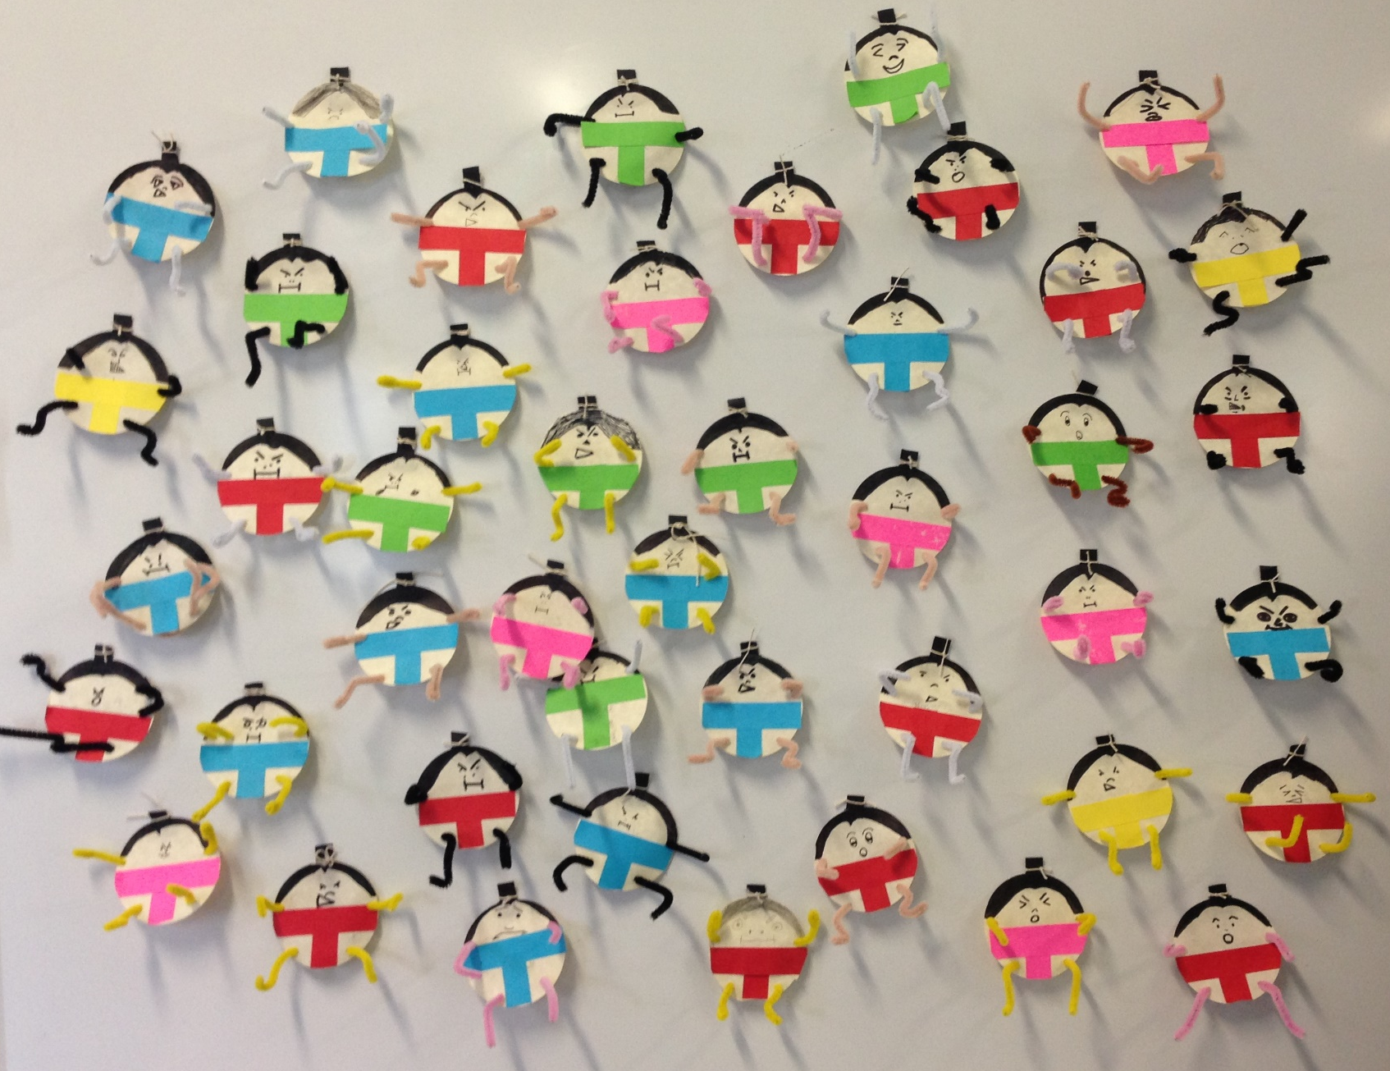
Sumo Fridge Magnets

Slide 2
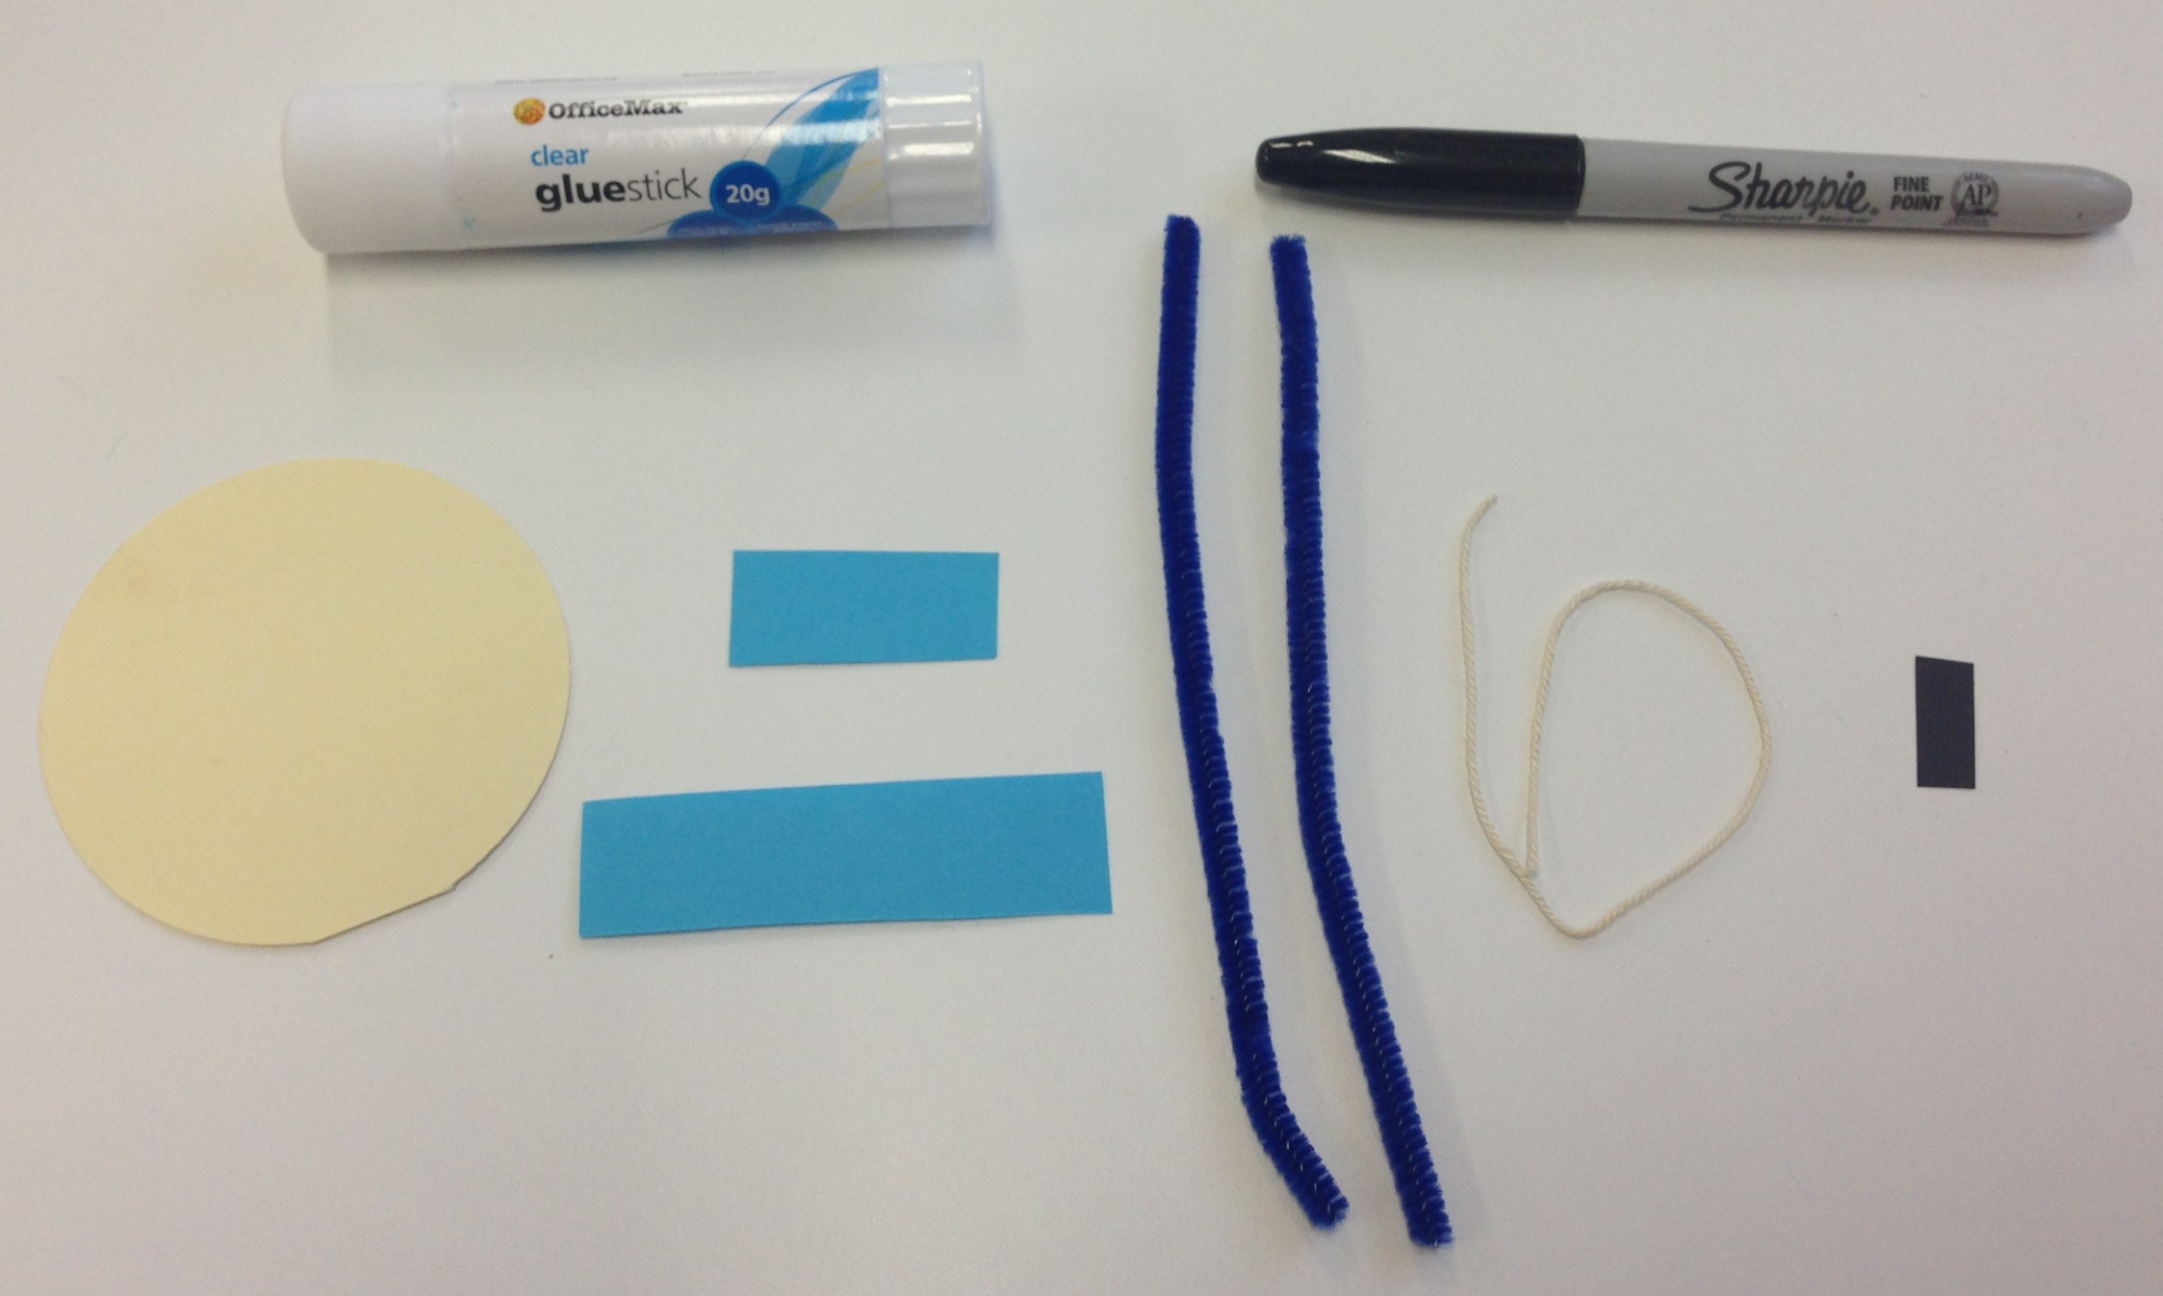
Sumo Fridge Magnets
You will need:
A glue stick
2 same colour
pipe cleaners
1 tiny
piece of
black card
1 cardboard
circle
1 long & 1 short piece
of coloured paper
(same colours)
1 piece
of string

Slide 3
Step 1
Step 2
Step 3
Glue the shorter piece
of coloured paper onto the
cardboard circle like below.
Glue the longer piece
of coloured paper onto the
cardboard circle like below.
Trim the edges of the
coloured paper hanging over
the edge of the circle.

Slide 4
Step 4
Step 5
Step 6
Bring the cardboard circle to
Sensei to have arm and leg
holes punched out.
Get a black marker and draw face and hair like below (return marker when finished so others can use).
Glue small piece of black
card to back of circle at the
top to maker the sumo’s top
knot .

Slide 5
Step 7
Step 8
Tie piece of string around the
top knot and tie a double
knot and then trim the ends.
Thread a pipe cleaner through the armholes like in the picture
below and then repeat with another pipe cleaner for the legs.
Bend the ends of the pipe cleaners over slightly to get rid of
sharp point.

Slide 6
Step 9
Step 10
Get a magnet from Sensei to
stick on the back of your
sumo.
Write your name on the back
of your sumo and place it on
the whiteboard (you can take
it home next week).
Sumo
Magnet
Complete
: )
Sensei

