Slide 1
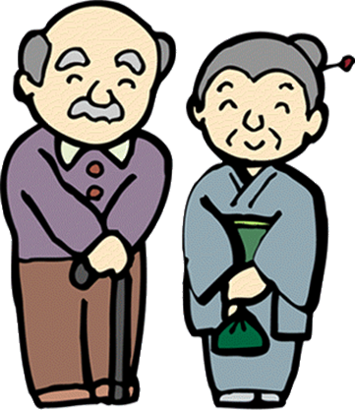
あいさつ

Slide 2
*****Starting Class*****
きりつ
れい
ちゃくせき
せんせい
みなさん
Stand Up
Bow to your teacher
Sit down
Teacher
Everyone

Slide 3
じこしょうかい
In Japan people are very into "Self Introductions". If you ever meet people you'll often be asked to introduce yourself.
です
You may have seen it written down as "Desu", but it's pronounced more like "dess". You need to think of it as a spoken full stop. So to introduce yourself you just say your name plus "desu". e.g. Richard Desu.

Slide 4
What is your name?
おなまえはなんですか。
なまえ
は
なん
なんですか
What is your name?
name
Particle
What
What is it

Slide 5
I am……. (My name is…..)
わたしはえりこです。
わたし
は
わたしは
ぼくはひろしです。
ぼく
は
ぼくは
I am Eriko
I , me (GIRLS)
~am
I am
I am Hiroshi
I , me (BOYS)
~am
I am

