Slide 1
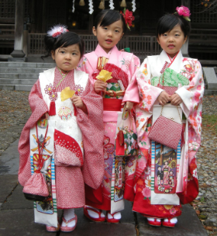
Shichi-go-san (November 15)
Health and Happiness Day / Children’s Day

Slide 2
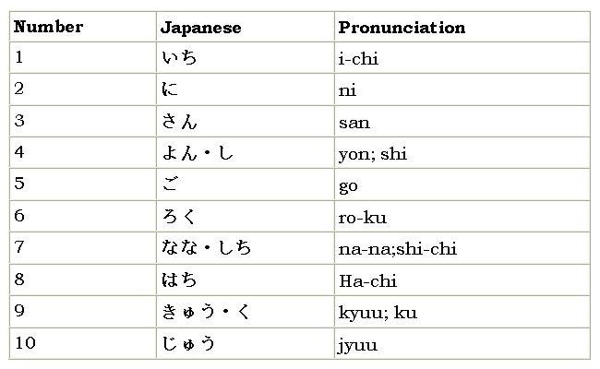

Slide 3
Why it is celebrated
The ages of 7, 5 and 3 are celebrated because they mark certain traditional milestones in the lives of the children.
According to ancient Japanese tradition, it was at the age of 3 that both girls and boys were allowed to let their hair grow. At 5 years of age, boys were given the chance to wear the hakama pants in public for the first time. At 7, girls were allowed to wear their first obi (the long fabric belt worn with a kimono).
In Japan odd numbers are lucky.
Hakama pants

Slide 4
How it is celebrated today
Many children are dressed up in traditional costumes. The girls might dress in a brilliantly coloured kimono and the boys in elaborate pleated skirts known as hakama.
For the girl aged 3, hair will be put up in an adult-like manner for the first time. When she reaches age 7, she is given her first obi (the silk sash that has to be worn with kimono).
For the 5-year-old boys, they are given their first hakama.

Slide 5
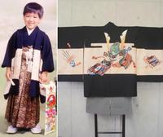
How it is celebrated today
Boys and girls aged three, boys aged five, and girls aged seven visit a Shinto shrine with their parents.
Most girls wear kimonos when making their visit, while boys wear haori jackets and hakama trousers.

Slide 6
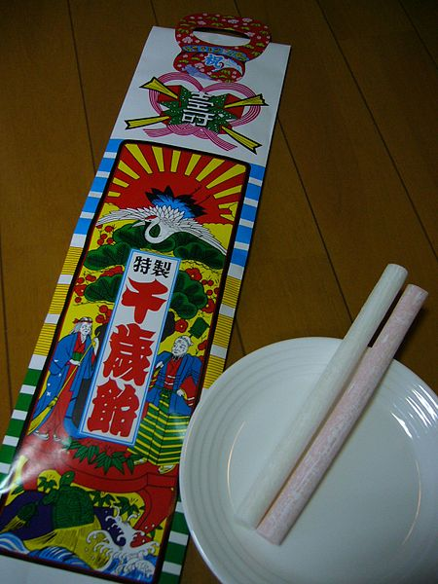
How it is celebrated today
After the visit to the shrine, parents generally buy chitose-ame (longevity candy) for the children. The candy is shaped like a stick and the red and white colours are said to bring good luck.
It comes in a bag that carries illustrations of cranes and turtles—which are symbols of long life.
The candy and the bag are expressions of the parents' wish that their children will lead long, prosperous lives.

Slide 7
Slideshow of Sichi-go-san photos
http://www.flickr.com/search/show/?q=shichi+go+san&s=int

