Slide 1
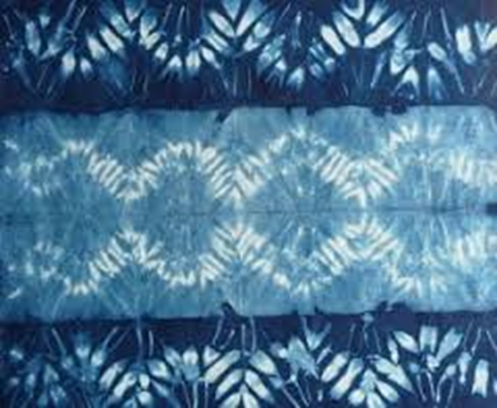
Shibori
しぼり

Slide 2
しぼり is folded and dyed fabric

Slide 3
Patterns are created by folding, stitching, binding and twisting the cloth.

Slide 4
Traditionally indigo dye was used

Slide 5
Indigo dyed しぼり

Slide 6
Later other colours were used

Slide 7
The fabric can then be made into things like kimono きもの

Slide 8
Happi coats はっぴ

Slide 9
Let’s make a folded しぼり

Slide 10
Yarikata やりかた
Fold your paper
Dip a corner into the dye (Always use yellow first), continue dipping until you have used a few colours
Leave folded
Place on newspaper to dry
Once dry - unfold to see your creation

Slide 11
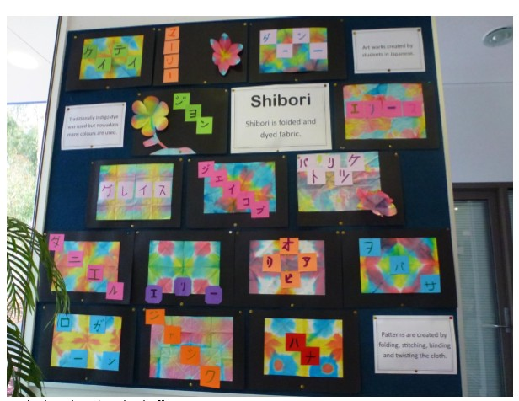
Student samples c/o K Severin at St Johns Lutheran Primary School

Slide 12
Make your name for your shibori しぼり in katakana かたかな
Practise writing your namae なまえ
Paste your shiboriしぼりon a piece of black card
Choose the colour of paper card (kami - かみ) for your name - If it matches your しぼりit will look better!
Cut out squares, one for each katakana letter of your namae なまえ
Write your なまえ in pencil and then carefully go over with texta – make it bold
Place your letters in an attractive design in order over your shibori
Paste them onto your shibori.
おわり

