Slide 1
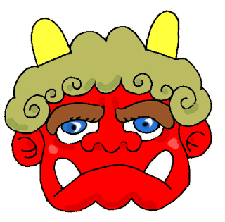
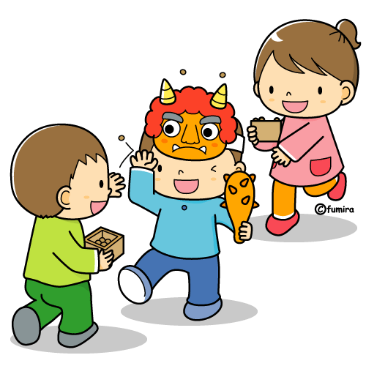
せつぶん
Se tsu bu n

Slide 2
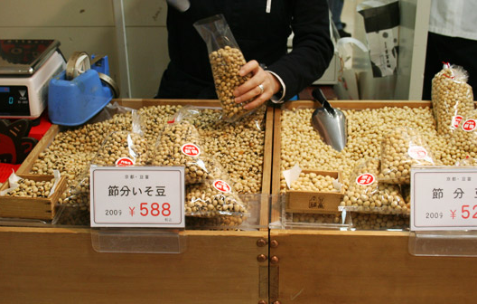
Setsubun no hi (せつぶんの日) takes place on the 3rd of February every year.
It traditionally marks the change of the season from Winter to Spring, based on the old lunar calendar.
It’s not a national holiday, but it is celebrated in houses and schools all over Japan. The activities are meant to drive away bad luck and bring in good luck for the year ahead. Most of the traditional rituals revolve around beans, because beans are considered to be very lucky.

Slide 3
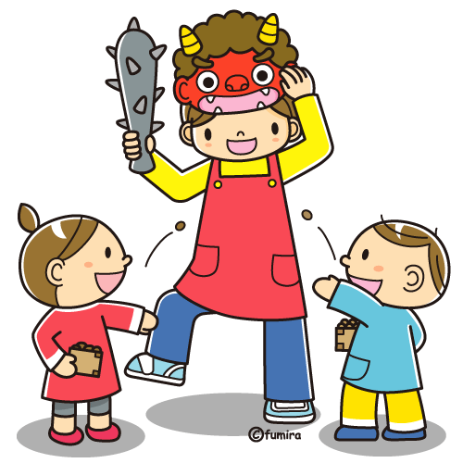
Mame-maki まめまき
On this day families, schools, temples and shrines hold bean throwing ceremonies. People take a handful of soy beans and throw them outside while shouting Oni wa soto! おにはそと(Demons, get out!).
They then throw another handful inside, shouting Fuku wa uchi! ふくはうち(Good luck, come in!).
Let’s watch some kindy children doing Mame-maki
まめまき.
http://www.youtube.com/watch?v=dxxftDPEjns

Slide 4
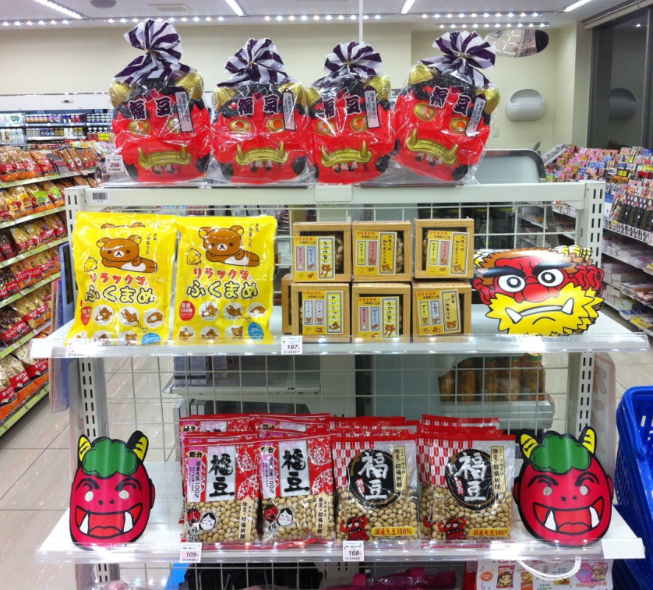
Usually someone plays the part of the oni おに (ogre or demon), wearing a mask – often mum or dad! They run outside covering their head and cowering while they are being bombarded by beans.
After all of the bean throwing you then eat the same number of beans as your age, plus one more.
You can buy your own せつぶん Set - anおに mask and a pack of soy beans - at any convenience store or supermarket just before
せつぶん.

Slide 5
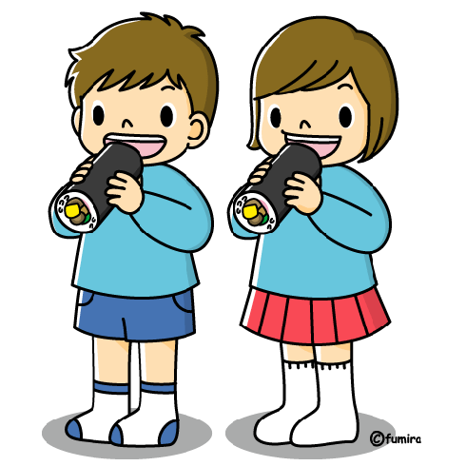
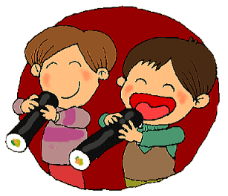
Another tradition on setsubun no hi is to eat a long, uncut sushi roll called ehōmaki えほうまき.
ehōmaki えほうまき are different to regular sushi rolls for four reasons:
1. It must contain seven ingredients, because seven is a lucky number.
2. It must not be cut, because it might cut (off) your luck.
3. You have to eat it while facing the lucky direction, which changes every year!
4. You must eat the whole roll in total silence.

Slide 6
This year’s lucky direction is North-North-West on a regular compass.
At our school what direction does this mean?
What would you be looking at if you were facing North-North-West?
The new playground
The canteen
The large car park
The oval

Slide 7
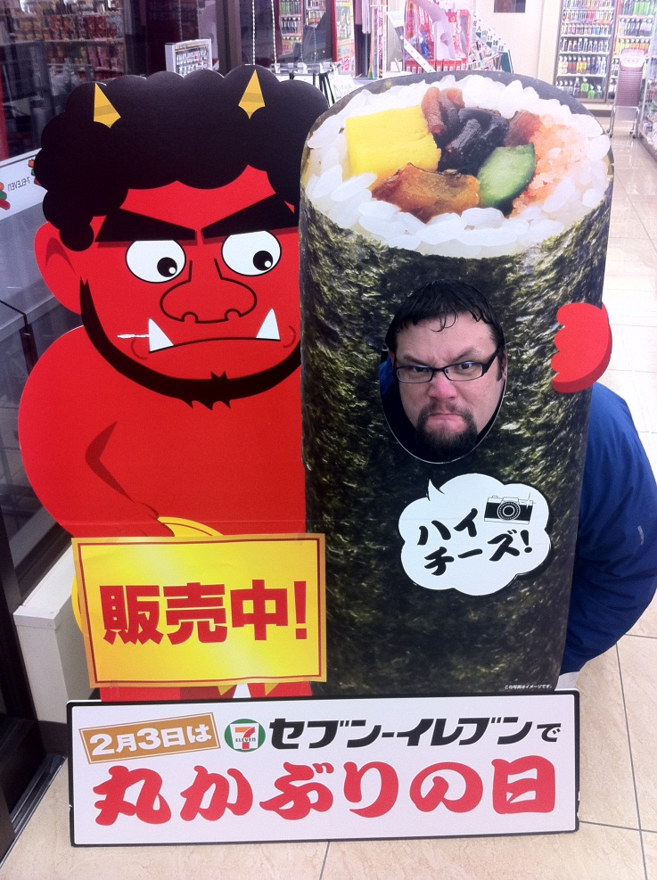
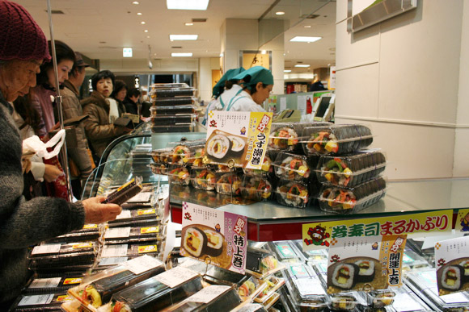
ehōmaki えほうまき
These special sushi rolls are sold fresh in supermarkets and convenience stores at Setsubun
せつぶん.
Some families will make their own but it is much easier to buy them!
You can even pretend to be an
ehōmaki えほうまき yourself!!

Slide 8
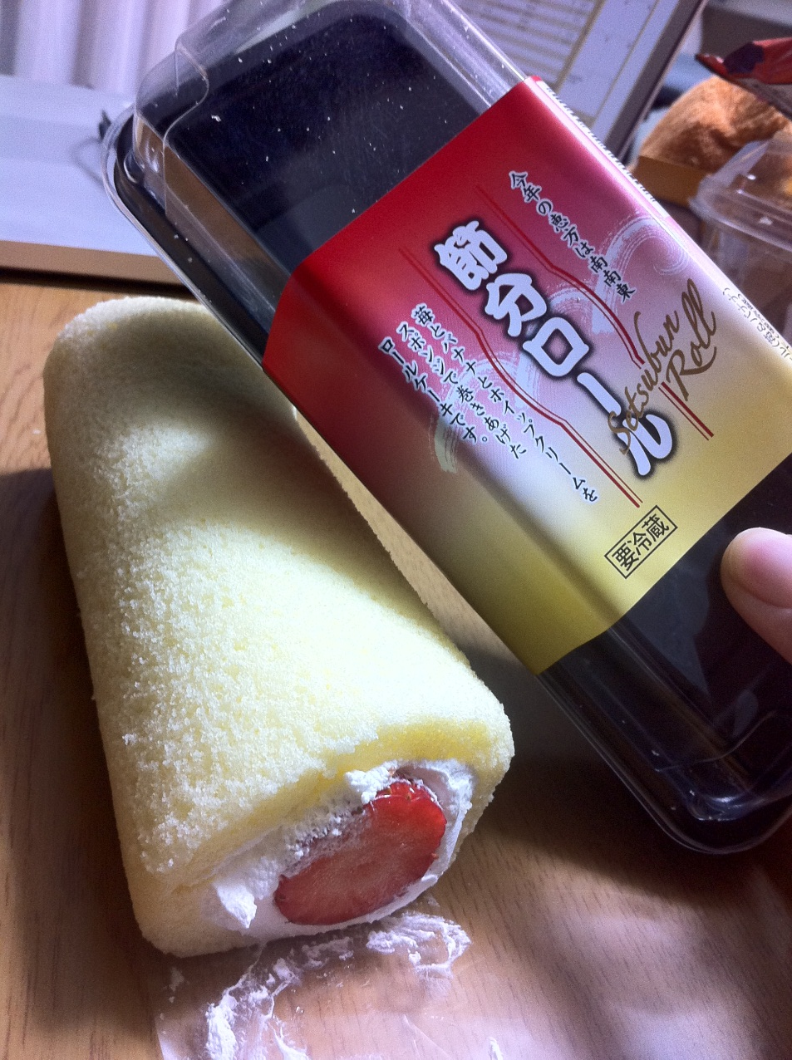
These days you could even eat this modern version of ehōmaki
えほうまき made from cake, cream and strawberries.
What ingredients could you use to create an Australian version of an ehōmaki えほうまき ?

Slide 9
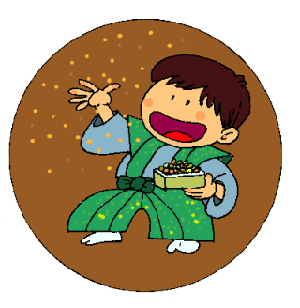
Let’s try doing aせつぶん setsubun jigsaw puzzle on the IWB!
http://www.dltk-kids.com/puzzles/pt.asp?id=20120201
http://www.dltk-kids.com/puzzles/pt.asp?id=20120203
Now let’s try the online version of Mame-maki まめまき.
Remember to only throw your soybeans at the おに oni, not at theふく fuku.
http://www.fujitv.co.jp/game/land/monthly20/mame2/

Slide 10
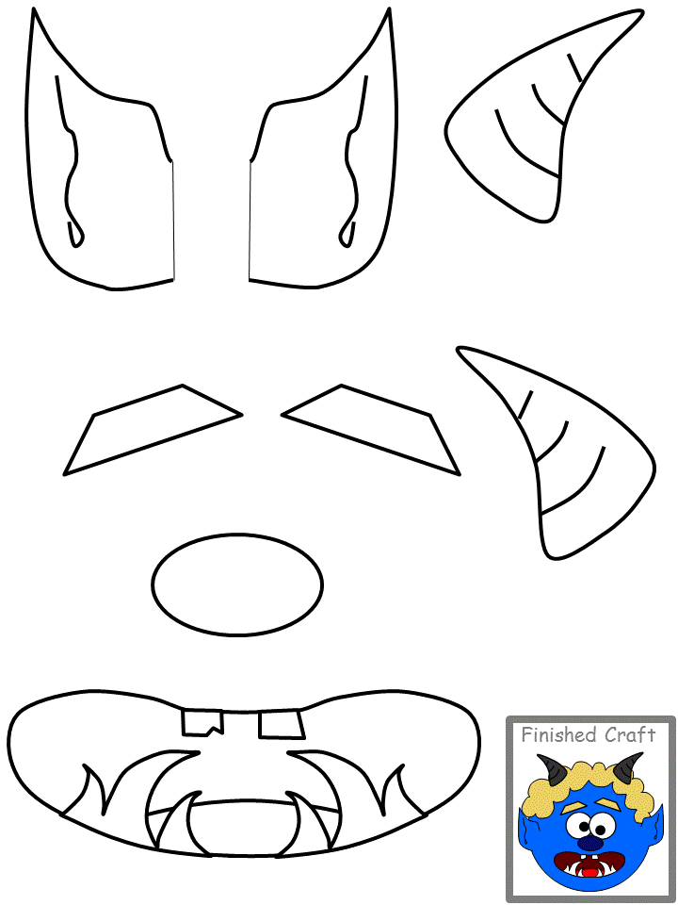
Now it’s time to try some せつぶん setsubun activities of our own.
EY - Paper Plate Mask
Colour these facial features
Stick them onto a paper plate
Cut out your eye holes
Add wool for hair
Attach a strap to finish your mask
Scare away the bad luck!
http://www.dltk-kids.com/world/japan/mplate-blue-oni.htm

Slide 11
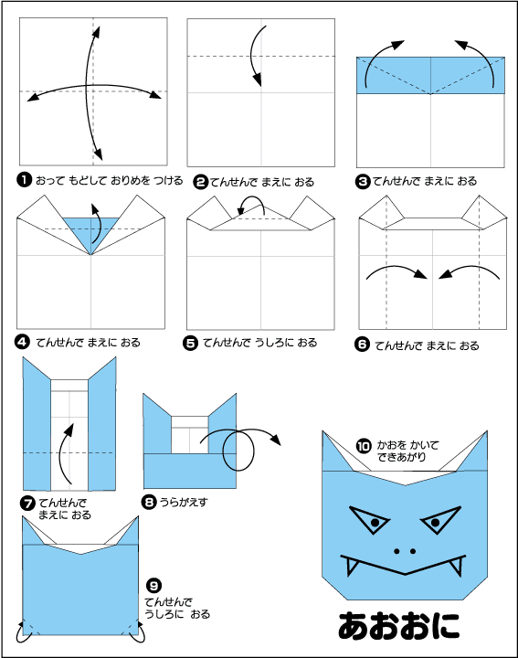
PY - Origami
1. Watch the Origami Club animation to make your own blue oni
あおおに
2. Draw on scary features
3. Display them in your Japanese Room
http://www.origami-club.com/season/2/oni/

Slide 12
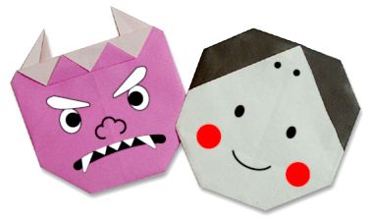
MY - Origami Pictures
1. Watch the Origami Club animations to make your own mini おに and ふく
2. Draw on scary features
3. Using your origami create a せつぶん scene on A4 paper, showing まめまき OR make a poster explaining せつぶん to younger students
3. Display them in your Japanese Room
http://www.origami-club.com/season/2/fuku-oni/index.html

Slide 13
せつぶん Quiz Time
What do you remember from our lessons?
Score a point for your team if you answer correctly. Score again if you remember another fact.
Which team is the winner?
What date is せつぶん? | _______ beans are used at せつぶん. | What does せつぶんtraditionally celebrate?
What are 4 important things to think about when you eat the せつぶん food? | In 2012 the lucky direction is ____ ____ ____. | What should you eat at せつぶん?
What are the Japanese names of the せつぶん characters? | Where can you celebrate せつぶん? | The ceremony getting rid of demons is called__________.

