Slide 1
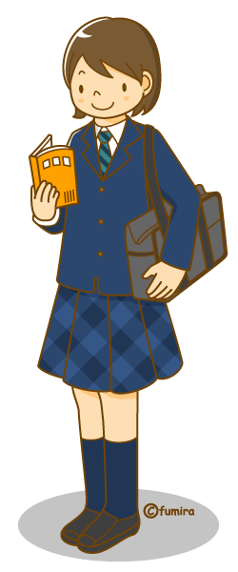
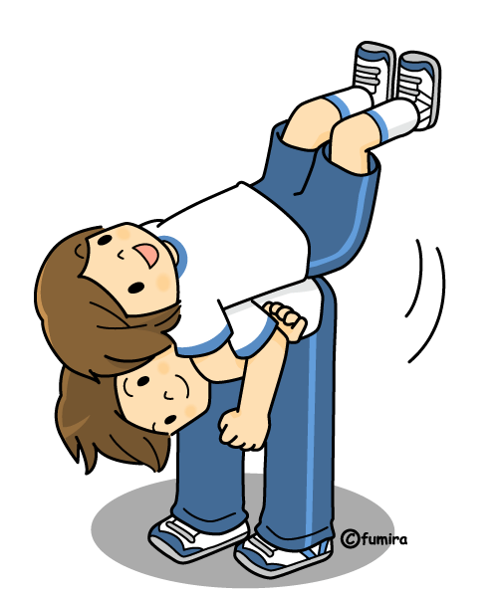
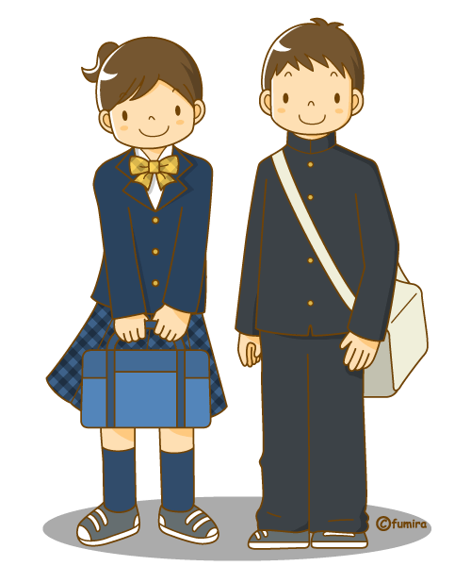
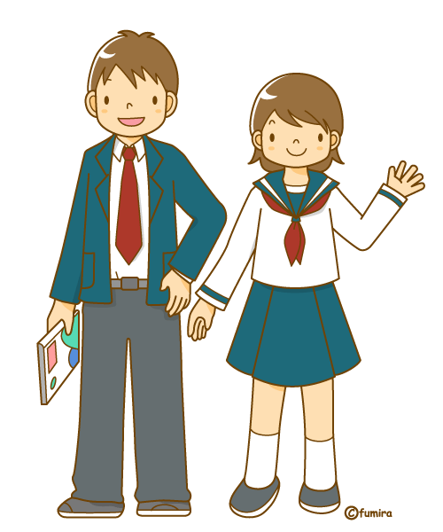
日本 の せいふく
nihon no seifuku
Japanese school uniforms

Slide 2
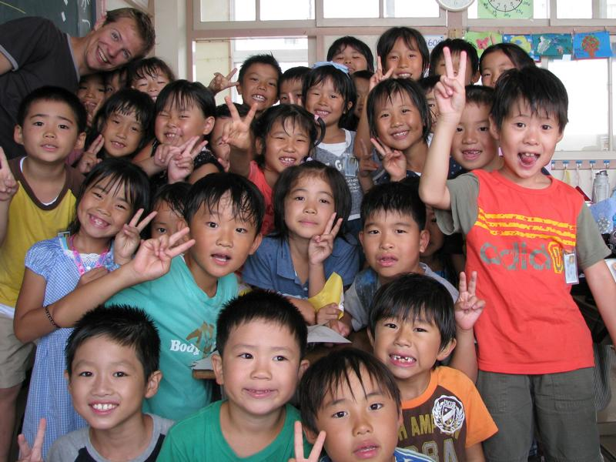
小学校 しょうがっこう
shoogakkoo – Primary School
Year 1 - 6
Generally, public primary schools do not
wear school uniforms, but often have
inside and outside shoes
school bag
school hat
name tag
school badge
PE uniform

Slide 3
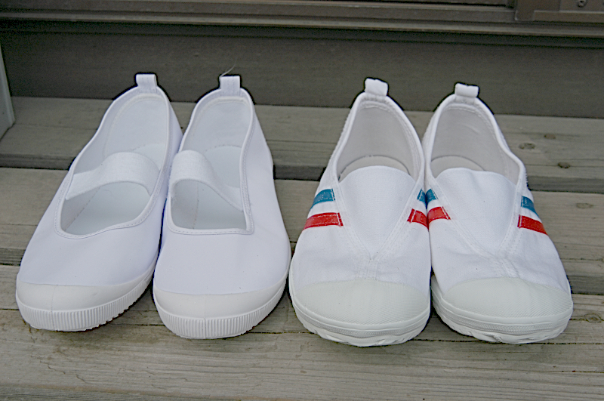
うわばき uwabaki
school inside shoes
soft canvas slip-on shoes
worn indoors to help keep school clean
kept in lockers or げたばこ (getabako) at school
bags for carrying shoes can be attached to ランドセル (randoseru)

Slide 4
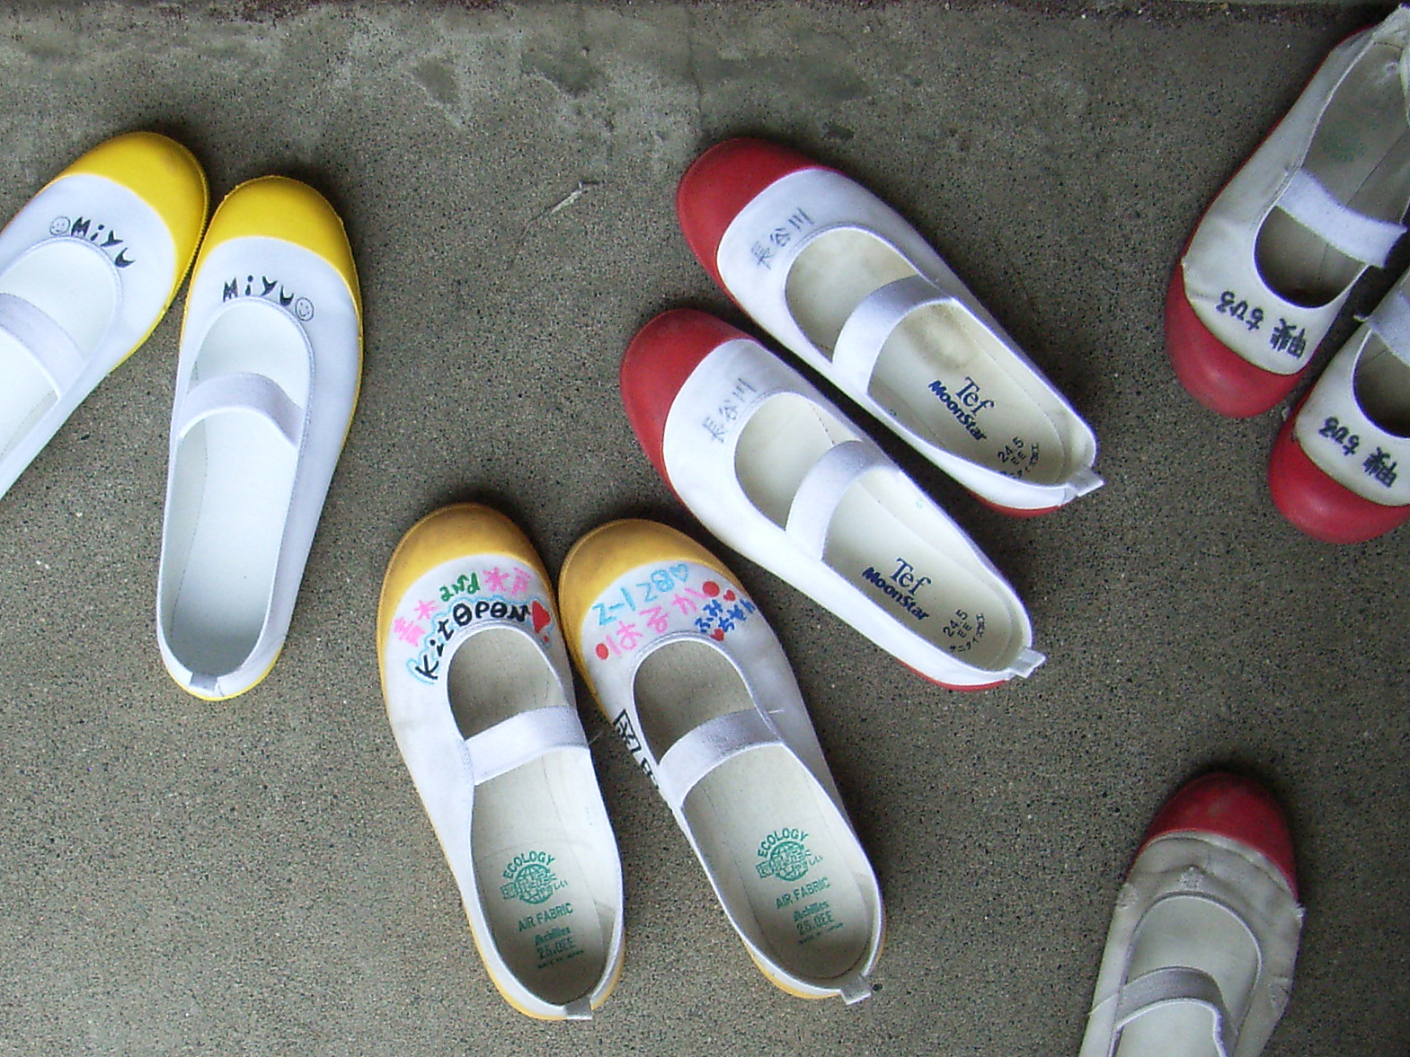

Slide 5
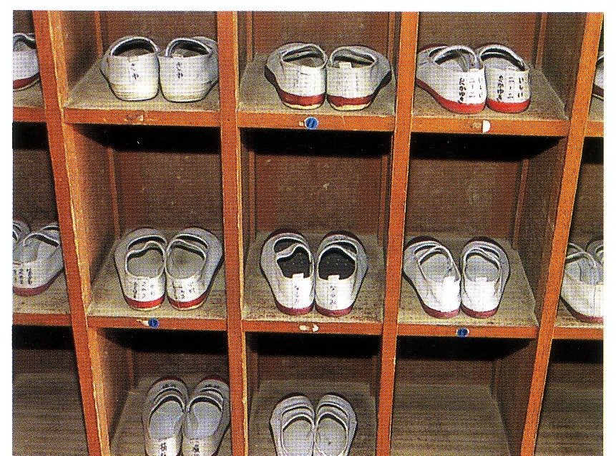

Slide 6
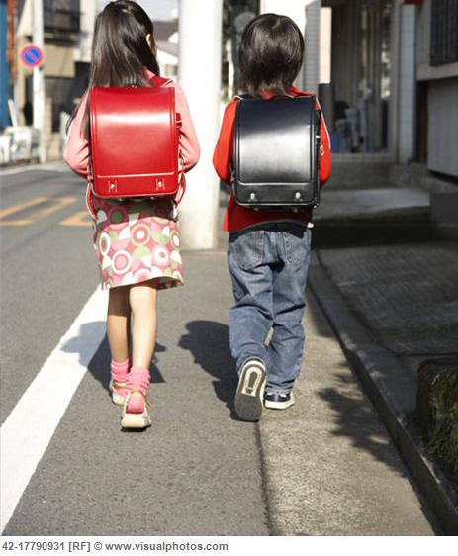
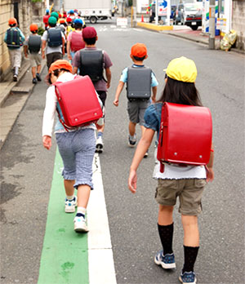
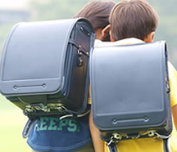
ランドセル randoseru
school bag
school backpack
traditionally, black for boys and red for girls, but now a variety of colours
leather and very expensive
lasts the whole of primary school

Slide 7
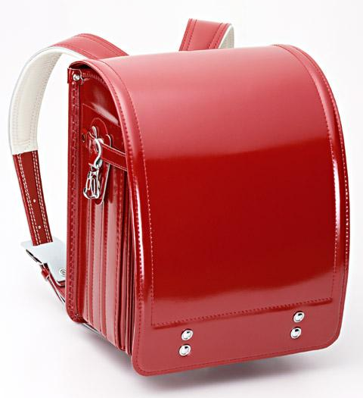
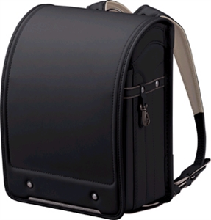
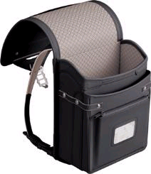
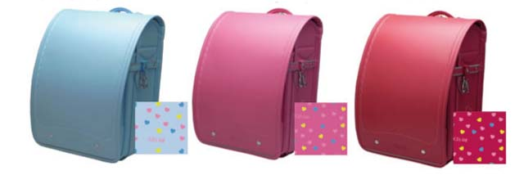

Slide 8
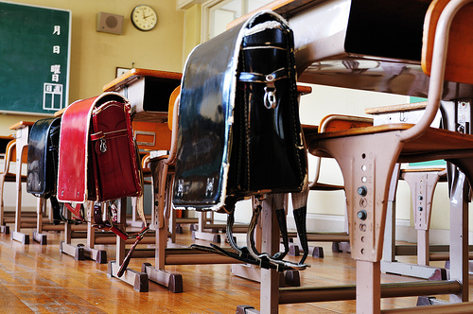

Slide 9
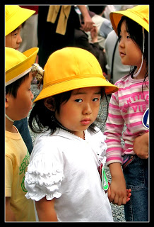
つうがくぼう tsuugakuboo
school hat
cloth hat, often yellow
worn between home and school
worn on school excursions
thought to help with safety

Slide 10
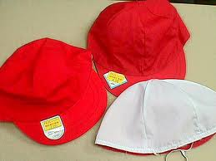
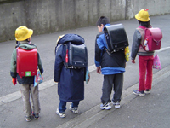
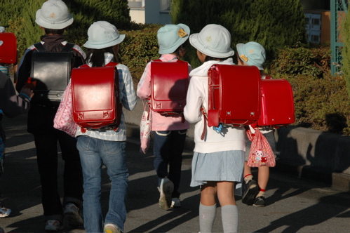
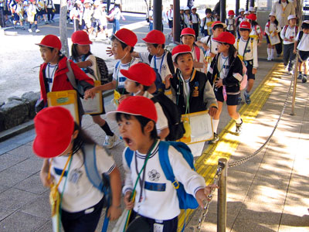

Slide 11
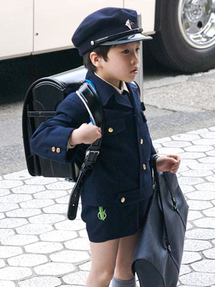
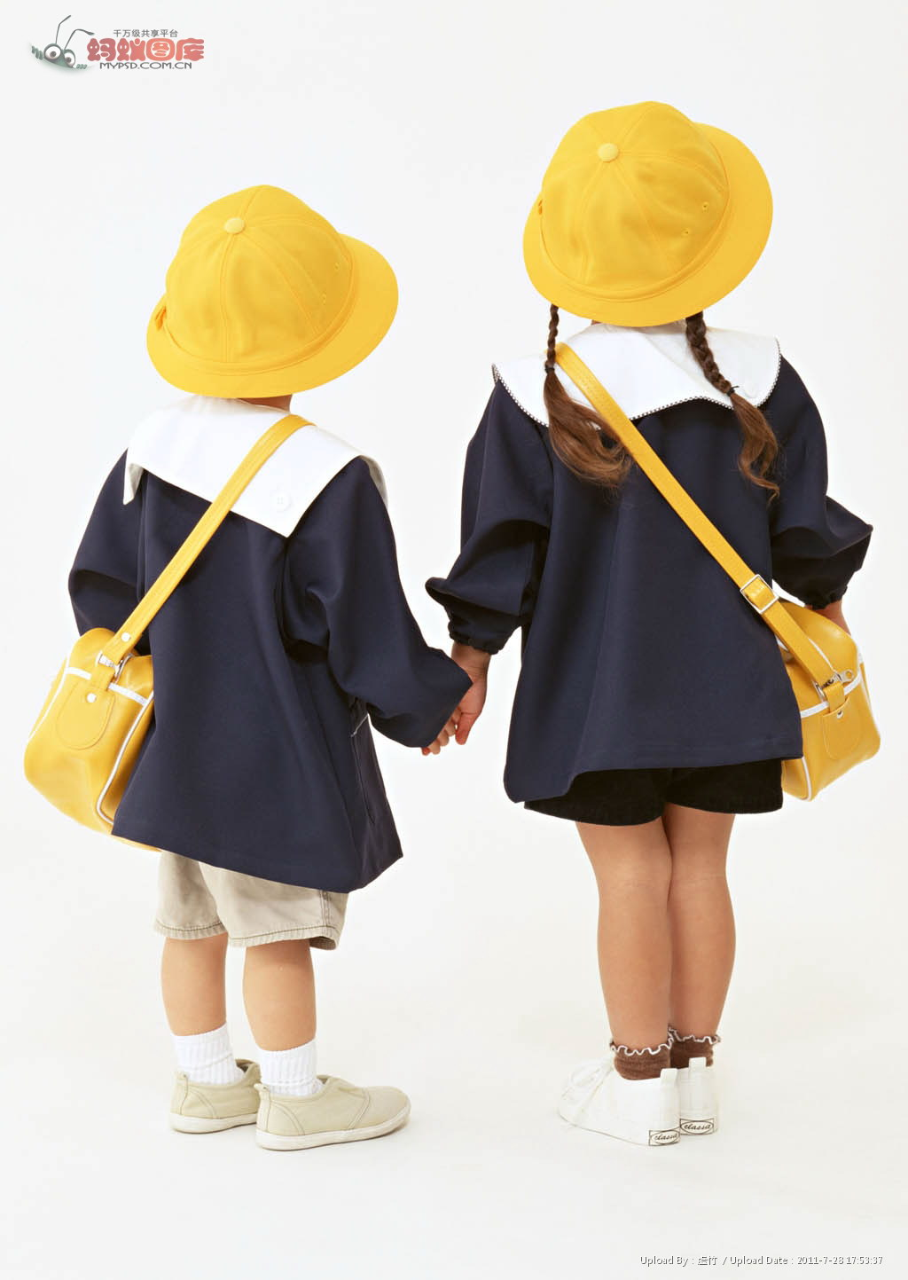
Private primary schools have uniforms, even for kindergarten.

Slide 12
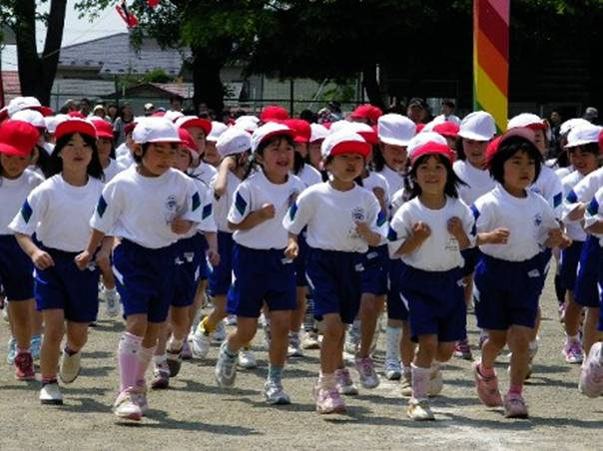
たいそうぎ taisoogi
sports uniform
usually, t-shirts and shorts
reversible red and white hats
often has the school logo on the uniform
can have different coloured hats for teams

Slide 13
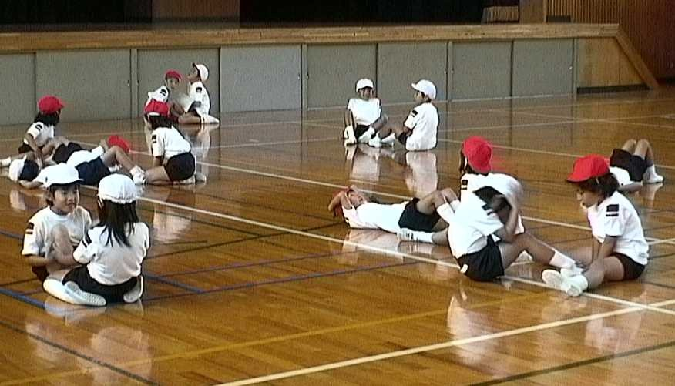

Slide 14
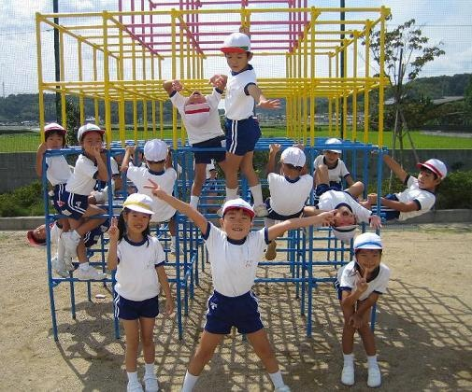

Slide 15
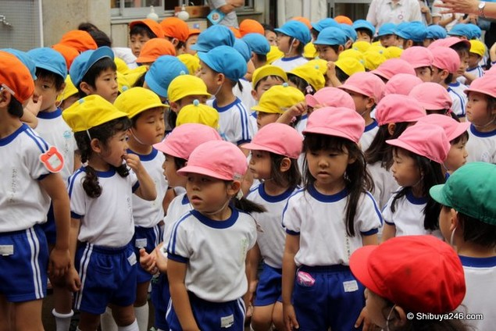

Slide 16
中学校 ちゅうがっこう
chuugakkoo – Junior High School
Year 1 – 3 (7 – 9)
高校 こうこう
kookoo – Senior High School
Year 1 – 3 (10 -12)
uniforms are compulsory
summer and winter uniforms
set dates to change uniforms
school badge or emblem
inside and outside shoes
sports uniform, including track suit

Slide 17
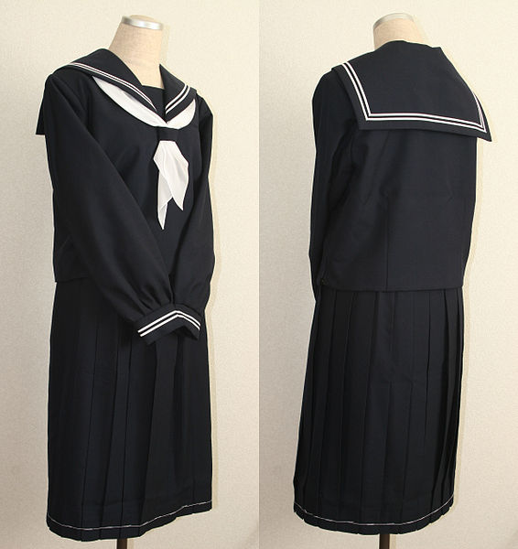

Slide 18
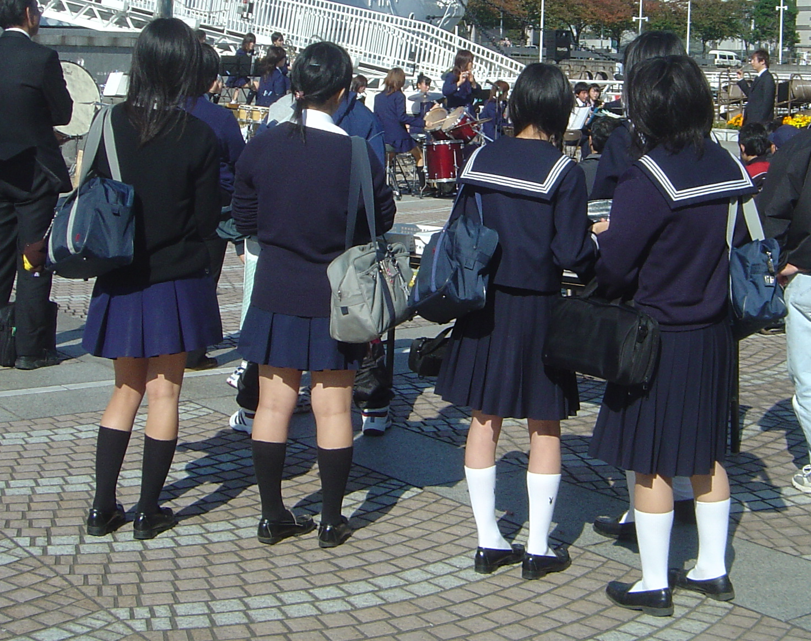

Slide 19
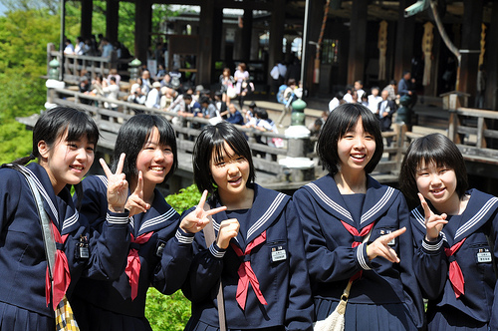

Slide 20
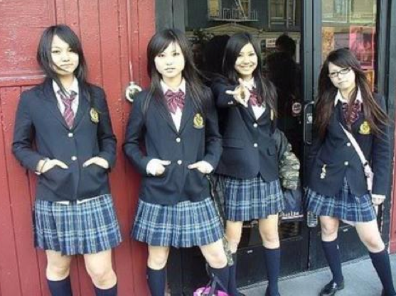

Slide 21
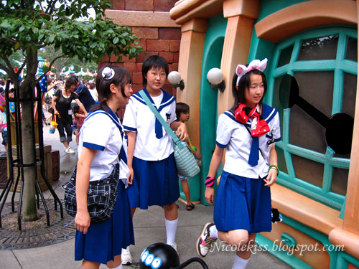

Slide 22
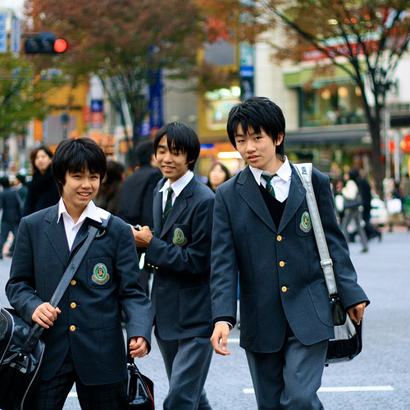

Slide 23
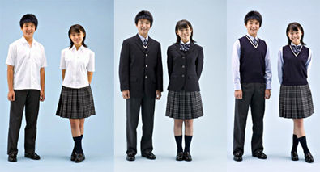

Slide 24
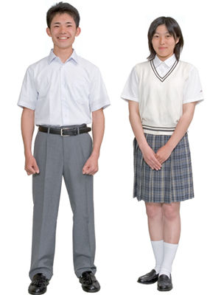
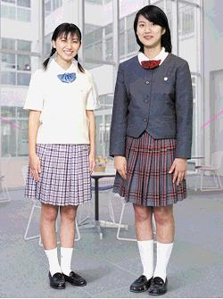

Slide 25
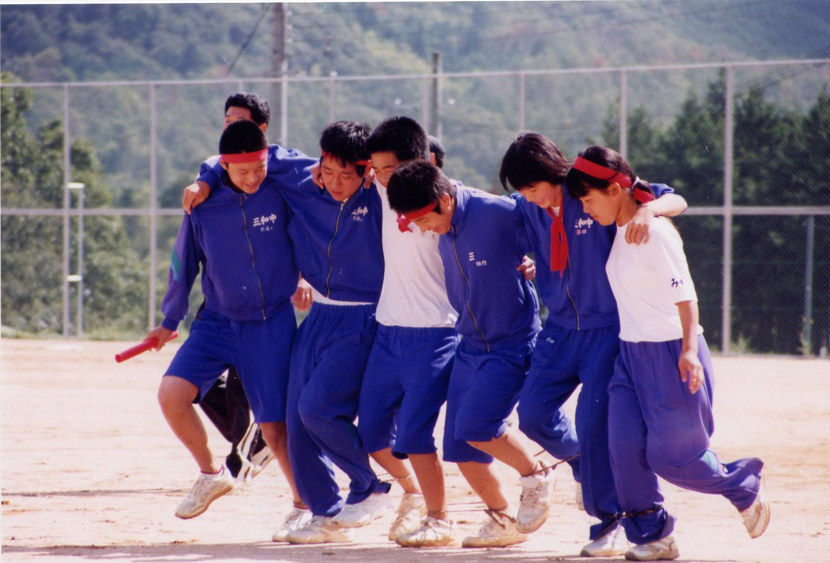

Slide 26
