Slide 1
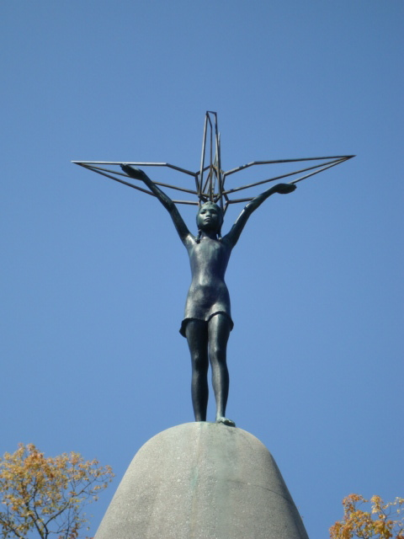
さだこ

Slide 2
Sadako and the 1000 paper cranes

Slide 3
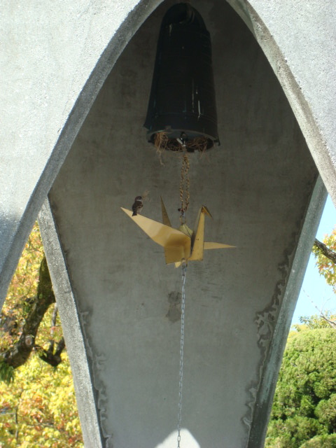
Complete these questions after reading the Sadoko さだこ story.
1. Who was Sadako さだこ?
2. Where was the story set?
(Country and city)

Slide 4
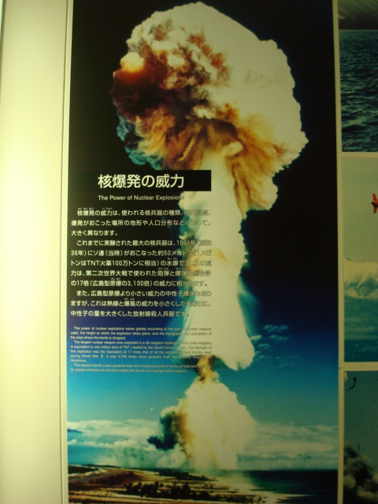
3. What was wrong with her and how did she get sick?
4. What was another name for the atomic bomb?

Slide 5
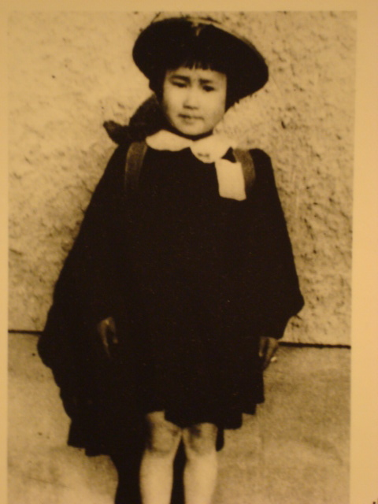
5. This story was set in 1954. Sadako さだこ was 11 years old. She was two when the atomic bomb was dropped. Using this information, what year did this occur?
6. What do you think about war?

Slide 6
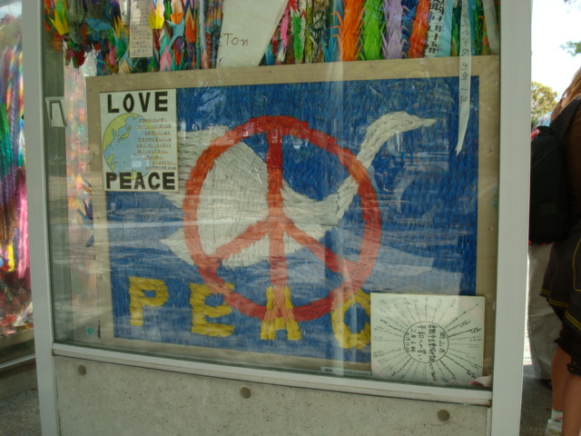
7. What other things could countries and/or governments do to prevent war (or going to war)?
What are some of the negative aspects
of nuclear warfare?

Slide 7
9. Illustrate one of the things you remember about the story?

Slide 8
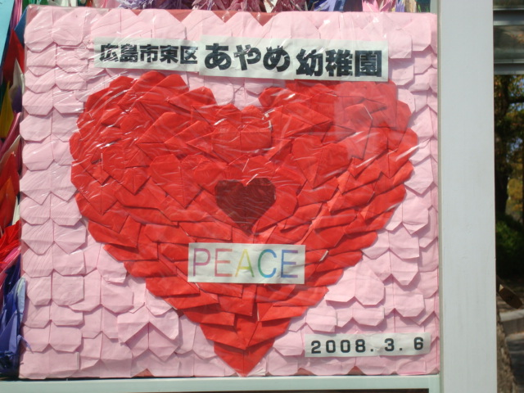
10. If you could write one sentence about peace （へいわ 平和）, that everyone in the world got a chance to read… what would it be?

Slide 11
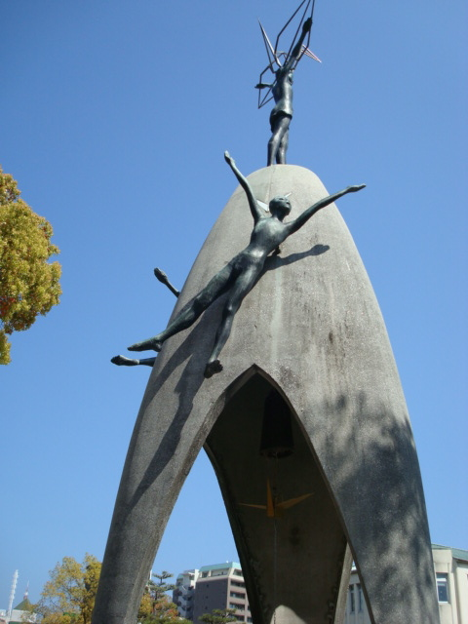

Slide 12
