Slide 1
Religions of Japan
日本 の しゅうきょう
Nihon no shuukyou

Slide 2
What do you know about religions in Japan?
Make a brainstorm map for it

Slide 3
Statistics – Religions
Source: Central Intelligence Agency (4 October 2012), “The World Factbook: Japan”, The World Factbook, The Central Intelligence Agency (The American Government), 2 November 2012, https://www.cia.gov/library/publications/the-world-factbook/geos/ja.html.

Slide 4
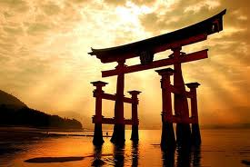
Overview
Floating Torii Gate at Itsukushima
Many religions are practiced in Japan – the two major ones are Buddhism and Shintoism.
Religion does not play a major role in the everyday life of the average Japanese.

Slide 5
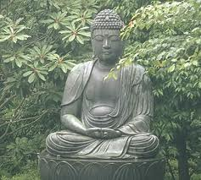
Overview (continued)
Religious rituals observed on special occasions such as birthdays, weddings, funerals and religious holidays.
Japanese people may observe practices across different religions for different occasions. E.g. Shintoist ceremony for weddings, and Buddhist ceremony for funerals.

Slide 6
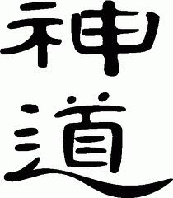
Shintoism
Shin (kami) = gods/deities
To – “the way of”
Native and earliest religion of Japan
It teaches that every natural thing in the environment, e.g. people, animals, rocks, trees, rivers, mountains has a spirit (kami) -> Compare Australian Aboriginal beliefs.

Slide 7
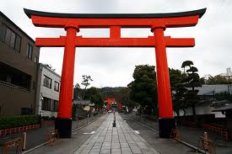
Shinto Shrines
A Shinto shrine has a torii gate at its entrance.
It symbolizes the transition from the secular to spiritual world.

Slide 8
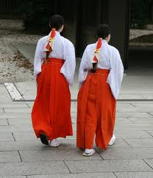
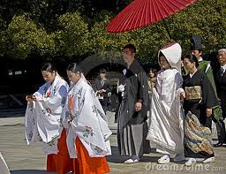
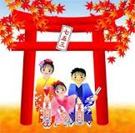
Shichi-go-san ceremony

Slide 9
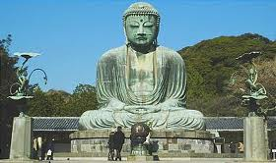
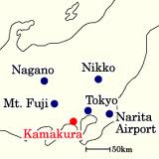
Buddhism
Buddhism originated from India, through China and Korea in 6th Century CE.
It consists of the teachings of the Buddha, Siddhartha Gautama.
Developed into a major religion during the Nara period (710 – 1185 CE)
Kamakura’s Great Buddha

Slide 10
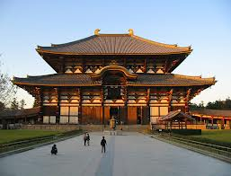
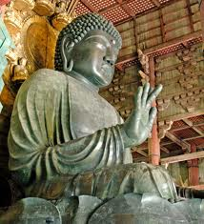
Buddhist Temples
Todaiji at Nara (est. 728)

Slide 11
Buddhism and Shintoism
Buddhism and Shintoism coexist in Japan. Japanese people will observe religious practices from both religions.
They use practices from both religions for birthdays, weddings and funerals. This also happens with traditional festivals in Japan.

Slide 12
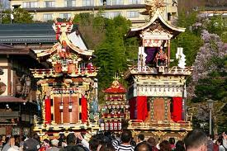
Festivals
Festivals in Japan are called ‘matsuri’.
They have origins in Shintoism.
These festivals usually symbolise the hope for abundant rice, prosperity and good health.

Slide 13
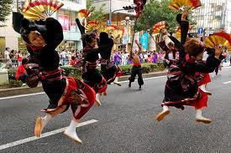
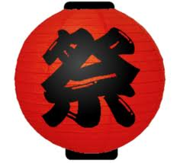
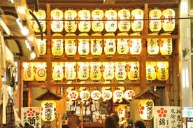

Slide 14
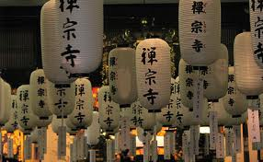
Festivals: Buddhist Influence
Obon festival
Annual visitation to family member’s graves
Also visitations to temples and decorations at altars at home
National holiday.

