Slide 1
Asking and saying what pet you own
Animal vocabulary

Slide 2
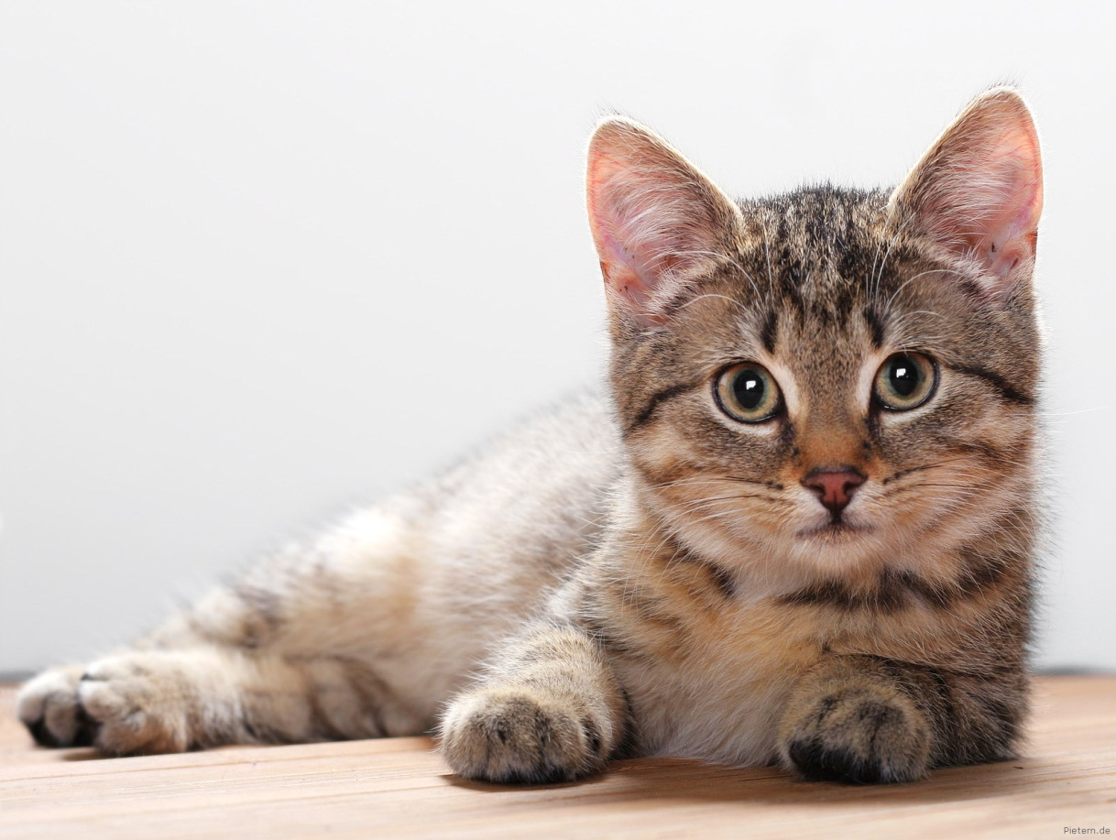
ねこ neko

Slide 3
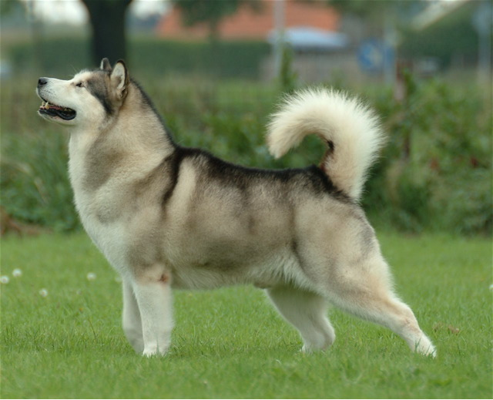
いぬ inu

Slide 4
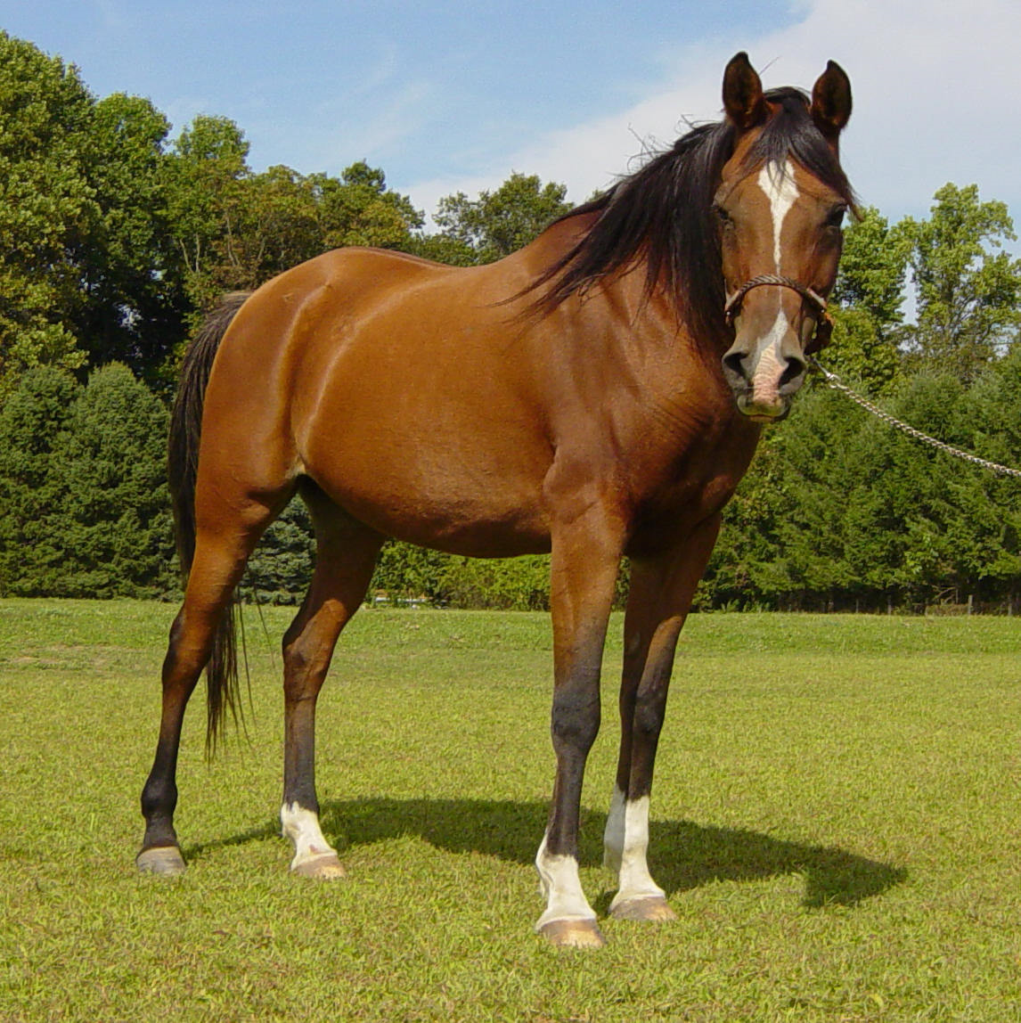
うま uma

Slide 5
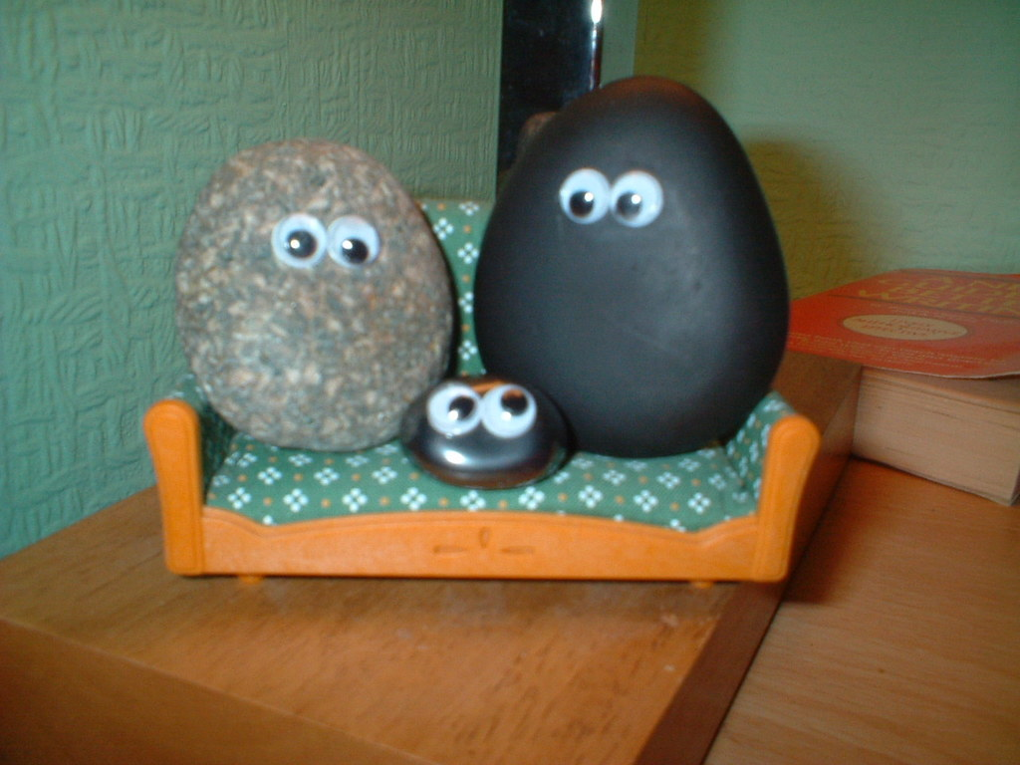
petto rokku
ペットロック

Slide 6
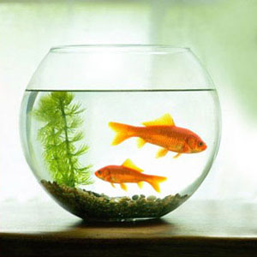
さかな sakana

Slide 7
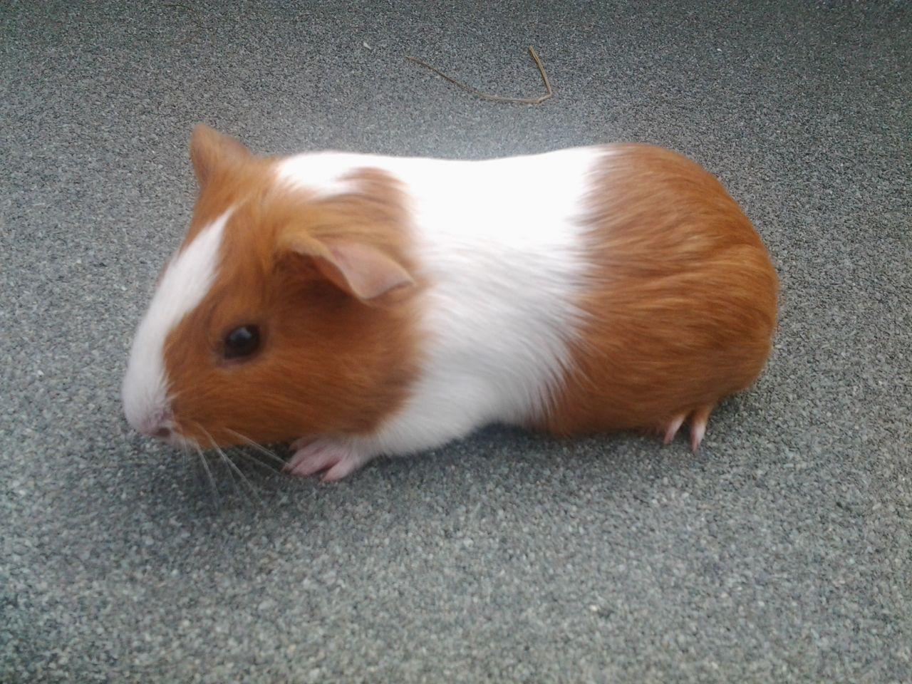
morumotto
もるもっと

Slide 8
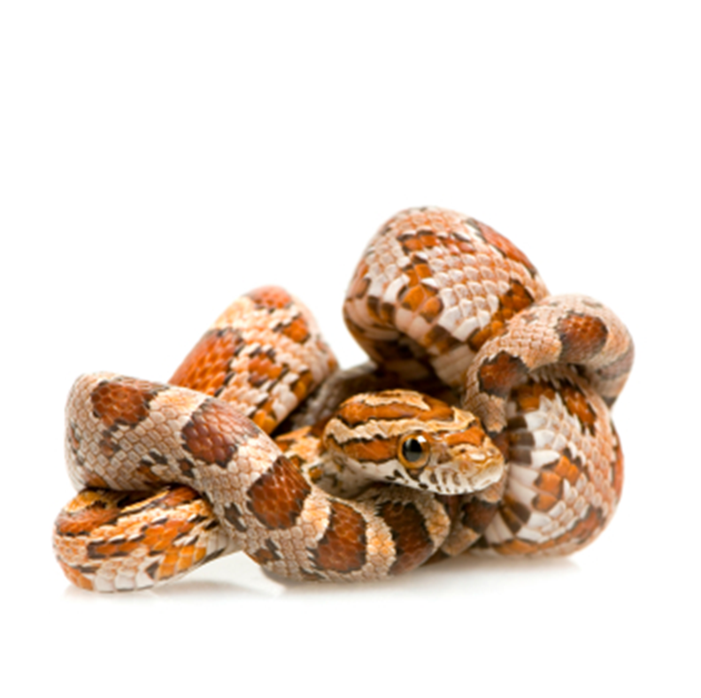
へび hebi

Slide 9
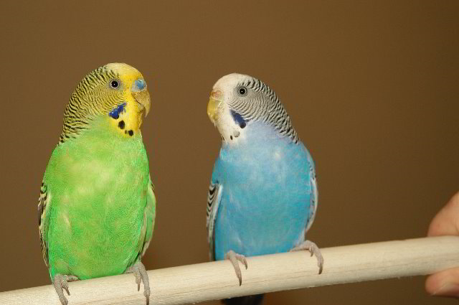
とり tori

Slide 10
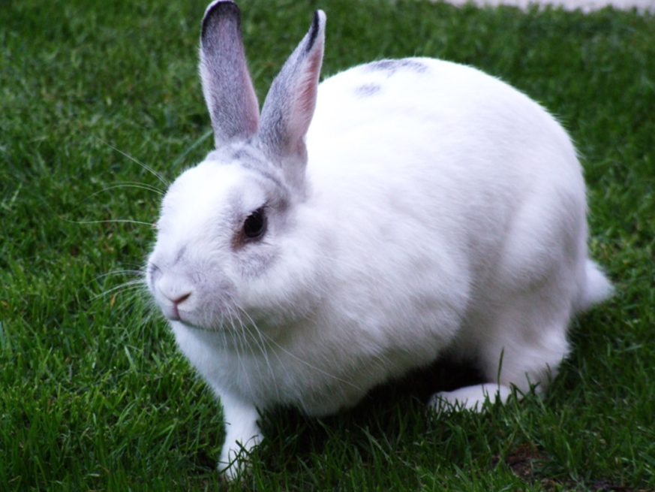
うさぎ usagi

Slide 11
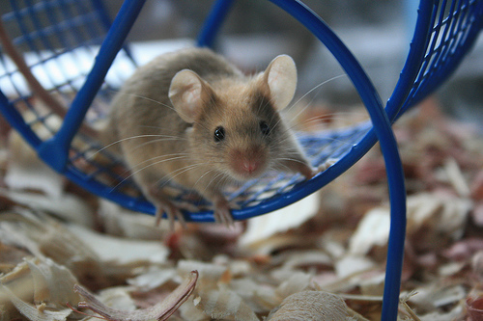
nezumi
ねずみ

Slide 12
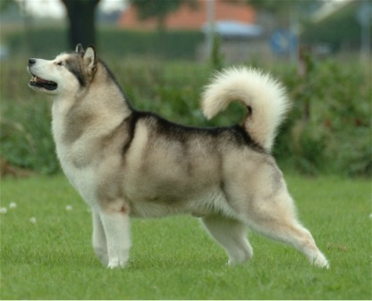
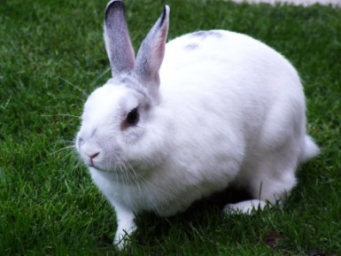

Slide 13
Asking and saying what pet you own:
Q | Petto wa nan desu ka? What pet do you have?
A1 | PET desu. I have a PET.
A2 | Petto wa PET desu. I have a pet PET.
ねこ neko
いぬ inu
へび hebi

Slide 14
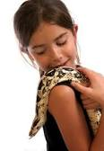
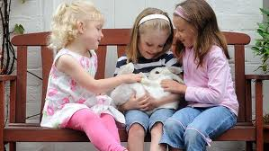
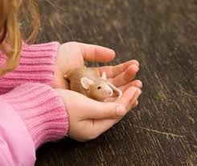
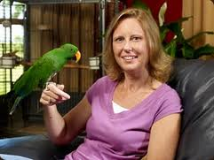
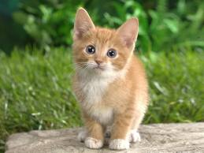
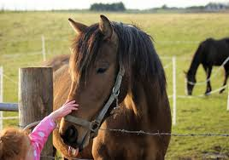
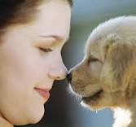
Petto wa nan desu ka?
3
4
1
5
7
2
8
6

Slide 15
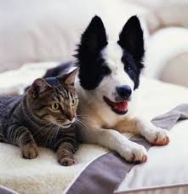
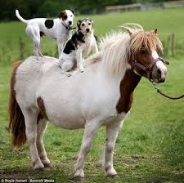
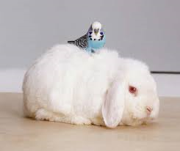
Two or more pets…
Q | Petto wa nan desu ka? What pet do you have?
A1 | PET to PET desu. I have a PET.
A2 | Petto wa PET to PET desu. I have a pet PET and PET.
ねこ neko
いぬ inu
うま uma
いぬ inu
とり tori
うさぎ usagi

Slide 16
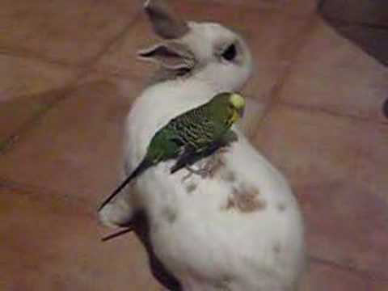
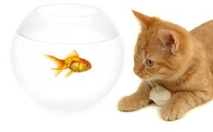
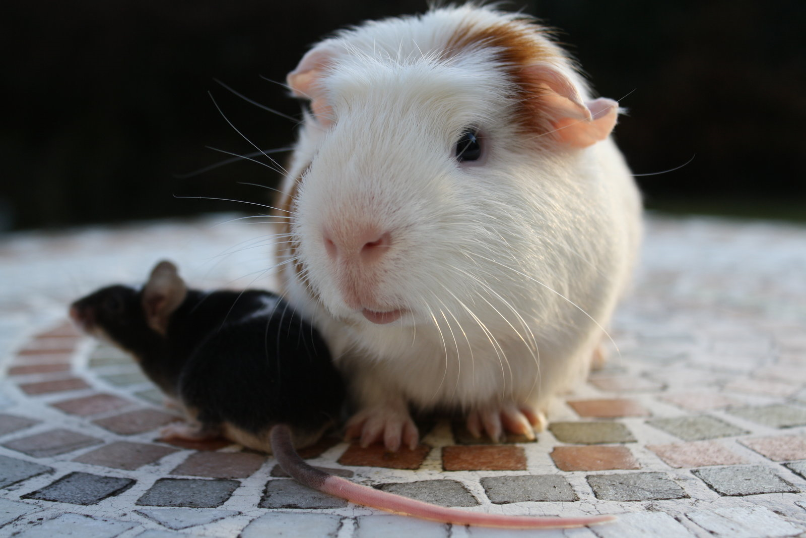
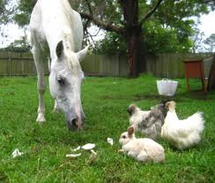
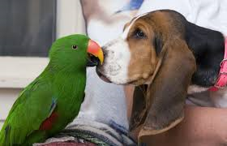
Petto wa nan desu ka?
4
1
3
5
2

Slide 17
PETS
Karuta

Slide 19
ねこ
neko
いぬ
inu
うま
uma
さかな
sakana
ペットロック
petto rokku
うさぎ
usagi
とり
tori
もるもっと
morumotto

Slide 20
ねずみ
nezumi
へび
hebi

