Slide 1
Obon おぼん
August.

Slide 2
Obon Festival – Mid August Each Year
Obon is an annual Buddhist event for commemorating one's ancestors. It is believed that each year during obon, the ancestors' spirits return to this world in order to visit their relatives. Traditionally, lanterns are hung in front of houses to guide the ancestors' spirits, obon dances (bon odori) are performed, graves are visited and food offerings are made at house altars and temples.
At the end of Obon, floating lanterns are put into rivers, lakes and seas in order to guide the spirits back into their world. The customs followed vary strongly from region to region.
Obon is observed from the 13th to the 15th day of the 7th month of the year, which is July according to the solar calendar. However, since the 7th month of the year roughly coincides with August rather than July according to the formerly used lunar calendar, Obon is still observed in mid August in many regions of Japan, while it is observed in mid July in other regions.
The Obon week in mid August is one of Japan's three major holiday seasons, accompanied by intensive domestic and international travel activities and increased accommodation rates.

Slide 3
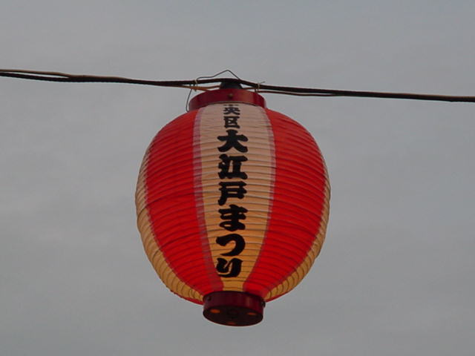
Matsuri lantern
Notes:
Matsuri lantern

Slide 4
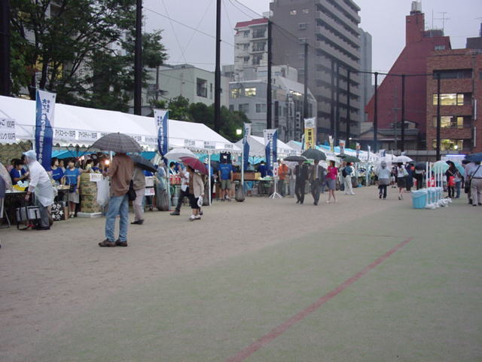
Getting ready for the matsuri
Notes:
Getting ready for the matsuri

Slide 5
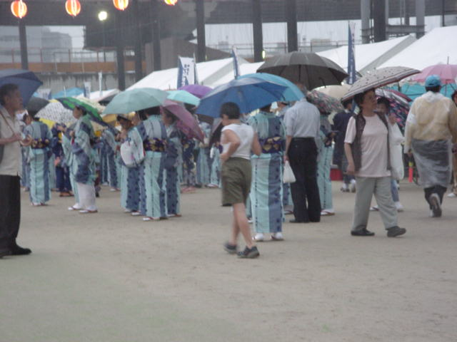

Slide 6
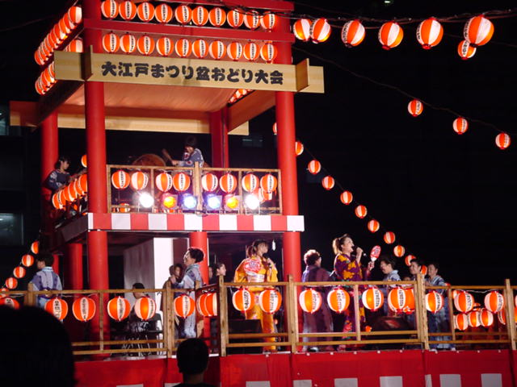
One of the many floats in the parade
Notes:
One of the many floats in the parade

Slide 7
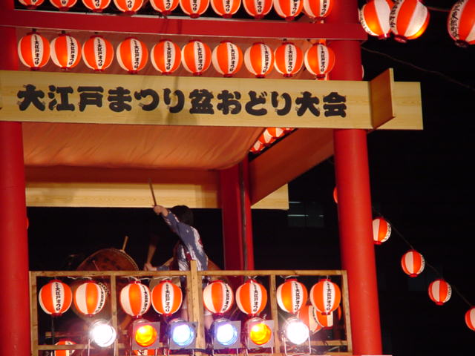

Slide 8
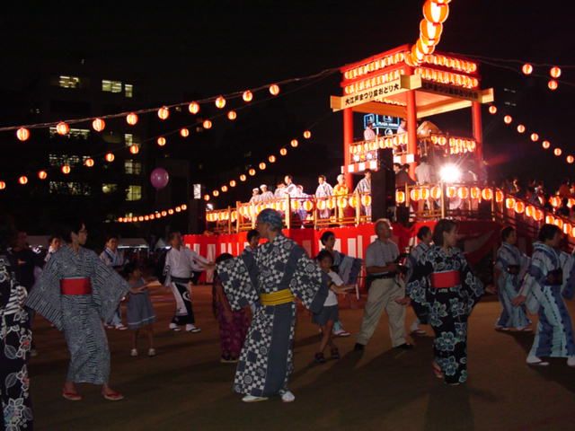
Everyone‘s dancing
Notes:
Everyone‘s dancing

Slide 9
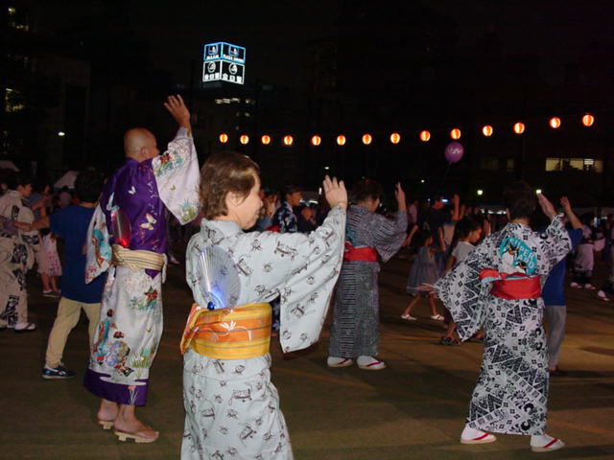

Slide 10
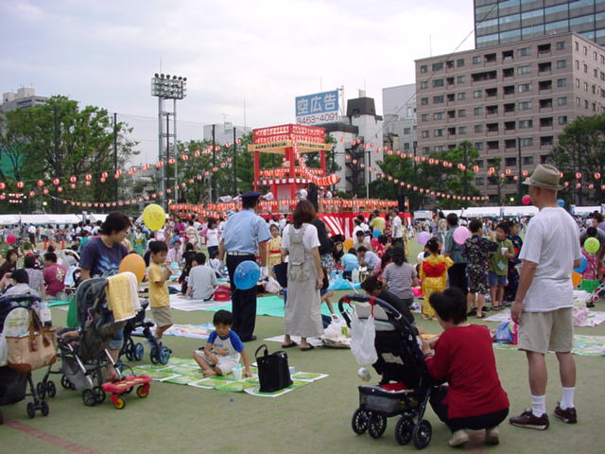
A day out
Notes:
A day out

Slide 11
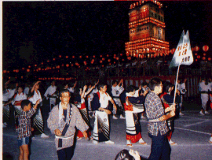
Lots of groups marching and dancing
Notes:
Lots of groups marching and dancing

Slide 12
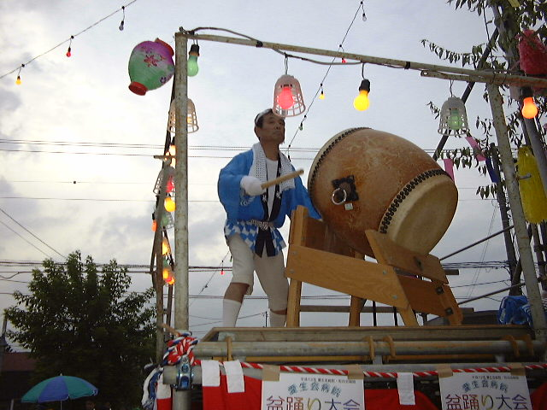

Slide 13
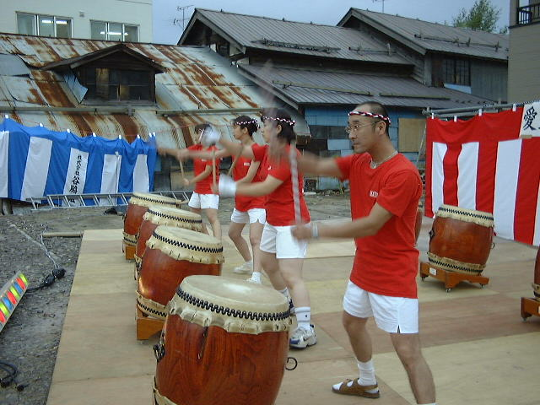

Slide 14
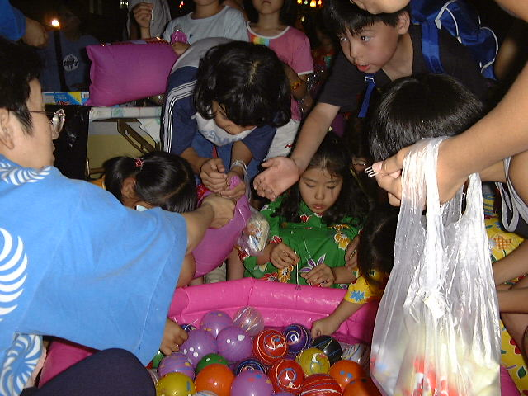
It’s a game
Notes:
It’s a game

Slide 15
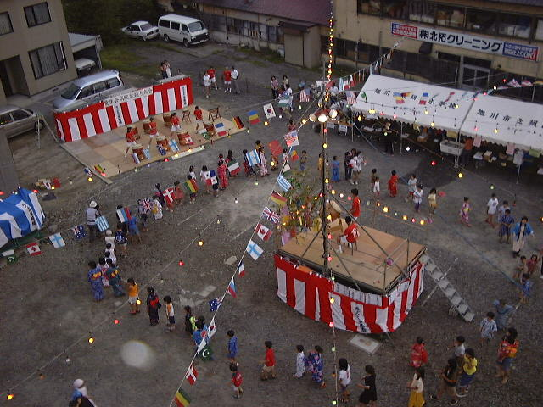
Local townspeople dancing
Notes:
Local townspeople dancing

Slide 16
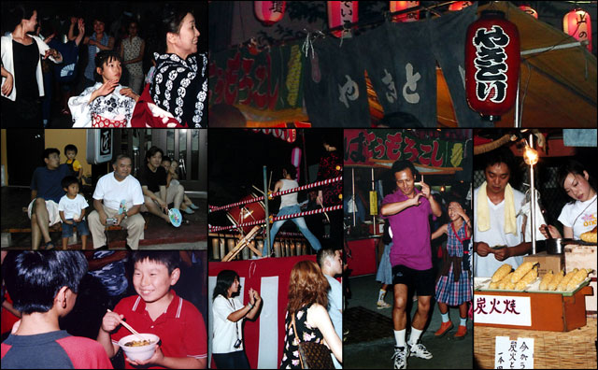
Some of the scenes
Notes:
Some of the scenes

Slide 17
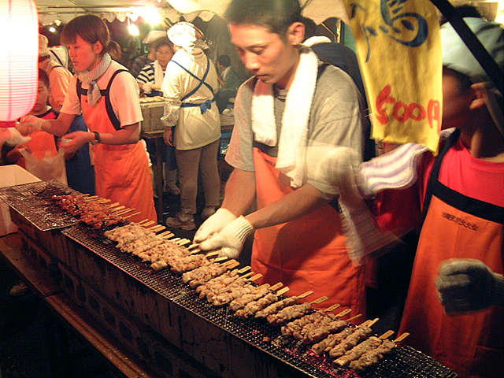
What about some yakitori?
Notes:
What about some yakitori?

Slide 18
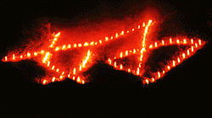
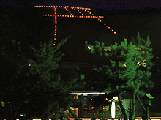
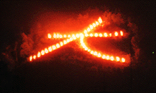
Mountain fire symbols
Notes:
Mountain fire symbols

Slide 19
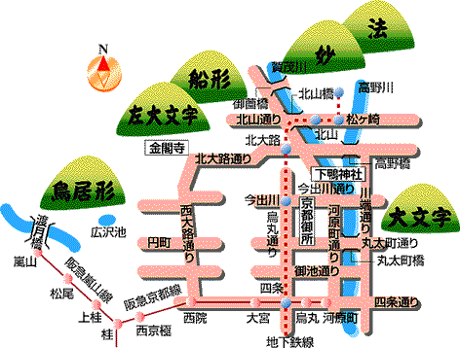
Kyoto ,where you can see the fires
Notes:
Kyoto where you can see the fires

Slide 20
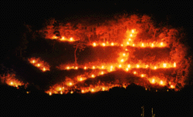

Slide 21
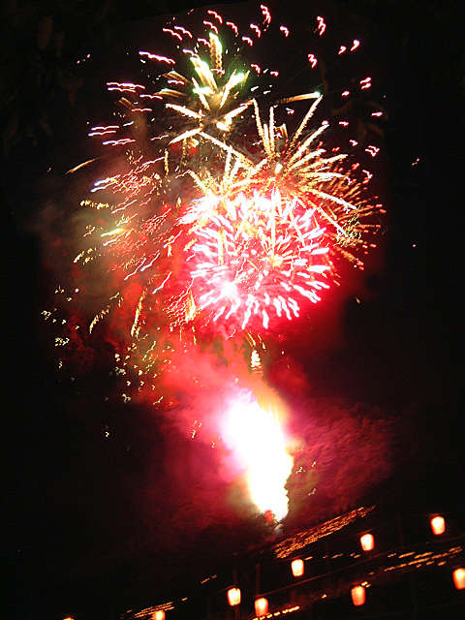
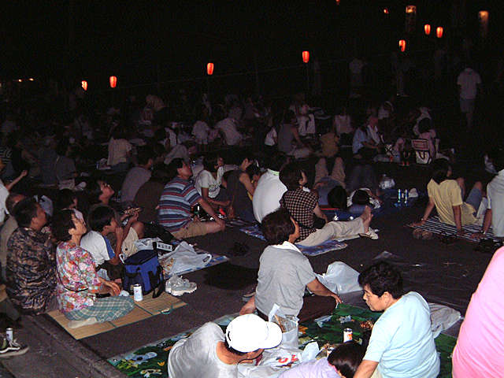
There are lots of hanabi
Notes:
There are lots of hanabi

Slide 22
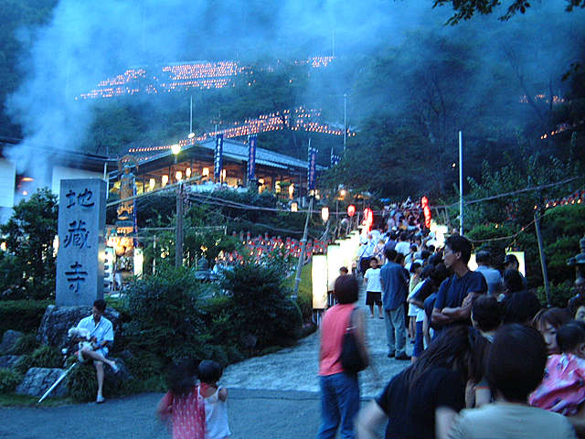
Visiting a temple is very important.
Notes:
Visiting a temple is very important.

Slide 23
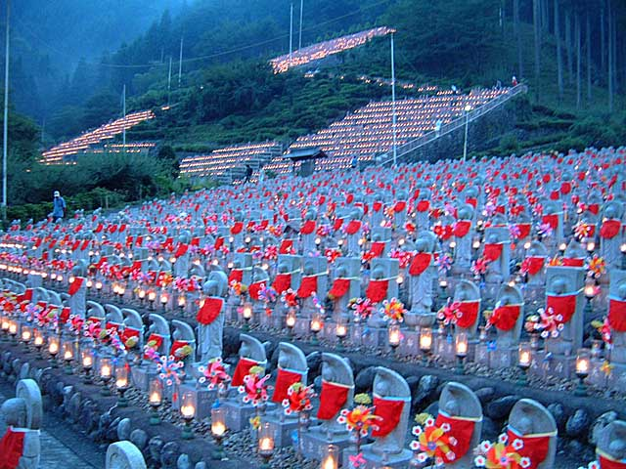
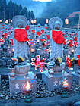

Slide 24
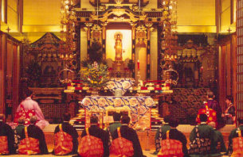
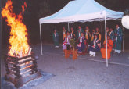

Slide 25
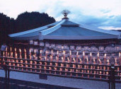
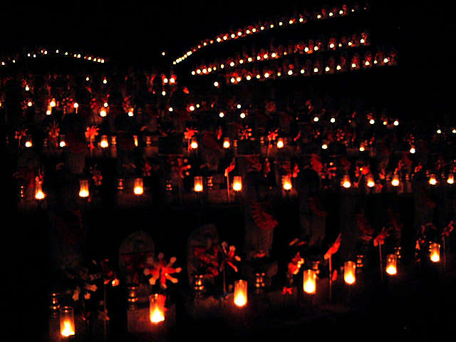
Lanterns are a major
event
Notes:
Lanterns are a major

Slide 26
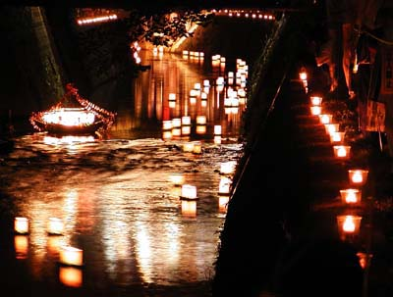
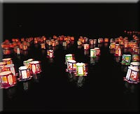

Slide 27
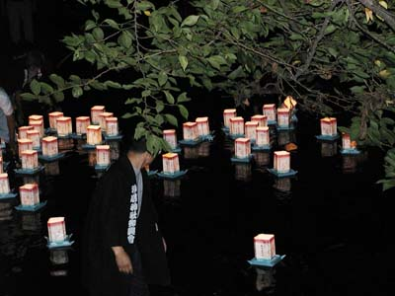
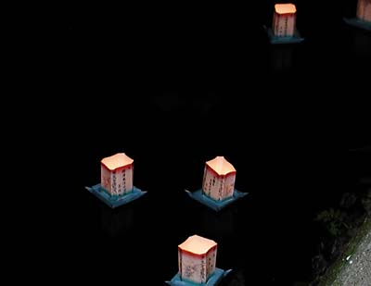

Slide 28
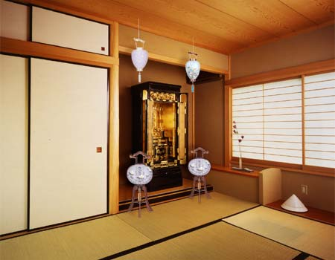
The shrine at home
Notes:
The shrine at home

