Slide 1
Adapted from: http://print-kids.net/print/kokugo/niteiru-hiragana-katakana/
カタカナ

Slide 2
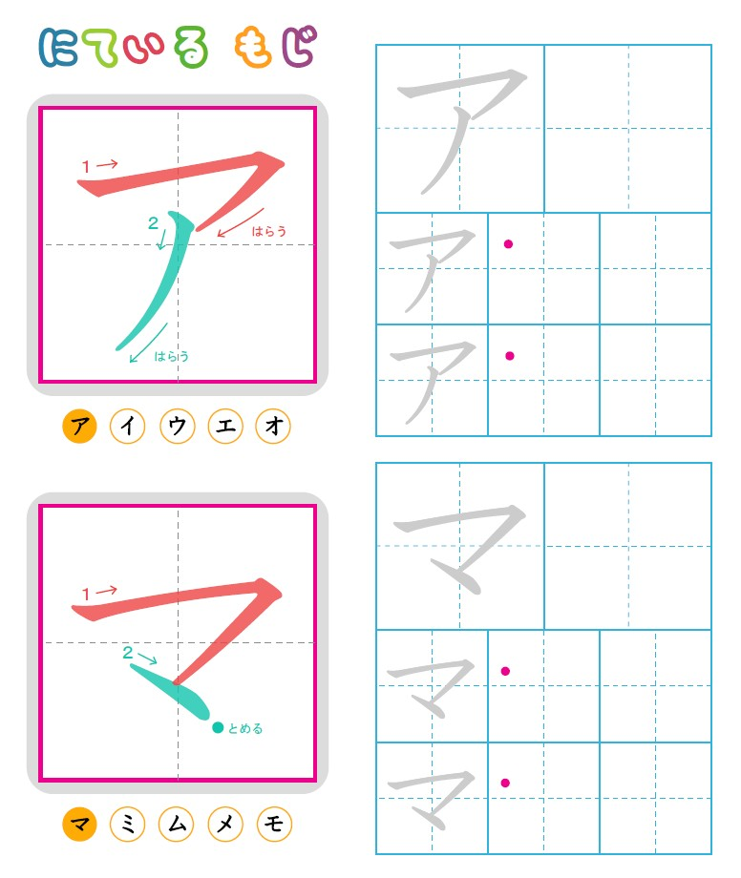
A
MA

Slide 3
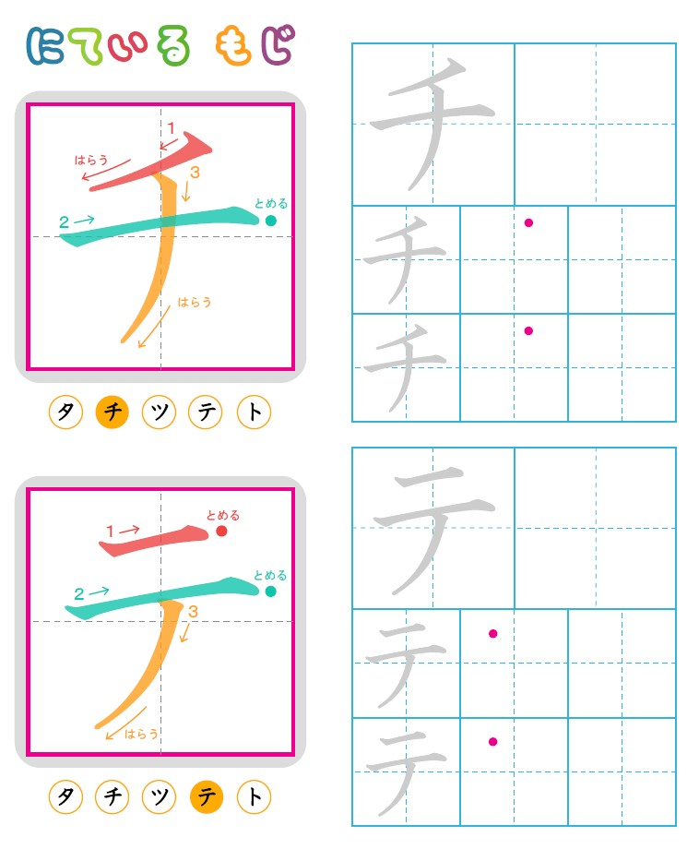
CHI
TE

Slide 4
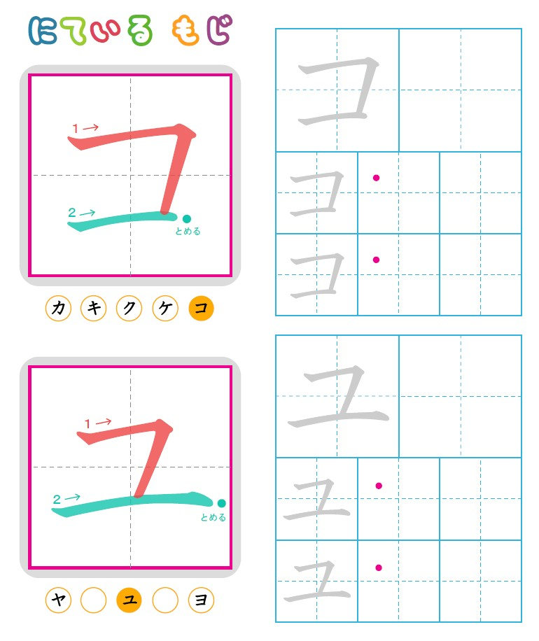
KO
YU

Slide 5
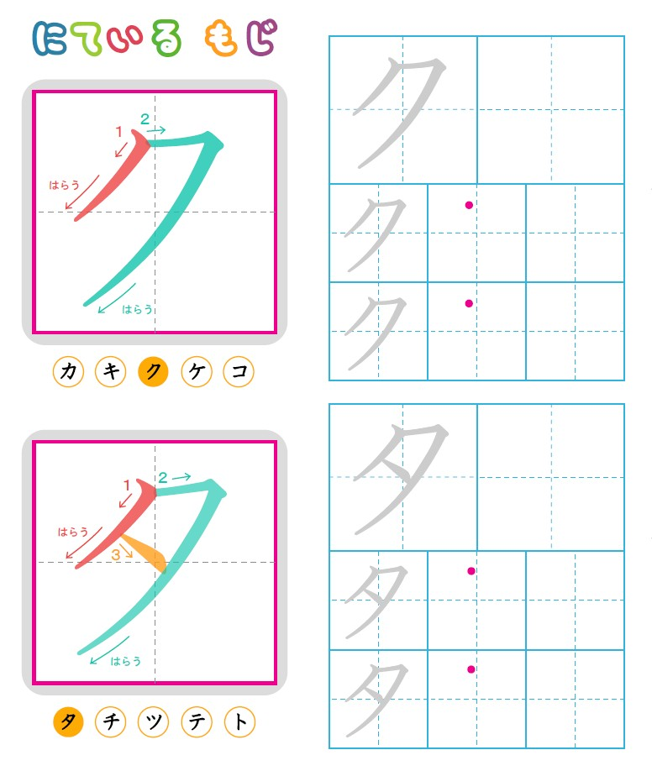
KU
TA

Slide 6
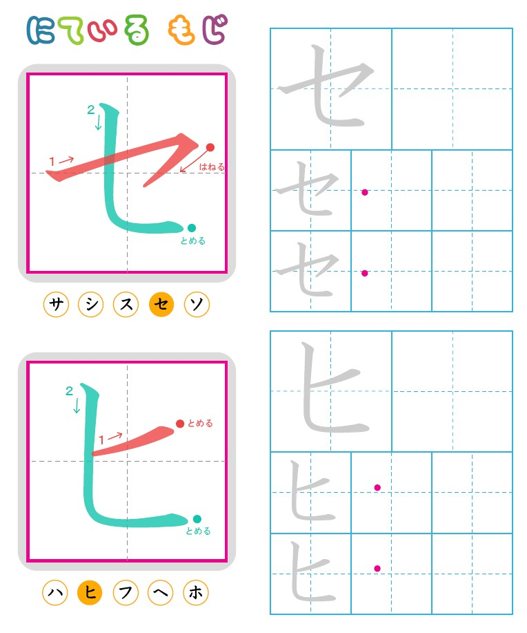
SE
HI

Slide 7
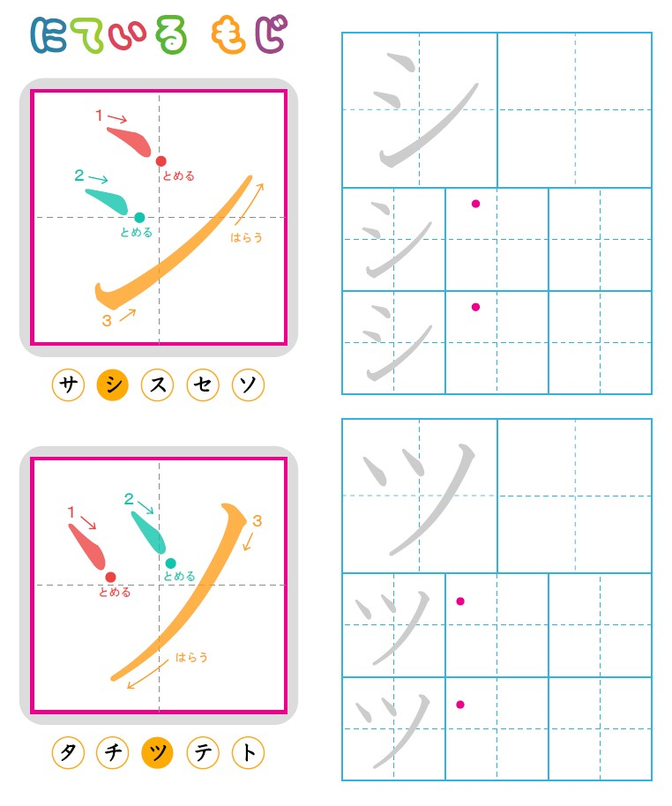
SHI
TSU

Slide 8
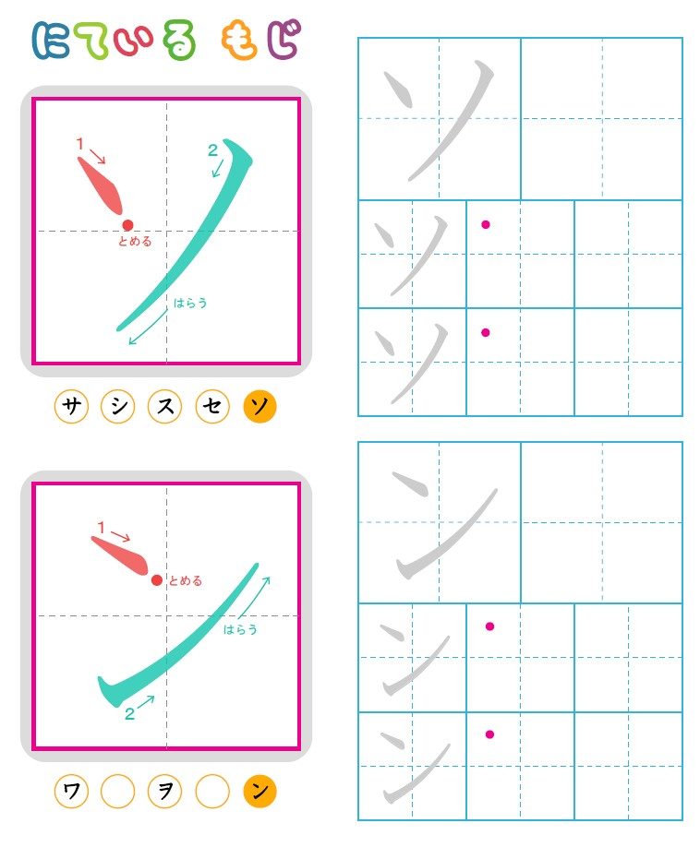
SO
N

Slide 9
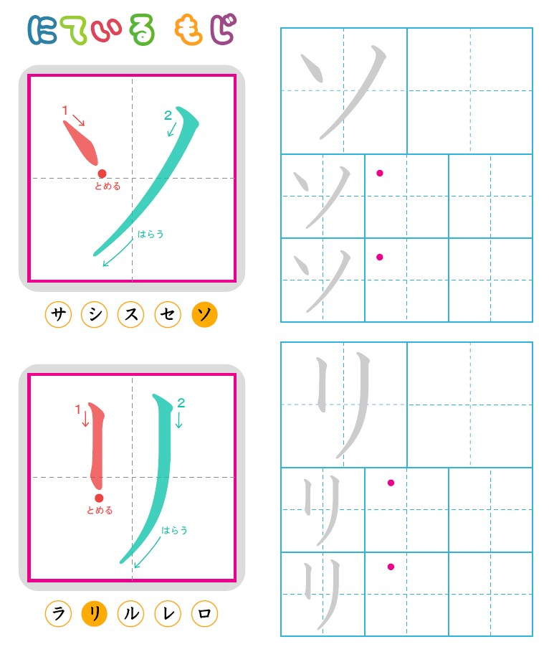
SO
RI

Slide 10
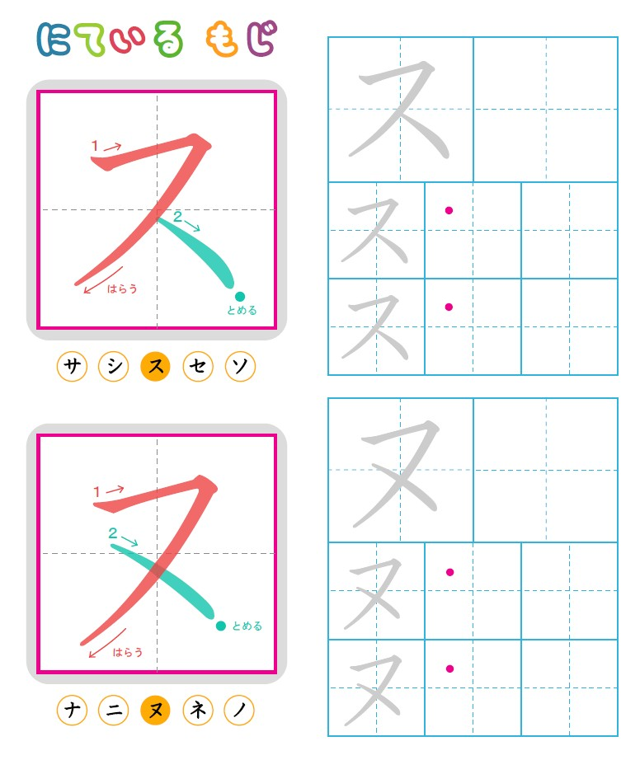
SU
NU

Slide 11
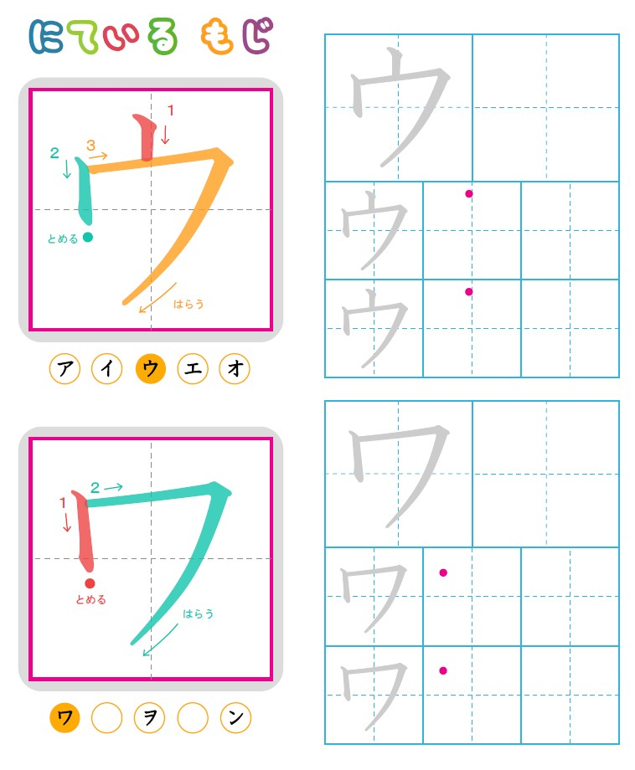
U
WA

Slide 12
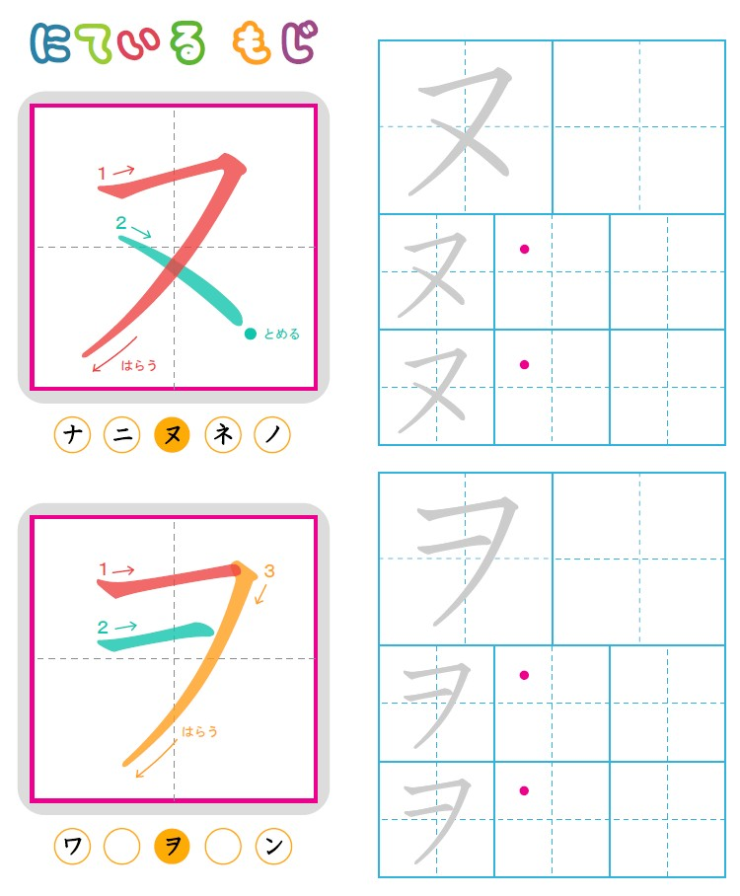
NU
WO

Slide 13
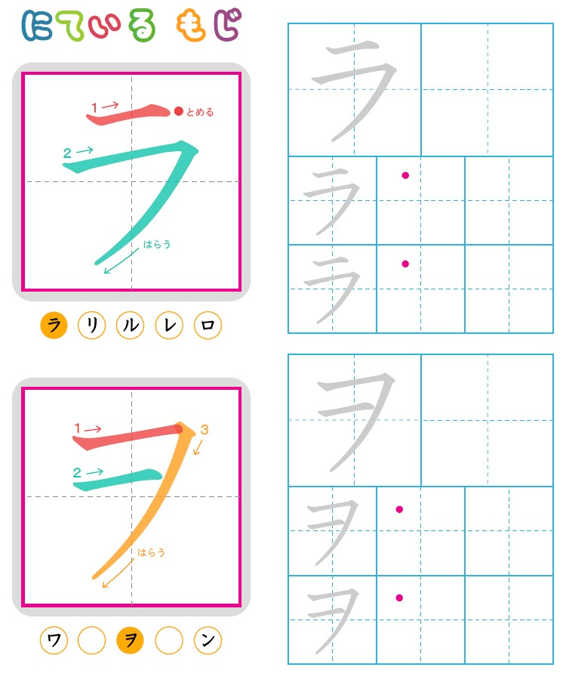
RA
WO

