Slide 1
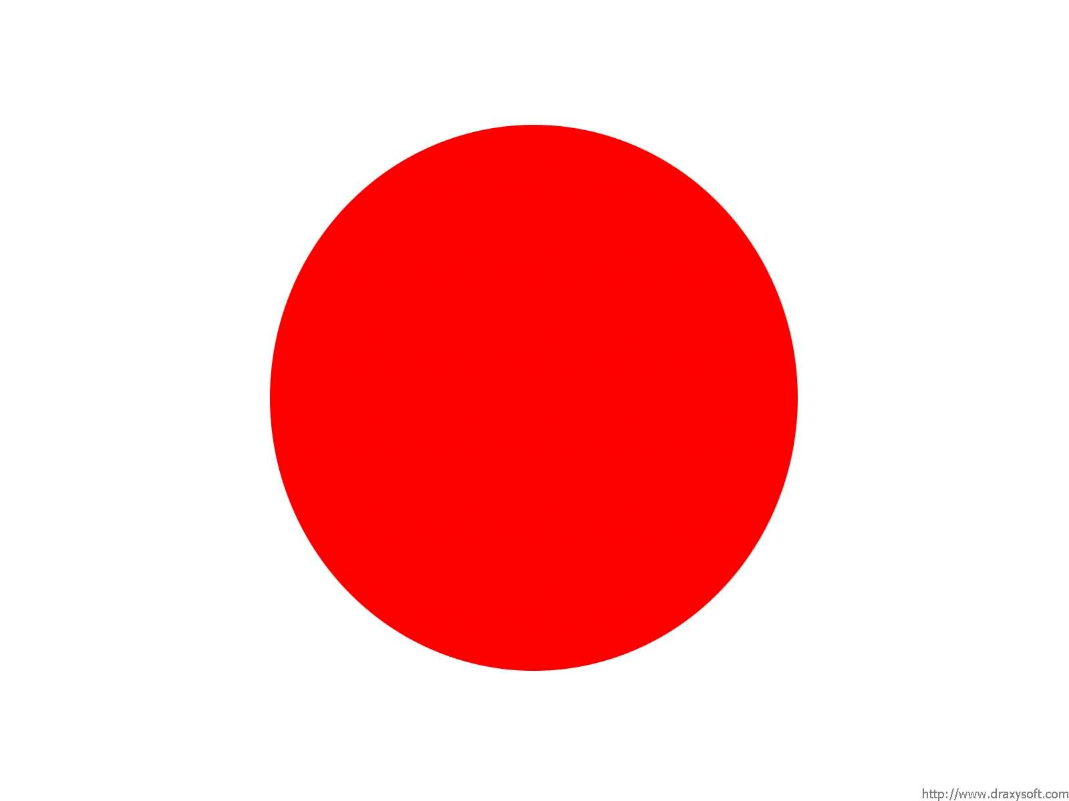
Nationality

Slide 2
Nationality
GRAMMAR STRUCTURE
Watashi wa (COUNTRY) jin desu.
I person
‘Watashi wa’ can be removed
Example:
Watashi wa nihon jin desu.
I am Japanese.
Watashi wa oosutoraria jin desu.
I am Australian.

Slide 3
NZ
Malaysia
Japan
Italy
Indonesia
Holland
Greece
France
Canada
Australia
China
Germany
America/USA
Thailand
Iran
England

Slide 4
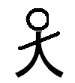
JIN
人
Jin = person
The kanji for ‘jin’ is
人

Slide 5
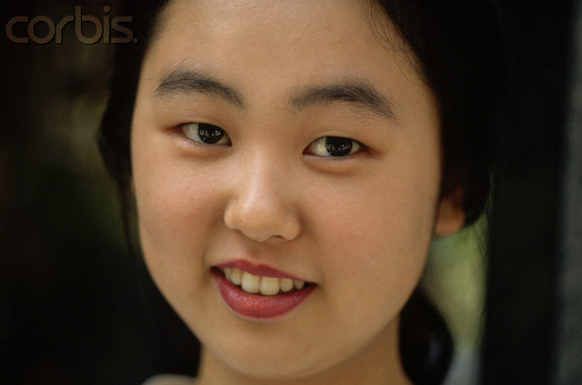
Watashi wa chuugoku jin desu.

Slide 6
Boku wa amerika jin desu.

Slide 7
Watashi wa doitsu jin desu.

Slide 8
It’s Your Turn!

Slide 9
kokuseki wa doku desu ka?

Slide 10
Remember!
Watashi wa (COUNTRY) jin desu.

Slide 11
Let’s Play ‘Where do you come from?’

Slide 12
Instructions
Everyone takes a country badge and sticks it on their shirt (know how to say you are a person from that country)
Walk around the room and ask:
Kokuseki wa doko desu ka?
(What is your nationality?)
The opposite person must answer
Watashi wa (COUNTRY) jin desu
(I am a person from ~)
Record the person’s name of your country sheet

Slide 13
QUESTION SHEET
Mary
John

