Slide 1
Nan Sai?
How old are you?

Slide 2
is-sai
一才
1 year old

Slide 3
ni-sai
二才
2 years old

Slide 4
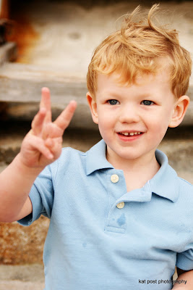
san-sai
三才
3 years old

Slide 5
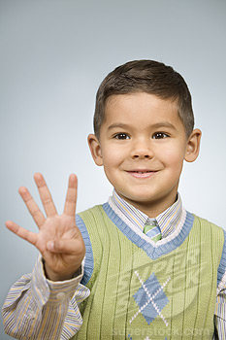
yon-sai
四才
4 years old

Slide 6
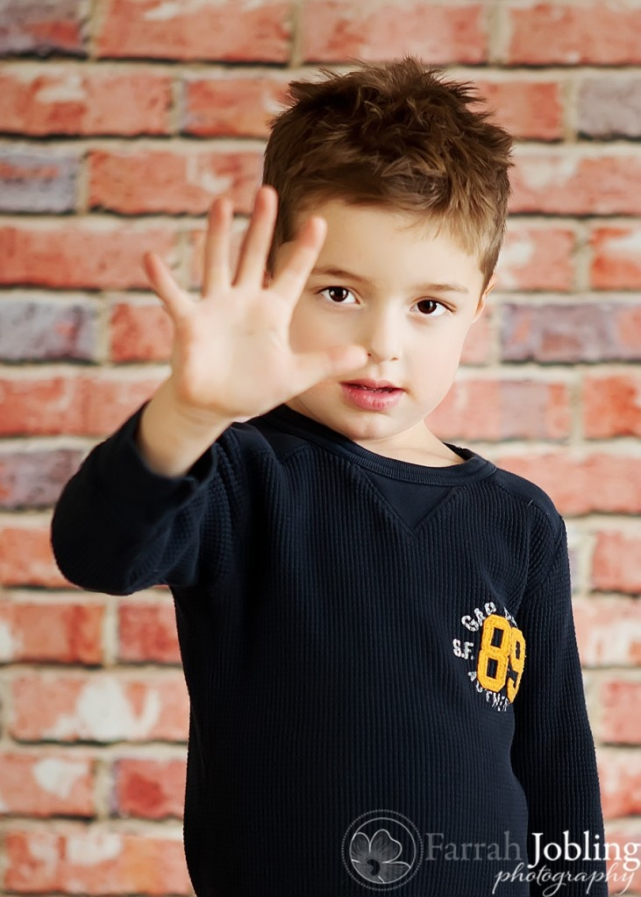
go-sai
五才
5 years old

Slide 7
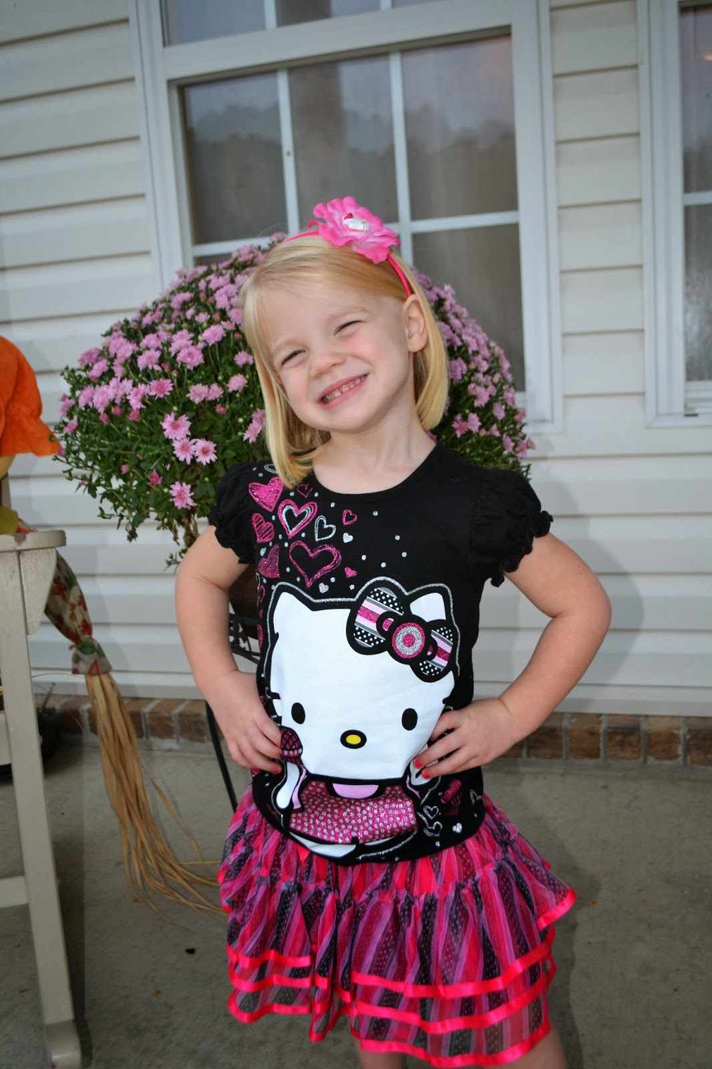
roku-sai
六才
6 years old

Slide 8
nana-sai
七才
7 years old

Slide 9
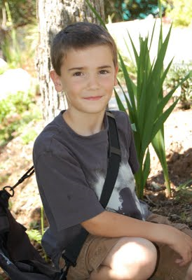
has-sai
八才
8 years old

Slide 10
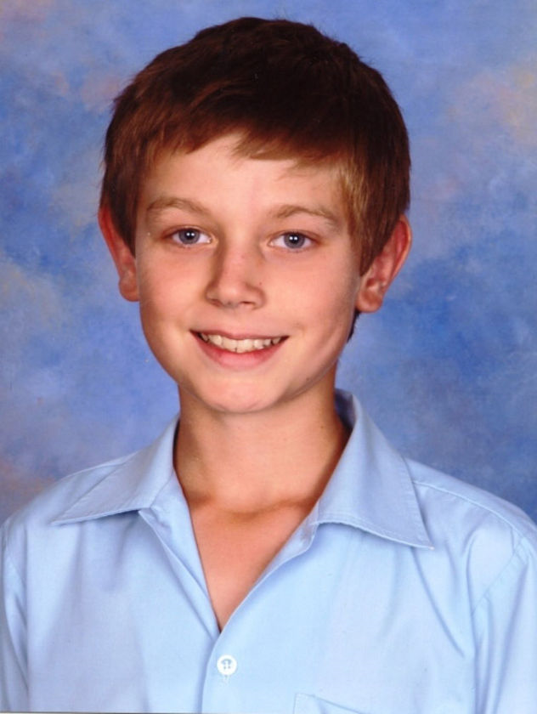
kyuu-sai
九才
9 years old

Slide 11
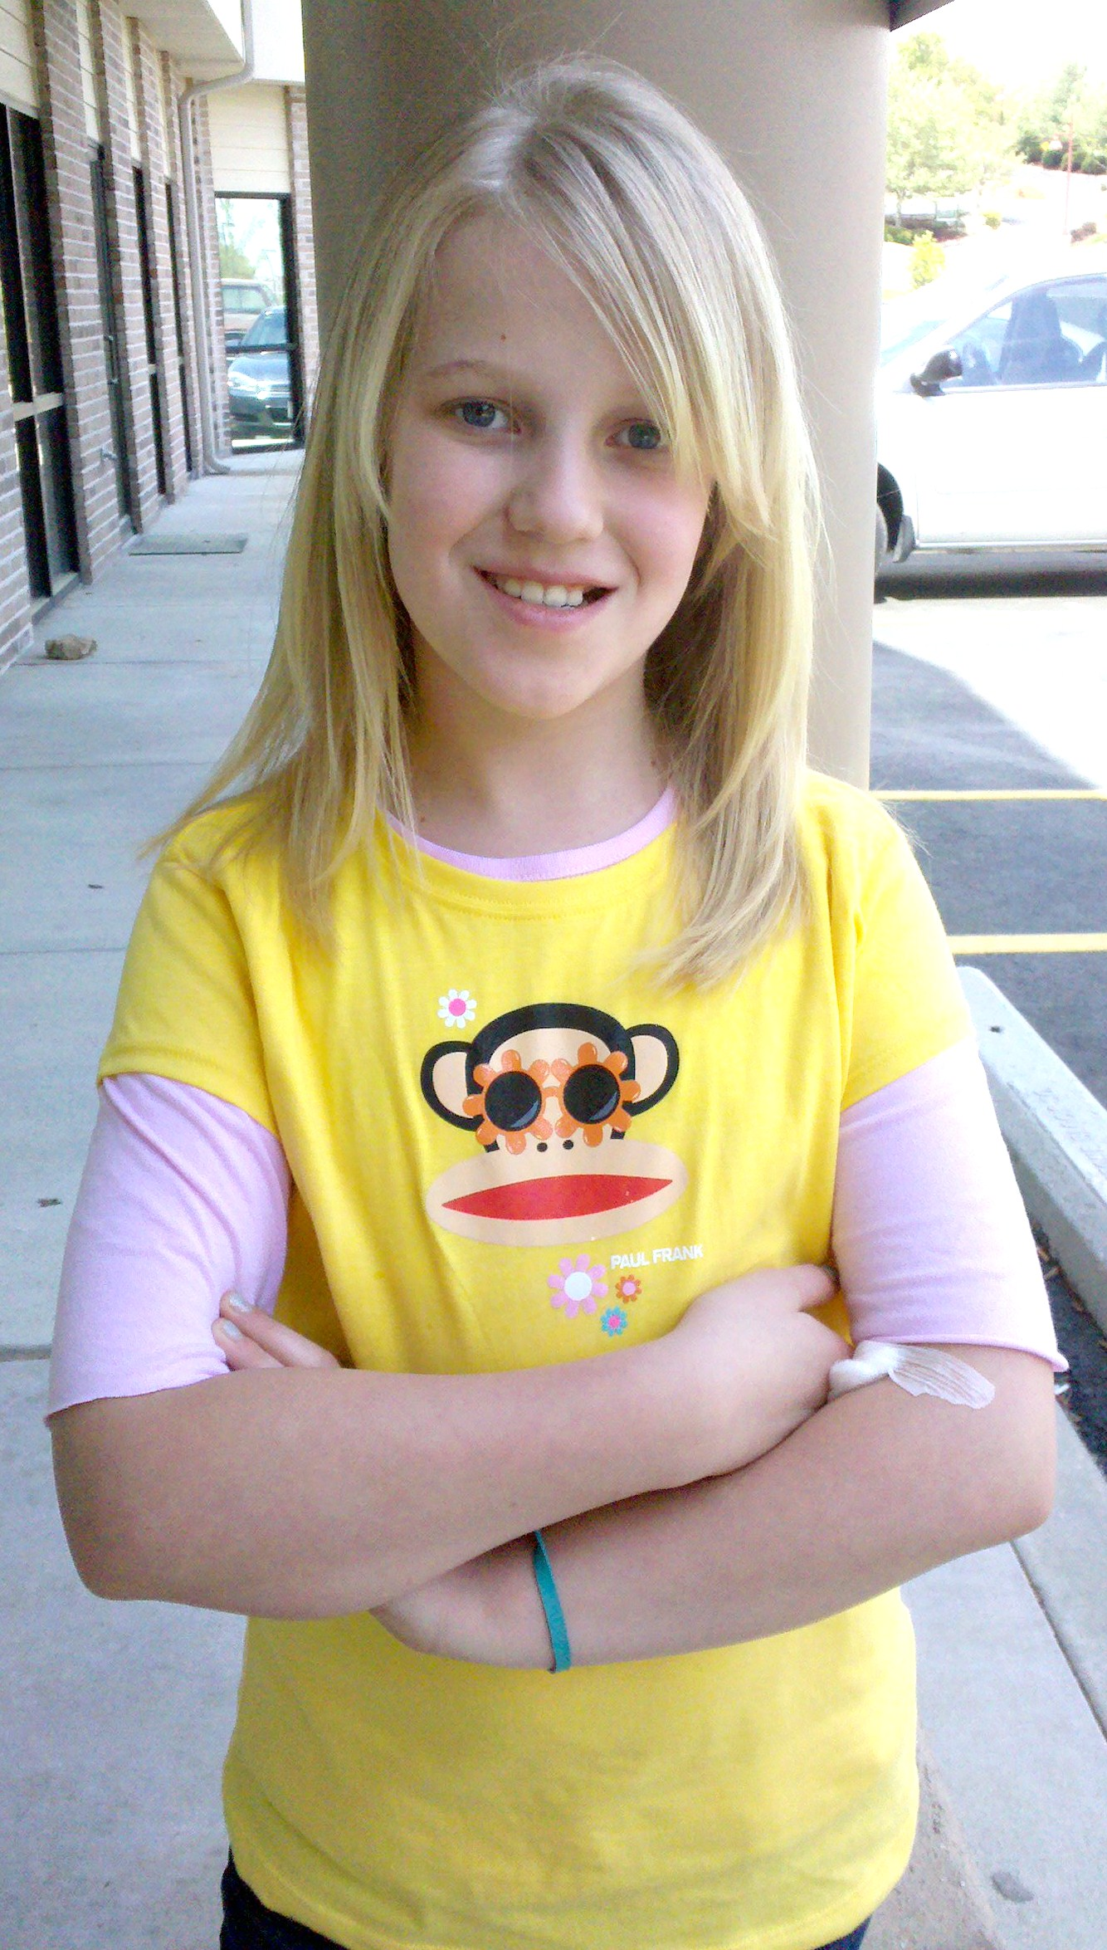
jus-sai
十才
10 years old

Slide 12
juu is-sai
十一才
11 years old

Slide 13
juu ni-sai
十二才
12 years old

Slide 14
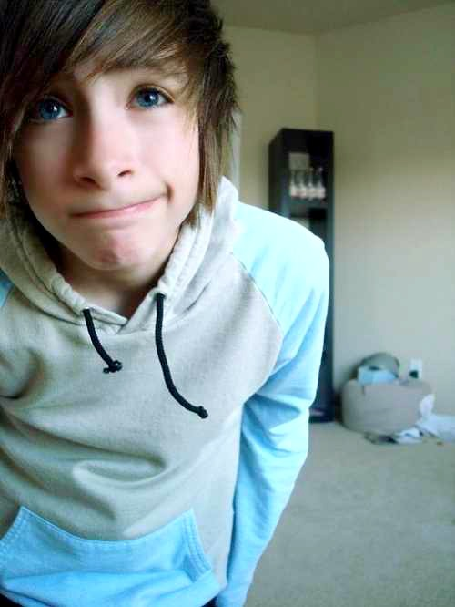
juu san-sai
十三才
13 years old

Slide 15
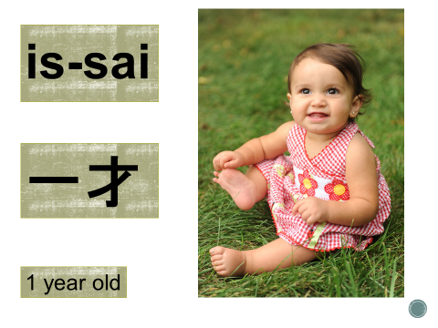

Slide 17
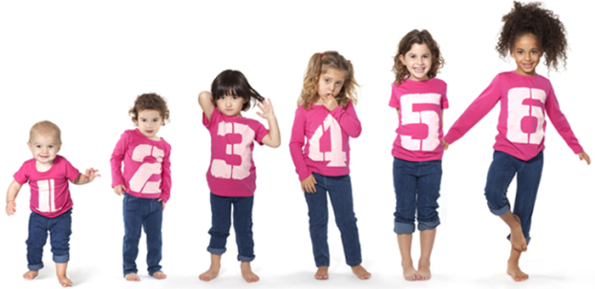
English | Romaji
1 year old | is-sai
2 years old | ni-sai
3 years old | san-sai
4 years old | yon-sai
5 years old | go-sai
6 years old | roku-sai
7 years old | nana-sai
8 years old | has-sai
9 years old | kyuu-sai
10 years old | jus-sai
11 years old | juu is-sai
12 years old | juu ni-sai
13 years old | juu san-sai
To say your age say the number in Japanese and add ‘sai’.
NUMBER + sai

Slide 18
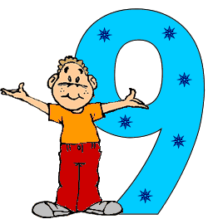
Saying how old you are…
Q | Nan sai desu ka? How old are you?
A1 | AGE desu. I’m AGE.
A2 | Watashi wa AGE desu. Boku wa AGE desu. I am AGE.
Remember!
English | Romaji
8 years old | has-sai
9 years old | kyuu-sai
10 years old | jus-sai
11 years old | juu is-sai
12 years old | juunisai
How old are you?
Practice saying asking and saying your age in Japanese with your classmates.

Slide 19
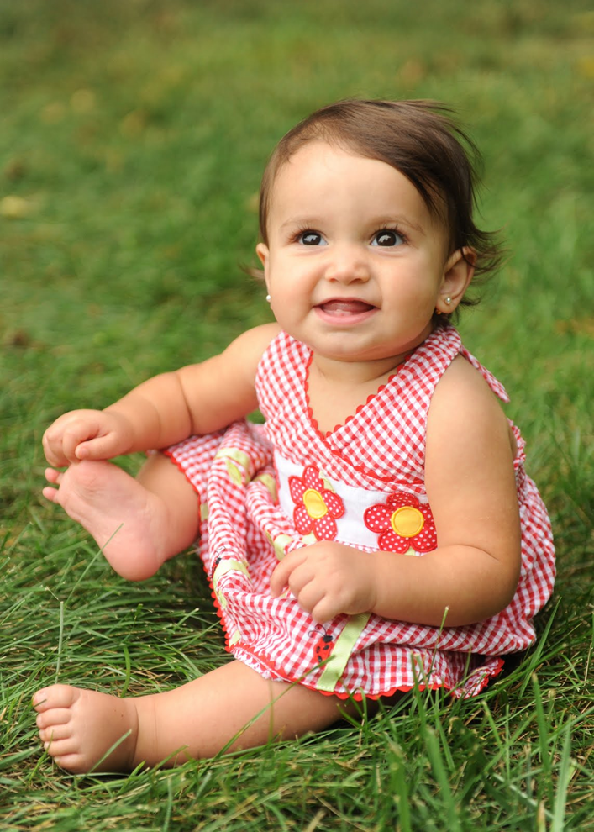
Can you remember how old?
Q | Nan sai desu ka? How old are you?
A | AGE desu. I’m AGE.
is-sai
一才
nana-sai
七才
kyuu-sai
九才

Slide 20
Can you remember how old?
Q | Nan sai desu ka? How old are you?
A | AGE desu. I’m AGE.
juu is-sai
十一才
jus-sai
十才
has-sai
八才

Slide 21
Can you remember how old?
Q | Nan sai desu ka? How old are you?
A | AGE desu. I’m AGE.
ni-sai
二才
go-sai
五才
roku-sai
六才

