Slide 1
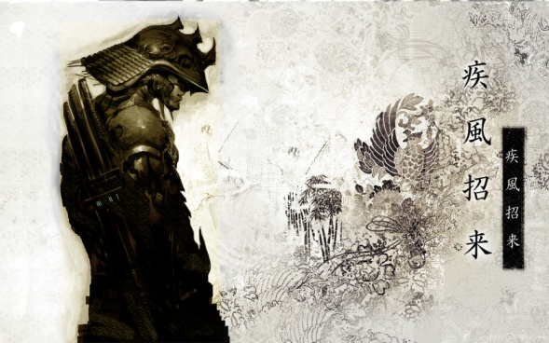
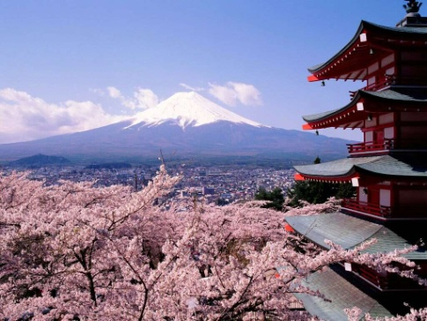
めいし （名刺）

Slide 2
Questions:
What do you think this is?
What information do you think is included?
When do you think this would be used?
Do we have a similar thing in Australia?
Most of the times the back of the card will be all in English. Why do you think this might be?

Slide 3
めいし
Your Meishi must include:
Your name
Your position
A phone number
An address
An email address

Slide 4
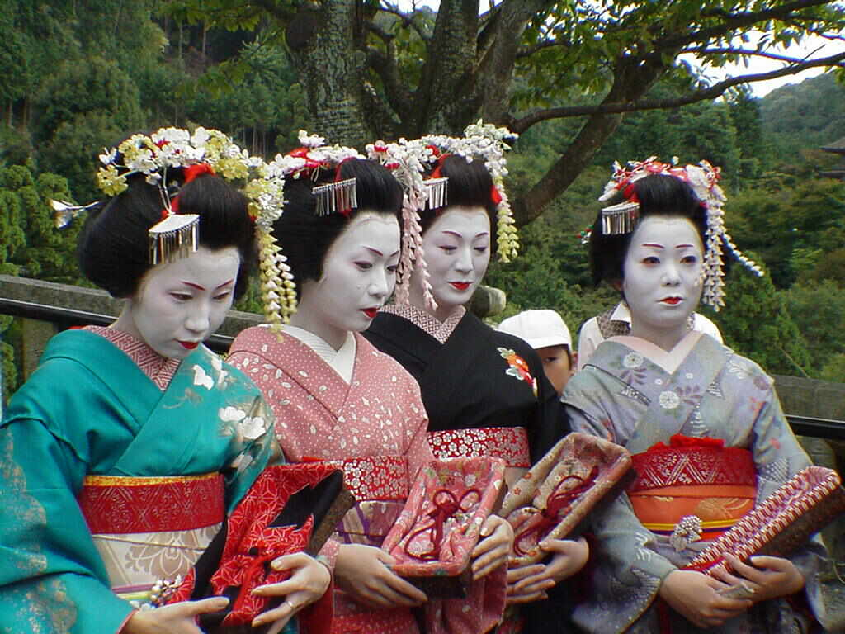
7 Golden Rules of めいし
１．Introduce Yourself:
２．Two Handed Card Handling
３．Card Quality
４．Repect Cards:
carefully arrange cards on the table in front of you
Never play with cards, bend or write on them.
Store meishi in a meishi case and never forget a card in the meeting room.

Slide 5
7 Golden Rules of めいし
Keep the cards
Use double sided Japanese and English cards
7. Bonus Points:
present your card lower when they have a higher status (e.g. a customer)
when placing the cards on the table put the highest ranking person's meishi in the best spot (such as on top of your meishi case).

Slide 6
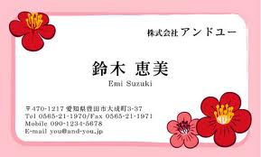
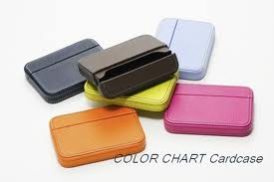
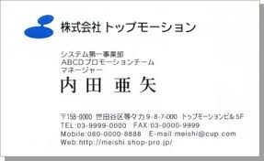

Slide 7
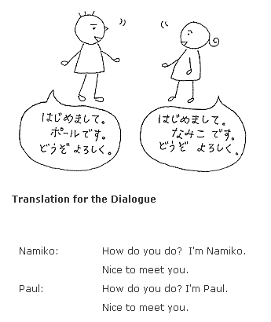

Slide 8
Task 2: Create your meishi using template
Write your name in Japanese, fill-in mobile and email details
Keep in your Japanese text books.
Task 3: Finish decorating your Japanese name tags which will be laminated.
ABC Primary School
Smith John
Student
Address:
Tel:
Mob:
Email:
ABC 小学校
スミス ジョン
せいと
Address:
Tel:
Mob:
Email:

