Slide 1
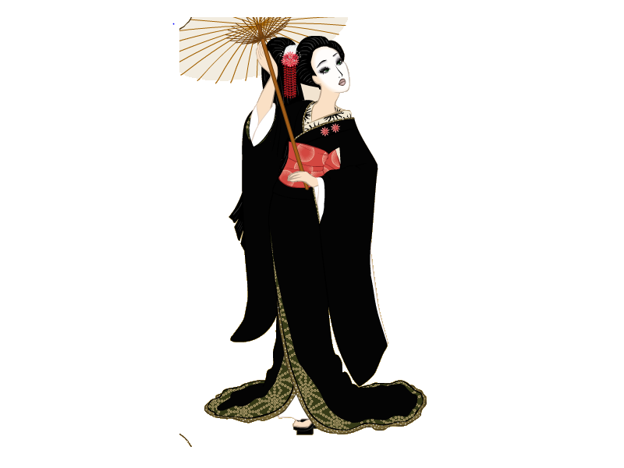
Hiragana

Slide 2
あ
い
う
え
お

Slide 3

a is for the antenna
あ

Slide 4
i is for Hawaii
い

Slide 5
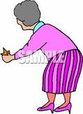
u is for the old lady
う

Slide 6
e is for the extra line
え

Slide 7
o is for on the green
お

Slide 8
か
き
く
け
こ

Slide 9
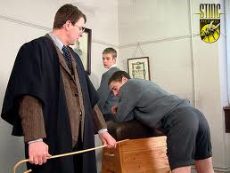
ka is for the cane
か

Slide 10

ki is for the key
き

Slide 11

ku is for the Kookaburra
く

Slide 12
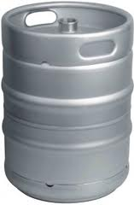
ke is for the keg
け

Slide 13

ko is for the coin
こ

Slide 14
さ
す
せ
そ
し

Slide 15
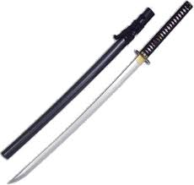
Sa is for the samurai sword
さ

Slide 16
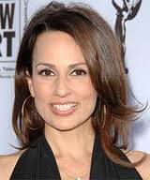
Shi is for she has long hair
し

Slide 17
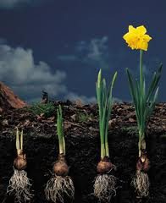
Su is for soon there will be a flower
す

Slide 18
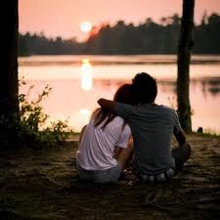
Se is for the sun setting
せ

Slide 19

So is for the sewing machine
そ

Slide 20
た
ち
つ
て
と

Slide 21
Ta is for T A
t a
た

Slide 22
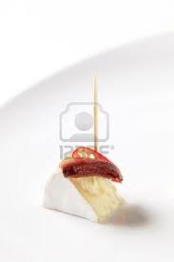
Chi is the cheese
ち

Slide 23
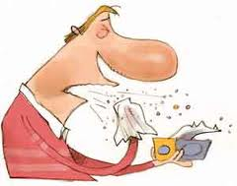
Tsu is for aaaatsuuuu
つ

Slide 24
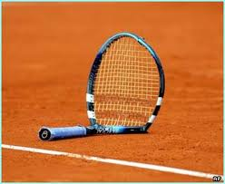
Te is for the broken tennis racket
て

Slide 25
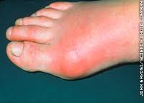
To is for the sore toe with a thorn sticking out
と

Slide 26
な
に
ぬ
ね
の

Slide 27
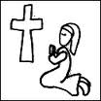
Na is for the Nun kneeling by the cross
な

Slide 28
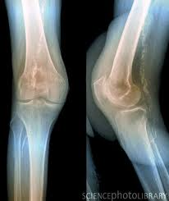
Ni is for the knee cap
に

Slide 29
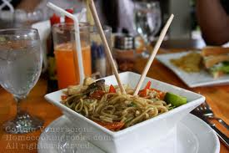
Nu is for the noodles
ぬ

Slide 30
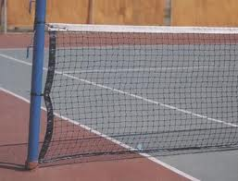
Ne is for the hole in the net
ね

Slide 31
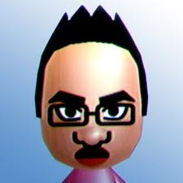
No is for the nose
の

Slide 32
は
ひ
ふ
へ
ほ

Slide 33
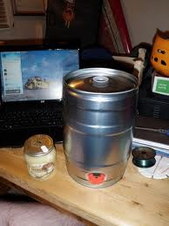
Ha is for the hole in the keg
は

Slide 34

Hi is for he has a big smile
ひ

Slide 35
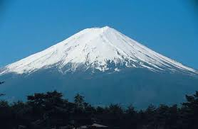
Fu is for Mt Fuji
ふ

Slide 36
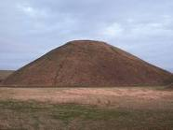
He is for heading up the hill
へ

Slide 37
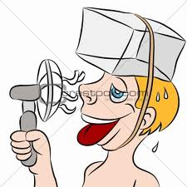
Ho is for the hot day
ほ

Slide 38
ま
み
む
め
も

Slide 39
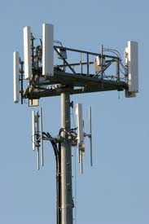
Ma is for call Ma ma on the telephone line
ま

Slide 40
Mi is for everyone is 21 except me
２１
み

Slide 41
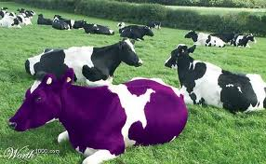
Mu is for the moo cow
む

Slide 42
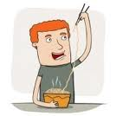
Me is for the messy eater
め

Slide 43

Mo is for more worms more fish
も

Slide 44
や
ゆ
よ

Slide 45
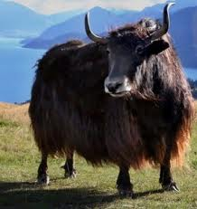
Ya is for the yuck yak
や

Slide 46

Yu is for the U-turn
ゆ

Slide 47
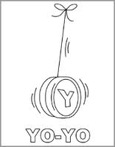
Yo is for the Yo-Yo
よ

Slide 48
ら
り
る
れ
ろ

Slide 49
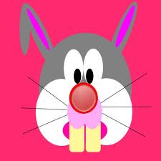
Ra is for the rabbit
ら

Slide 50

Ri is for the ribbon
り

Slide 51
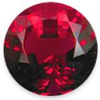
Ru is for the ruby
る

Slide 52
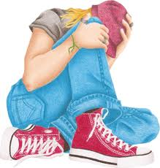
Re is for the person resting
れ

Slide 53
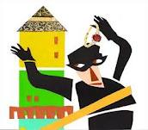
Ro is the robber stealing the ruby
ろ

Slide 54
わ
ん
を

Slide 55

Wa is for wave that magic wand
わ

Slide 56
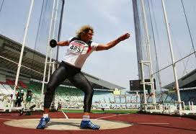
O is for the Olympic thrower (remember it is typed wo)
を

Slide 57
N is for the letter n
ん
n

