Slide 1
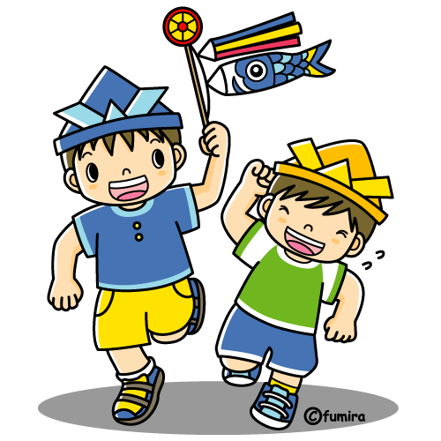
KODOMO NO HI こども の ひ CHILDREN’S DAY

Slide 2
こどものひ or Children’s day is a celebration for both boys and girls on the 5th of May each year. But, before 1947, this day was celebrated as the Boy’s Festival or ‘Tangonoseku’ たんごのせく.
Today, こどものひ is celebrated to wish all children happiness and health.

Slide 3
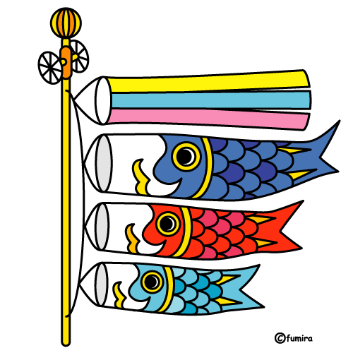
Families fly carp streamers from flagpoles outside their house. These carp streamers are called ‘koinobori’ こいのぼり.
The large black carp represents the father, the next large carp represents the mother, and all the smaller carps on the flagpole represents the children in the family.

Slide 4
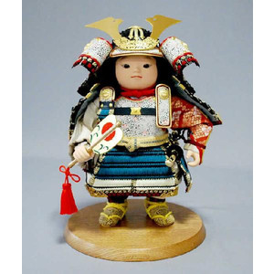
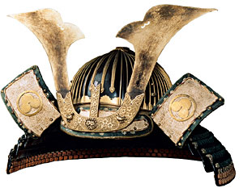
Koinobori traditionally symbolised the strength of males because carp are very strong swimmers.
Inside the house, in the alcove called the ‘tokoma’
とこま, children display a warrior’s helmet or ‘kabuto’
かぶと and warrior dolls called ‘mushaningyo’
むしゃにんぎょう.

Slide 5
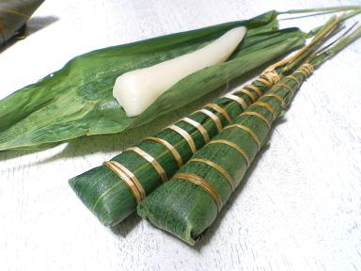
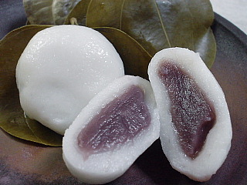
Special food eaten on this day include:
- a type of rice cake wrapped in bamboo leaves
called ‘chimaki’ ちまき
- rice balls filled with red beans and wrapped in
an oak leaf called ‘kashiwamochi’ きさわもち

Slide 6
On Kodmonohi こどものひ this traditional song is sung:
Yane yori takai koinobori
やね より たかい こいのぼり
Ookii magoi wa otoosan
おおきい まごい は おとうさん
Chiisai higoi wa kodomotachi
ちいさい ひごい は こどもたち
Omoshirosoo ni oyoideru
おもしろそう に およいでる。
English translation:
Carp streamers are higher than the roof
The biggest carp is the father
The small carp are children
Enjoying swimming in the sky.

Slide 7
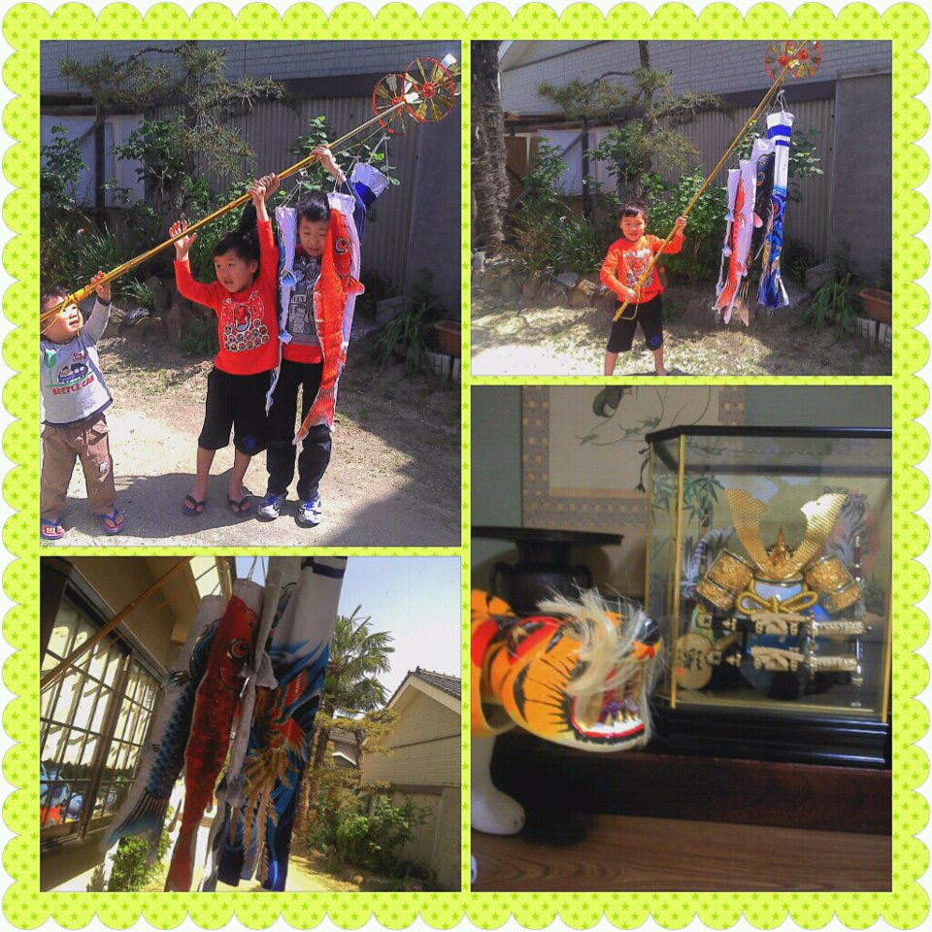
Setting up the koinobori こいのぼり

