Slide 1
カタカナ
Katakana
Video Myu Sings Katakana: http://www.youtube.com/watch?v=QzsaTY5K3Zg
Images from: http://japaneselanguageculturefood.com/graphics/katakana/japanese-language-katakana-writing-wo.png

Slide 2
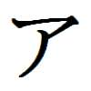
Katakana ‘A’

Slide 3
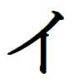
Katakana ‘I’

Slide 4
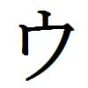
Katakana ‘U’

Slide 5
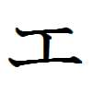
Katakana ‘E’

Slide 6
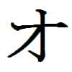
Katakana ‘O’

Slide 7
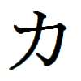
Katakana ‘KA’

Slide 8
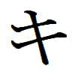
Katakana ‘KI’

Slide 9
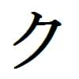
Katakana ‘KU’

Slide 10
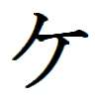
Katakana ‘KE’

Slide 11
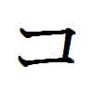
Katakana ‘KO’

Slide 12
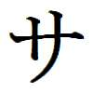
Katakana ‘SA’

Slide 13
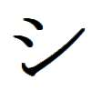
Katakana ‘SHI’

Slide 14
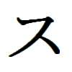
Katakana ‘SU’

Slide 15
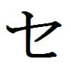
Katakana ‘SE’

Slide 16
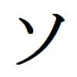
Katakana ‘SO’

Slide 17
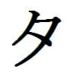
Katakana ‘TA’

Slide 18
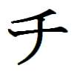
Katakana ‘CHI’

Slide 19
Katakana ‘TSU’

Slide 20
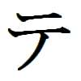
Katakana ‘TE’

Slide 21
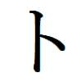
Katakana ‘TO’

Slide 22
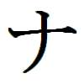
Katakana ‘NA’

Slide 23
Katakana ‘NI’

Slide 24
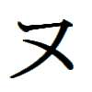
Katakana ‘NU’

Slide 25
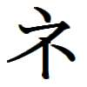
Katakana ‘NE’

Slide 26
Katakana ‘NO’

Slide 27
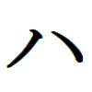
Katakana ‘HA’

Slide 28
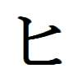
Katakana ‘HI’

Slide 29
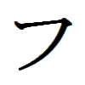
Katakana ‘FU’

Slide 30
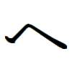
Katakana ‘HE’

Slide 31
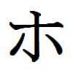
Katakana ‘HO’

Slide 32
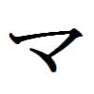
Katakana ‘MA’

Slide 33
Katakana ‘MI’

Slide 34
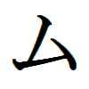
Katakana ‘MU’

Slide 35
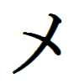
Katakana ‘ME’

Slide 36
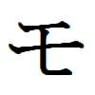
Katakana ‘MO’

Slide 37
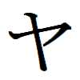
Katakana ‘YA’

Slide 38
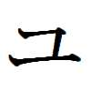
Katakana ‘YU’

Slide 39
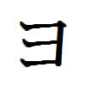
Katakana ‘YO’

Slide 40
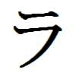
Katakana ‘RA’

Slide 41
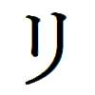
Katakana ‘RI’

Slide 42
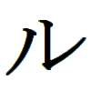
Katakana ‘RU’

Slide 43
Katakana ‘RE’

Slide 44
Katakana ‘RO’

Slide 45
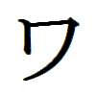
Katakana ‘WA’

Slide 46
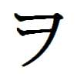
Katakana ‘WO’

Slide 47
Katakana ‘N’

