Slide 1
Japanese mythical creatures
Stories and pictures from: http://japanlover.me/

Slide 2
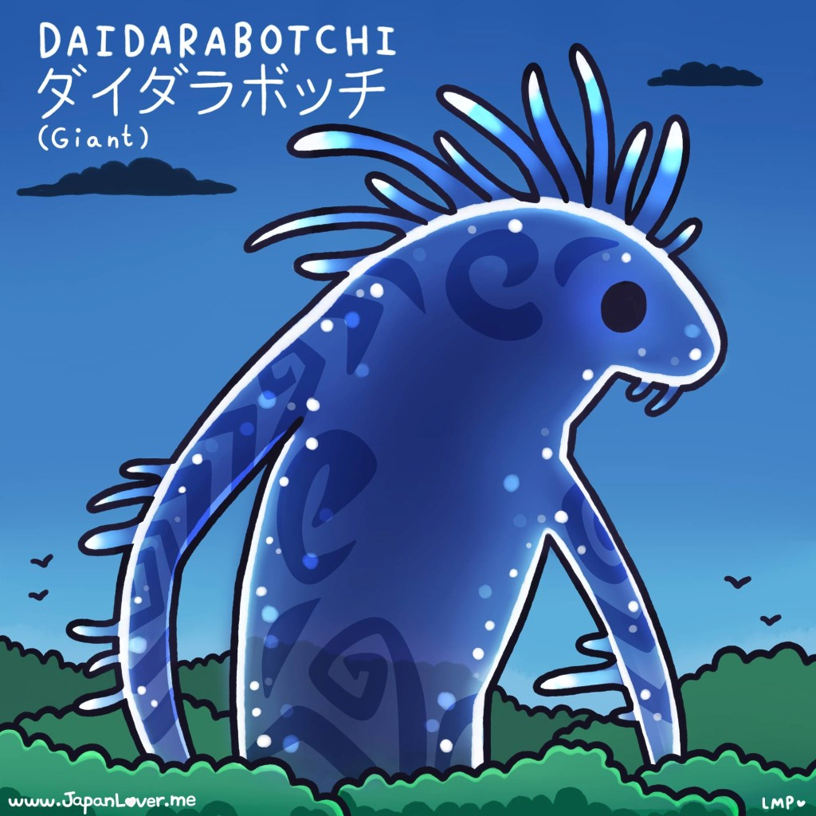
Page 1

Slide 3
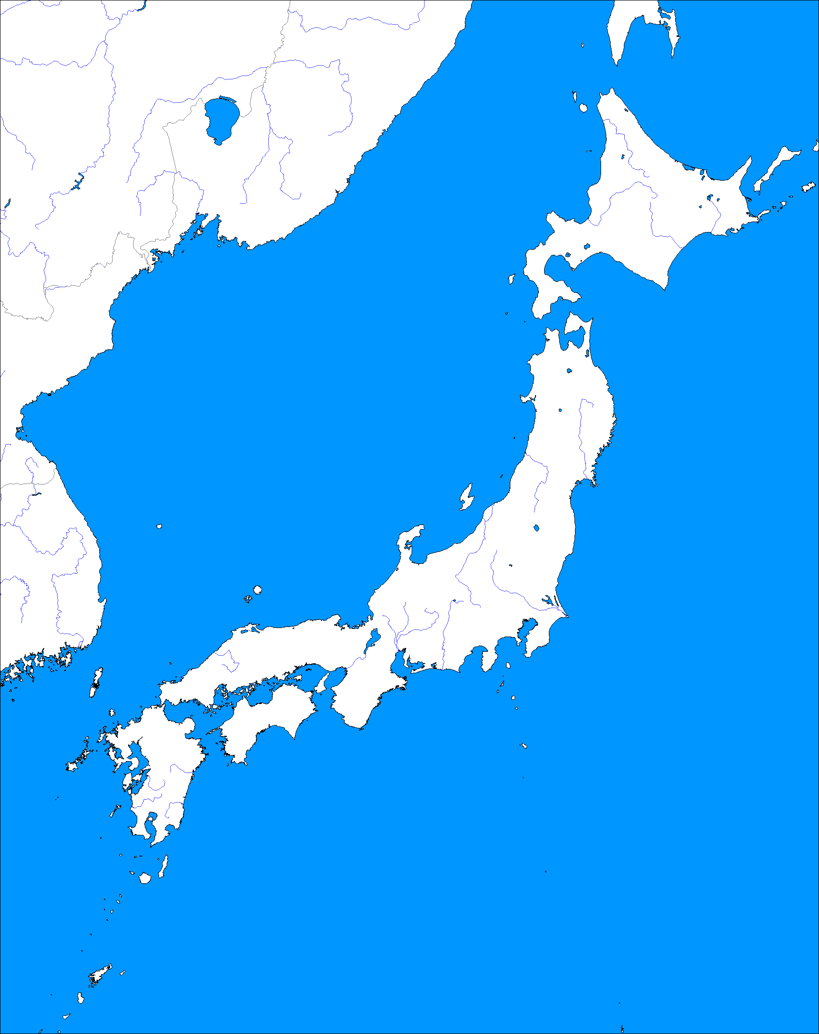
ダイダラボッチ
Daidarabotchi ダイダラボッチ are gigantic yōkai ようかい (supernatural phantom-like creature) in Japanese folklore. It is said that their gigantic footsteps are responsible for lakes and various bodies of water in Japan. (ノ*゜▽゜*)
Ｉn one story, a daidarabotchi once weighed Mt. Fuji and Mt. Tsukuba in its hands to see which is bigger and heavier, and when it found out that Mt. Fuji is bigger, it dropped Mt. Tsukuba in the ground.The force of the drop caused Mt. Tsukuba's peak to split, which is allegedly the origin of it's twin peaks now.
The illustration shows the forest spirit in Studio Ghibli's Princess Mononoke when it transformed into a daidarabotchi at night!
Meanwhile in Naruto, the Ten-Tails' original form is based on a daidarabotchi.
Mt Tsukuba
Tokyo
Mt Fuji
Page 2

Slide 4
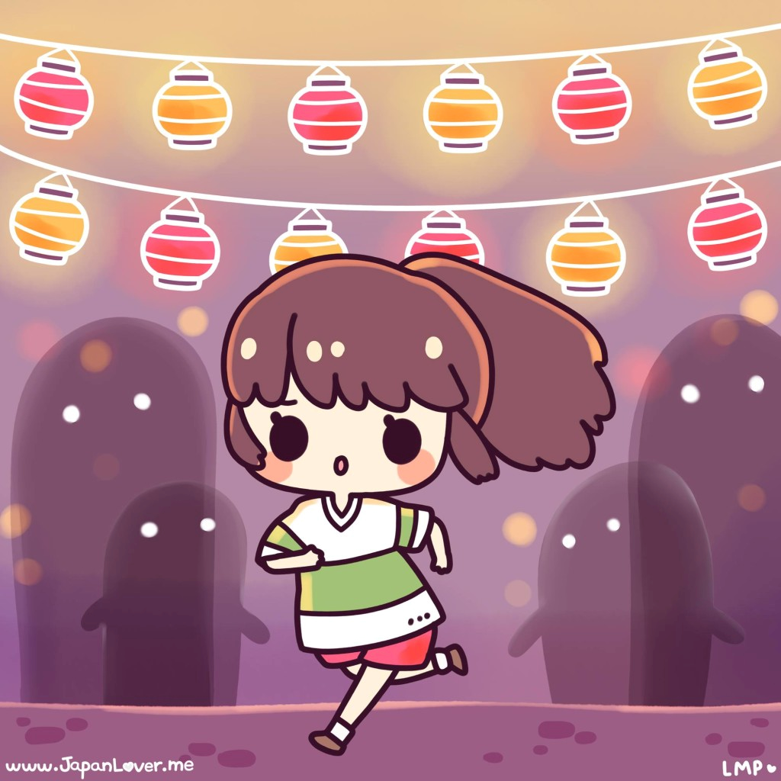
Page 1

Slide 5
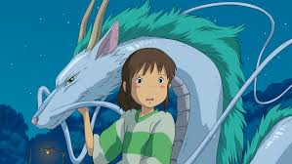
Ｓｐｉｒｉｔｅｄ ａｗａｙ
In Japanese folklore, when a person disappears mysteriously, he or she is said to be taken to the spirit world, or has been "spirited away". It is also said that when a person comes back from being spirited away, he/she is now a new and better "enlightened" person than before.
In Hayao Miyazaki’s film "Spirited Away", Chihiro started to become "see-through" upon prolonged exposure to the spirit world. Haku then gives her a bit of spirit food that helps her from disappearing and makes her one with the spirit world, because according to Japanese folklore, if someone eats food from the spirit world, they are then allowed and bound to stay, until a powerful spirit releases them from their curse.
Page 2

Slide 6
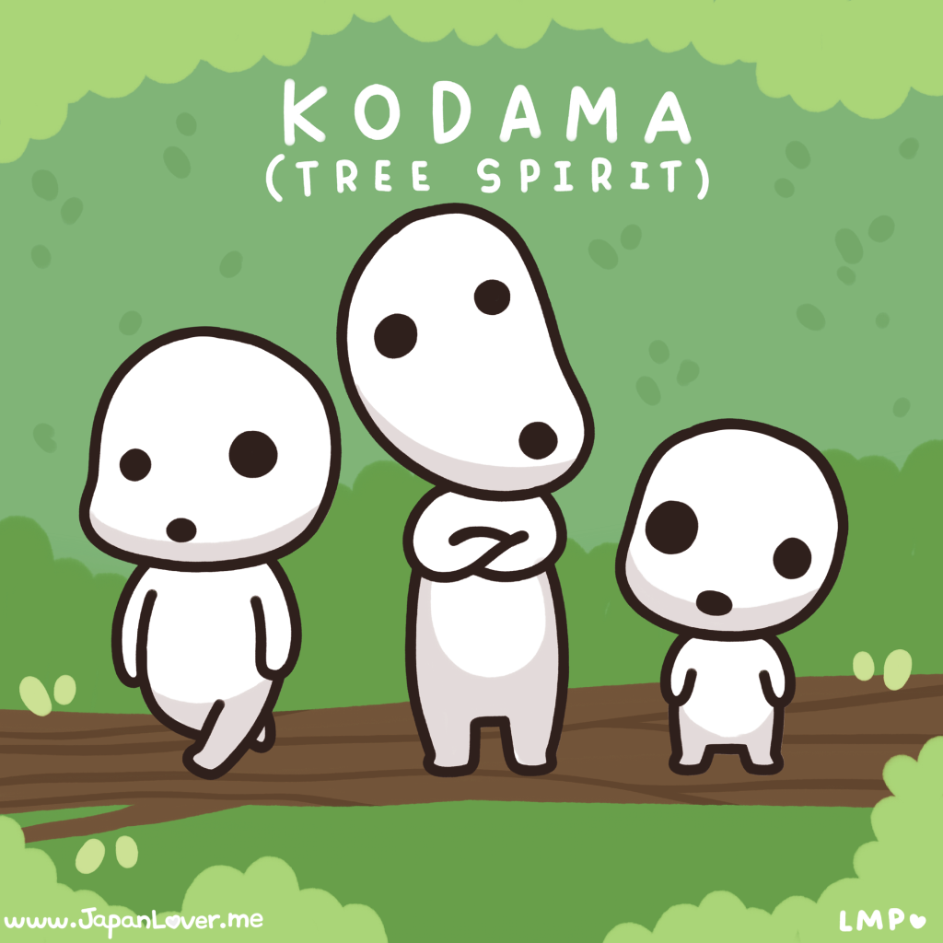
Page 1

Slide 7
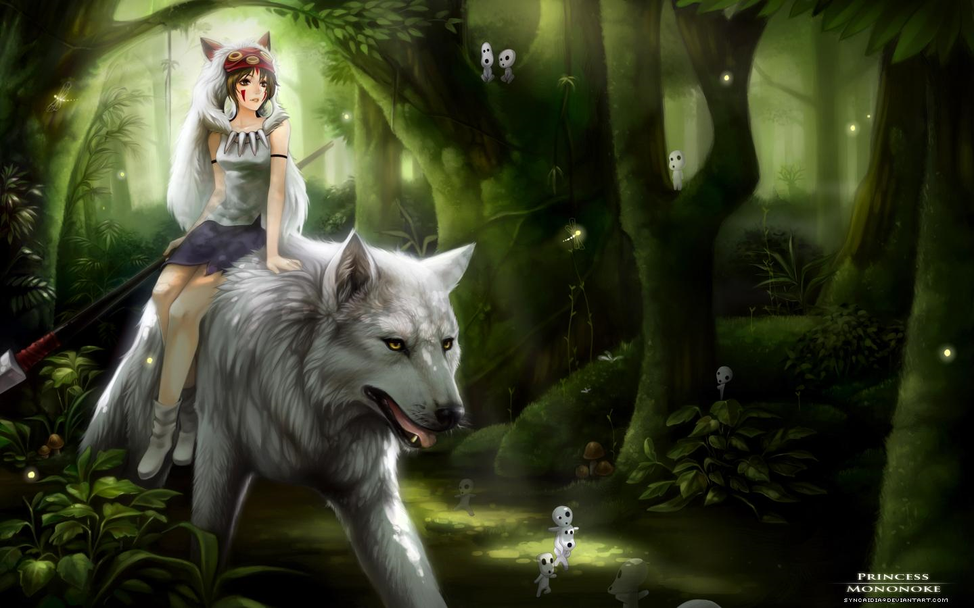
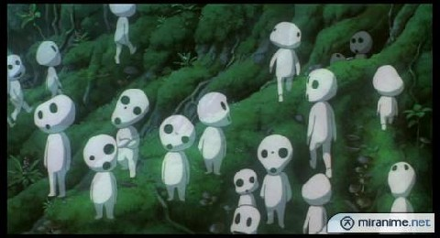
こだま
The tree creatures in Princess Mononoke are こだま Kodama or tree spirits. They inhabit trees and are sometimes called "protectors of the forest", because it is said that they curse anyone who destroys the tree that they are living in.
In some places in Japan, it is said that when a tree reaches 100 years old, it instantly produces its own spirit, thus becoming a kodama itself. Such trees are considered sacred, and are marked with a shimenawa しめなわ (enclosing ritual rope).
Kodama are sometimes portrayed in old tales as human-like youkai ようかい, which stand guard beside the tree, and sometimes interact with unknowing passers-by.
Page 2

Slide 8
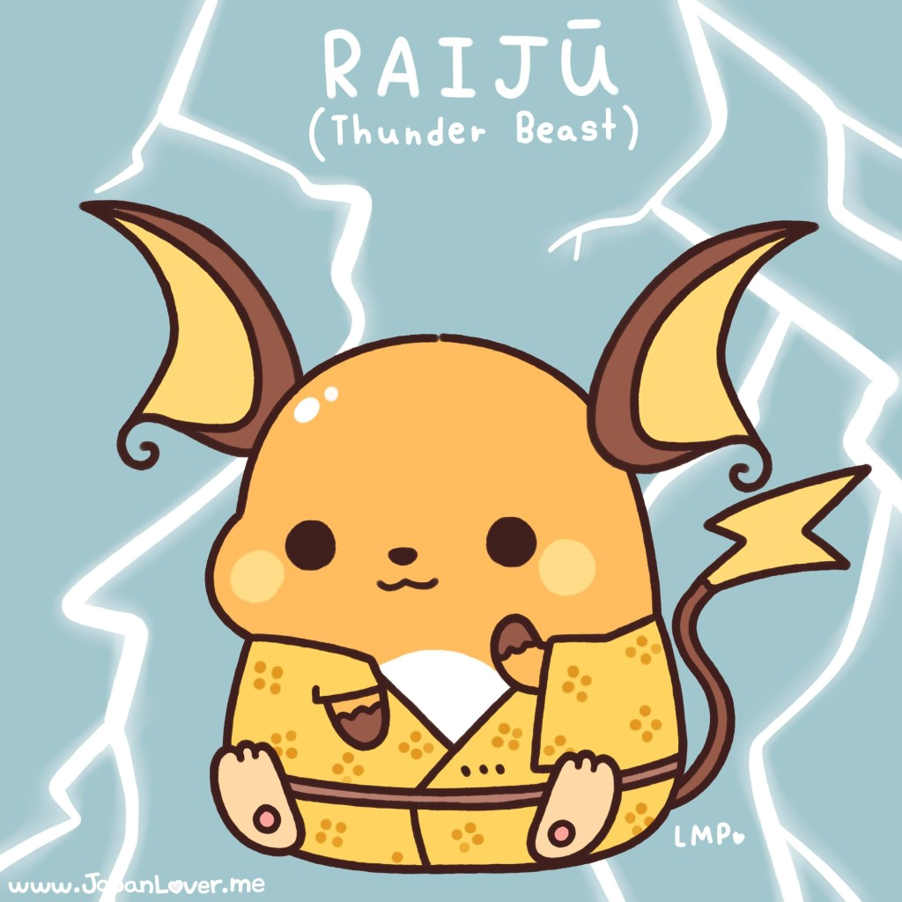
Page 1

Slide 9
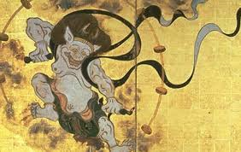
らいじゅう
Pokémon’s Raichu is based on a legendary creature in Japanese folklore called “Raijū” らいじゅう, or the thunder beast who had the powers of lightning. Raijū is said to be the companion of Raijin, the Shinto god of lightning. It is usually calm and harmless and likes to sleep on sleeping people's tummies! In thunderstorms though, it becomes extremely playful and restless, jumping from tree to tree in meadows and forests. Lightning marks on trees are said to be caused by Raiju's claws.
Page 2

Slide 10
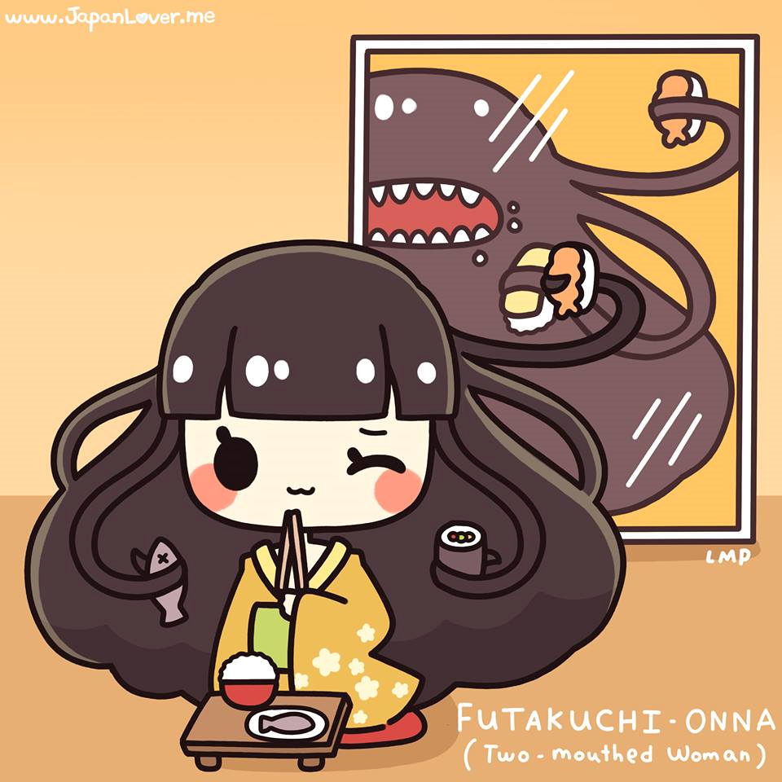
Page 1

Slide 11
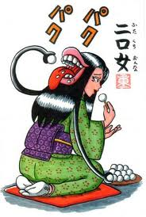
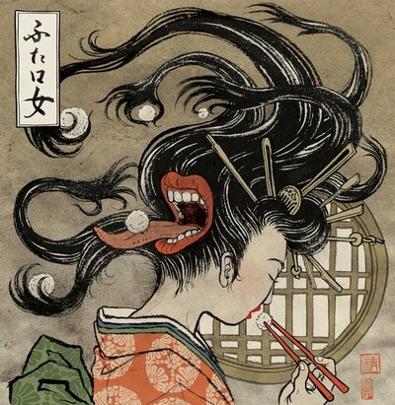
ふたくちおんな
A Futakuchi-onna (二口女) is a type of yōkai from Japanese folklore that is in the form of a woman with two mouths: one normal mouth, and one big mouth on the back of her head. These women appear be very innocent and eat only a little bit of food at first, but when they think nobody is watching, a big, ghastly mouth opens up as a slit at the back of her head, and they use their long, writhing hair to shovel tons of food into it (because a futakuchi-onna's second mouth has a huge appetite!).
Page 2

Slide 12
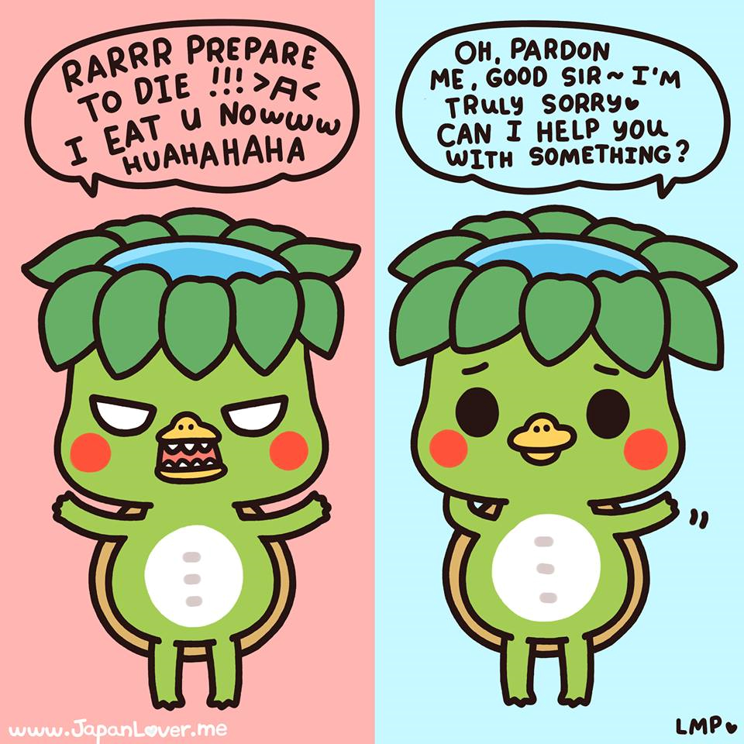
Page 1

Slide 13
かっぱ
Kappa (河童), are creatures from Japanese folklore that are most of the times dangerously mischievous and brutally deadly, but can be obsessively polite and helpful at times. They are said to be really scary. It is said that in order to save yourself from getting drowned, killed, and eaten by kappa かっぱ, you must take advantage of the fact that as much as they want to kill you, they are also overly obsessed with being polite.
If you ever come across a kappa, try bowing politely in front of it. The kappa is too polite not to return the bow, and when it does, the water on the dent on top of its head will spill, rendering it critically weak (it gets its energy and life from the water). And if you decide to refill its dent with water, it will be eternally grateful to you and will serve you for a lifetime. Some say that if you give it treats and gifts, especially its favourite food, the cucumber, it will make sure of your safety, and/or it will teach you valuable (sometimes superhuman) skills. Also, it is said that if ever you catch a kappa in the act of hurting someone, it can be made to apologize. You can even ask it to make a written apology! Kappa are also bound to every oath that they make, which is why in stories, humans usually trick them into promising to help or to do things, and if they do make a promise, they cannot and will not break it.
Page 2

Slide 14
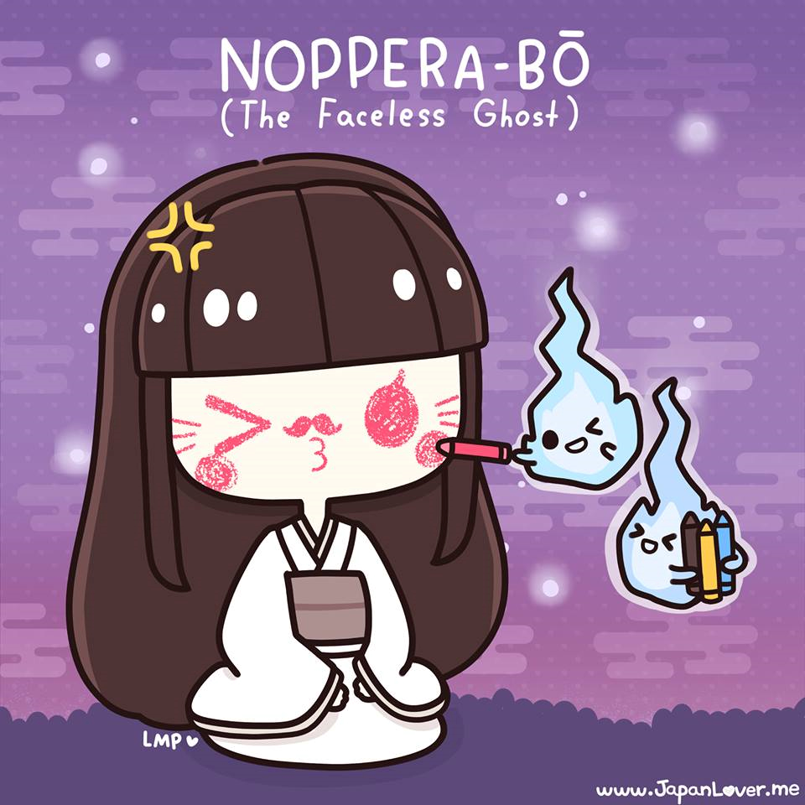
Page 1

Slide 15
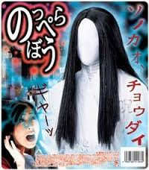
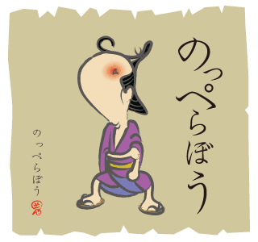
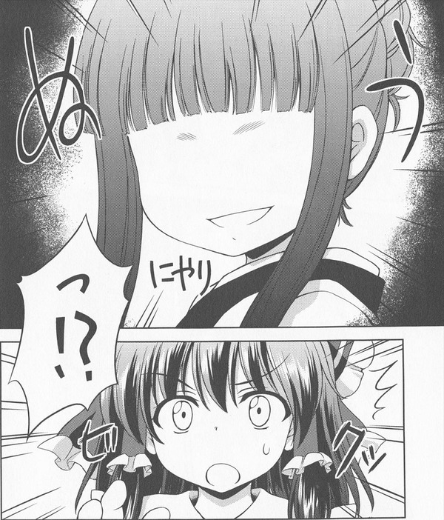
のっぺらぼう
Noppera-bo のっぺらぼう or the “faceless ghost”, is a legendary creature from Japanese folklore that has inspired numerous stories. They are known to frighten humans by imitating another person's face before revealing their own blank face, but they are otherwise harmless.
Page 2

Slide 16
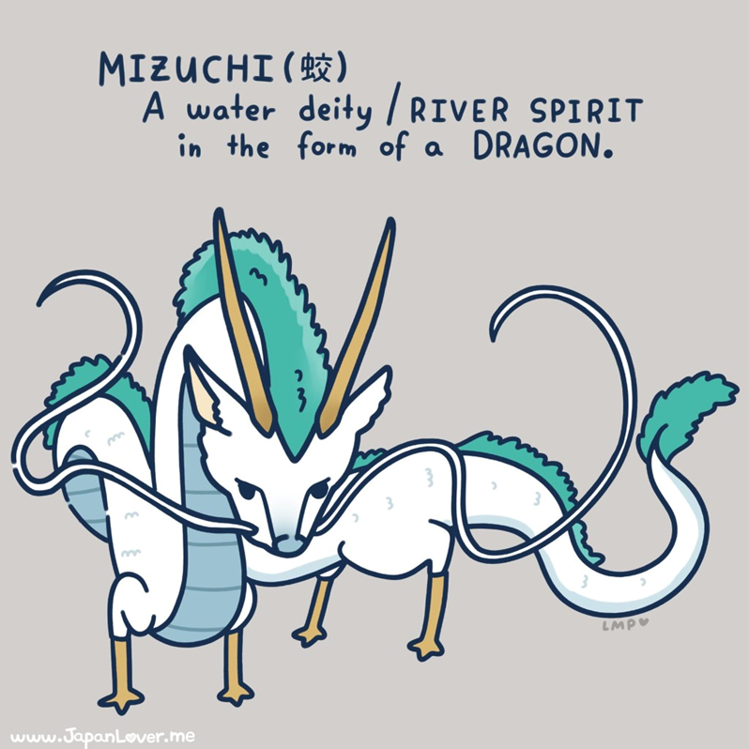
Page 1

Slide 17
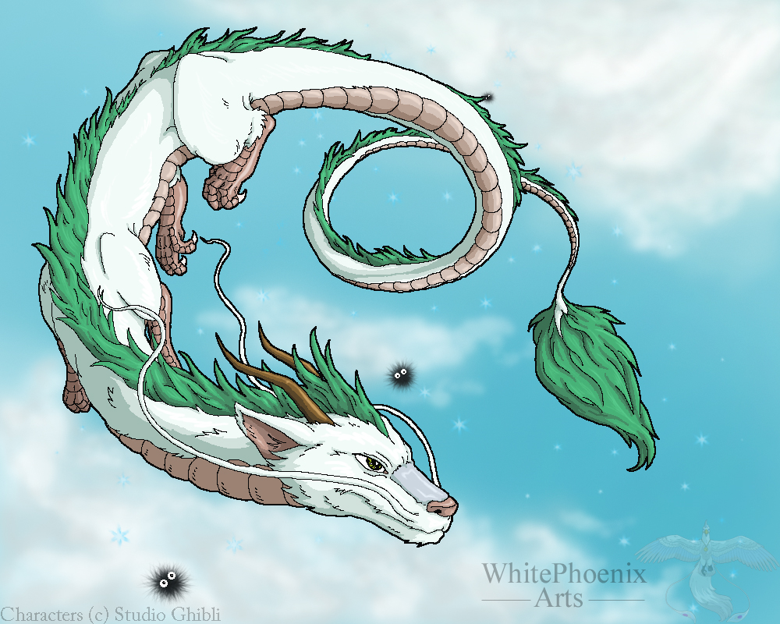
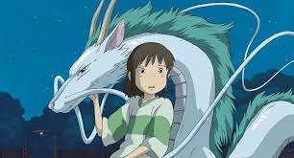
みずち
Mizuchi みずち is a kind of mythological Japanese dragon that is associated with water, and is actually a deity or a powerful river (or lake) spirit in folklore.
It has the same description as a dragon-slash-river-spirit that is seen in Spirited Away called Haku.
Page 2

Slide 18
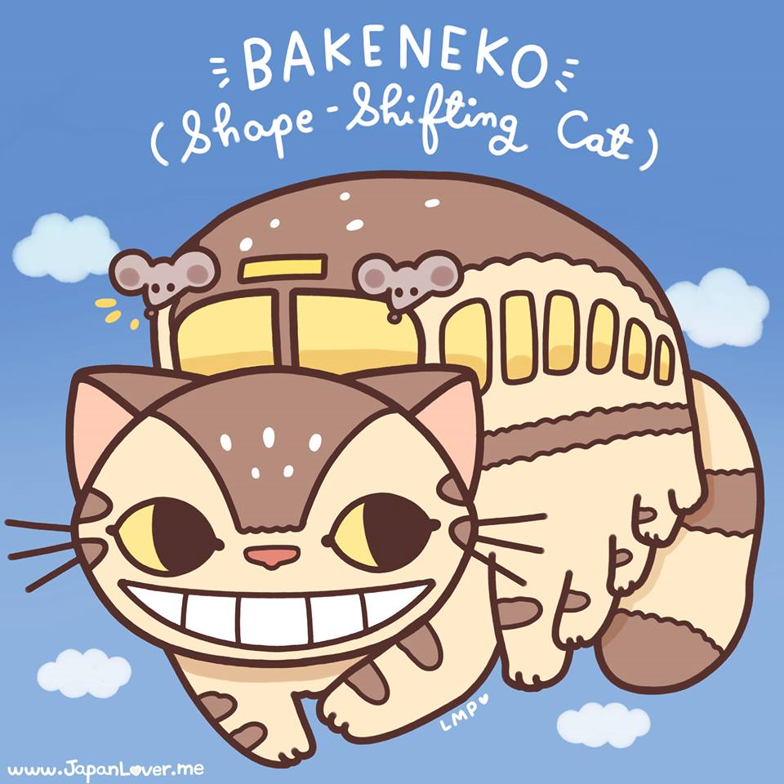
Page 1

Slide 19
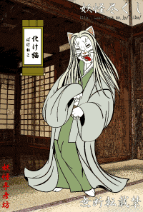
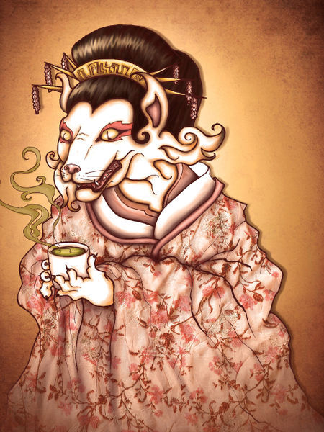
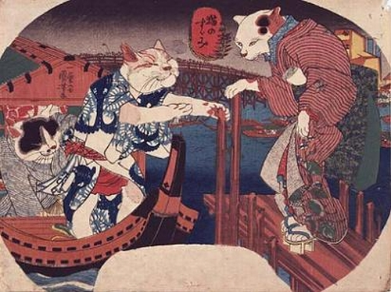
ばけねこ
In Japanese folklore, it is said that when a cat reaches 100 years old, it gains supernatural powers and becomes a Bakeneko ばけねこ.
These supernatural powers include the ability to fly, communicate with other creatures, travel to the spirit realm, and most of all, transform or shape-shift into any form that it likes, for example, a bus.
Page 2

Slide 20
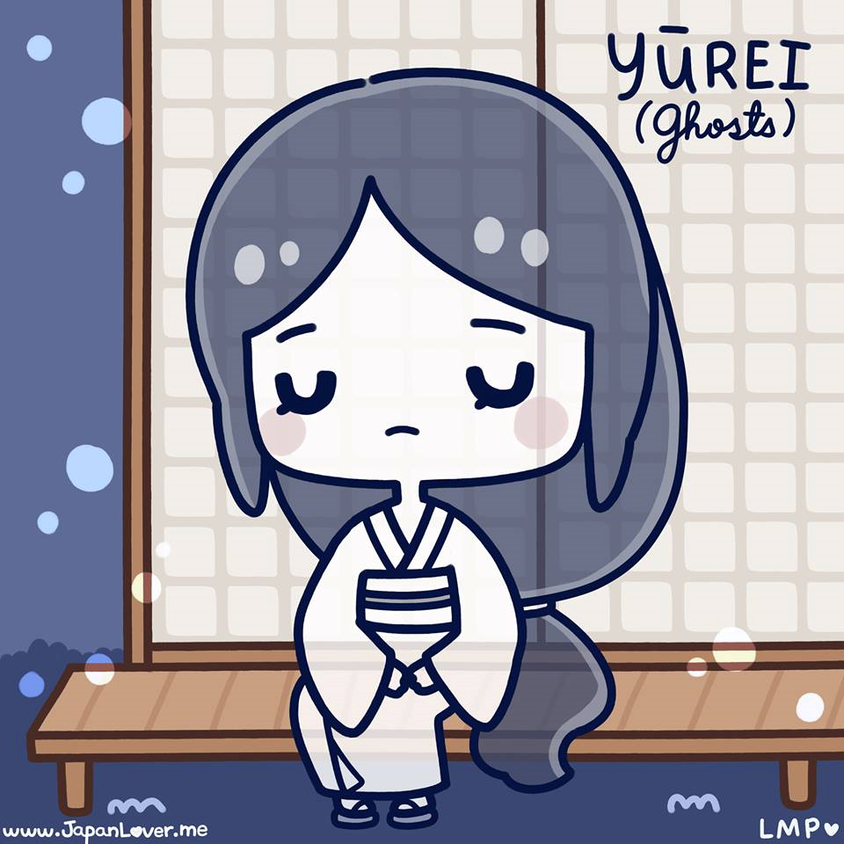
Page 1

Slide 21
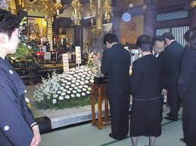
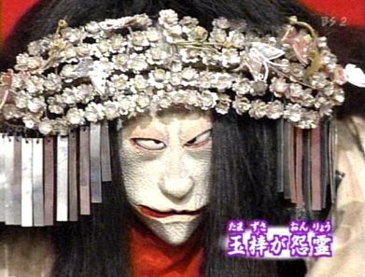
ゆうれい
Yūrei (ゆうれい) are “ghosts” in Japanese folklore. The kanji directly translates to “faint spirit”. It is a traditional Japanese belief that for a dead person‘s spirit to rest in peace and join its ancestors (sometimes even becoming the protector of their living loved ones), it has to be given a proper funeral and burial rites. It is said that if a dead person has not been given a proper burial, or has been a victim of a violent death, its spirit lingers in the land of the living as a yūrei ゆうれい (or sometimes as an onryō おんりょう or “vengeful spirit”). Sometimes, extreme feelings (such as love and anger), or an unfinished business may also cause a yūrei ゆうれい to stay.
Page 2

Slide 22
The Samurai and his wife
むかしむかし, there lived a poor but skilful samurai. He met the woman of his dreams and married her, and together they lived a happy but simple life in a small village. They were very happy, until one day, the samurai was offered a high position in the emperor's palace, which was in a faraway city. The samurai, blinded by power and money, immediately decided to leave home. He promised his wife that he would return soon, then he excitedly set off to the faraway place.
Once he got there, he was amazed by all the luxury that lay before him: delicious food, all kinds of extravagant things. He even met a lovely lady which made him forgot all about his wife. He spent his days relaxing and having fun when he was not working. Five years passed, and soon he got weary of his life in the city. He missed his simple life with his loving wife, and everyday he grew more homesick.
One day, he finally decided to go home to the small village. He found their house looking the same way when he left it, but it was very clean and tidy. He found his wife sitting on their porch, and she smiled warmly upon seeing him, her eyes shining with tears. He hugged her, feeling very guilty. That night, the samurai and his wife fell asleep arm in arm. He whispered to her, "I'm sorry I left you. I missed you so much.“ "Don't worry,” she replied, “I'm happy you've come home now. I love you, and I missed you too.” He fell asleep.
The next morning, he was shocked by what he saw when he woke. Next to him was a corpse, and when he looked around the room, everything was old and dusty! He ran outside to his neighbour's house and demanded that they tell him what happened to his home. They replied: "When you left, she waited for you to come back. When she did not receive any letters from you, she became very distant and depressed as time went by. She stopped talking to us and she stopped coming out of your house, until one day, we thought we smelled a rotten odour coming from your house, and we figured that she had died. Nobody ever came to check on your house because everyone thought she had put a curse on it.“ The samurai, was very shocked and sorry. He went back to his house and started to cry. That afternoon, he took his wife's corpse and buried it. He cleaned the house, and continued with his life. Sometimes, when he felt really sad and alone, he could have sworn that he could still see his wife sitting on their porch, smiling at him warmly and sweetly.
Page 3

