Slide 1
日本料理 Japanese Cuisine
お弁当（おべんとう）Lunch Box
Bentou is a single-portion takeout or home-packed meal common in Japanese cuisine. A traditional bento consists of ごはん, さかな or にく, and one or more pickled or cooked やさい, usually in a box-shaped container.
Containers range from disposable mass produced to hand crafted lacquerware.
In Japan, bento are readily available in many places throughout Japan, including convenience stores, train stations, and department stores.

Slide 2
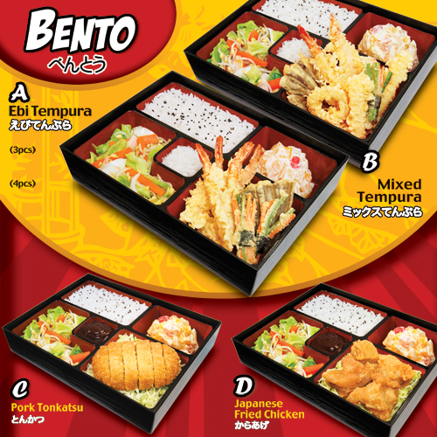
お弁当（おべんとう）

Slide 3
日本料理 Japanese Cuisine
丼もの（どんぶりもの）Rice bowl
丼（どんぶり）literally menas ‘rice bowl’
Donburi is a Japanese “rice bowl dish” consisting of さかな,
にく, やさい or other ingredients simmered together and
served over ごはん.
Donburi meals are served in oversized rice bowls.

Slide 4
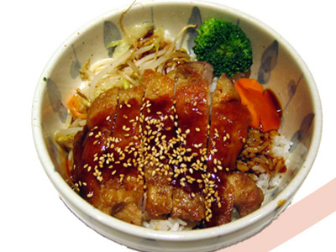
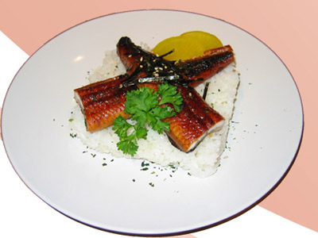
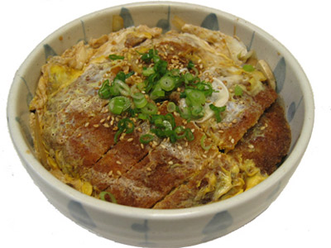
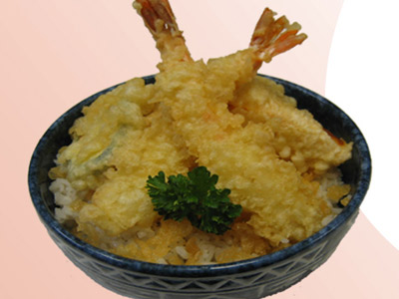
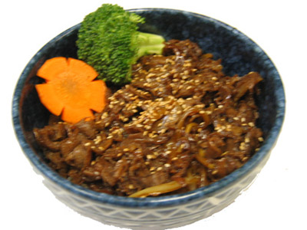
丼もの（どんぶりもの）

Slide 5
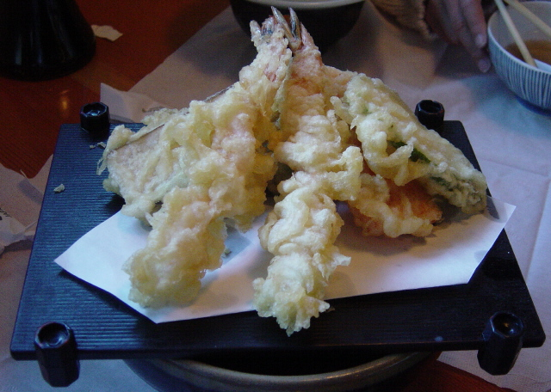
日本料理 Japanese Cuisine
天ぷら（てんぷら）Tempura
Tempura is a Japanese dish of seafood or vegetables that have been battered and deep fried.

Slide 6
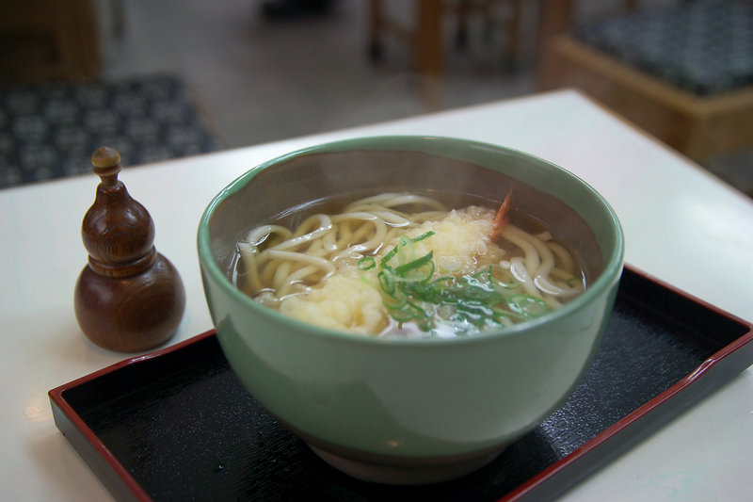
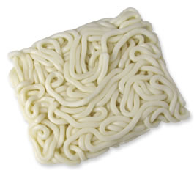
日本料理 Japanese Cuisine
うどん Udon
Udon is a type of thick wheat-flour noodle of Japanese cuisine.

Slide 7
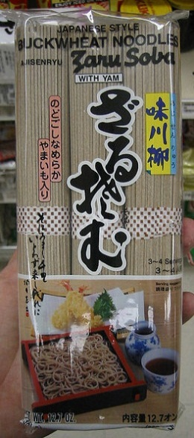
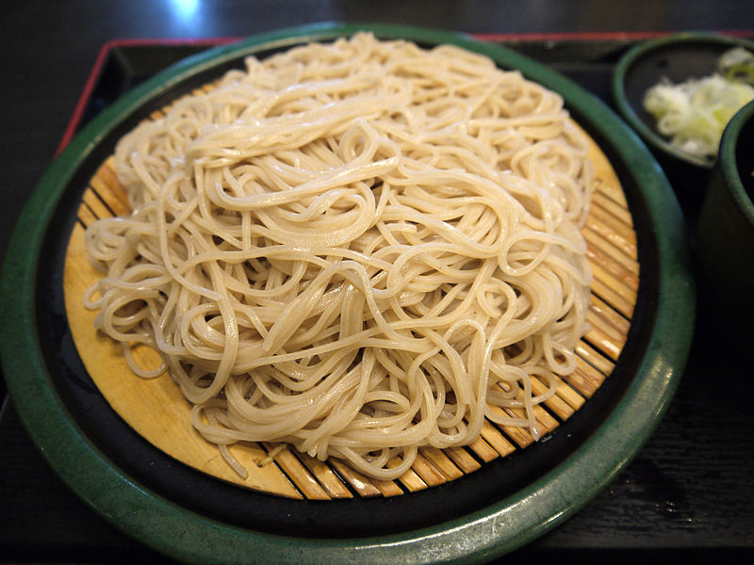
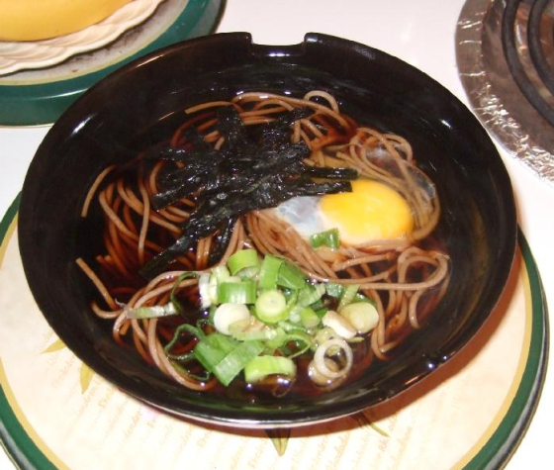
日本料理 Japanese Cuisine
そば Soba
Soba is the Japanese name for buckwheat.
In Japan Soba can refer to any thin noodle (unlike thick wheat noodles, known as udon).
Soba noodles are served either chilled with a dipping sauce, or in hot broth as a noodle soup.

Slide 8
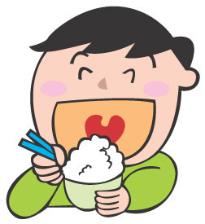
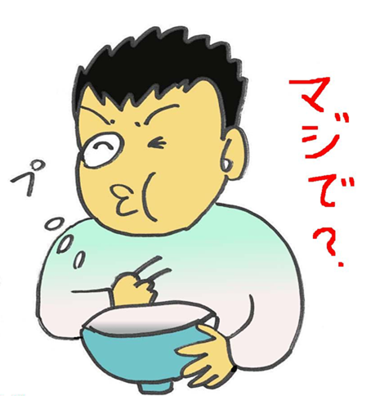
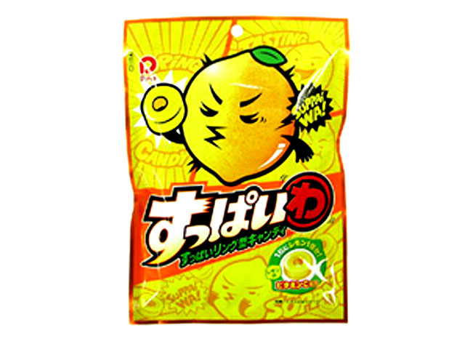
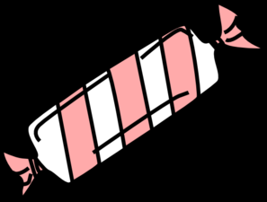

Slide 9
Describing taste/flavour
おいしい
まずい
しおからい
あまい
すっぱい
にがい
Yummy/delicious
Bad tasting
Salty
Sweet
Sour
Bitter

