Slide 1
Ima nan ji?
Hours and ½ hour

Slide 2
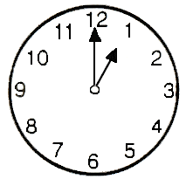
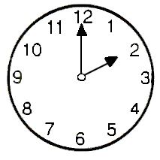
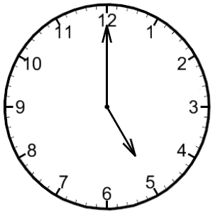
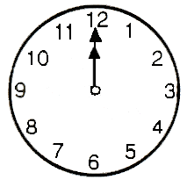
o’clock (HOURS)
NUMBER + JI
Ichi ji = 1 o’clock
NOTE:
Exception
YO JI
NOT YON JI
How would we say these times?

Slide 3
o’clock (HOURS)
NUMBER + JI
Ni ji = 2 o’clock
Go ji = 5 o’clock
Juu ni ji = 12 o’clock

Slide 4
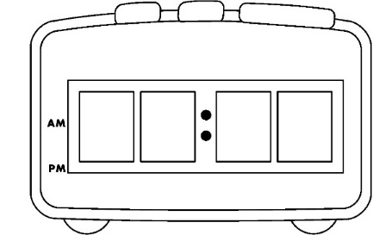
o’clock (HOURS)
ji
NUMBER + じ
ichi ji
いち じ = 1 o’clock
NOTE:
Exception
よじ
YO JI
NOT YON JI
How would we say these times?
0
5
0
0

Slide 5
ANSWERS
NUMBER + じ
ni ji
に じ = 2 o’clock
go ji
ご じ = 5 o’clock
0
5
0
0
juu ni ji
じゅうに じ = 12 o’clock

Slide 6
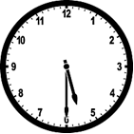
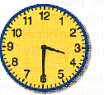
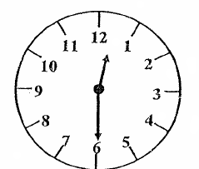
½ past
HOUR + じ + はん
go ji han
ご じ はん = ½ past 5
How would we say these times?
0
2
3
0

Slide 7
ANSWERS
HOUR+ じはん
san ji han
さん じはん = ½ past 3
juu ni ji han
じゅうに じはん = ½ past 12
ni ji han
に じはん = ½ past 2
0
2
3
0

Slide 8
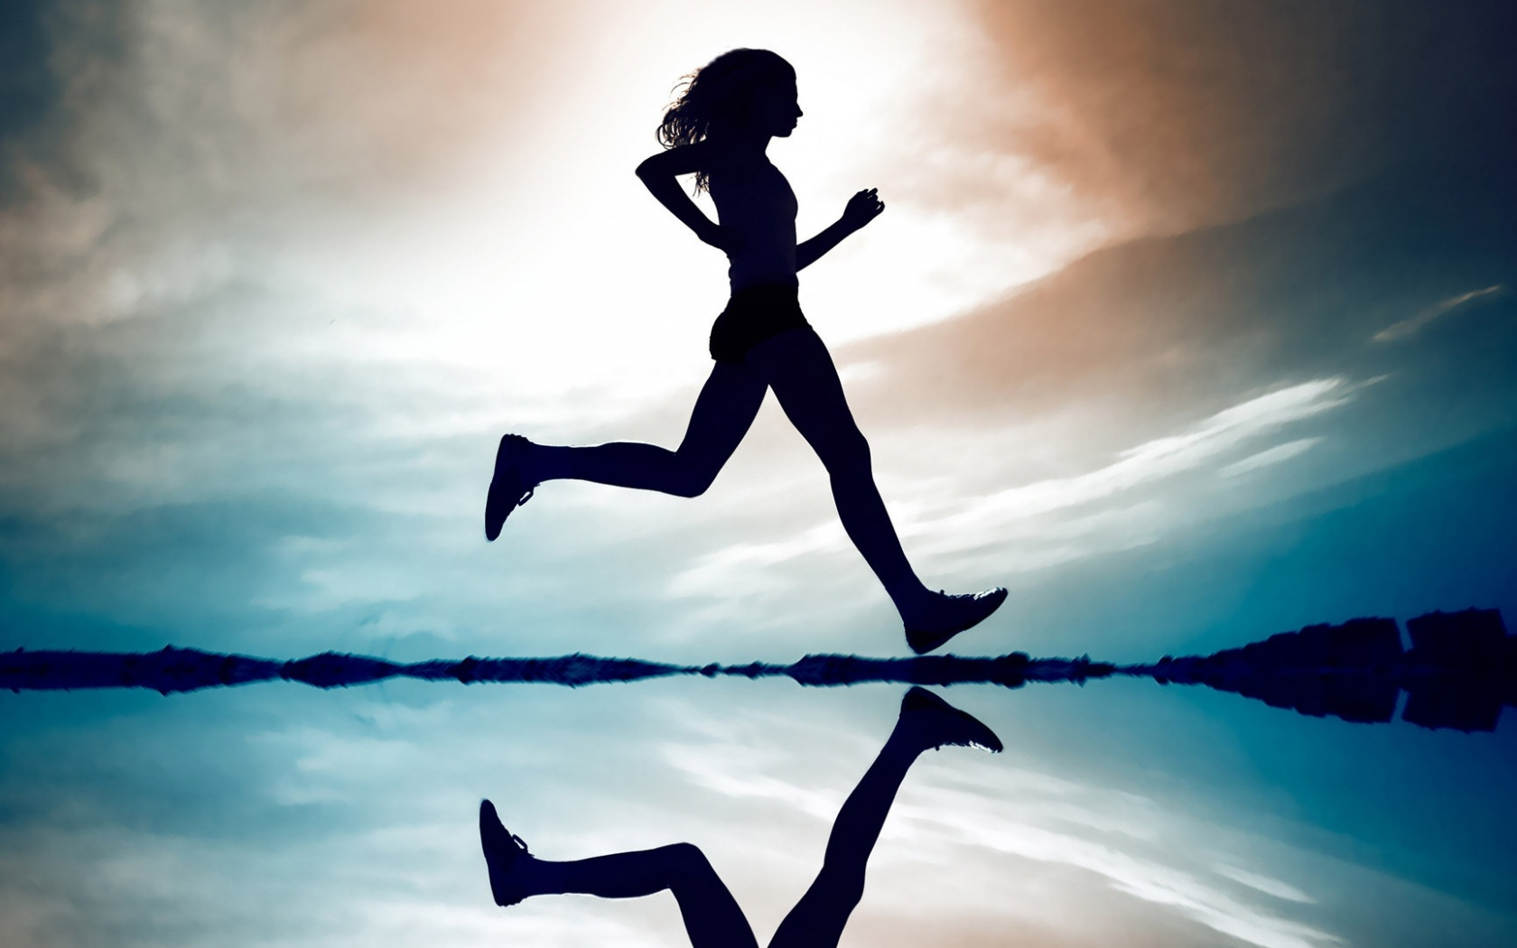
AM and PM
gozen ji
ごぜん+ HOUR+ じ
I meditate in the morning ‘gozen’.
gogo ji
ごご+ HOUR+ じ
I go for a run in the afternoon ‘gogo’.

Slide 9
What time is it?
Q1 | いま なんじ ですか。 What time is it now? | Ima nanji desu ka? What time is it now?
Q2 | PLACE は いま なんじ ですか。 In PLACE, what time is it now? | PLACE wa ima nanji desu ka? In PLACE, what time is it now?
A1 | ごぜんHOURじ（はん）です。 It is HOUR (thirty) am. | Gozen HOUR-ji (han) desu. It is HOUR (thirty) am.
A2 | ごごHOURじ（はん）です。 It is HOUR (thirty) pm. | Gogo HOUR-ji (han)desu. It is HOUR (thirty) pm.
A3 | PLACEは いま HOURじです。 In PLACE, it is HOUR now. | PLACE wa ima HOUR-ji desu. In PLACE, it is HOUR now.
9:30 pm
Thursday 7 August 2014
Time in Japan
10:30 pm
Thursday 7 August 2014
Time in Australia

Slide 10
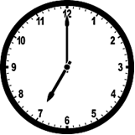

Slide 11
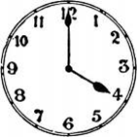

Slide 12
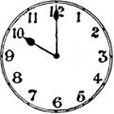

Slide 13
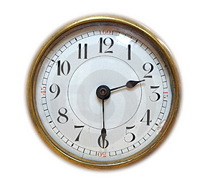

Slide 14
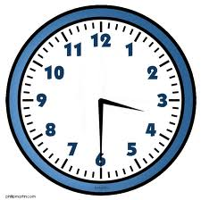

Slide 15
Ima nan ji?
Minutes

Slide 16
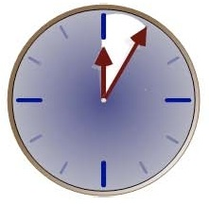
minutes
MINUTES ending in 5 + FUN
5 fun | Go fun | 5 minutes
15 fun | Juu go fun | 15 minutes
25 fun | Ni juu go fun | 25 minutes
35 fun | San juu go fun | 35 minutes
45 fun | Yon juu go fun | 45 minutes
55 fun | Go juu go fun | 55 minutes

Slide 17
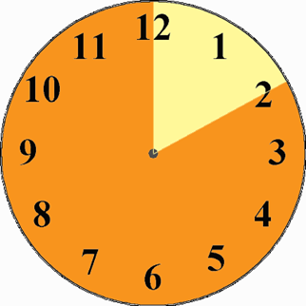
minutes
MINUTES ending in 10 + JUP-PUN
10 pun | Jup-pun | 10 minutes
20 fun | Ni jup-pun | 20 minutes
30 fun | San jup-pun | 30 minutes
40 fun | Yon jup-pun | 40 minutes
50 fun | Go jup-pun | 50 minutes

Slide 18
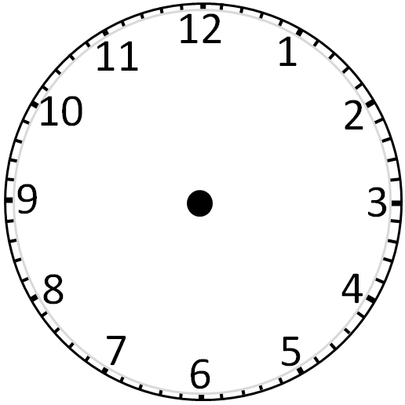
go juu go fun
go fun
yon juu go fun
juu go fun
san juu go fun
ni juu go fun

Slide 19
Go jup-pun
Jup-pun
Yon jup-pun
Ni jup-pun
San Jup-pun

Slide 20
JI
go juu go fun
go fun
Go jup-pun
Jup-pun
yon juu go fun
juu go fun
Yon jup-pun
Ni jup-pun
san juu go fun
ni juu go fun
San Jup-pun

Slide 21
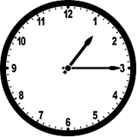
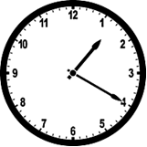
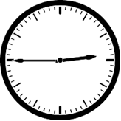
TIME
HOUR + JI + MINUTES + FUN/PUN
Ichi ji Juu go fun = quarter past 1
How would we say these times?

Slide 22
How do we say the following times?
Let’s practise…

Slide 23
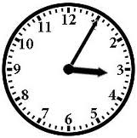

Slide 24
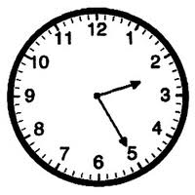

Slide 25
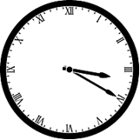

Slide 26
