Slide 1
いくらですか？

Slide 2
Supermarket/Fish market video
Watch the video carefully and keep in mind the following points you will discuss after the video.
SUPERMARKET:
What is your first impression of prices of supermarket items?
FISH MARKET:
Which items did the Japanese person introduce?
How much were they?
What do you think the following mean?
「(あとで）けいさんしてください」、「やすい」、「おいしい」、「ちいさい」、「おおきい」

Slide 3
Fish Market video
http://www.youtube.com/watch?v=GbOgjt7QQ6Y

Slide 4
Discuss in groups the following
What is the key question used to ask how much something is?
What is your first impression of prices of supermarket items?
Which items did the Japanese person introduce?
How much were they?

Slide 5
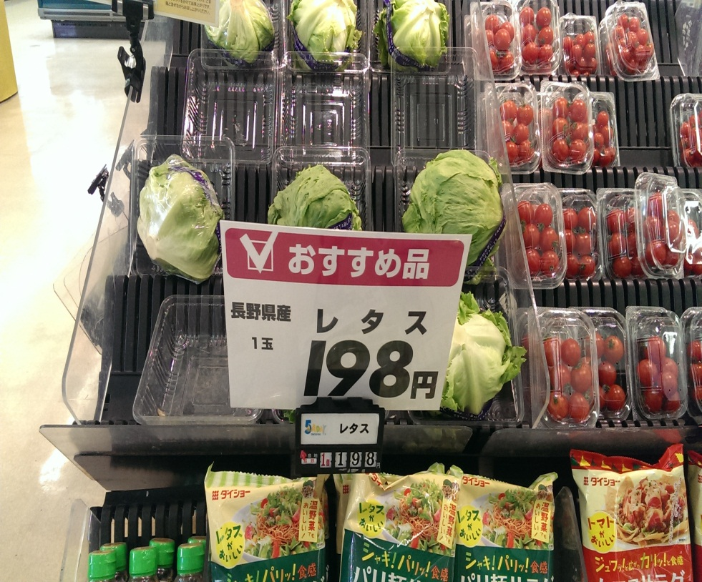
いくらですか
1. ９８円
2. １９８円
3. ４９８円
4. ５０８円

Slide 6
２

Slide 7
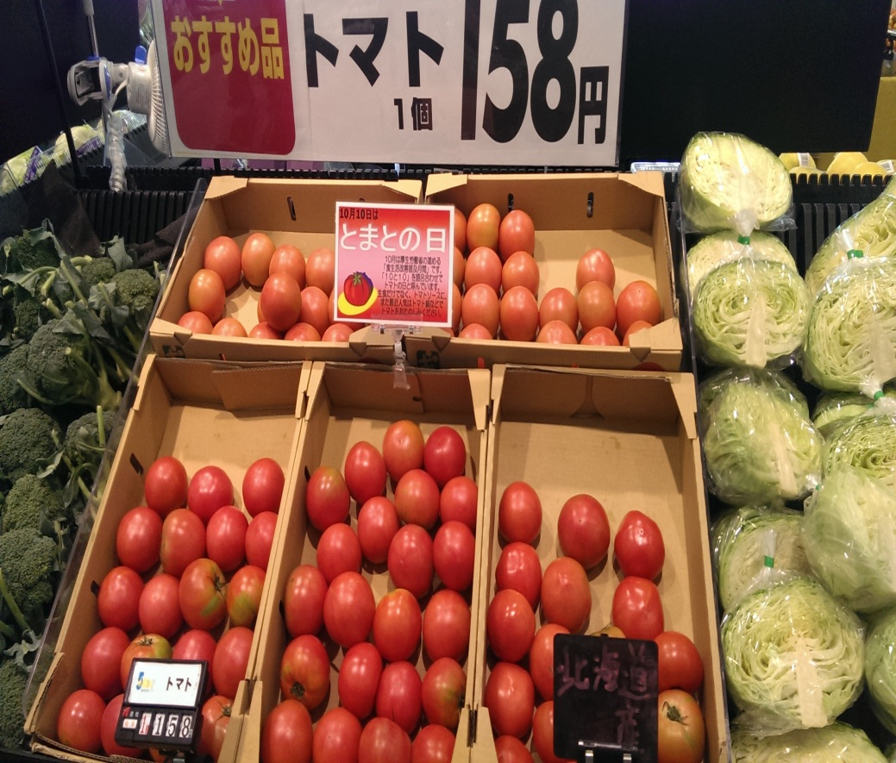
いくらですか
1. ３８円
2. ７８円
3. ９８円
4. １５８円

Slide 8
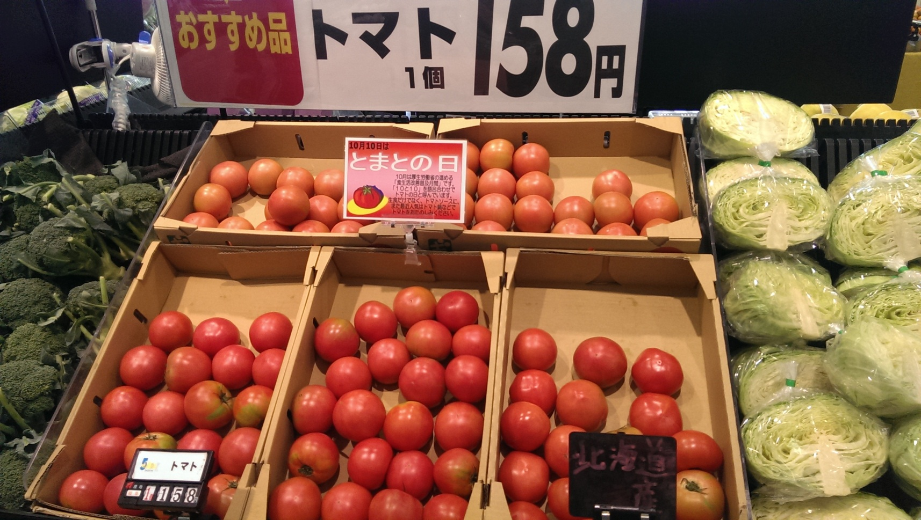
４．
1. ９８円
2. １９８円
3. ４９８円
4. ５０８円

Slide 9
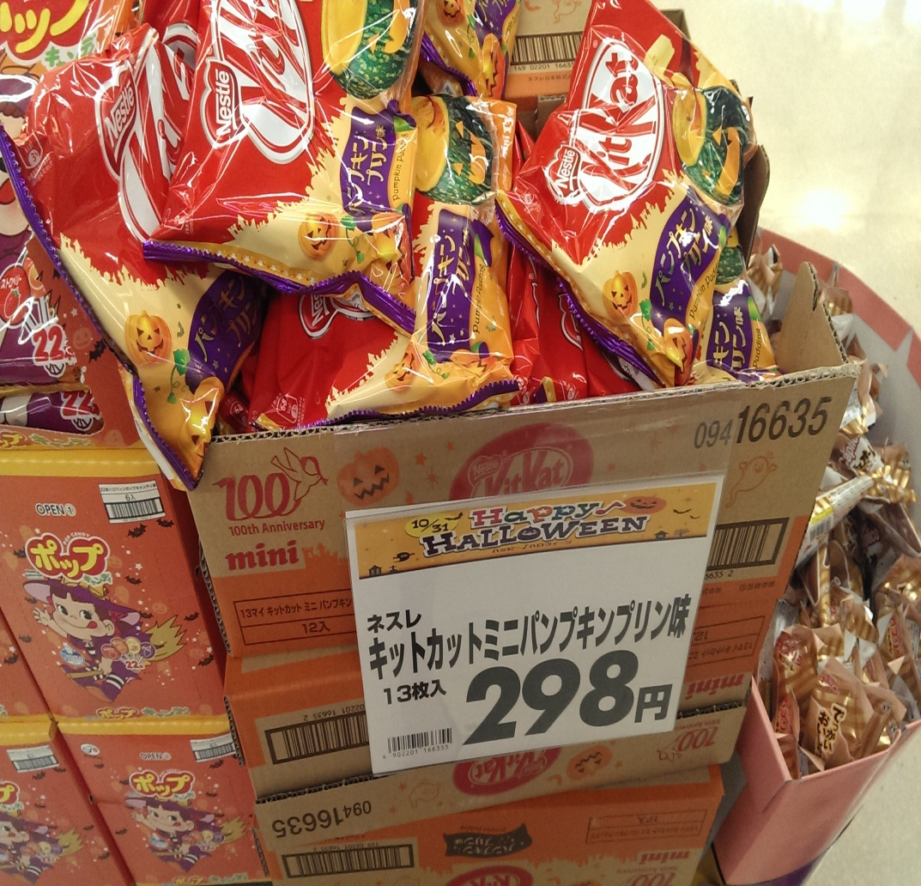
いくらですか
1. 98円
2. ２９８円
3. ４９８円
4. ９９８円

Slide 10
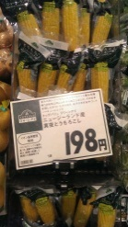
２．

Slide 11
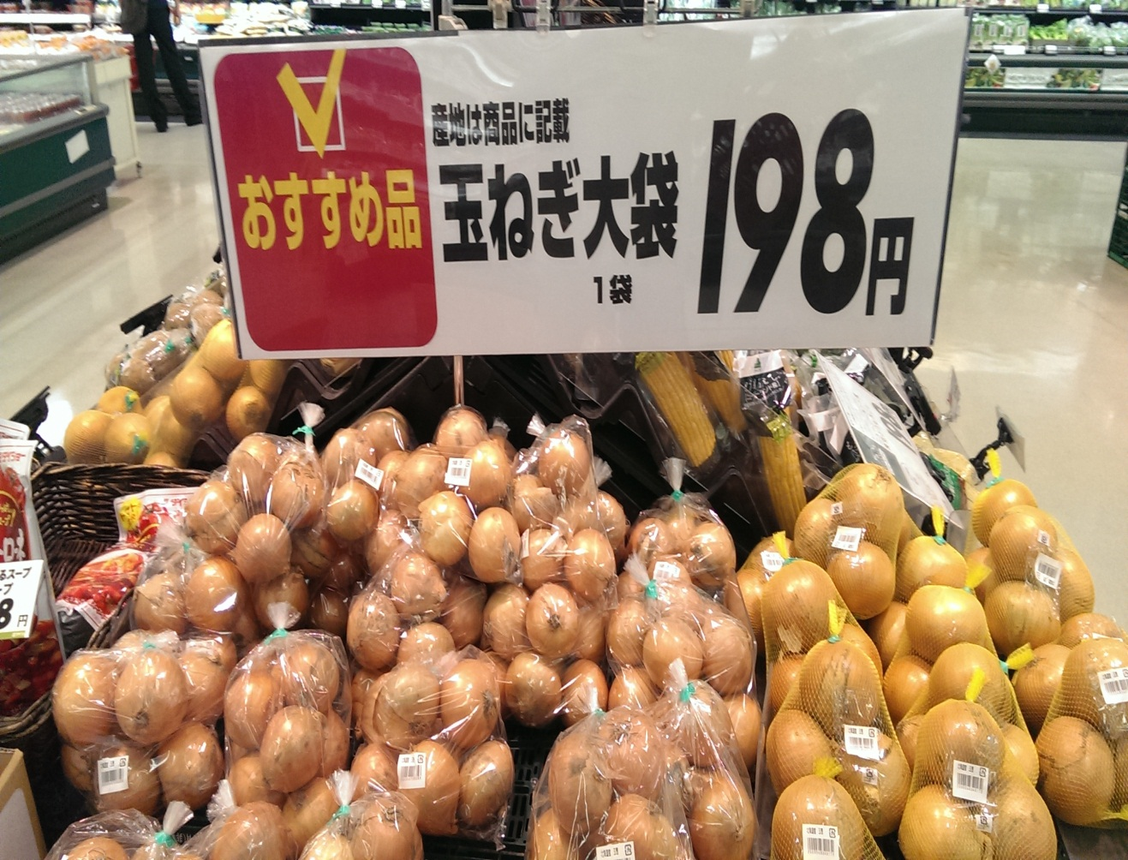
いくらですか
３９円
６８円
９８円
１９８円

Slide 12
4

Slide 13
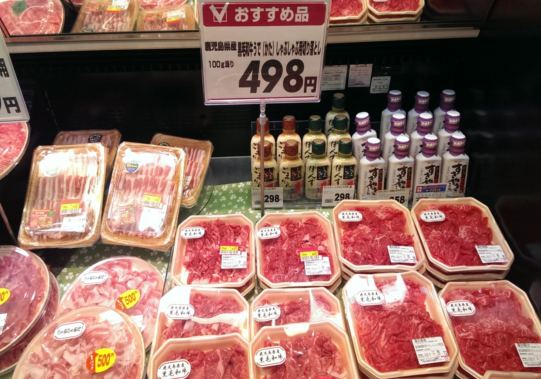
いくらですか
1. ９８円
2. １９８円
3. ４９８円
4. ５０８円

Slide 14
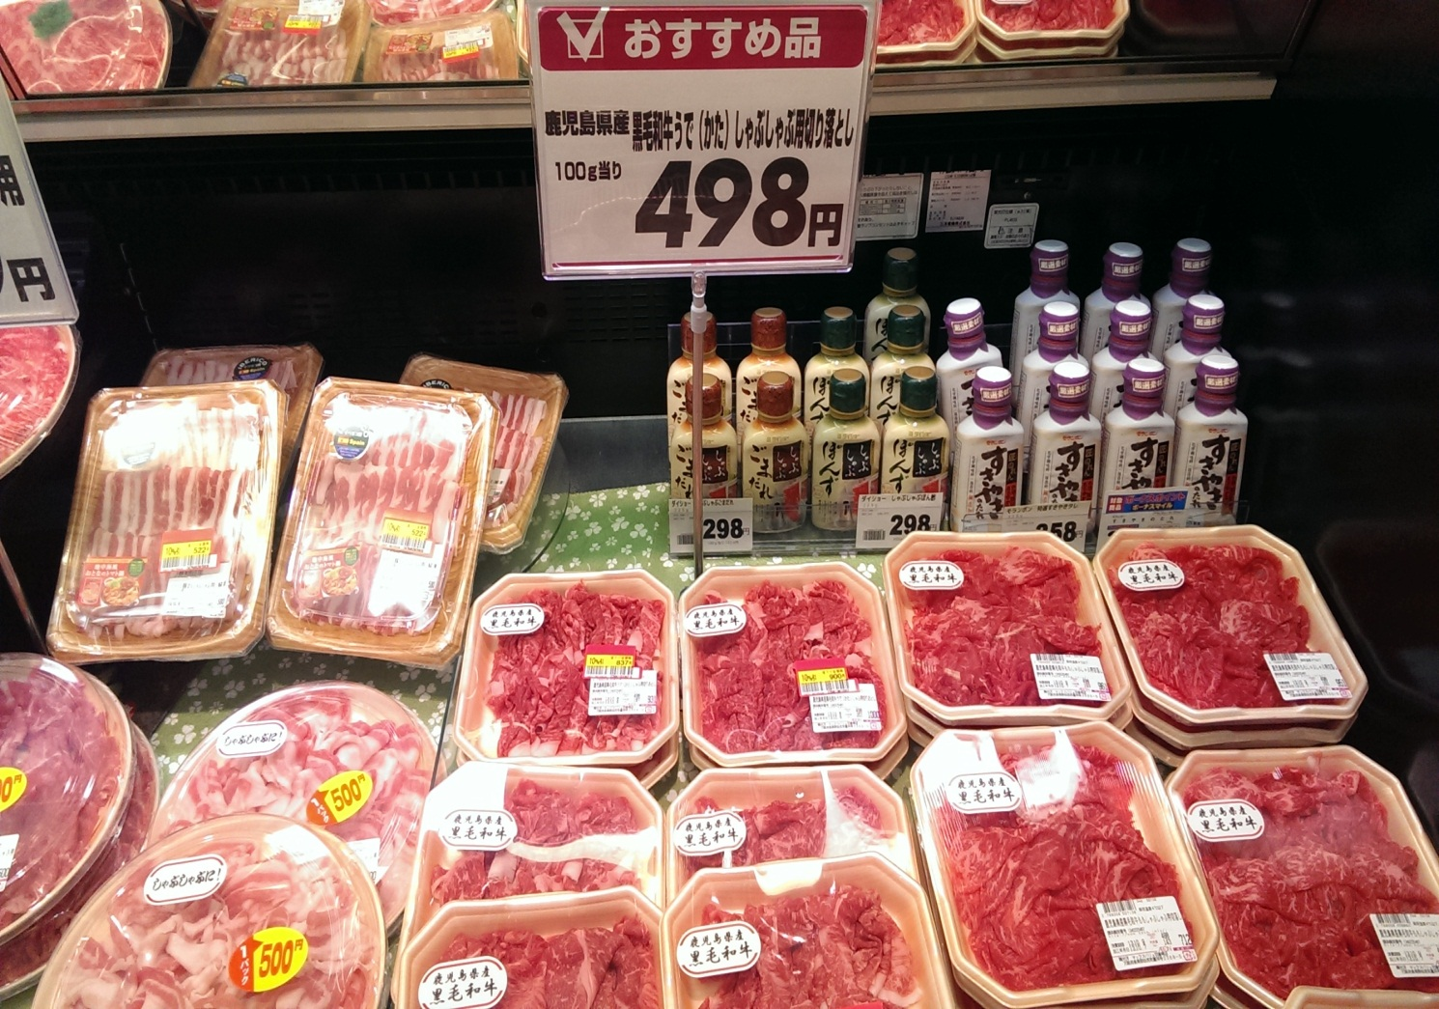
３．

Slide 15
Speaking Task
Pairwork exercise using Japanese ちらし
すみません、それはなんですか。
これは。。。です。
いくらですか。
。。。えんです。
Other tasks: 1) Find the cheapest/most expensive item 2) An item you would like to try and WHY (best to use ちらし with item students will like.

Slide 16
AUSドルではいくらですか Choose 10 items from the ちらし and calculate the amount in dollars.
Item (Japanese) | Item (English) | 円 | ドル
例(れい） たまねぎ | Onions | 198円 | …..

Slide 17
AUSでいくらですか
Use the same 10 items and compare prices in your local supermarket.
Item (Japanese) | Item (English) | 日本 ＄ | ＄
例(れい） たまねぎ | Onions

Slide 18
Summary
How do prices compare between Australia and Japan?
Give reasons for your answers above.
Are you able to conclusively say which country is more expensive?
Some other things to consider (Why is fruit priced per item? Why is the meat sliced thinner than here?)

