Slide 1
Housing In Japan

Slide 2
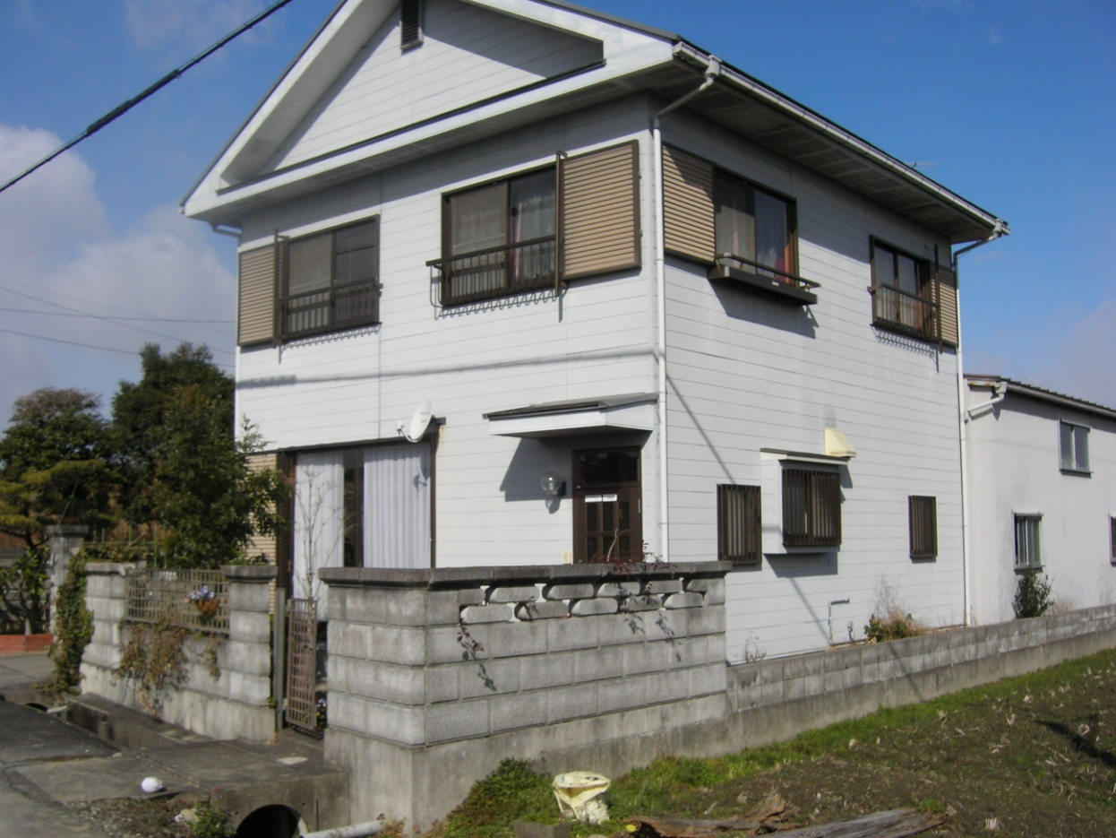
いえ - House

Slide 3
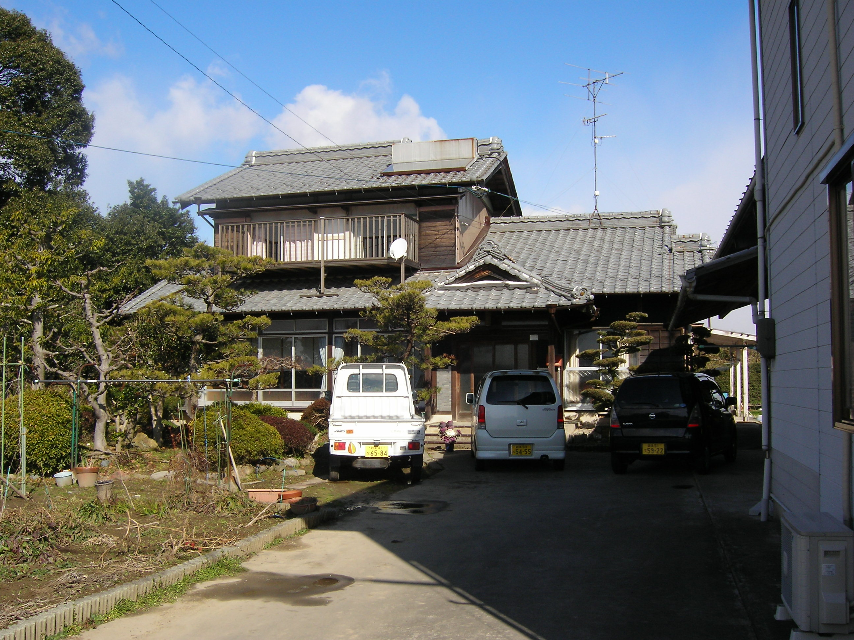

Slide 4
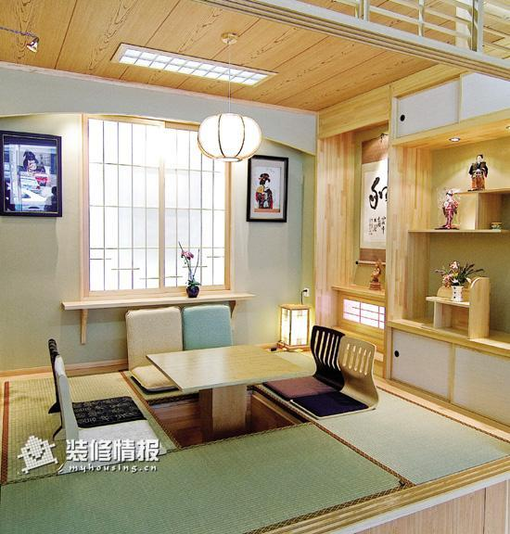

Slide 5
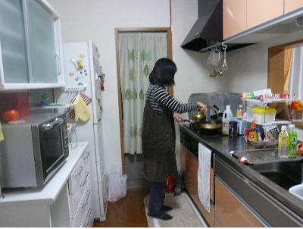

Slide 6
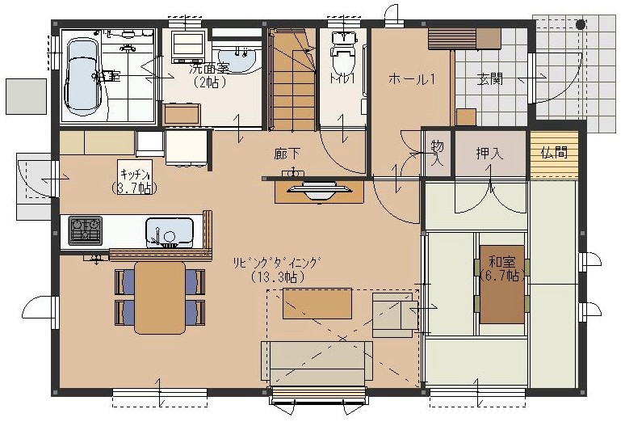

Slide 7
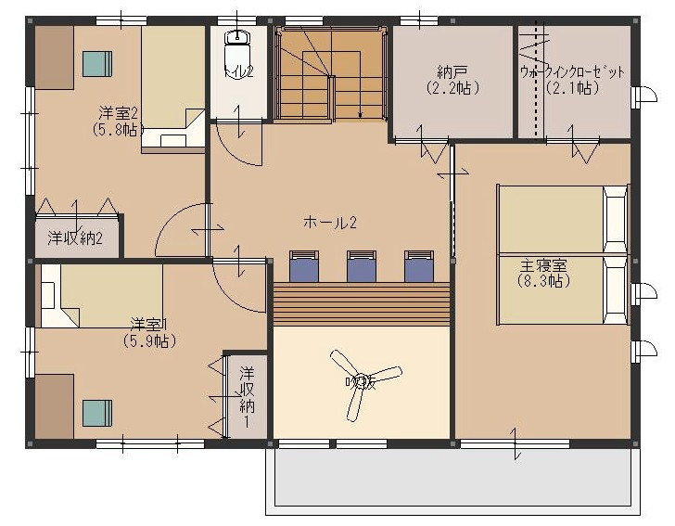

Slide 8
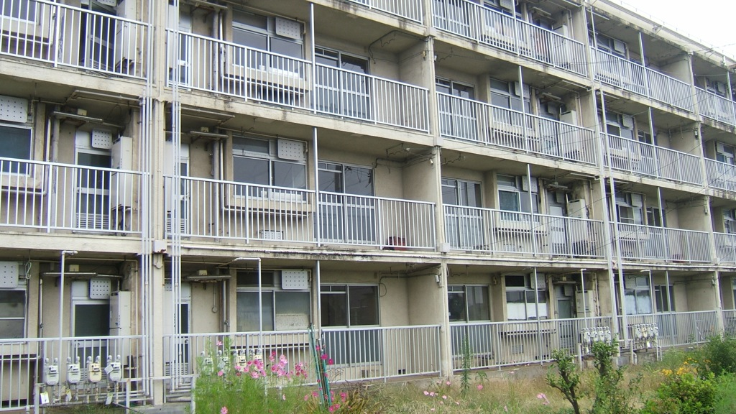
アパート - Apartments
They are often older buildings which are usually only a few stories in height, without a central secure entrance

Slide 9
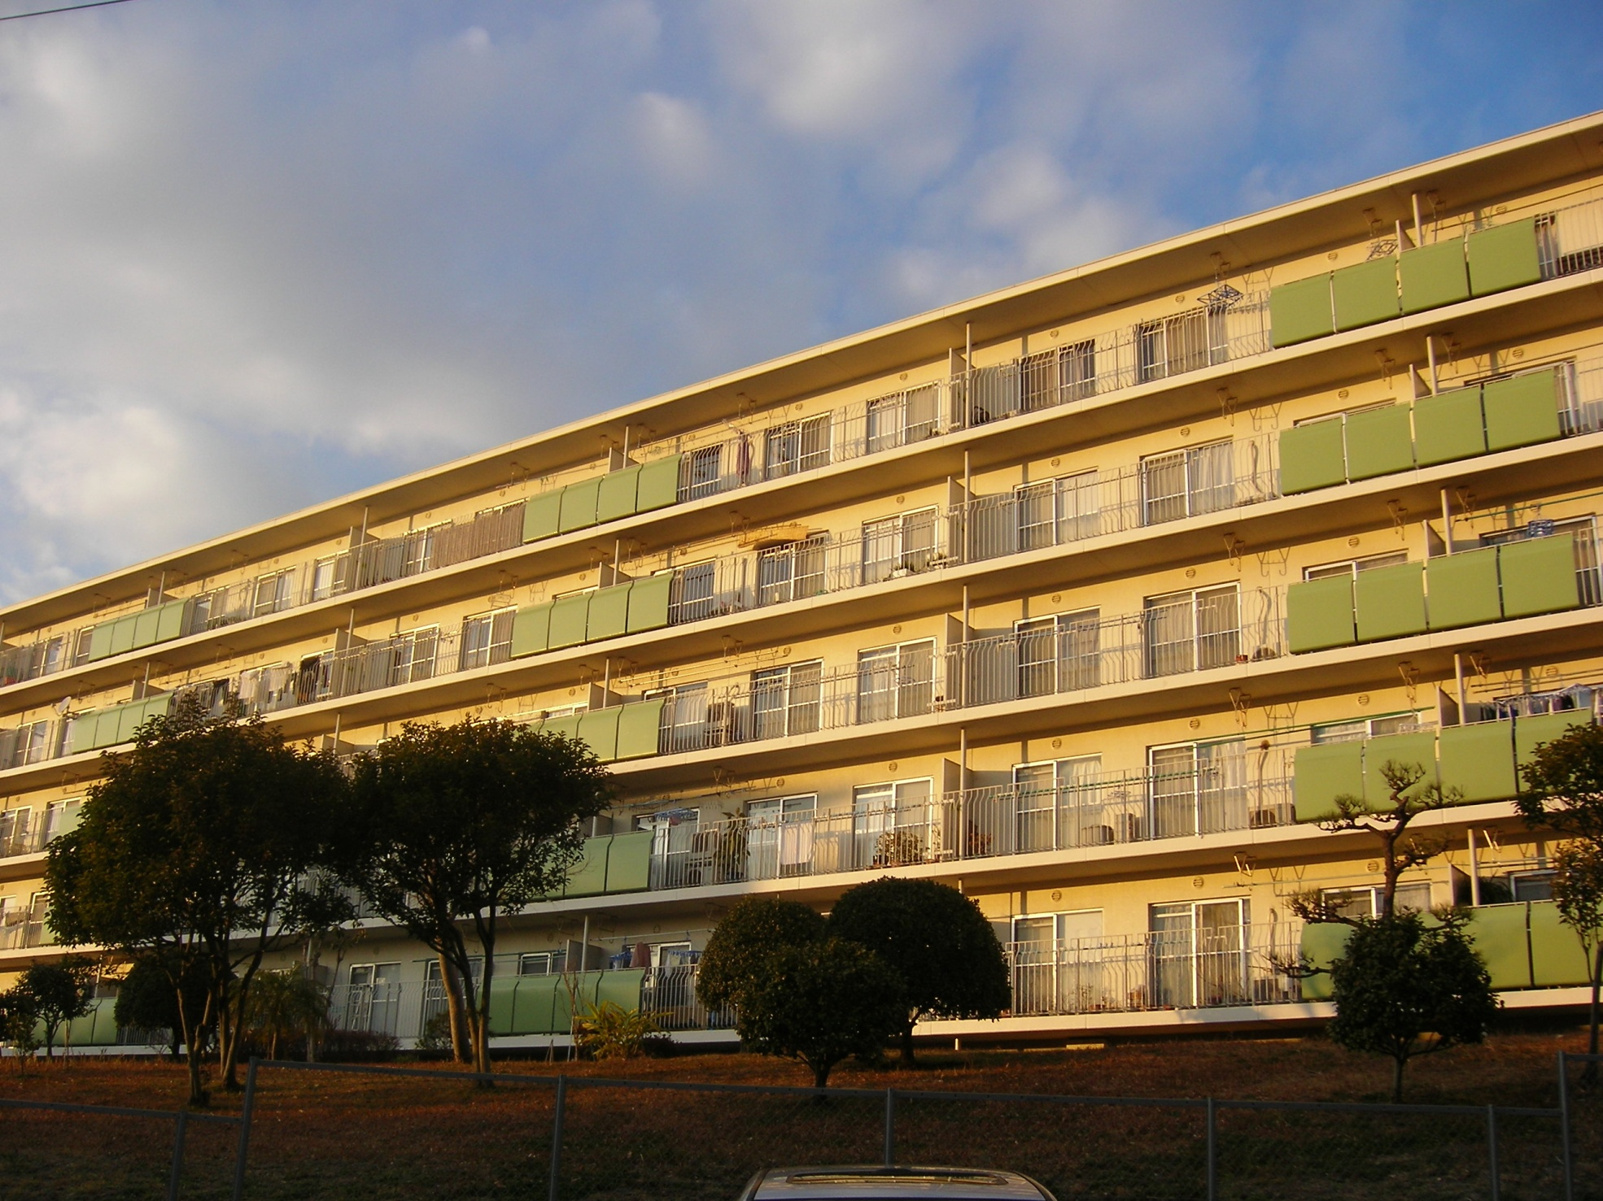

Slide 10
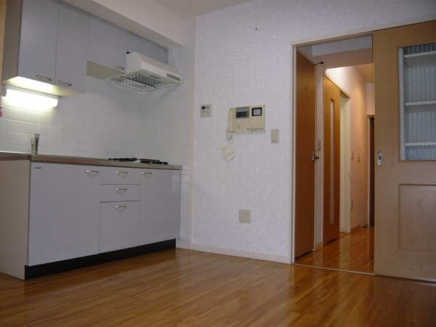

Slide 11
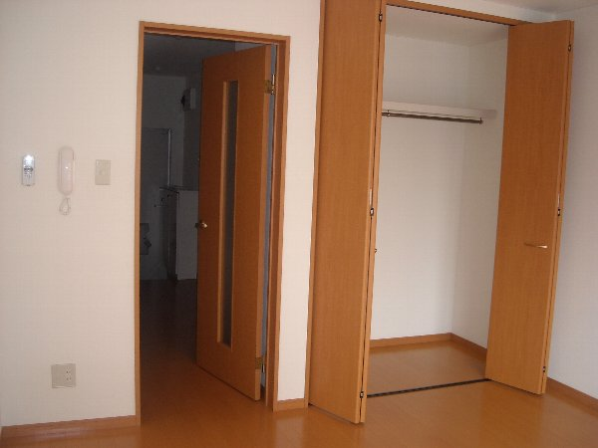

Slide 12
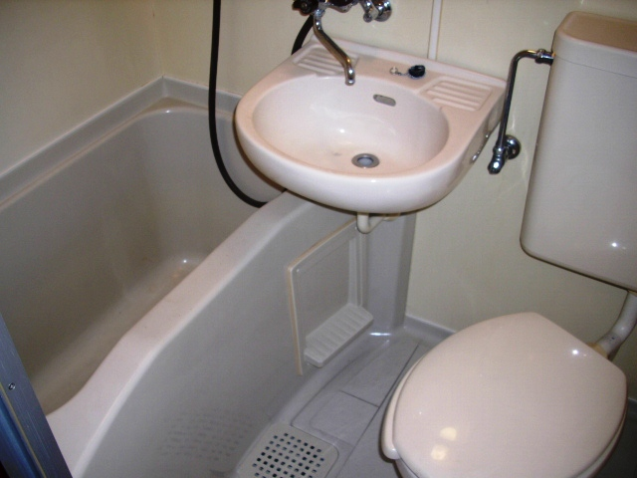

Slide 13
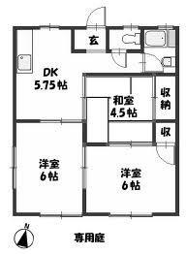

Slide 14
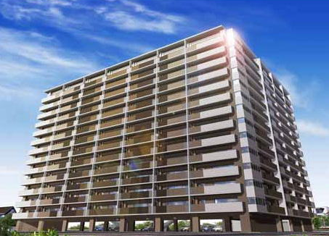
マンション - Mansion
More modern, expensive buildings with multiple floors, elevators, and a communal secure gate, with centralised postboxes. They are usually more sturdily built than apaato.

Slide 15
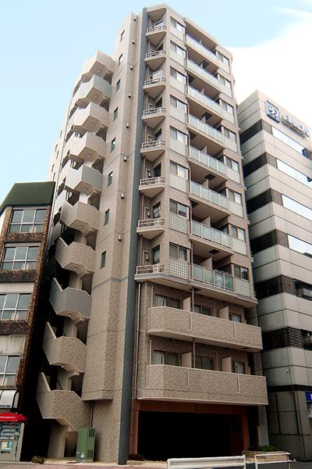

Slide 16
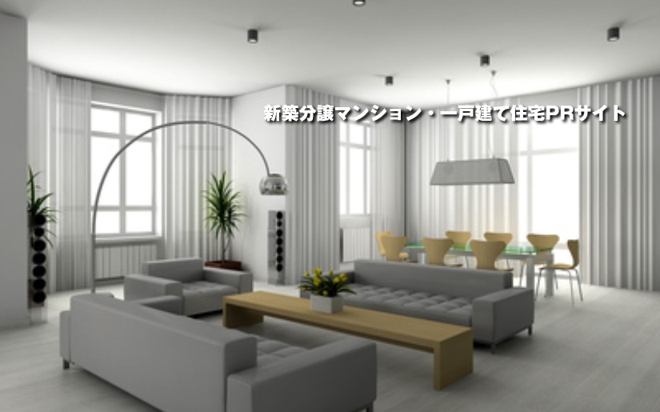

Slide 17
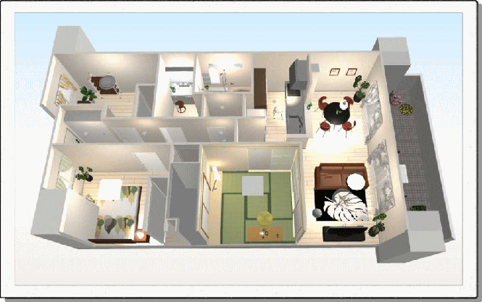

Slide 18
りょかん – Traditional Inn
A typical ryokan is an Japanese-style inn. Like a Western-style inn, maintaining the special, atmosphere and appearance is more important than providing the latest modern conveniences. A ryokan is for travelers who wish to experience Japanese culture and enjoy the comforts of Japanese hospitality and service.

Slide 19
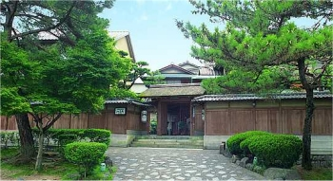
Entrance

Slide 20
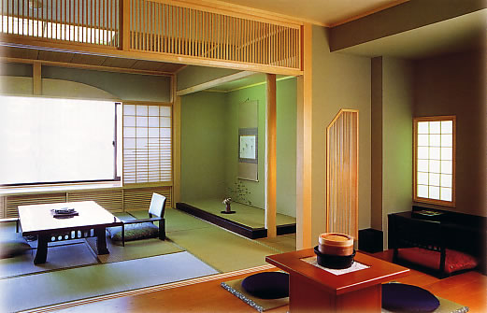
Inside a Room

Slide 21
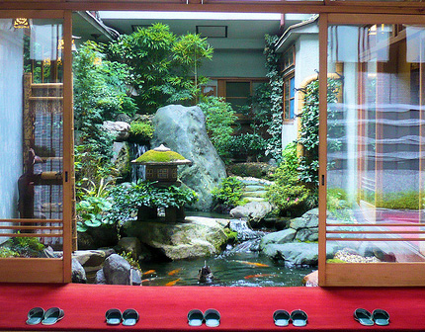
Internal Garden

Slide 22
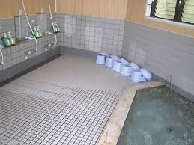
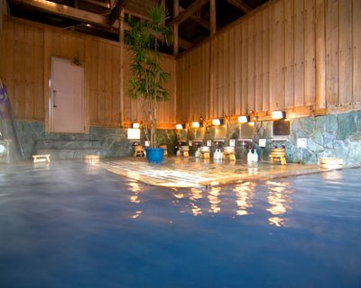
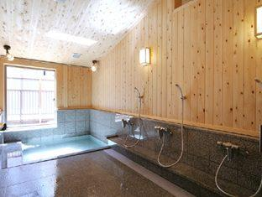
Communal Bathroom

