Slide 1
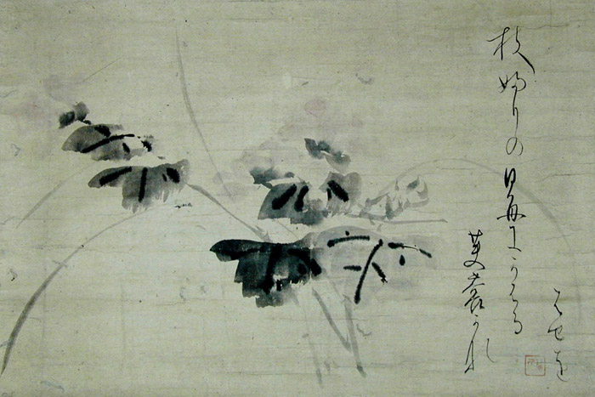
Writing Haiku
for Peace or as Protest

Slide 2
What is Haiku?
Haiku is a poetic form that originated in Japan hundreds of years ago and continues today.
Haiku reflects many characteristics of the Japanese people such as their appreciation of tradition and their sensitivity to nature.
Haiku is a thoughtful, unrhymed Japanese poem that attempts to capture the essence of a moment in which nature is linked to human life.
As one of the most important forms of traditional Japanese poetry, a well-written haiku creates tension between contrasting elements.
Haiku uses just a few words to capture a moment and create a picture in the reader’s mind. It is like a tiny window into a scene much larger than itself

Slide 3
Haiku Form
Syllable Count::
The poem consists of 17 syllables, a must in Japanese. Traditionally haiku is written in three lines, with five syllables in the first line, seven syllables in the second line and five syllables in the third line;
Kigo:
The poem should indicate through a kigo, a seasonal word, the season in which the haiku is set. Often the kigo is not obvious and may therefore be implied;
Division:
The poem contains a division between two contrasting parts, a certain imaginative distance should exist between the two sections, both of which must enrich the understanding of the other.

Slide 4
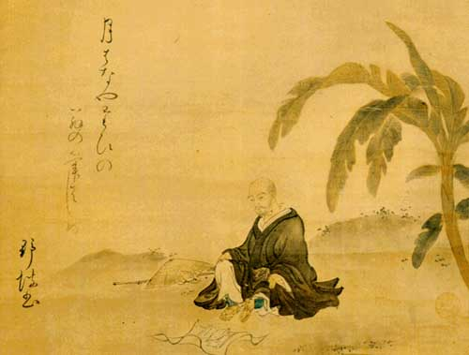
Matsuo Bashō
(1644 -1694)
Haiku originally began as a comic style of verse that was simple to write. But in the late 1600’s, Matsuo Basho changed haiku into a serious art form. His haiku, written according to strict rules, describe subjects in nature and contain a reference to a season of the year. These poems merely suggest ideas and feelings, and so the reader must use imagination to interpret them.

Slide 5
Showing no sign of an early death— a cicada’s voice
—Matsuo Basho
Under the tree in the soup, salad, and everywhere— cherry blossoms
—Matsuo Basho

Slide 6
A lightning flash— and piercing the darkness a heron’s shriek
—Matsuo Basho
A giant firefly flickers and then moves on
—Kobayashi Issa

Slide 7
Haiku for Peace and Haiku as Protest

Slide 8
Haiku as Protest
Many people have written haiku as a way of protesting against war and as a means of expressing their wishes for peace. Rick Black lived in Israel when he wrote the following haiku. He used the haiku medium as a means of conveying the stark images “of peace and war, of hope and fear – and the way they blend together”.
purple bougainvillea
beyond the barbed wire
flowering wildly
—Rick Black

Slide 9
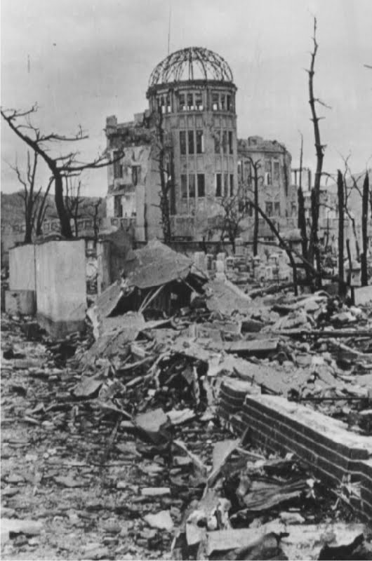
so joyously,
a pair of doves flirting over
a soldier's gravestone
—Rick Black
rainbow's arc
the old city's domed rooftops
still glistening
—Rick Black

Slide 10
Haiku for Peace
Following are some other examples of haiku, from the website ‘Peace is a haiku song’ (http://peace.muralarts.org/haiku), that express individuals’ hope for peace and protest against war:
a hornet asleep
maybe peace looks different
than I thought it did
—KD, 23rd July 2013

Slide 11
though war is
old is has not
become wise …
—Alice Walker, 23rd August 2012
Grandmothers, mothers
daughters, each generation
chants a hymn of hope
—Debjani Chatterjee, 23rd August 2012

Slide 12
The sprawling sound
of peace sails on the wind
A white butterfly
—Sonia Sanchez, 23rd August 2012

Slide 13
Student’s Haiku for Peace and as Protest
Destruction surrounds
Tears and screams are shouted out
No one understands.
— Katarina
Imagine a world
With no sorrow or death
And no more crying
—Sana

Slide 14
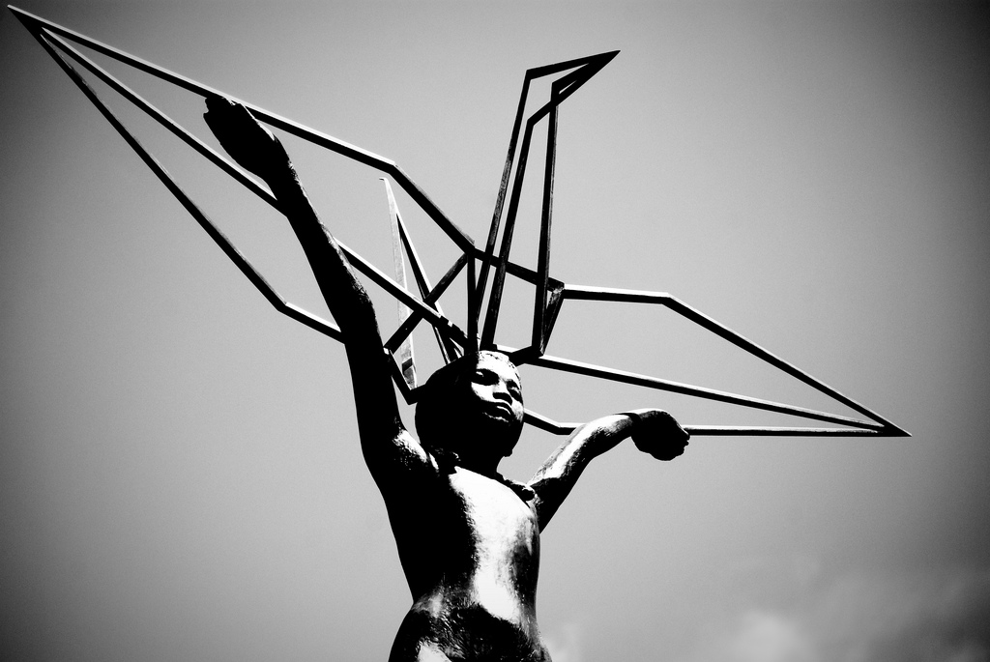
I will write peace
on your wings and you will fly,
all over the world
—Sadako Sasaki

Slide 15
For Peace or as Protest?
Now it’s your turn –
Write your own haiku
for Peace or,
as Protest.

