Slide 1
Going Places
Year 9 Japanese – Term 2

Slide 2
よくきいて ください…
Please listen to the following recordings and answer the questions on the sheet provided.

Slide 3
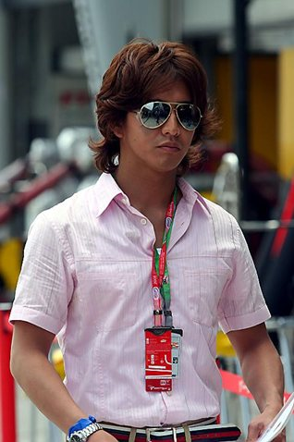
Listen to Kenta’s Plans
Where is he going on Wednesday?
To the cinema
To the beach
To school
To his friend’s house
Please choose the correct answer from the options provided
2. How is he going to get there?
A. By bus
B. By train
C. By bicycle
D. On foot
3. Ext. - Who is he going with?
With his friend
With his younger brother
By himself
With his mother

Slide 4
Listen to the two school friends talking
1. What date is it today?
2. What event did Shiho miss?
3. What is the time now?
4. Ext. – What are Shiho’s plans now?
In English, please answer the questions according to the information you hear

Slide 5
Listen to the teacher talking to her class
Ext. – What instructions does she give her class?
In English, please answer the questions she asks. Use information from your real life to help you answer the questions

Slide 6
Listen to the two colleagues talking after work
Where is Yamamoto-san going?
To a restaurant
To netball practice
To a department store
To a football game
4. Ext. – How is Yamamoto- san getting there?
By bullet train
By ferry
On foot
By scooter
2. What day is Yamamoto going?
On Monday
On Friday
On the weekend
On Saturday afternoon
5. What additional information can you provide about Yamamoto- san?
Please choose the correct answer from the options provided
3. Who is she going with?
Her family
Her older sister
Her friends
Her boyfriend

