Slide 1
Flavours!!!
In Japanese

Slide 2
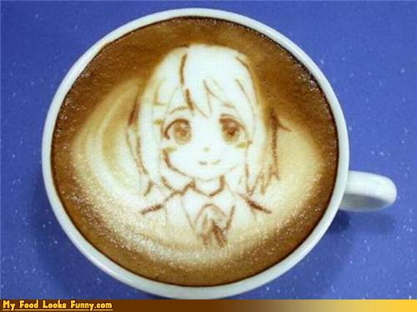
Open your books
Write the following flavours into you books in ENGLISH, HIRAGANA AND ROMAJI. Yes, all three alphabets (no whinging). Quiz at the end!

Slide 3
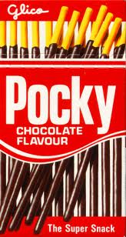
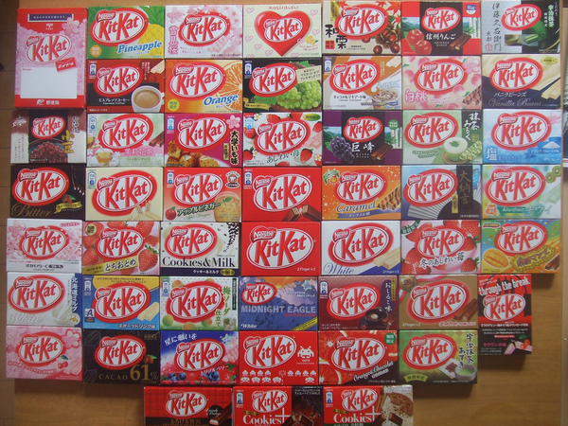
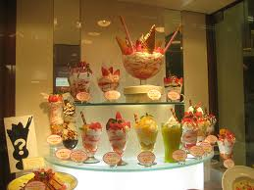
delicious
おいしい | oishii

Slide 4
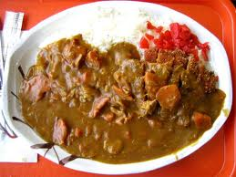
spicy
からい | karai

Slide 5
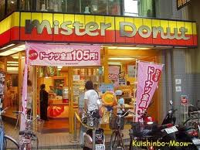
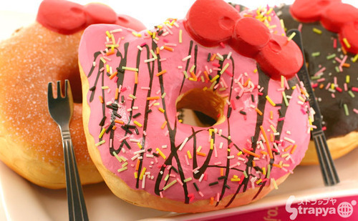
sweet
あまい | amai

Slide 6
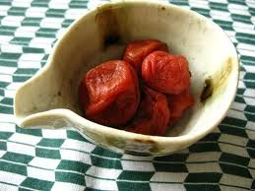
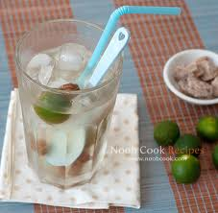
sour
すっぱい | suppai

Slide 7
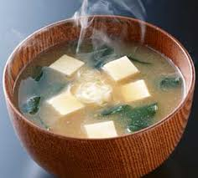
salty
しょっぱい | shoppai

Slide 8
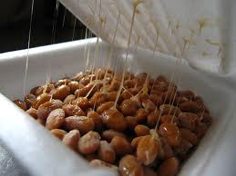
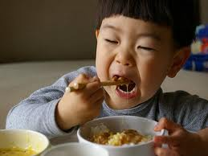
yuck
まずい | mazui

