Slide 1
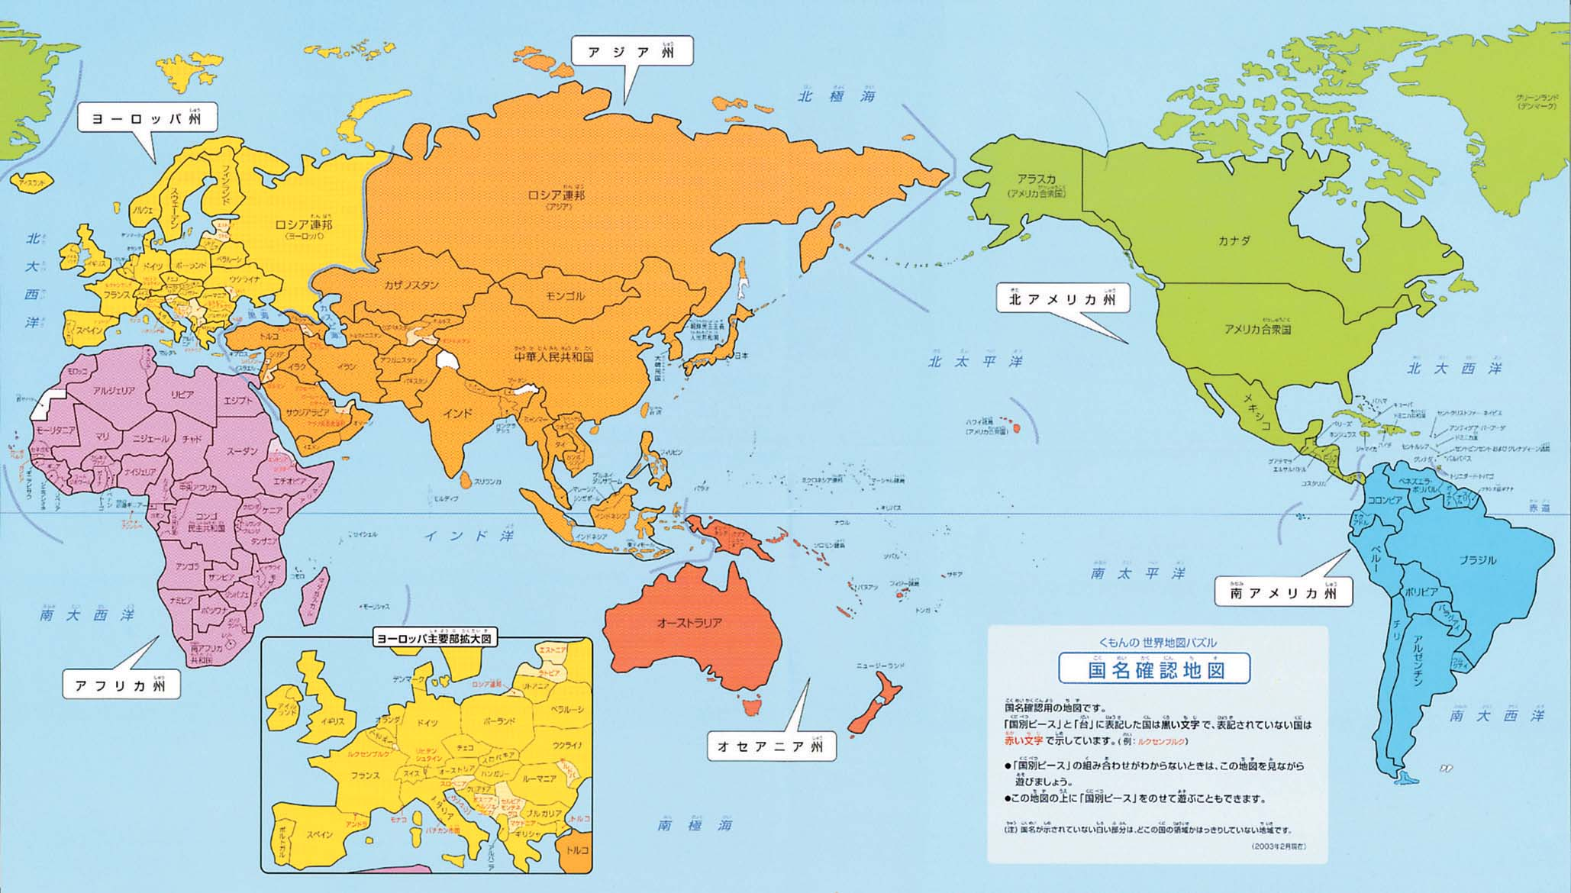
Date
Japanese,Lesson
XXXX Sensei
Title
Where do you come* from?
Doko kara kimashita ka

Slide 2
Objectives :
Learn the Japanese names for 10 countries.
Learn how ask and answer the question ‘Where are you from?’ In Japanese.

Slide 3
Q. Where do you come from? 質問： Doko kara kimashita ka
Q. I come from *COUNTRY*?
答え： Watashi wa *KUNI* kara kimashita

Slide 4
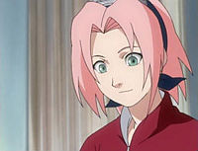
Doko kara kimashita ka
Watashi wa *KUNI* kara kimashita
Nihon 日本

Slide 5
Watashi wa *KUNI* kara kimashita
igirisu
Doko kara kimashita ka

Slide 6
ni hon
日本

Slide 7
Igirisu

Slide 8
Amerika

Slide 9
Chu goku
中国

Slide 10
Betonam

Slide 11
Furansu

Slide 12
Kan koku
韓国

Slide 13
Burajiru

Slide 14
Jyamaika

Slide 15

O-sutoraria

Slide 16
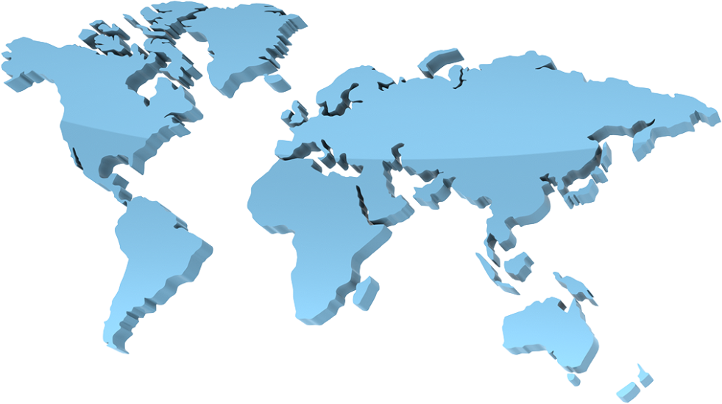

Kuni wa ?

Slide 17
Slap the board!!
Dansei tachi v. Josei tachi
Race to hit the image that matches the Japanese country names you hear
3
4
5
2
6
1
7
Countries (Kuni 国)
10
9
8

Slide 18
Write the Japanese next to the English. There will be one Romaji word left over, see if you can work out what it means…
jyamaika
Supe-n
Japan _______________
China _______________
Vietnam _______________
South Korea _____________
America _______________
England _______________
France _______________
Brazil _______________
Jamaica _______________
Australia _______________
_____________ _____________
O-sutoraria
brajiru
Amerika
nihon
Furansu
kankoku
Chugoku
Igirisu
betonam

Slide 19
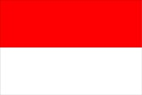
Now look up the Japanese for other countries.
http://www.learn-japanese-adventure.com/japanese-country-names.html
http://www.dicts.info/dictionary.php?l1=English&l2=Japanese_Romaji
__________________
__________________
__________________
__________________
__________________
Do you have family members that are from different parts of the world? Grandma? Grandad?
Look up the Japanese for the family members you would need to give an accurate description of your nationality.
Write the English and the Japanese!
____________________________________________________________________________________________________________________________________________
____________________________

Slide 20
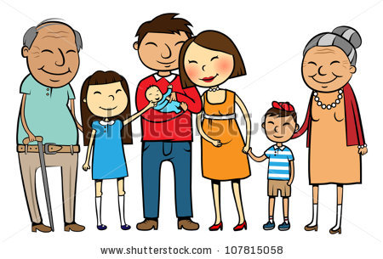
Watashi wa igirisu kara kimashita. Demo …
I come from England but…
Match the sentences to the image
Okaasan wa furansu kara kimashita. ( )
Ojiisan wa kankoku kara kimashita. ( )
Otousan wa burajiru kara kimashita. ( )
A
C
B

Slide 21
Use the last activity to answer the following questions
1. What does ‘okaasan’ mean?
_______________________________
2. What does ‘otousan’ mean?
_______________________________
3. What does ‘ojisan’ mean?
_______________________________
4. What do you think ‘obaasan’ means?
_______________________________

Slide 22

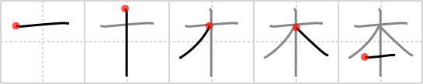
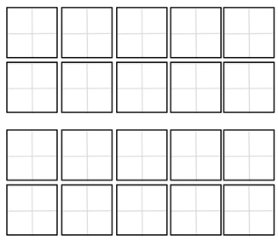
Kanji Practice
Ｊａｐａｎ
1
日 本 ＝ Ｊａｐａｎ
Ni hon
日本
Practise writing the kanji in the boxes provided.
1. Use the first rows to practise the individual strokes.
2. Write 日本 in each of these boxes.
1
2
2
A)
B)
日本
日本

Slide 23

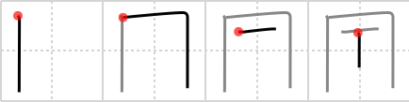
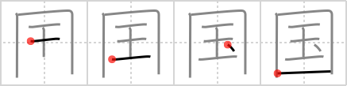
Kanji Practice
Ｃｈｉｎａ
1
中 国 ＝ China
Chu goku
中国
Practise writing the kanji in the boxes provided.
Use the first rows to practise the individual strokes.
Write 中国 in the last row
1
2
2
A)
B)
中国

Slide 24

Doko kara kimashita ka?
Write an answer to the question below.
Draw and label the flags of the nationalities mentioned in your description
Watashi/Boku wa… _________________________________________________.Demo*,________________ wa _________________________________________________._________________________________________________
*but
TIP: You can use Romaji and Kanji…

