Slide 1
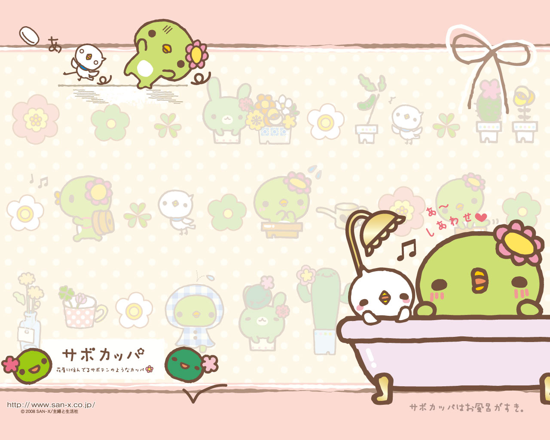
何をしますか
Nani o shimasu ka?

Slide 2
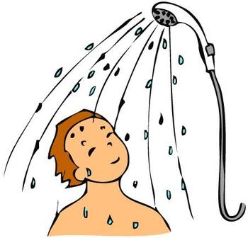
Shawa- o abimasu

Slide 3
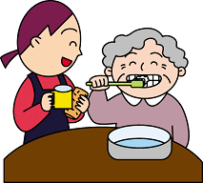
Ha o migakimasu

Slide 4
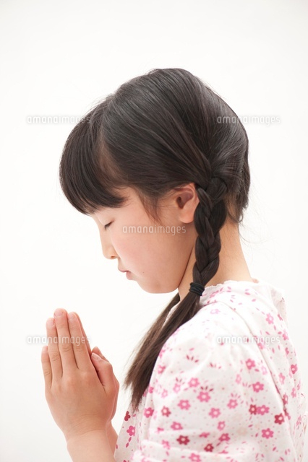
Oinori shimasu

Slide 5
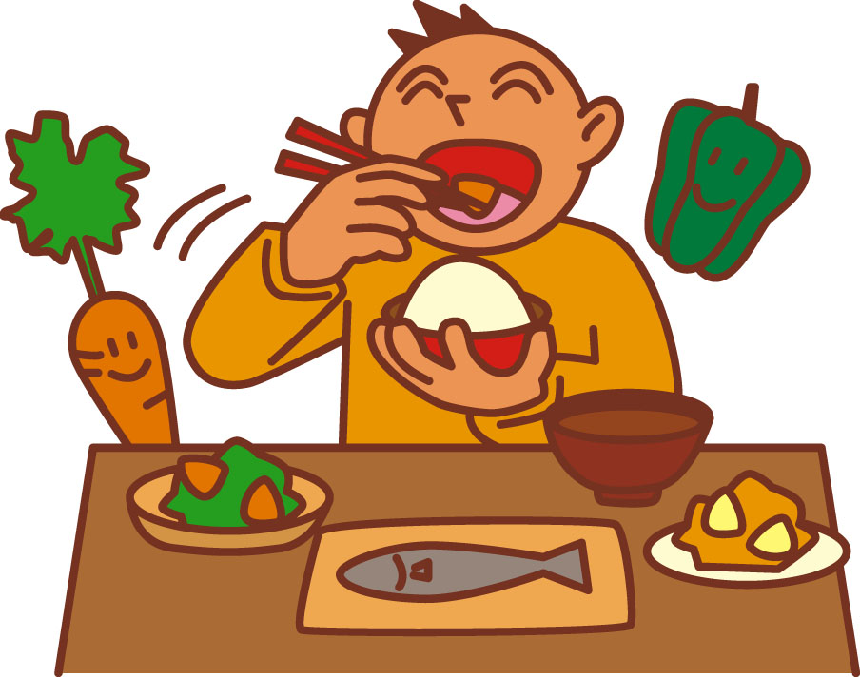
Gohan o tabemasu

Slide 6
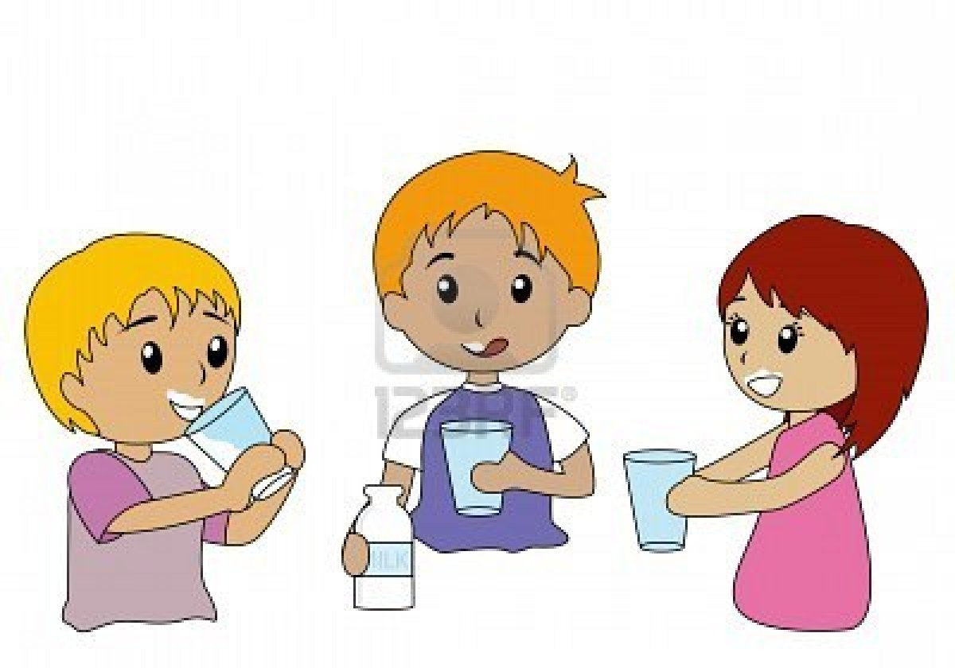
Miruku o nomimasu

Slide 7

Jyogingu shimasu

Slide 8

Shinbun o yomimasu

Slide 9
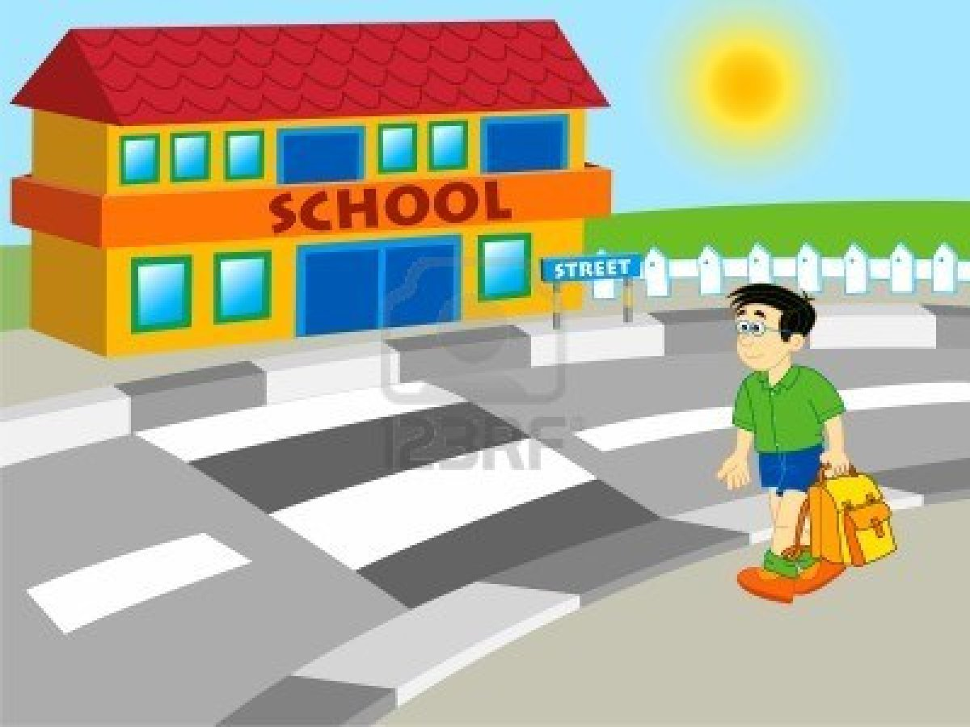
Gakkou e ikimasu

Slide 10
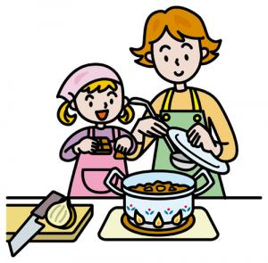
Ryouri o shimasu

Slide 11
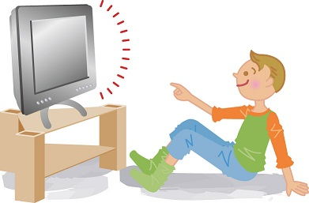
Terebi o mimasu

Slide 12
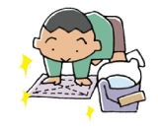
Soujishimasu

Slide 13
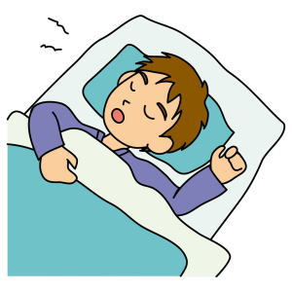
Nemasu

Slide 14
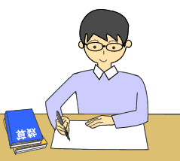
Benkyou shimasu

Slide 15
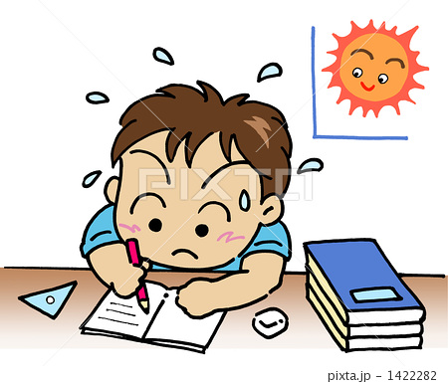
Shukudai o shimasu

Slide 16
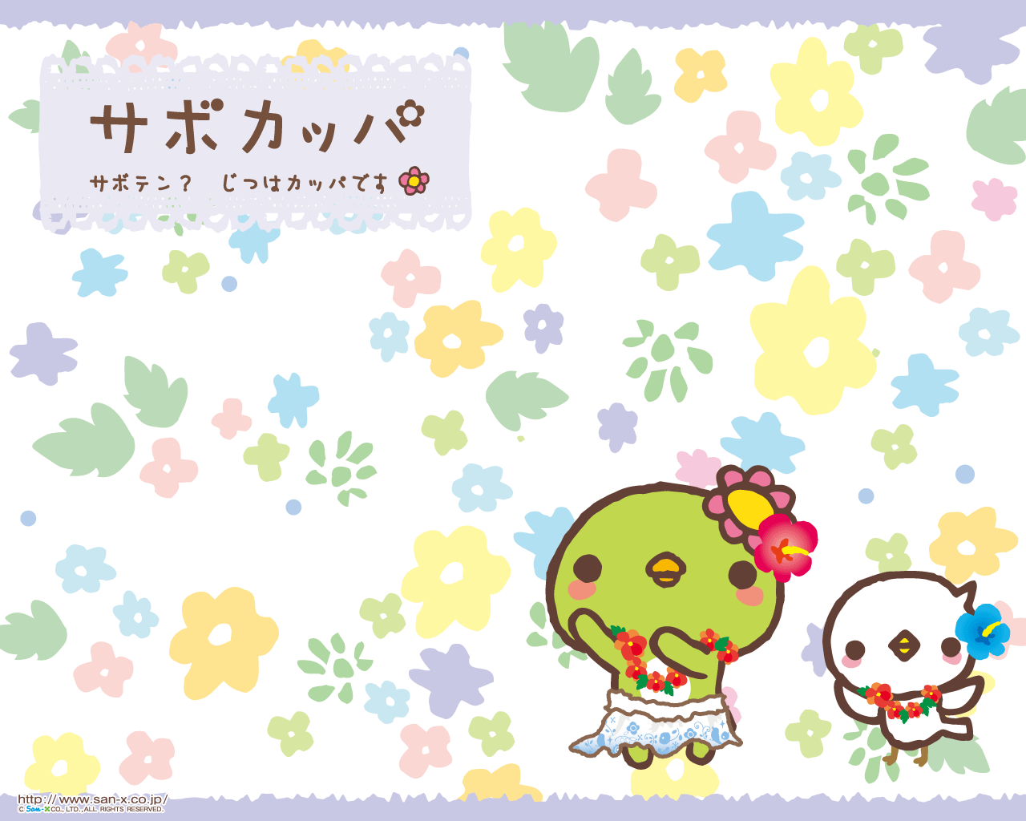
Arigatou …

