Slide 1
COUNTING THINGS

Slide 2
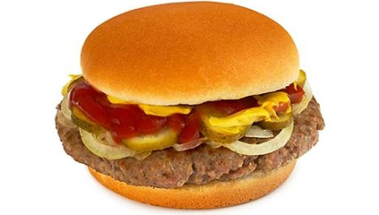
HITOTSU ひとつ

Slide 3
FUTATSU ふたつ

Slide 4
MITTSU みっつ

Slide 5
YOTTSU よっつ

Slide 6
ITSUTSU いつつ

Slide 7
MUTTSU むっつ

Slide 8
いくつ Ikutsu? How many?
hitotsu
futatsu
mittsu
yottsu
itsutsu
muttsu

Slide 9
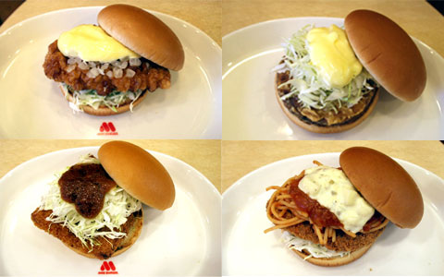
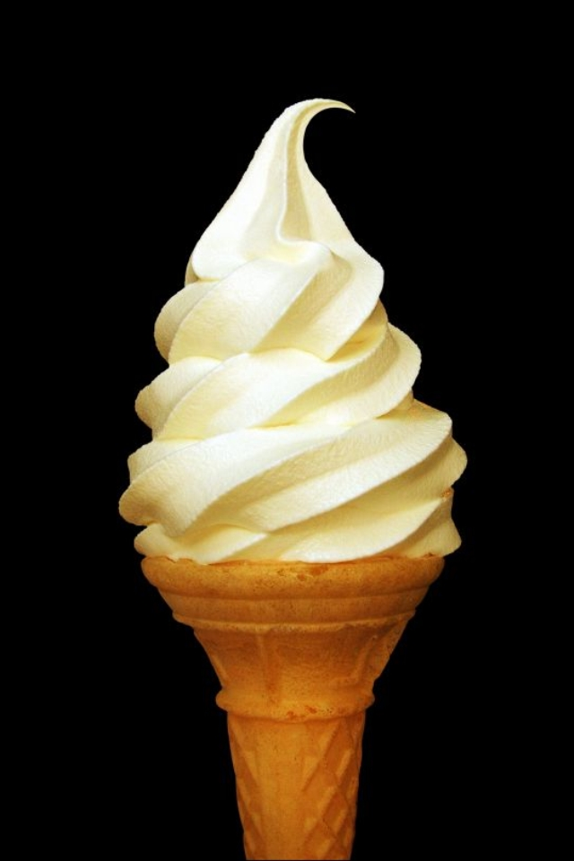
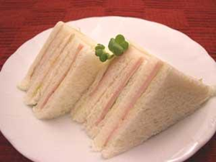
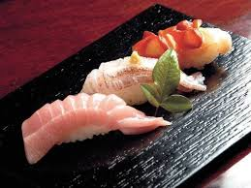
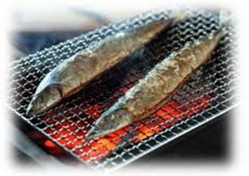
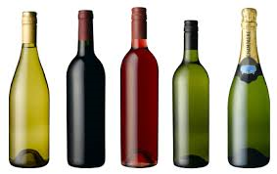
いくつ Ikutsu? How many?
yottsu
hitotsu
muttsu
mittsu
futatsu
itsutsu

Slide 10
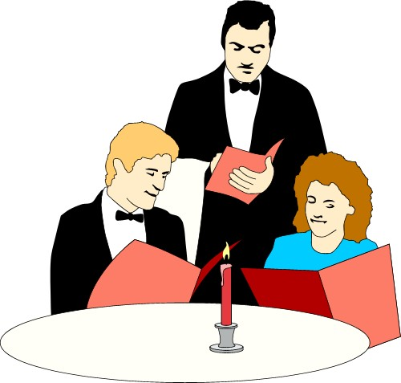
Examples:
Wain o futatsu kudasai.

Slide 11
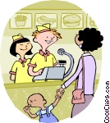
Hanbāgā o mittsu
kudasai.

Slide 12
Kōhii o hitotsu to
kōcha o hitotsu
kudasai.

Slide 13
Renshū 1
Take a picture, roll the dice and then order the food on the picture accordingly.
THING o NUMBER kudasai.
Example:
Kōra o hitotsu kudasai.
I’d like one coke please.

Slide 14
Renshū 2
Take two pictures, roll the two dice and then order the food on the pictures accordingly.
THING o NUMBER to THING o NUMBER kudasai.
Example:
Kōra o hitotsu to kōhii o hitotsu kudasai.
I’d like one coke and one coffee please.

Slide 15
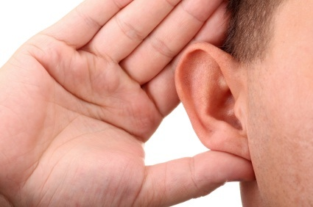
Listening!
Page 33 #7

Slide 16
Kaiwa o shimashō!
Imagine you are in a restaurant in Japan. Order some food and drinks.
Waiter: Irasshaimase!
Customer: Thing o number kudasai.
Waiter: Hai. Thing o number desu ne?
Customer: Hai, sō desu.
Level 1
Waiter: Irasshaimase! Nani ni nasaimasu ka?
Customer: Thing o number to thing o number kudasai.
Waiter: Hai. REPEAT ORDER desu ne?
Customer: Hai, sō desu.
OR Iie, chigaimasu. Thing o number kudasai.
Level 2

