Slide 1
Counting Body Parts
Ikutsu?

Slide 2
HITOTSU
Me ga hitotsu arimasu.

Slide 3
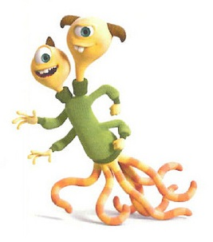
HITOTSU
FUTATSU
Atama ga futatsu arimasu.

Slide 4
HITOTSU
FUTATSU
MITTSU
Me ga mittsu arimasu.

Slide 5
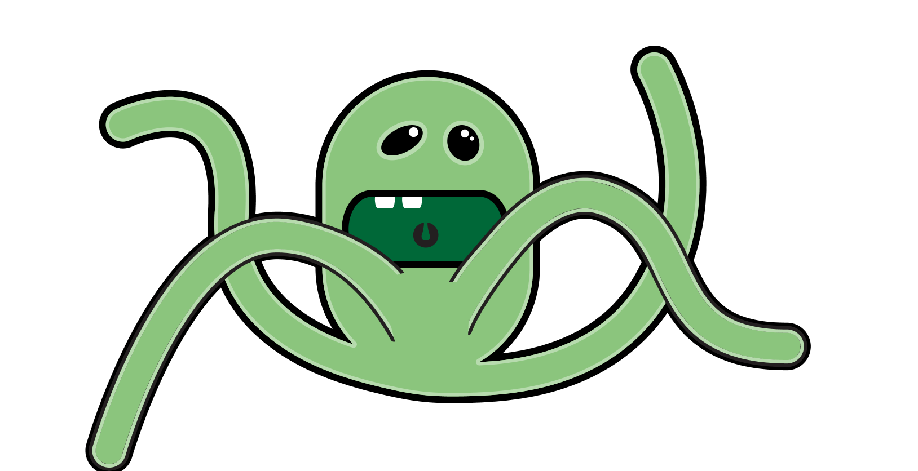
FUTATSU
HITOTSU
MITTSU
YOTTSU
Ashi ga yottsu arimasu.

Slide 6
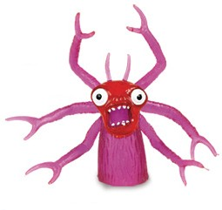
HITOTSU
FUTATSU
MITTSU
MUTTSU
ITSUTSU
YOTTSU
Ude ga muttsu arimasu.

Slide 7
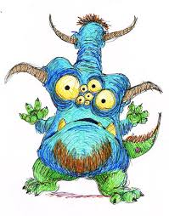
HITOTSU
FUTATSU
NANATSU
MITTSU
YOTTSU
MUTTSU
ITSUTSU
Me ga nanatsu arimasu.

Slide 8
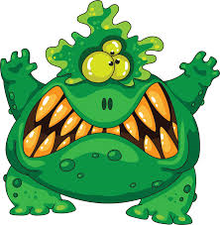
TAKUSAN
Ha ga takusan arimasu.

Slide 9
ARIMASEN
Ude ga arimasen.

Slide 10
English | Japanese
There is one | hitotsu arimasu
There are two | futatsu arimasu
There are three | mittsu arimasu
There are four | yottsu arimasu
There are five | itsutsu arimasu
There are six | muttsu arimasu
There are seven | nanatsu arimasu
There are many | takusan arimasu
There are none | arimasen
A | BODY PART ga ikutsu arimasu ka? How many BODY PARTS are there?
B | BODY PART ga NUMBER arimasu There are NUMBER of BODY PARTS.
NOTE: The ‘tsu’counter is used when counting general things. Arms and legs can also be counted using the ‘hon’ counter (long thin things) i.e. ippon, nihon, sanbon, yonhon, gohon, roppon, nanahon.

Slide 11
Ikutsu arimasu ka?
How many are there?

Slide 12
Kuchi
HITOTSU
Kuchi ga hitotsu arimasu.

Slide 13
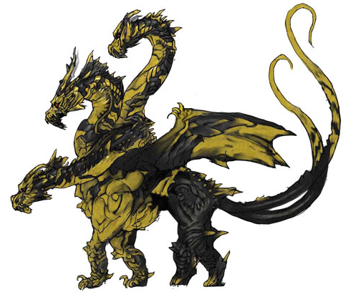
Shippo
HITOTSU
FUTATSU
Shippo ga futatsu arimasu.

Slide 14
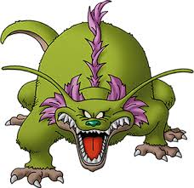
Ashi
YOTTSU
HITOTSU
MITTSU
FUTATSU
Ashi ga yottsu arimasu.

Slide 15
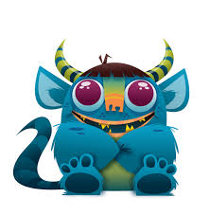
Atama
HITOTSU
FUTATSU
Tsuno ga futatsu arimasu.

Slide 16
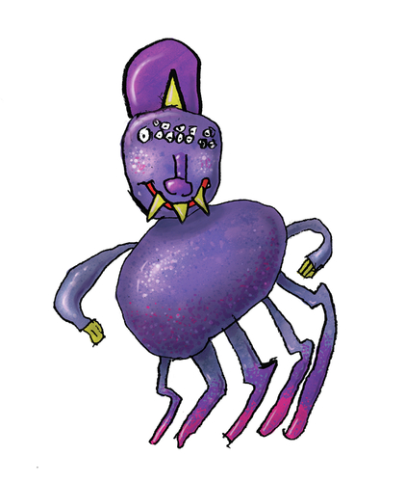
Ashi
ITSUTSU
HITOTSU
FUTATSU
MITTSU
YOTTSU
Ashi ga itsutsu arimasu.

Slide 17
Shippo
HITOTSU
Shippo ga hitotsu arimasu.

Slide 18
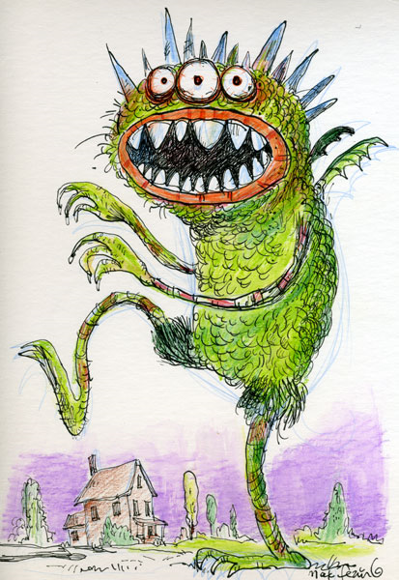
Me
FUTATSU
HITOTSU
MITTSU
Me ga mittsu arimasu.

Slide 19
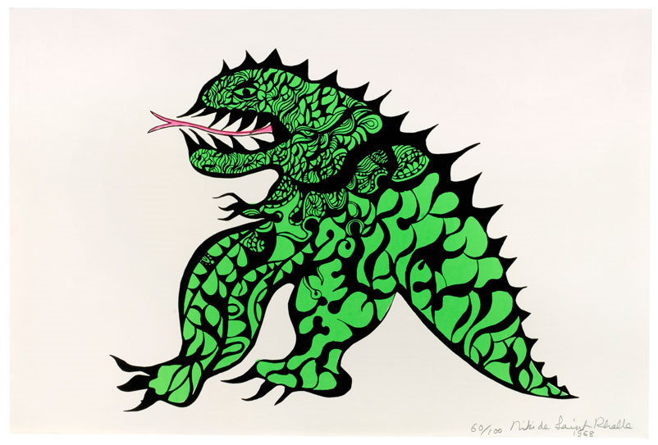
Ashi
HITOTSU
FUTATSU
Ashi ga futatsu arimasu.

Slide 20
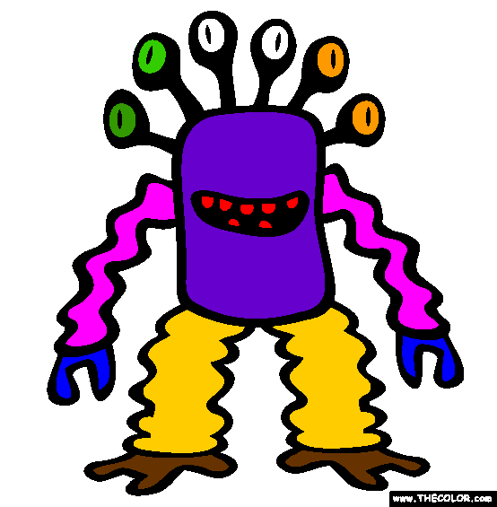
Me
FUTATSU
MITTSU
YOTTSU
HITOTSU
ITSUTSU
MUTTSU
Me ga muttsu arimasu.

Slide 21
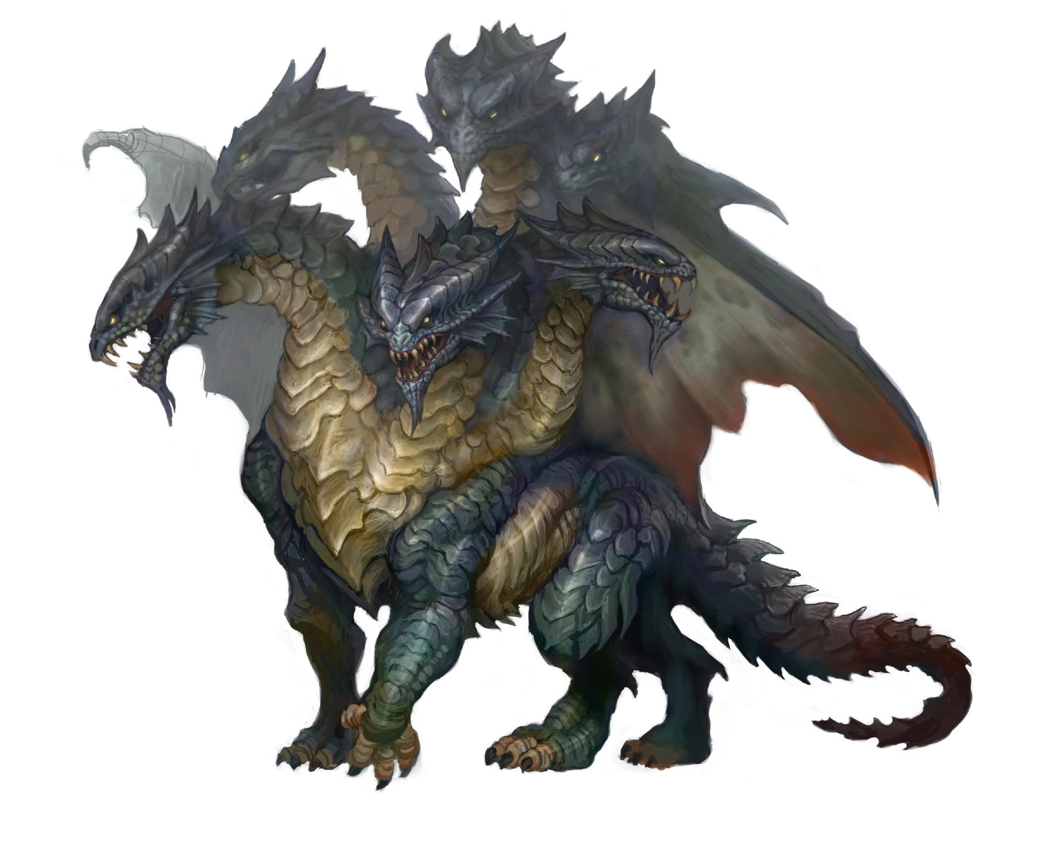
Atama
FUTATSU
MITTSU
YOTTSU
HITOTSU
ITSUTSU
MUTTSU
Atama ga muttsu arimasu.

