Slide 1
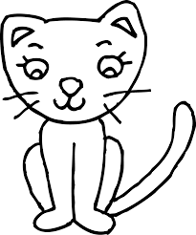
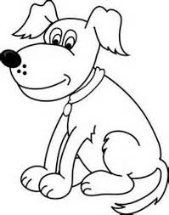
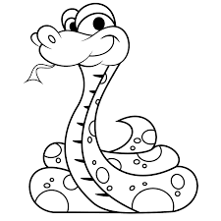
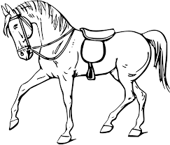
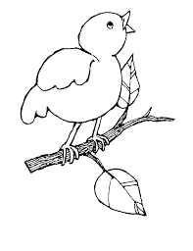
Neko wa orenji to shiro desu.
Uma wa kiiro to chairo desu.
Inu wa chairo to kuro desu.
Hebi wa ao to aka desu.
Namae : ……………………...
Watashi no petto wa _____________ desu.
Sakana wa pinku to midori desu.
Tori wa murasaki to kiiro desu.
Petto no Iro

Slide 2
