Slide 1
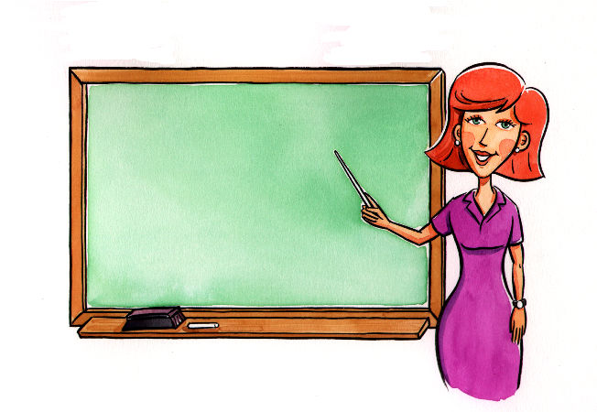
Classroom Expressions

Slide 2
Wakarimasu ka? Hai. Wakarimasu. Iie. Wakarimasen.
Do you understand?
Yes, I understand.
No, I don’t understand.

Slide 3
Shitsumon ga arimasu. Shitsumon wa arimasu ka?
I have a question.
Any questions?
?

Slide 4
Nan desu ka?
What is it?
?

Slide 5
～ wa Nihongo de, nan desu ka?
What’s ~ in Japanese?
日本語で？

Slide 6
Tetsudatte kudasai.
Please help.

Slide 7
Mō ichidō itte kudasai.
Can you repeat that please?

Slide 8
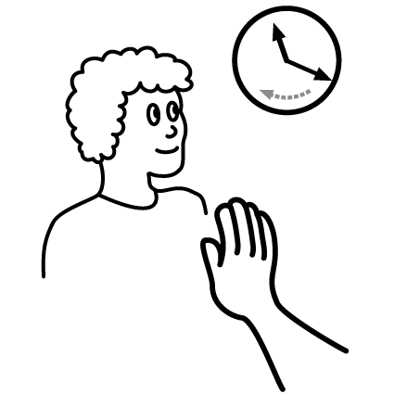
Chotto matte (kudasai).
Wait a minute.

Slide 9
Kiite kudasai.
Please listen.

Slide 10
Yonde kudasai.
Please read.

Slide 11
Mite kudasai.
Please look.

Slide 12
Kaite kudasai.
Please write down.

Slide 13
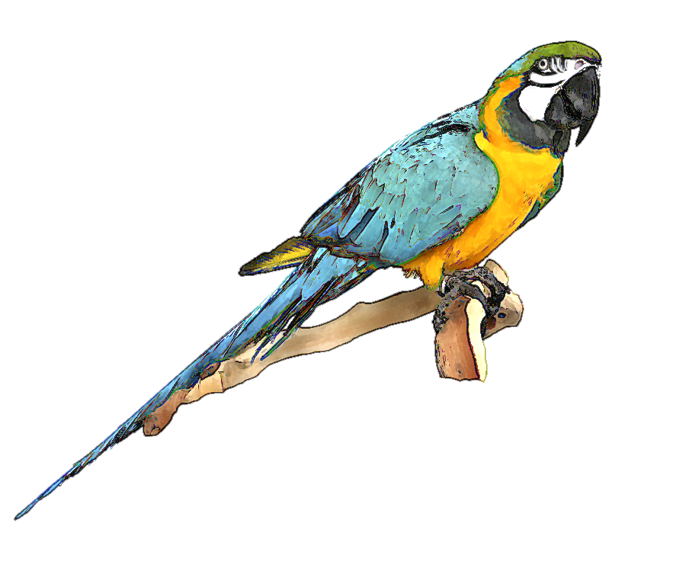
Kurikaeshite kudasai.
Repeat after me.
くりかえして
くりかえして

Slide 14
Te o agete kudasai.
Hands up.

Slide 15
Futarigumi ni natte kudasai.
Please form pairs.

Slide 16
Yatte mite kudasai.
Try and do it please.

