Slide 1
Japanese Public Transport

Slide 2
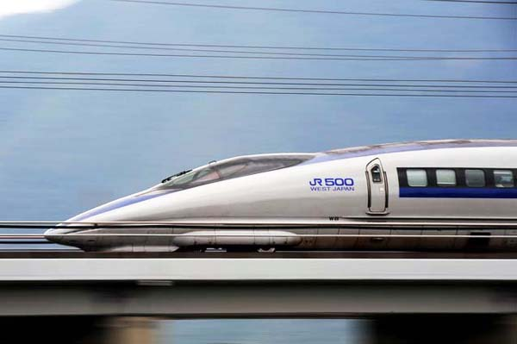
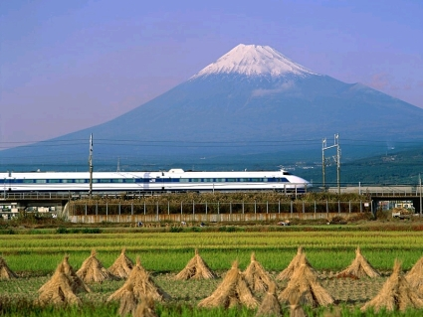
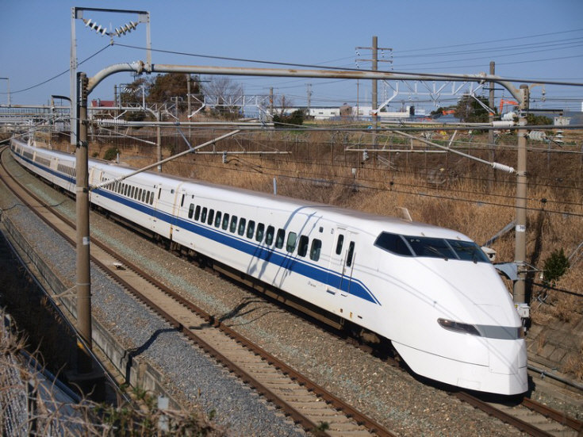
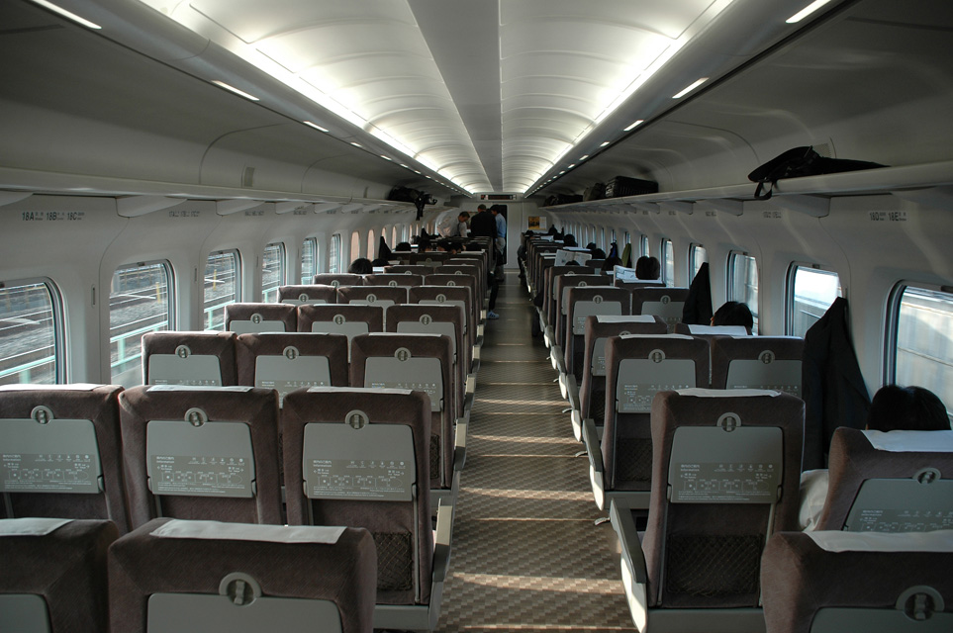
Shinkansen しなかんせん

Slide 3
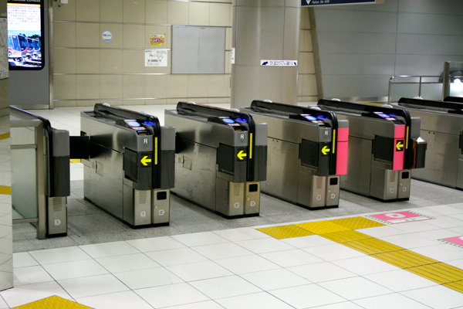
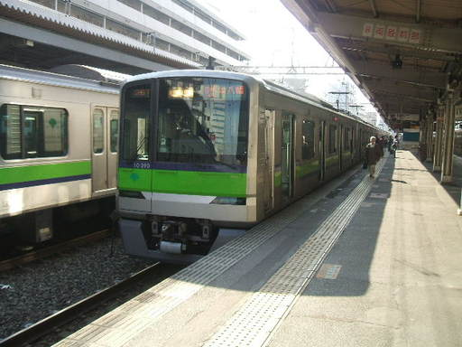
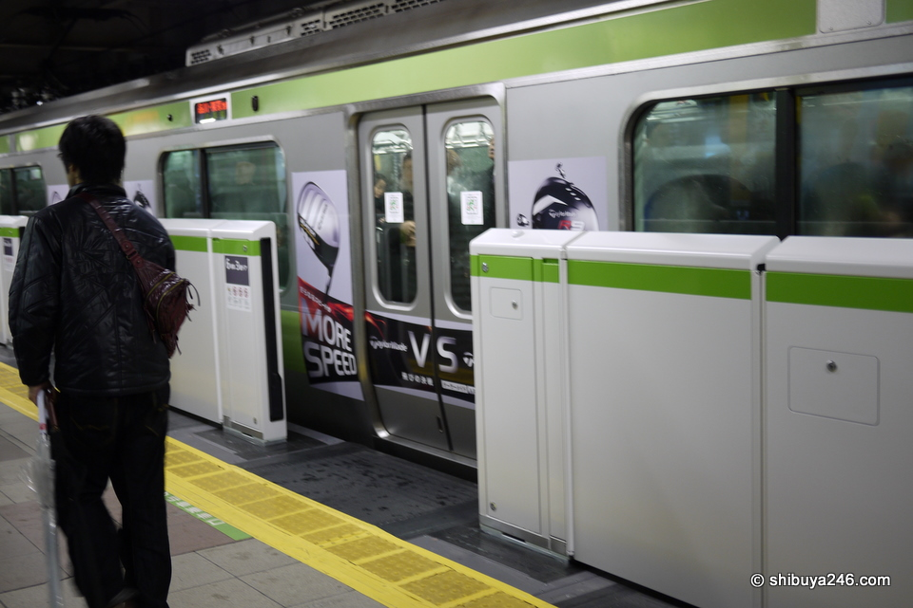
DENSHA でんしゃ

Slide 4
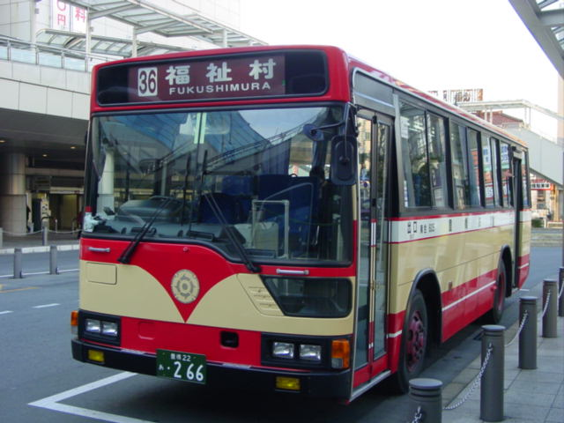
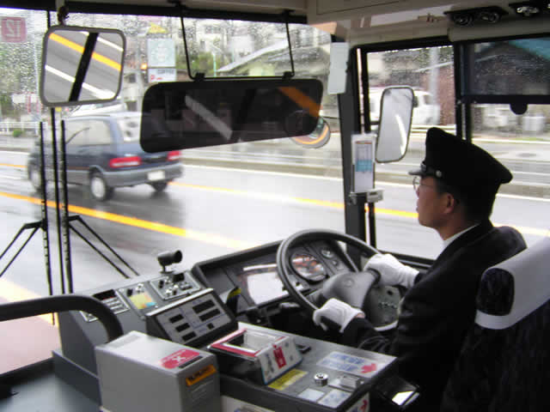
Basu バス

Slide 5
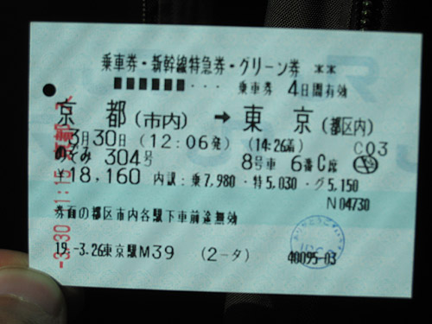
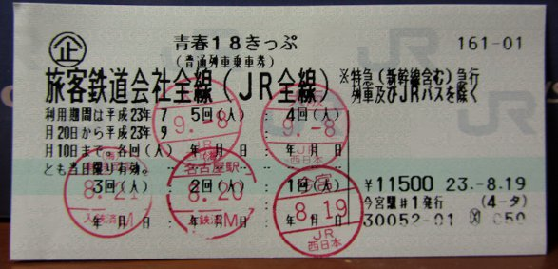
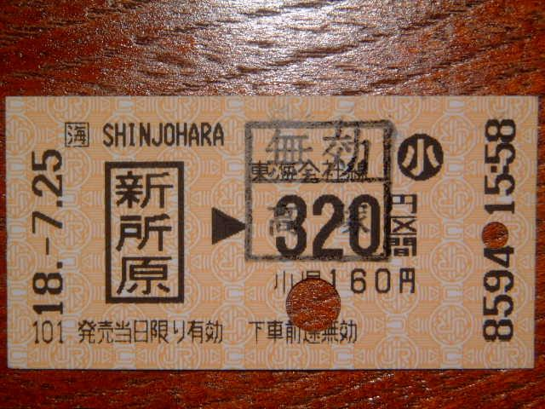
Kippu 切符 きっぷ

Slide 6
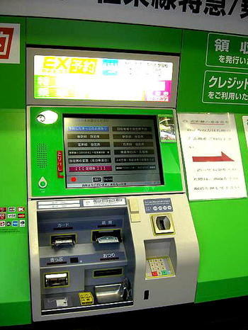
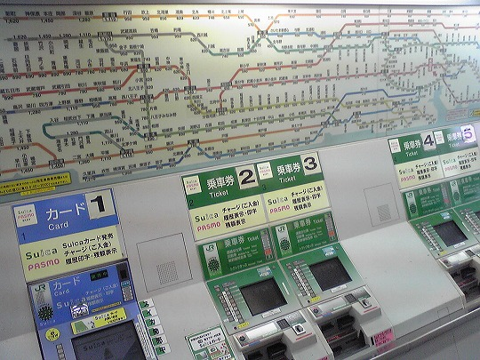
JIDōHanbaiki 自動販売機 じどうはんばいき

Slide 7
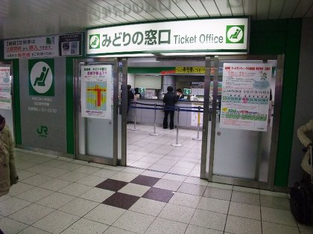
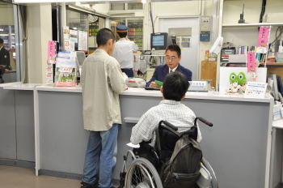
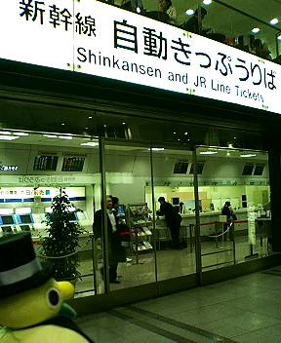
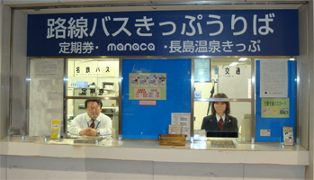
Kippu-uriba きっぷうりば

Slide 8
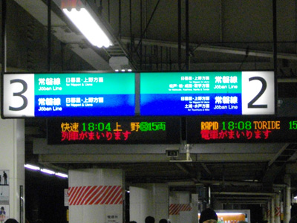
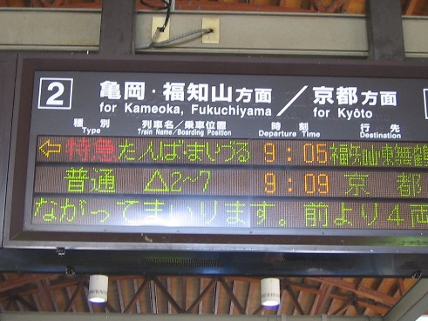
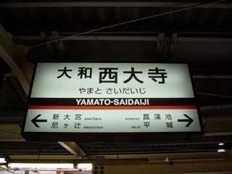
BANSEN 番線 ばんせん

Slide 9
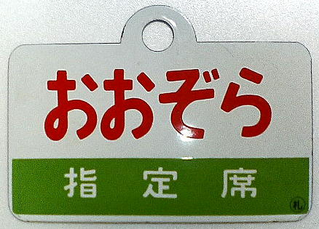
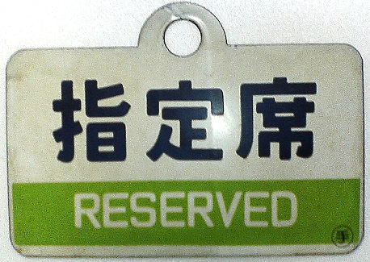

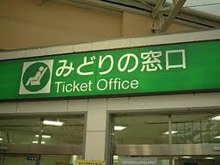
Shiteiseki 指定席 していせき

Slide 10
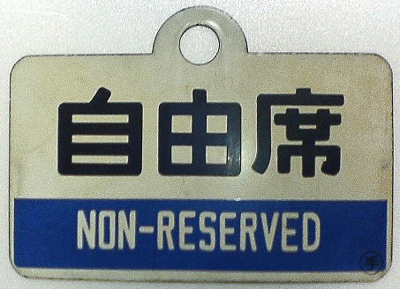
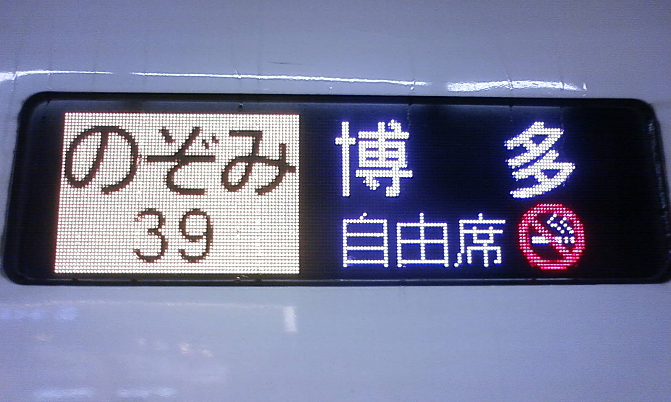
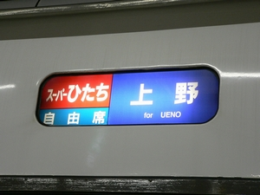
JIYŪseki 自由席 じゆうせき

Slide 11





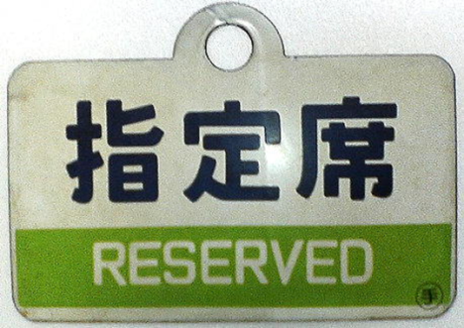

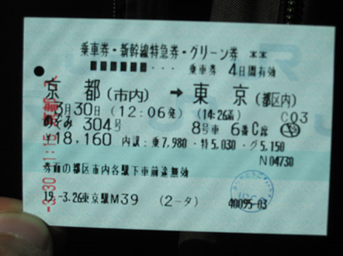


Slide 12
Ima nan ji?
What’s the time?

Slide 13
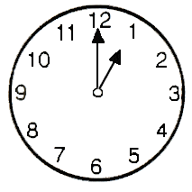
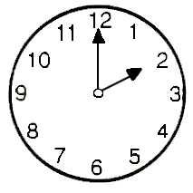
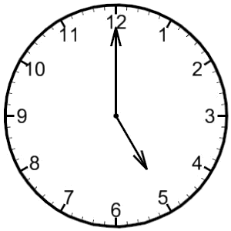
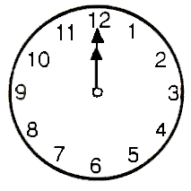
o’clock (HOURS)
NUMBER + JI
Ichi ji = 1 o’clock
NOTE:
Exception
YO JI
NOT YON JI
How would we say these times?

Slide 14
o’clock (HOURS)
NUMBER + JI
Ni ji = 2 o’clock
Go ji = 5 o’clock
Juu ni ji = 12 o’clock

Slide 15
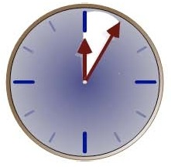
minutes
MINUTES ending in 5 + FUN
5 fun | Go fun | 5 minutes
15 fun | Juu go fun | 15 minutes
25 fun | Ni juu go fun | 25 minutes
35 fun | San juu go fun | 35 minutes
45 fun | Yon juu go fun | 45 minutes
55 fun | Go juu go fun | 55 minutes

Slide 16
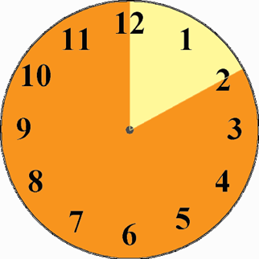
minutes
MINUTES ending in 10 + JUP-PUN
10 pun | Jup-pun | 10 minutes
20 fun | Ni jup-pun | 20 minutes
30 fun | San jup-pun | 30 minutes
40 fun | Yon jup-pun | 40 minutes
50 fun | Go jup-pun | 50 minutes

Slide 17
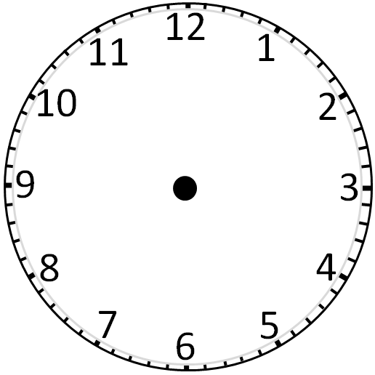
go juu go fun
go fun
yon juu go fun
juu go fun
san juu go fun
ni juu go fun

Slide 18
Go jup-pun
Jup-pun
Yon jup-pun
Ni jup-pun
San Jup-pun

Slide 19
JI
go juu go fun
go fun
Go jup-pun
Jup-pun
yon juu go fun
juu go fun
Yon jup-pun
Ni jup-pun
san juu go fun
ni juu go fun
San Jup-pun

Slide 20
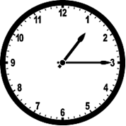
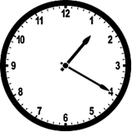
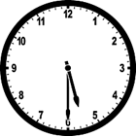

TIME
HOUR + JI + MINUTES + FUN/PUN
Ichi ji Juu go fun = quarter past 1
How would we say these times?

Slide 21
How do we say the following times?
Let’s practise…

Slide 22
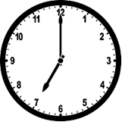

Slide 23
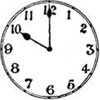

Slide 24
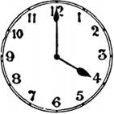

Slide 25
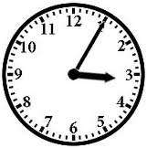

Slide 26
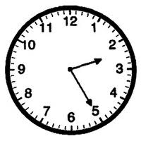

Slide 27
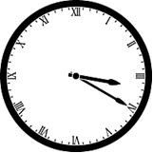

Slide 28
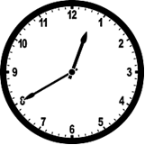

Slide 29
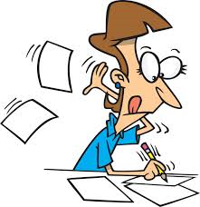
Renshuu o shimashou! (Let’s practice)
- Time worksheet

Slide 30
When’s the next train to…
GRAMMAR STRUCTURE
Q: Tsugi no PLACE yuki wa nan-ji desu ka?
A: TIME-ji desu.
Example:
Tsugi no Yokohama yuki wa nan-ji desu ka?
Jū-san-ji desu.

Slide 31
When does it arrive?
GRAMMAR STRUCTURE
Q: PLACE wa nan-ji ni tsukimasu ka?
A: PLACE wa TIME-ji ni tsukimasu.
Example:
Q: Yokohama wa nan-ji ni tsukimasu ka?
A: Yokohama wa Jū-ji ni tsukimasu.

Slide 32
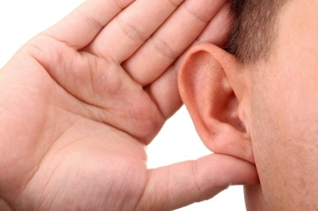
Listening!
Page 80 - #2 and #3

Slide 33
It’s your turn!

Slide 34
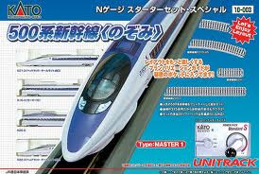
Sanyo Shinkansen 参与新幹線
Station駅 | Train No.電車 | Train No.電車 | Train No.電車
 | Nozomi 200 | Nozomi 128 | Nozomi 42
Kyoto 京都 | 06:40 | 13:30 | 17:50
Nagoya 名古屋 | 06:50 | 14:20 | 18:30
Shin-Fuji 新富士 | ǁ | ǁ | ǁ
Shin-Yokohama 新横浜 | 08:10 | 15:30 | 19:50
Tokyo 東京 | 08:35 | 15:55 | 20:30
*All seats in ordinary cars are non-reserved during weekdays. However, some seats are reserved on Saturdays, Sundays and national holidays.
Adapted from: http://english.jr-central.co.jp/info/timetable/

Slide 35
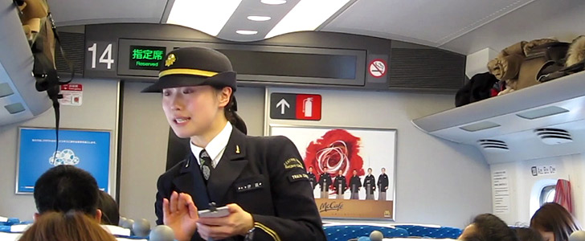
Buying train tickets

Slide 36

ichi mai

Slide 37

ni mai

Slide 38
san mai

Slide 39
Two one-way tickets…
GRAMMAR STRUCTURE
PLACE made katamichi o NUMBER mai kudasai.
ōfuku
Example:
Yokohama made katamichi ni mai
Tōkyō made ōfuku o ichi mai kudasai.

Slide 40
How much is it to…?
GRAMMAR STRUCTURE
Q: PLACE made ikura desu ka?
A: (PLACE made) PRICE-en desu.
Example:
Yokohama made ikura desu ka?
Hyaku go ju en desu.

Slide 41
Listening!
Page 81 - #5 and #6 (not a)

Slide 42
At the Kippu-uriba…
You are at the Kippu-uriba at Narita Airport. How would you ask for:
2 one-way tickets Tokyo
1 return ticket Kyoto
1 reserved ticket Hiroshima
3 unreserved tickets Osaka
When next train Shinjuku
How much Yokohama
When does train arrive in Yokohama

Slide 43
Does this train go to…
GRAMMAR STRUCTURE
Q: Kono TRANSPORT wa PLACE e ikimasu ka?
A1: Hai, ikimasu.
A2: Iie, ikimasen.
Example:
Kono densha wa Yokohama e ikimasu ka?
Kono basu wa Tōkyō e ikimasu ka?

Slide 44
Which platform…?
GRAMMAR STRUCTURE
Q: PLACE yuki wa nan-ban sen desu ka?
A: NUMBER ban sen desu.
Example:
Yokohama yuki wa nan-ban sen desu ka?
Ni ban sen desu yo.

Slide 45
Listening!
Page 82 - #3

Slide 46
At the Kippu-uriba…
You are at the Kippu-uriba at Narita Airport. How would you ask for:
Train arriving - go to Kyoto
Which platform Nagano
What time is the next train to Kobe
How much Yokohama
When does train arrive in Shibuya

Slide 47
Kaiwa o shimashō!
Imagine you are travelling around Japan. Find out train arrival and departure times, ticket prices and platform numbers.
Q1
Q: Sumimasen, tsugi no PLACE yuki wa nan-ji desu ka?
A: TIME ji desu.
Q: Sumimasen, PLACE wa nan-ji ni tsukimasu ka?
A: TIME ni tsukimasu.
Q 2
Q: Sumimasen, PLACE made ikura desu ka?
A: PRICE-en desu.
Q 3
Q: Sumimasen, PLACE yuki wa nan-ban sen desu ka?
A: NUMBER ban sen desu.
Q 4

Slide 48


