Slide 1
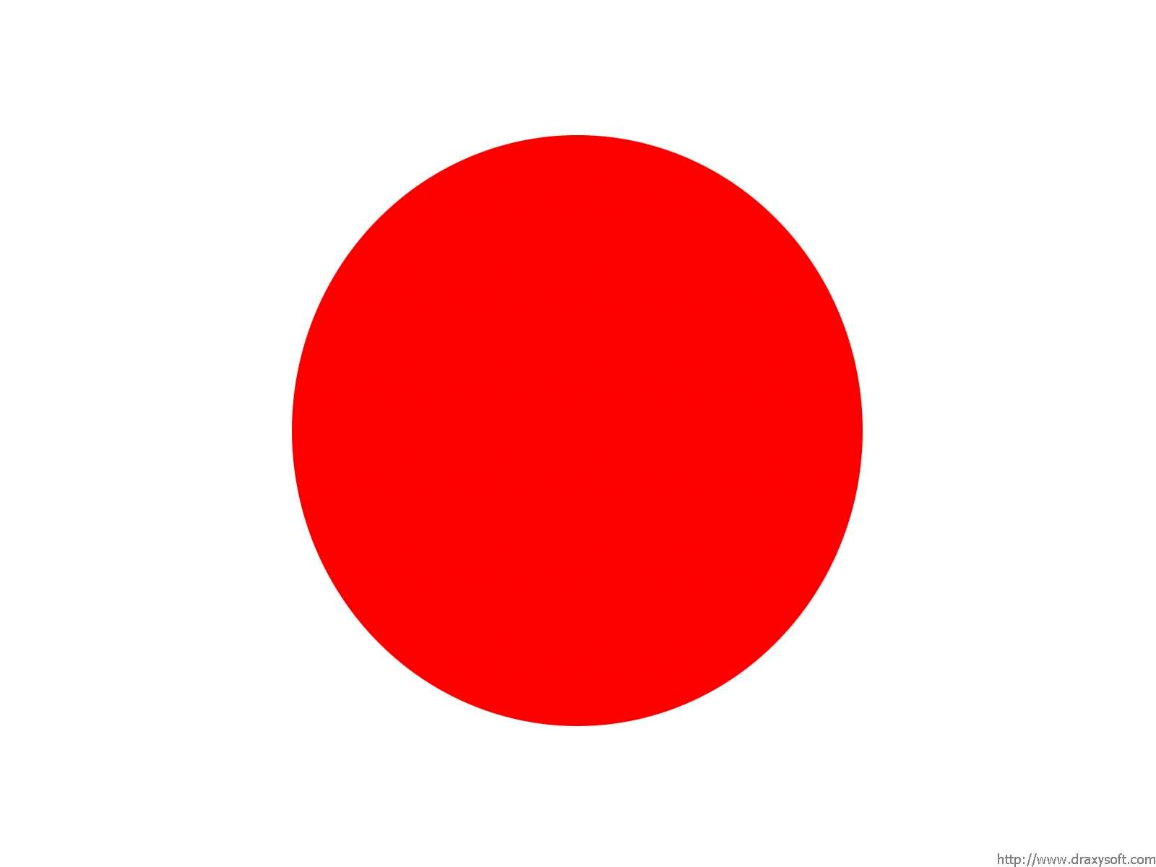
Age

Slide 2
Age
GRAMMAR STRUCTURE
Watashi wa (Number for age) sai desu.
I years old
“Watashi wa” can be removed altogether
Example:
Watashi wa go sai desu.
Watashi wa nana sai desu.

Slide 3
Irregular Numbers - Age
えいご | 日本語 | Kanji かんじ
1 year old | issai | 一才
2 years old | nisai | 二才
3 years old | sansai | 三才
4 years old | yonsai | 四才
5 years old | gosai | 五才
6 years old | rokusai | 六才
7 years old | nanasai | 七才
8 years old | hassai | 八才
9 years old | kyuusai | 九才
10 years old | jussai | 十才
11 years old | juissai | 十一才
12 years old | junisai | 十二才

Slide 4
Watashi wa hassai desu.

Slide 5
Boku wa jussai desu.

Slide 6
Watashi wa san sai desu.

Slide 7
It’s Your Turn!

Slide 8
Nan sai desu ka?

Slide 9
Remember!
Watashi wa (Number for age) sai desu.

