Slide 1

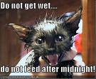
Petto!
かわいい か こわい？
ka wa i i Ko wa i
Cute or SCARY?

Slide 2



Cute…
かわいい
ka wa i i
The boys in Hawaii are cute!
The girls in Hawaii are cute!

Slide 3
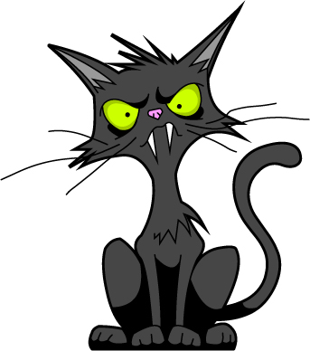
Scary…
こわい
ko wa i

Slide 4
Big…
おおきい
o o ki i
Ook, he’s big!

Slide 5
Small…
ちいさい
chi i sa i
A chicks size is small!

Slide 6
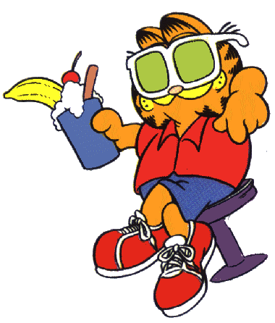
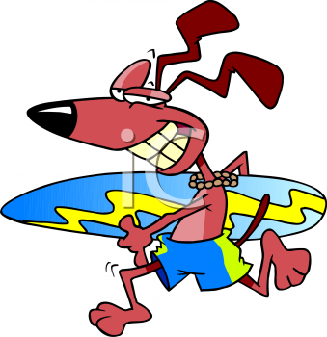
Cool / Great / Amazing/ etc...…
すごい！
su go i

Slide 7
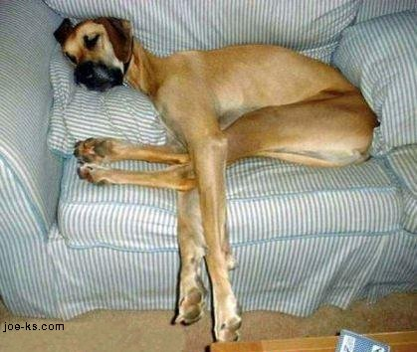
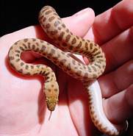
Long…
ながい
na ga i

Slide 8


Noisy…
うるさい
You’re a siren!
u ru sa i

Slide 9
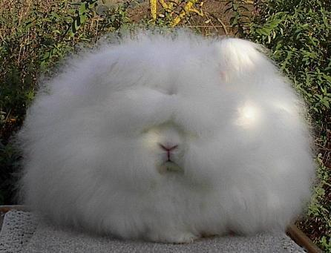
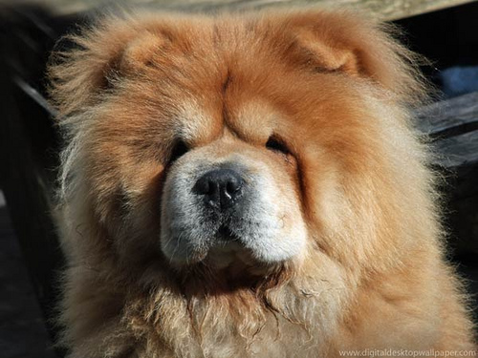
Fluffy…
ふわふわ
fu wa fu wa

Slide 10
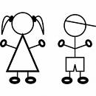
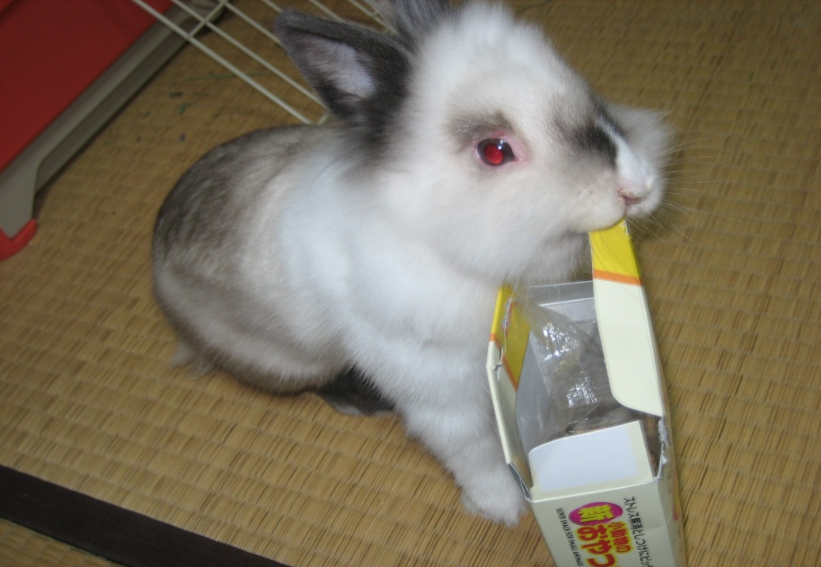
Commenting on pets…
kawaii desu ne。
She’s cute, isn’t she?
Sou desu ne。
(Yes, she is.)

Slide 11
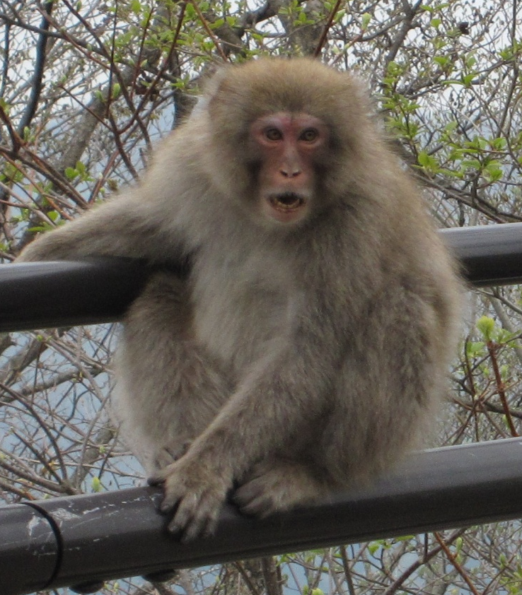
Commenting on pets…
kowai desu ne。
It’s scary, isn’t it?
sou desu ne。
(Yes, it is.)

Slide 12
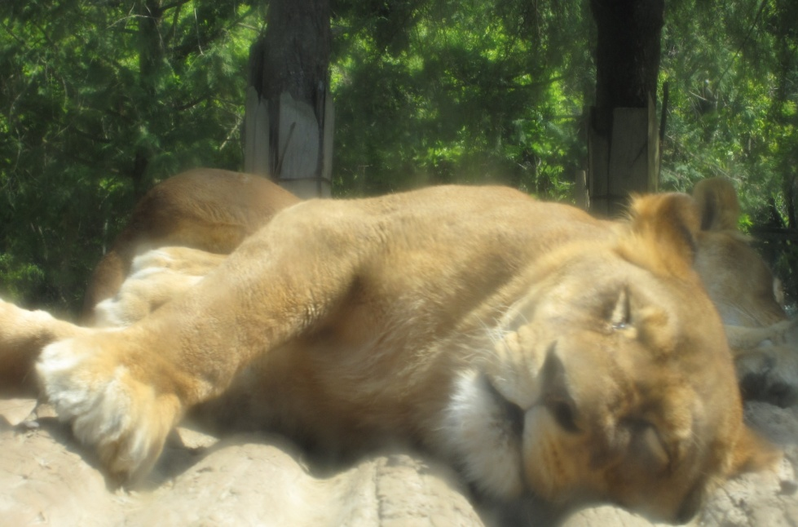
Commenting on pets…
ookii desu ne。
It’s big, isn’t it?
sou desu ne。
(Yes, it is.)

Slide 13

Commenting on pets…
kawaii desu ne。
It’s cute, isn’t it?
iie!
(No!)

Slide 14
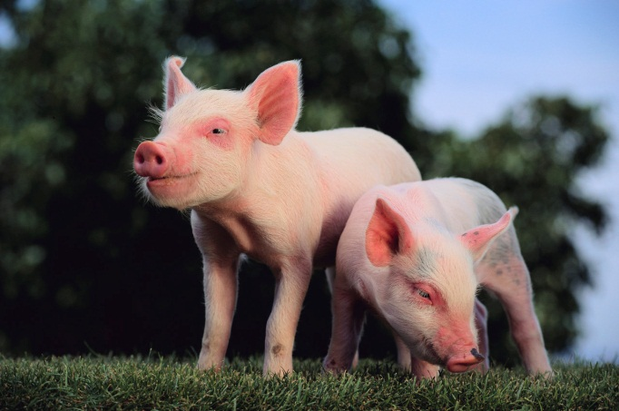
Write these down…...
kawaii - cute
kowai - scary
ookii - big
chiisai – small
sugoi – cool / great
nagai – long
urusai - noisy
fuwafuwa - fluffy
________ desu ne. – It’s _____, isn’t it.
Sou desu ne. - Yes, it is.
Iie! - No!

