Slide 1
Name

Slide 2
My name is ….
GRAMMAR STRUCTURE
Watashi no namae wa (NAME) desu.
My name
‘Boku’ can replace ‘Watashi’ – only for boys!
Surname before first name
Example:
Watashi no namae wa Mary desu.
Watashi no namae wa Smith John desu.

Slide 3
I am ….
GRAMMAR STRUCTURE
Watashi wa (NAME) desu.
I
Example:
Watashi wa Mary desu.
Boku wa Smith John desu.

Slide 4
Watashi wa Michiko desu.

Slide 5
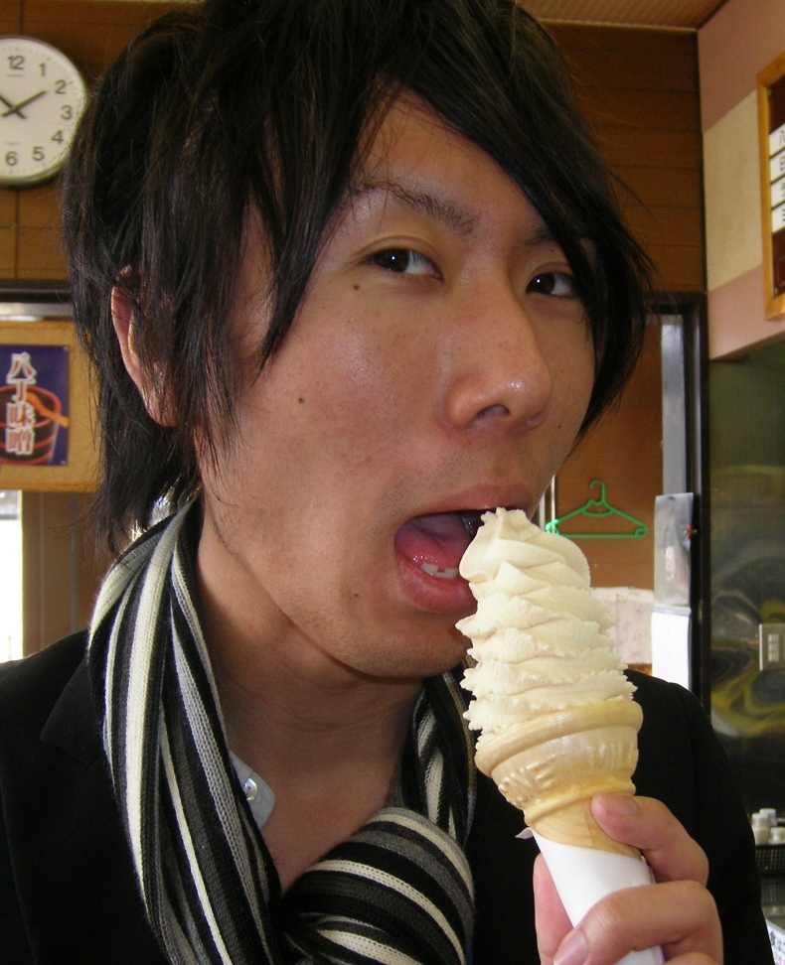
Boku wa Mitsu desu.

Slide 6
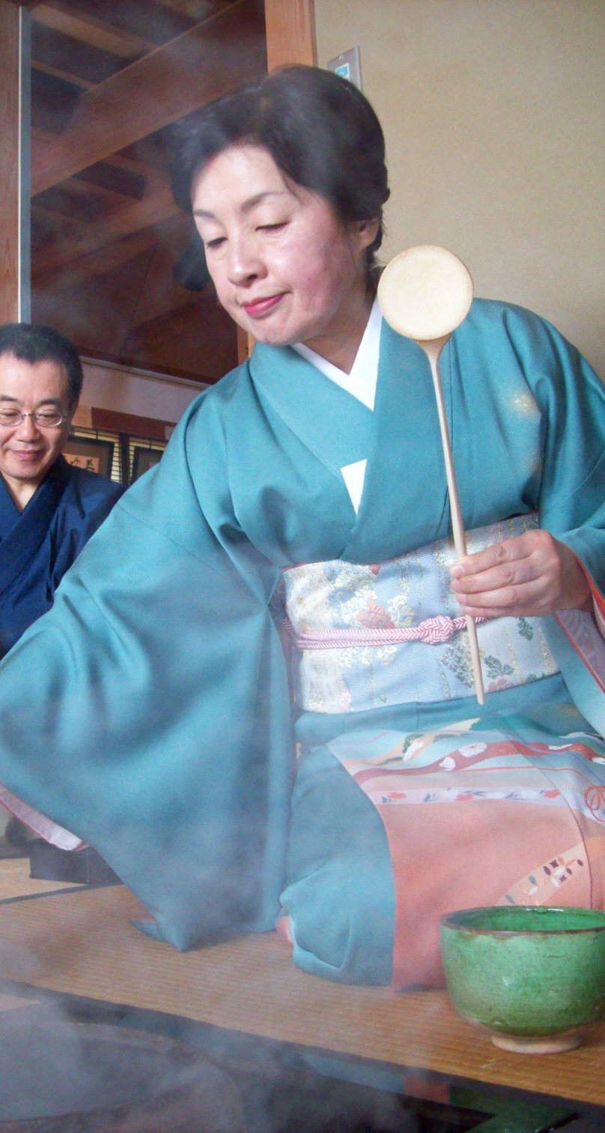
Watashi no namae wa Toyoda Fuyuko desu.

Slide 7
It’s Your Turn!

Slide 8
Onamae wa nan desu ka?

Slide 9
Remember!
Watashi no namae wa (NAME) desu.
OR
Watashi wa (NAME) desu.

