Slide 1
Hobbies

Slide 2
My hobby is ….
GRAMMAR STRUCTURE
Watashi no shumi wa (hobby) desu.
My hobby
‘Watashi no’ can be removed
Example:
Watashi no shumi wa ikebana desu.
shumi wa tenisu desu.

Slide 3
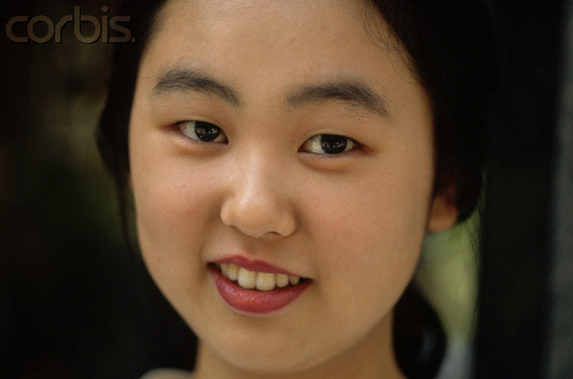
Watashi no shumi wa piano desu.

Slide 4
Boku no shumi wa karate desu.

Slide 5
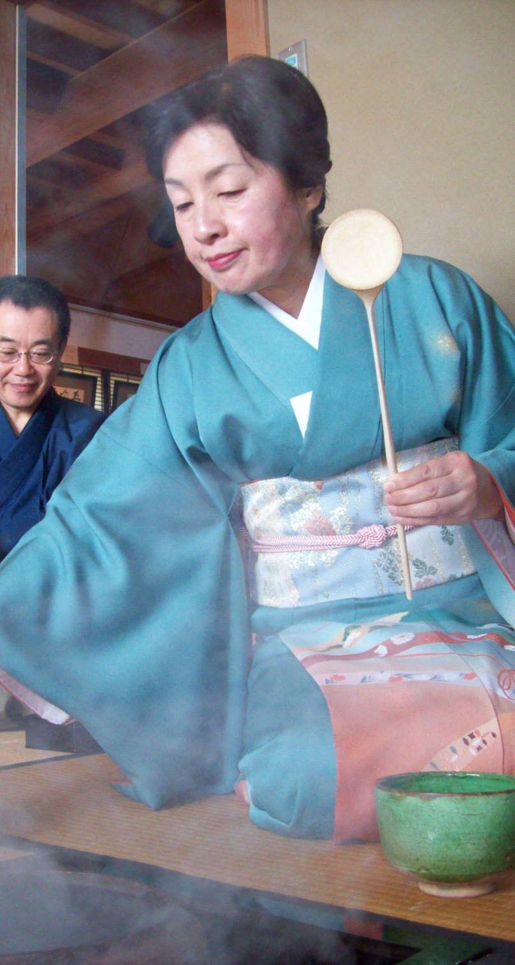
shumi wa sadō desu.

Slide 6
It’s Your Turn!

Slide 7
shumi wa nan desu ka?

Slide 8
Remember!
Watashi no shumi wa (hobby) desu.

Slide 9
Let’s Play ‘Dare desu ka?’

Slide 10
Instructions
Walk around the room and ask your classmates what their hobby is in Japanese ONLY:
Say: “Shumi wa nan desu ka?” = what is your hobby?
Your classmate must answer:
Say: “Shumi wa _________ desu”
(Only choose a hobby from the sheet that matches yours)
3. Make sure you record the person’s name in the blank for that hobby. If it is already taken ask the question again or move on to someone else.

