Slide 1
じどうはんばき
Vending machines

Slide 2
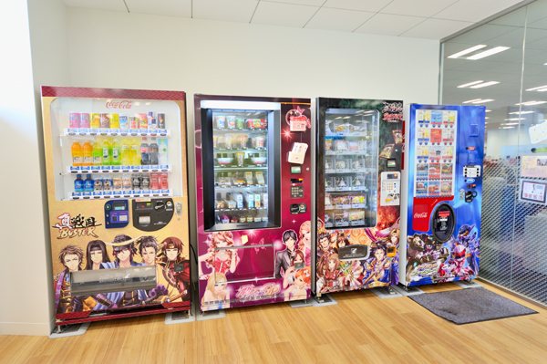
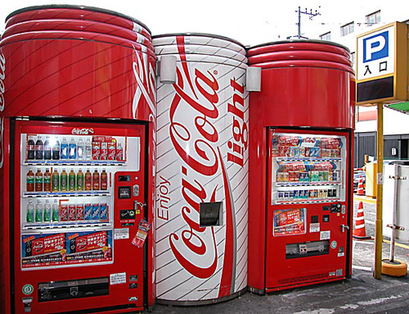
自動販売機 じどうはんばいき
What things do you think you can you buy in a じどうはんばいき？
There are more than 20 million じどうはんばいき
in Japan.

Slide 3
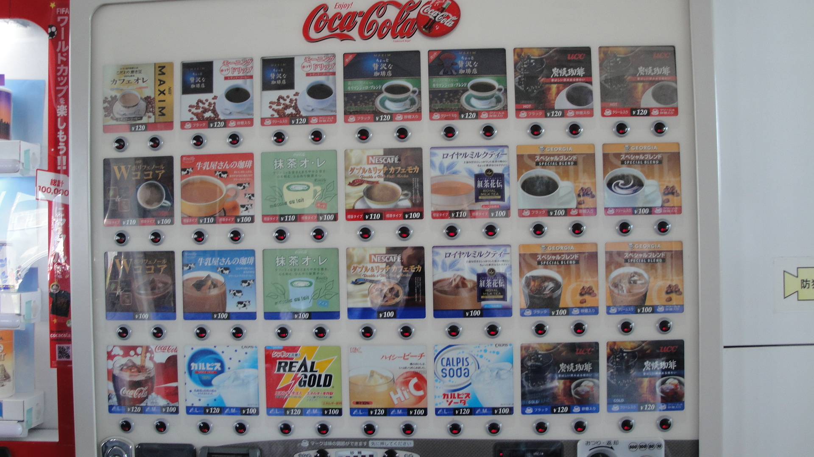
コーヒー

Slide 4
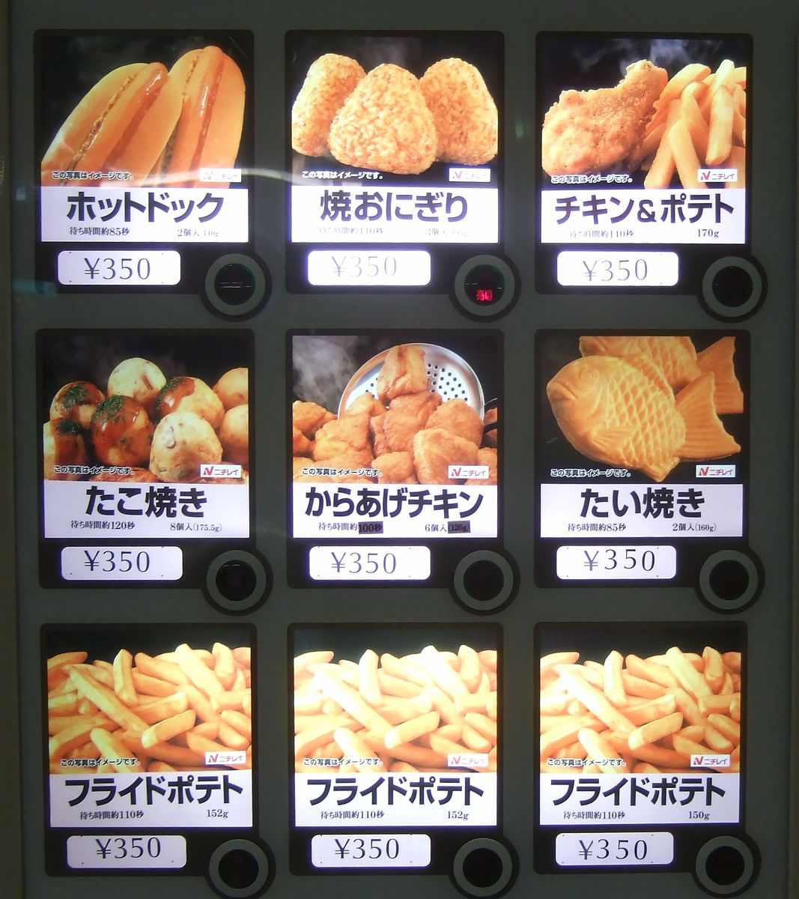
Hot food

Slide 5
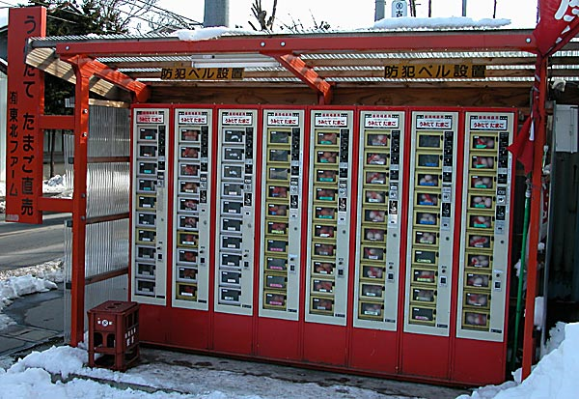
たまご

Slide 6
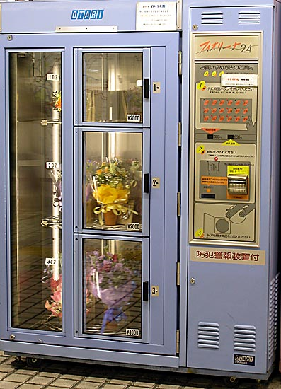
はな

Slide 7
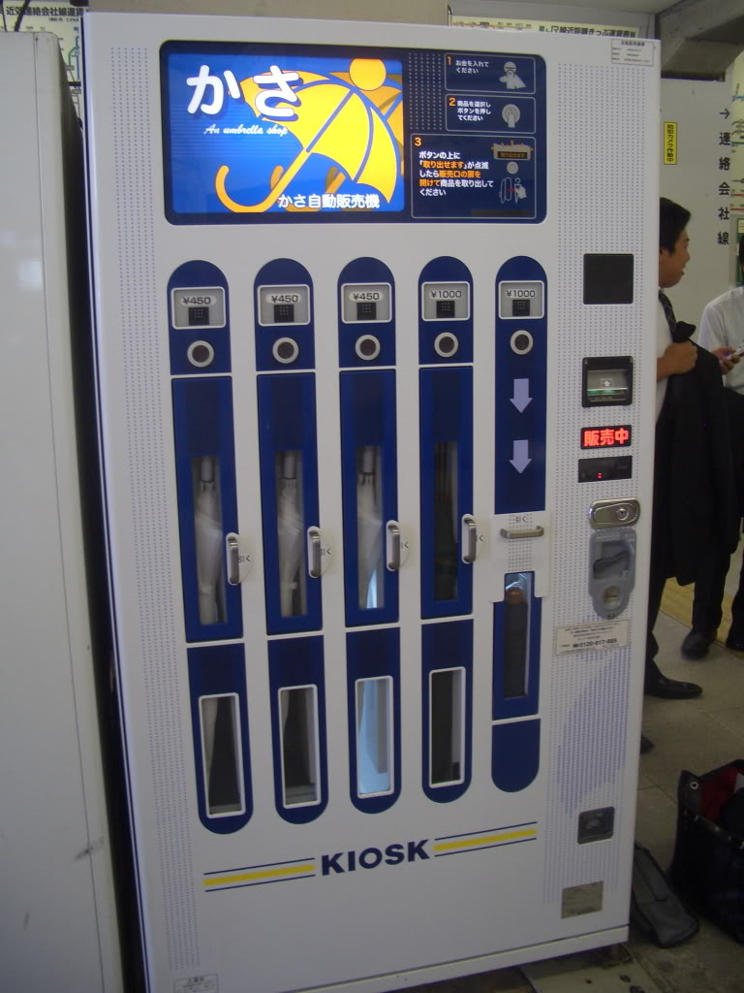
かさ

Slide 8
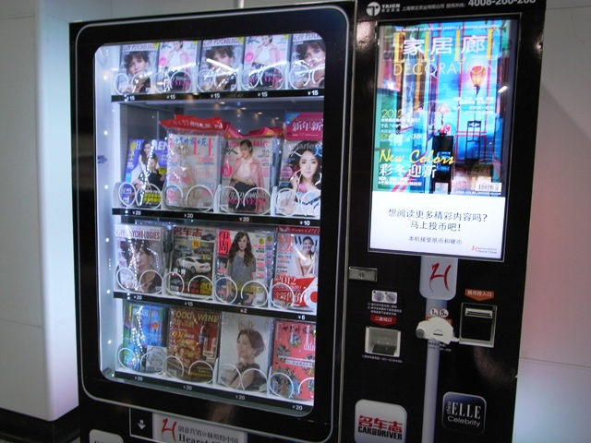
さっし

Slide 9
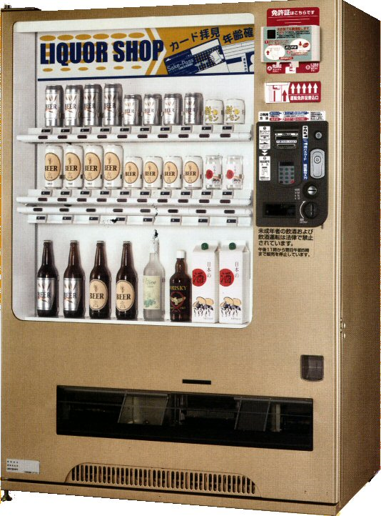
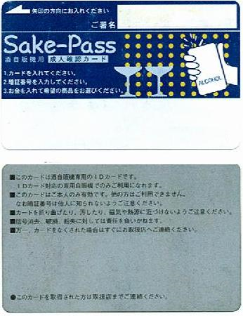
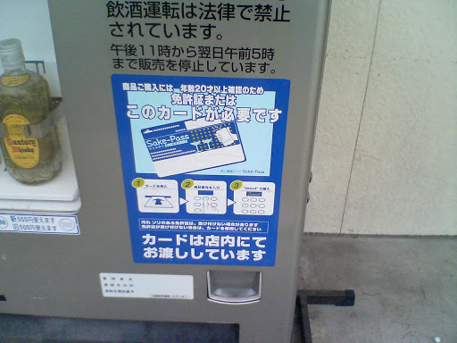
Vending machines that sell alcoholic beverages are usually switched off at 23:00. Increasingly, these machines, especially those located near schools, require the use of a special "Sake Pass" (酒パス・カード) obtainable at the city hall of the city the machine is located in. The pass is available to anyone of twenty years of age or over, the age of maturity in Japan.
ビール

Slide 10
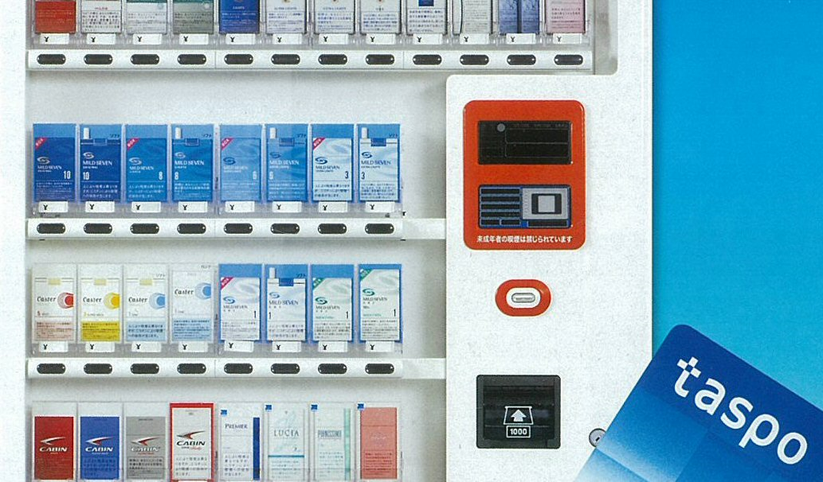
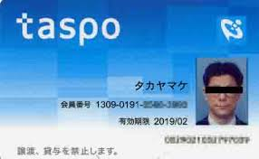
たばこ

Slide 11
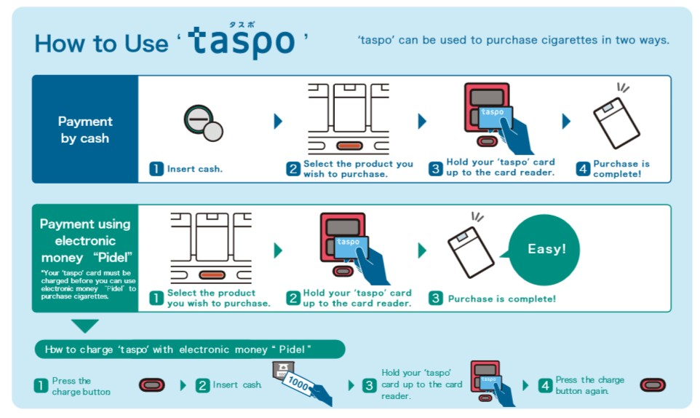
http://www.taspo.jp/english/pdf/taspo_en.pdf

