Slide 1
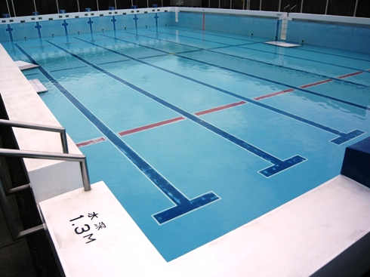
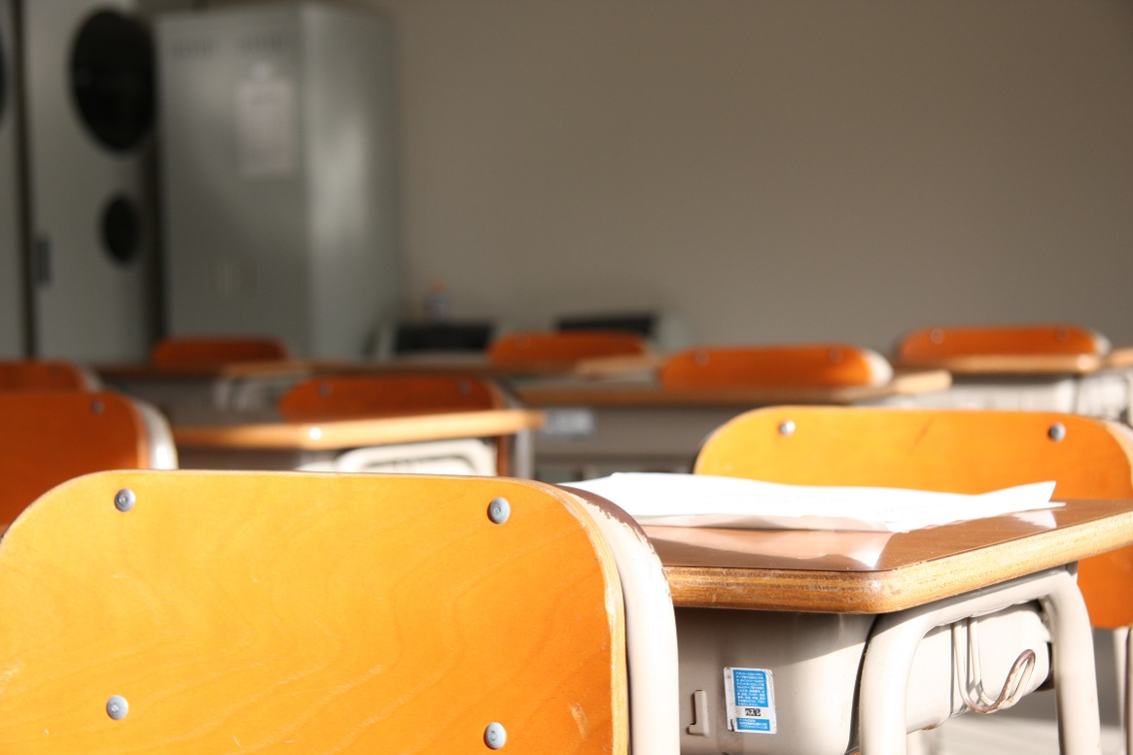
にほんのがっこう nihonnogakkou

Slide 2
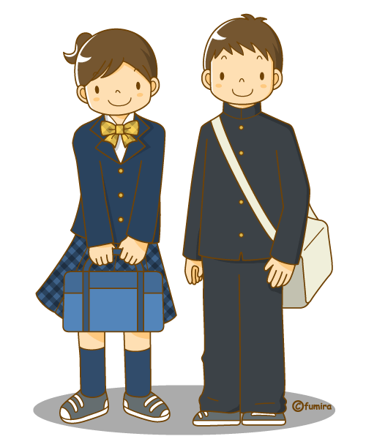
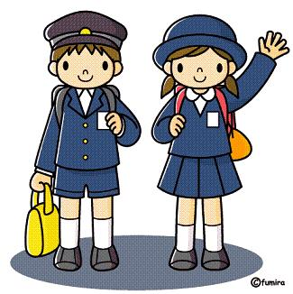
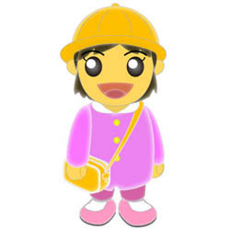
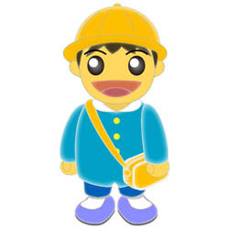
Japanese school system
ようちえん ほいくえん :youchien
Hoikuen
kindergarten
しょうがっこう
:shougakkou
Primary school
ちゅうがっこう
:chuugakkou
Middle school
Age :１～５
Age: ６～１２
Age :１２～１５

Slide 3
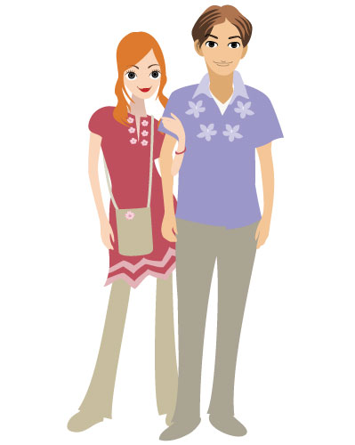
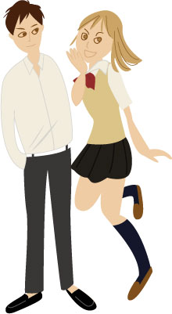
こうこう
：koukou
High school
だいがく
:daigaku
university
Age : 15～18
Age ：18～22
We have to take an entrance examination.

Slide 4
1st term: April ~ middle of July
Summer vacation: middle of July ~ August
2nd term: September ~ middle of December
Winter vacation: middle of December ~ January
3rd term: January ~ middle of March
Spring vacation: middle of March ~ April
1st term: April ~ middle of August
Summer vacation: middle of August ~ October
2nd term: October ~ middle of December
Winter vacation: middle of December ~ January
3rd term: January ~ middle of March
Spring vacation: middle of March ~ April

Slide 5
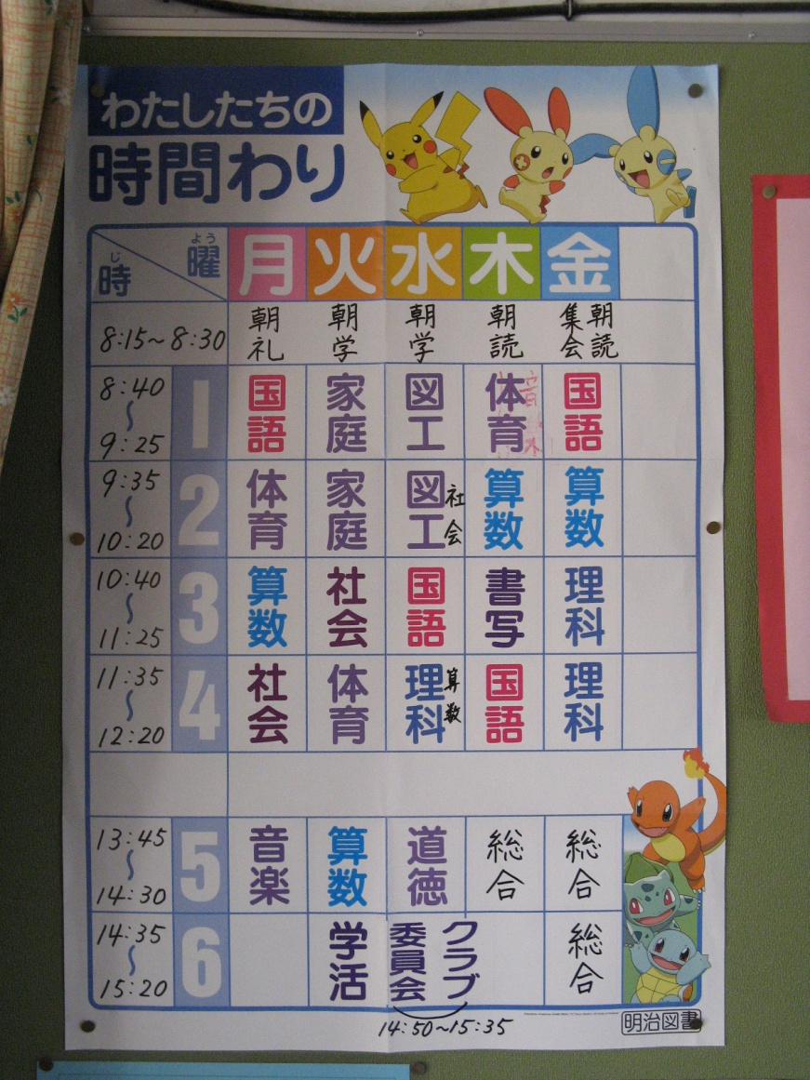
じかんわり ： jikanwari
しょうがっこう
8:15~8:30 | Reading a book, study or meeting
8:40~9:25 | 1st period
9:35~10:20 | 2nd period
10:40~11:25 | 3rd period
11:35~12:20 | 4th period
12:25~13:10 | Lunch
13:15~13:40 | Cleaning time
13:45~14;30 | 5th period
14:35~15:20 | 6th period

Slide 6
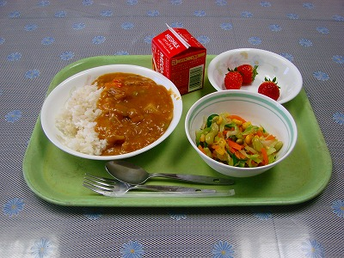
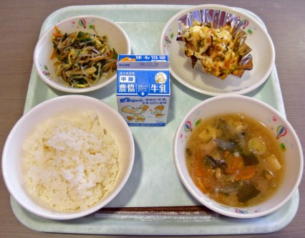
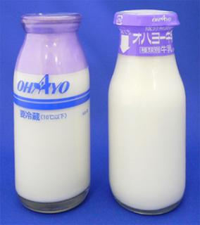
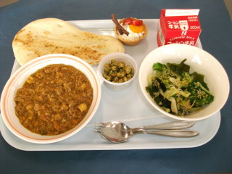
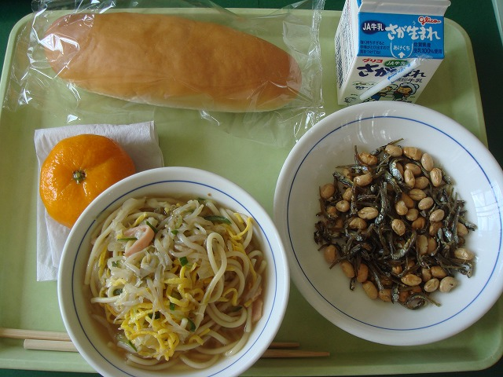
きゅうしょく ： Kyuushoku

Slide 7
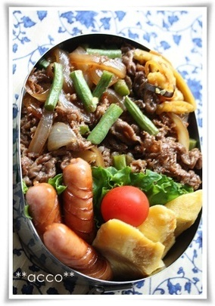
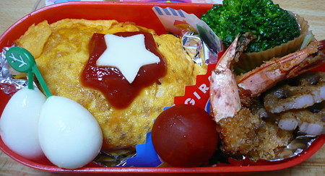
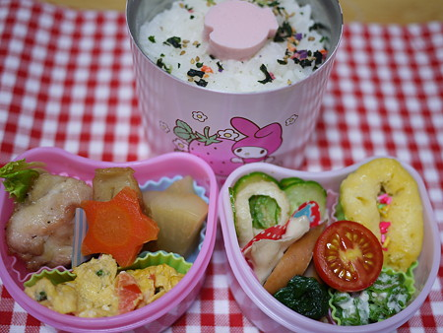
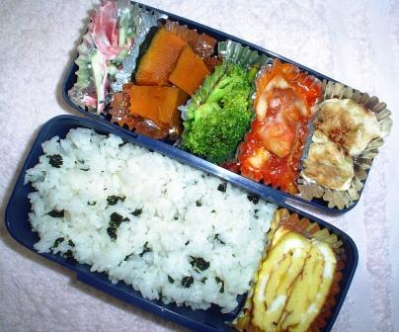
べんとう ： bentou

Slide 8
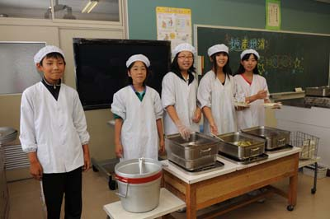
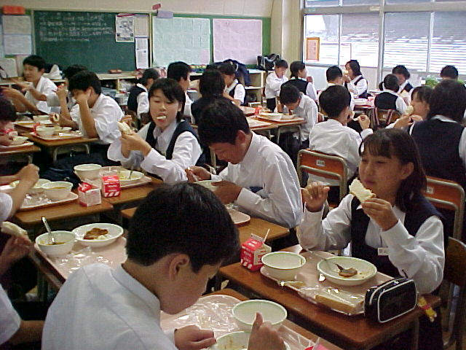
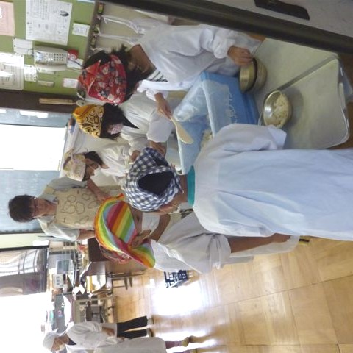
きゅうしょくのじかん ： kyuushokunojikan
We eat lunch in the classroom!!
We take turns in serving lunch to our classmates!!

Slide 9
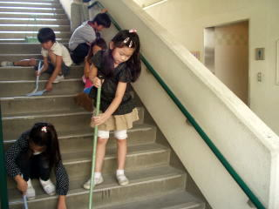
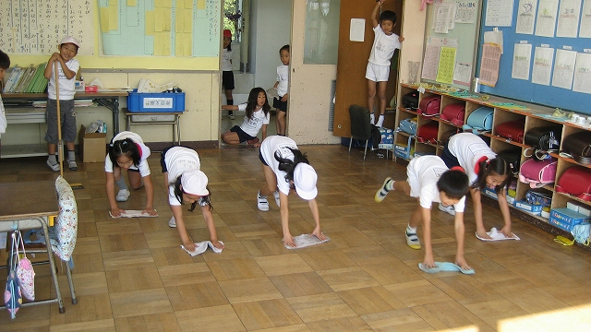
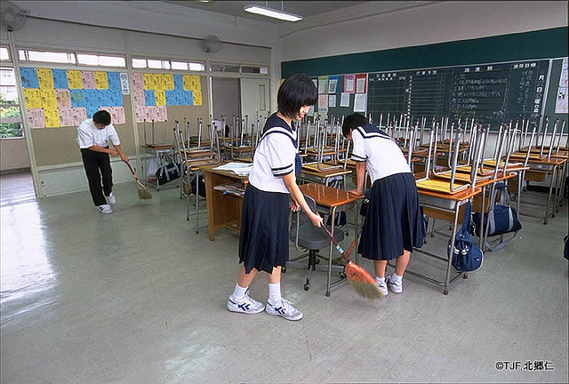
そうじのじかん ： soujinojikan
We clean everyday!

Slide 10
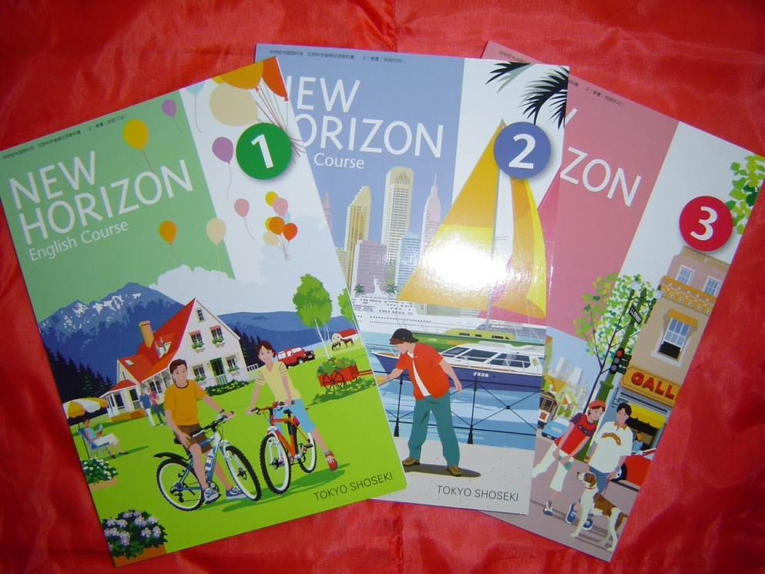
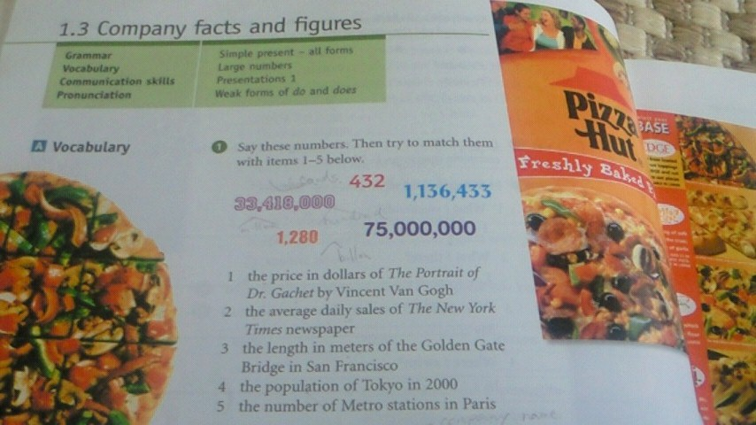
えいごのきょうかしょ ： eigonokyoukasho

Slide 11
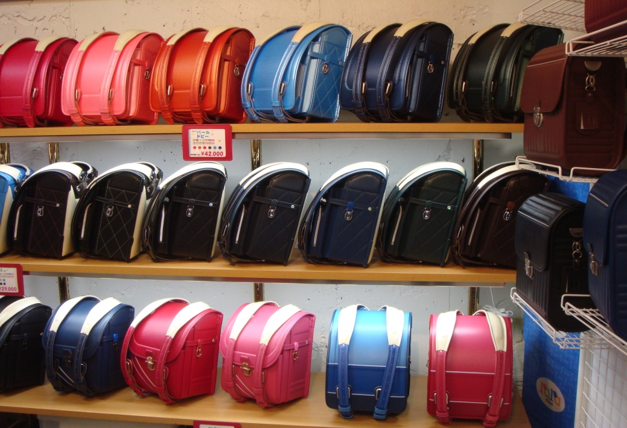
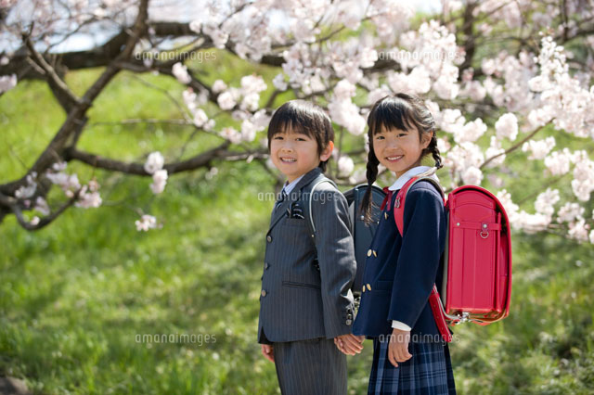
ランドセル ： randoseru

