Slide 1
In my town there is a…
Machi ni ___ ga arimasu.

Slide 2
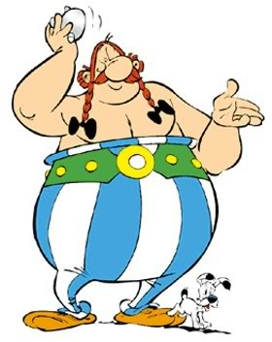
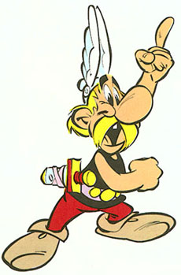
Machi ni ____ ga arimasu =
In my town there is a ______.
(We are Learning to ...)
(What I’m looking for...)
To know at least 8 places in town.
To understand what there is/isn’t
You know and can say at least 8 places in town.
You know how to say what there is/isn’t
A challenge for starters…
Can you remember the words below?
1. Toshokan 2. eigakan 3. kawa

Slide 3
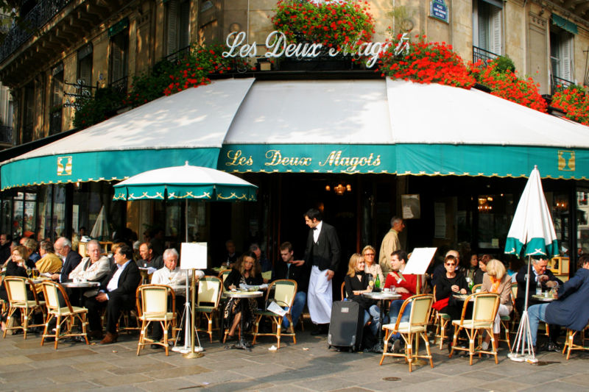
Machi ni _______ ga arimasu.
kissaten

Slide 4
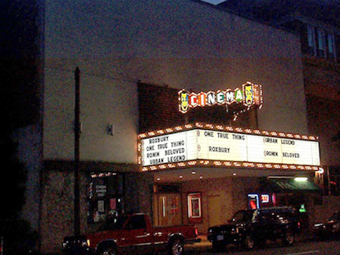
Dans ma ville il y a
Machi ni _______ ga arimasu.
eigakan

Slide 5
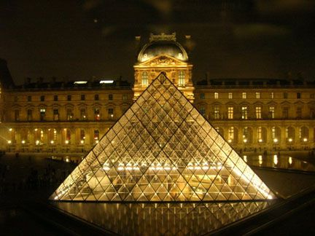
Dans ma ville il y a
Machi ni _______ ga arimasu.
hakubutsukan

Slide 6

Dans ma ville il y a
Machi ni _______ ga arimasu.
yuubinkyoku

Slide 7
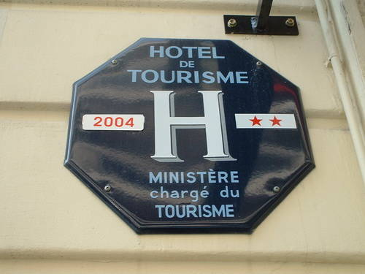
Dans ma ville il y a
Machi ni _______ ga arimasu.
hoteru

Slide 8
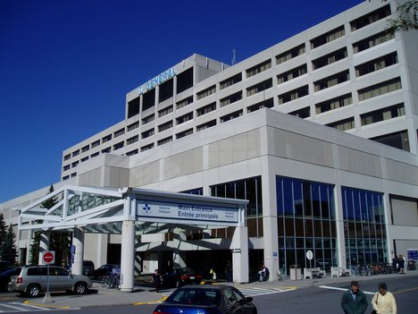
Dans ma ville il y a
Machi ni _______ ga arimasu.
byouin

Slide 9
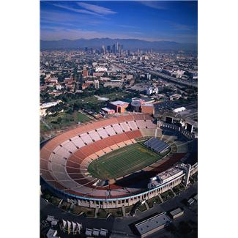
Dans ma ville il y a
Machi ni _______ ga arimasu.
sutajiamu

Slide 10
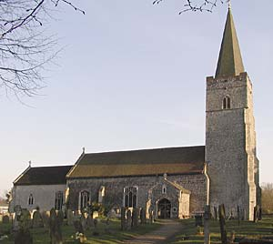
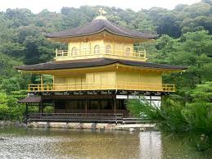
Dans ma ville il y a
Machi ni _______ ga arimasu.
otera
kyoukai

Slide 11
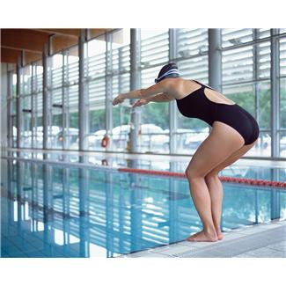
Dans ma ville il y a
Machi ni _______ ga arimasu.
suimingupuuru

Slide 12

Dans ma ville il y a
Machi ni _______ ga arimasu.
ginkou

Slide 13
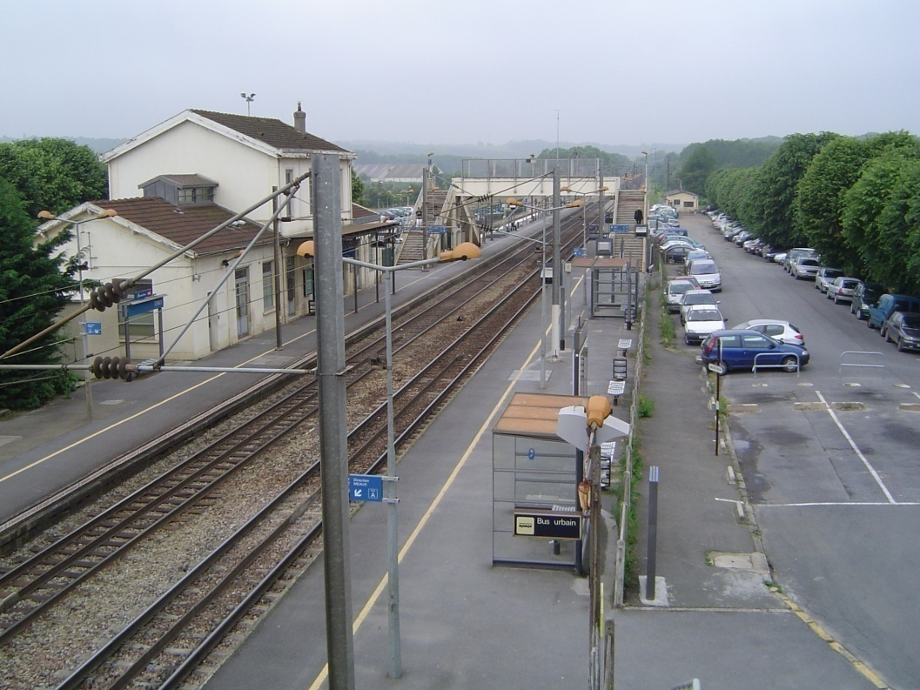
Dans ma ville il y a
Machi ni _______ ga arimasu.
eki

Slide 14
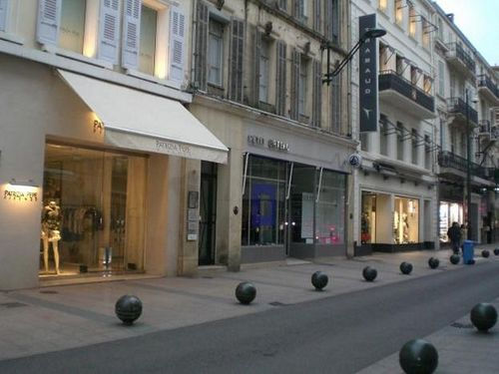
Dans ma ville il y a
Machi ni _______ ga arimasu.
mise

Slide 15
Machi ni ____ ga arimasu =
In my town there is
How many full sentences can you make in 2 minutes?
k_ssat_n
_ig_k_n
Ha_ubu_sukan
_ter_
Ho_eru
B_o_in
Suta_iam_
K_o_kai
Yu_bin_yoku
Su_mingup_uru

Slide 16

Race against a partner to hit the picture that corresponds to what your teacher says.

Slide 17


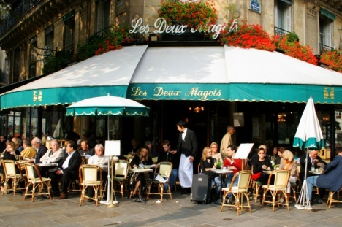

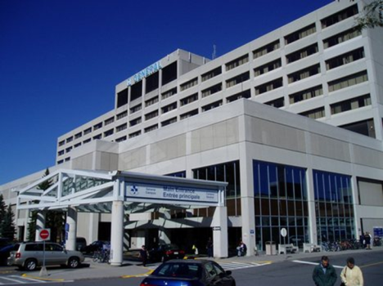

Slide 18
To = and
toshokan
ga arimasu.
toshokan
to
eigakan
ga arimasu.

Slide 19
Shikashi, ___ ga arimasen
a
b
c
d
Use ‘ga arimasen’ to say what there isn’t in your town.

Slide 20
Work with a partner
Tick off each place in your list as your partner guesses it. First to guess all 5 places is the winner!
Note 5 places
Do not show your partner
Machi ni | byouin | ga arimasu ka.
 | doubutsuen
 | yuubinkyoku
Hai, | (place) | ga arimasu.
Iie, | (place) | ga arimasen.

Slide 21
Writing practice:
?
Machi ni ginkou (1) __ (2) _____. Takusan no (3) _____ to (4) ________ mo arimasu. (5) ______, toshokan ga (6)_______.
arimasu
mise
arimasen
shikashi
ga
resutoran

