Slide 1
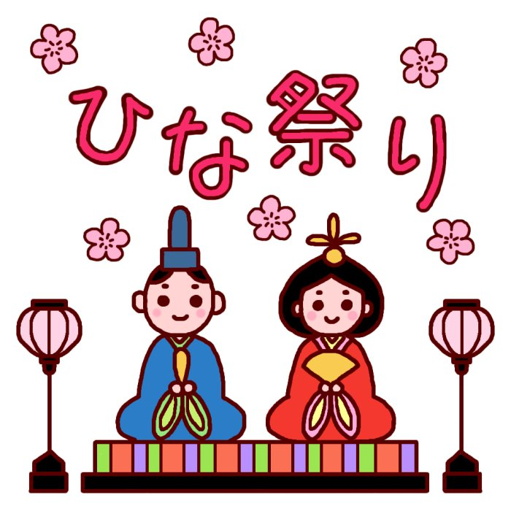
Hinamatsuri

Slide 2
When is hinamatsuri held on??
1. March 1st
2. March 3rd
3. Today

Slide 3
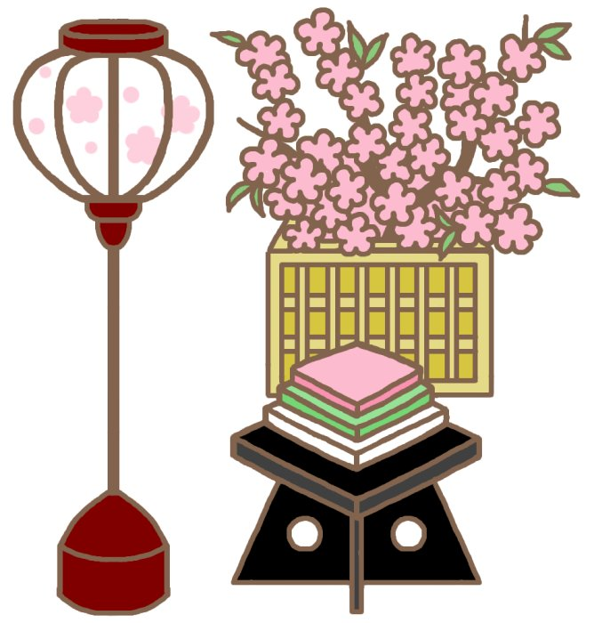
What is HINAMATSURI??
The Japanese Doll Festival(Hina-matsuri) or Girls' Day, is held on March 3. Platforms covered with a red carpet are used to display a set of ornamental dolls (hina-ningyō) representing the Emperor, Empress, attendants, and musicians in traditional court dress of the Heian period.

Slide 6
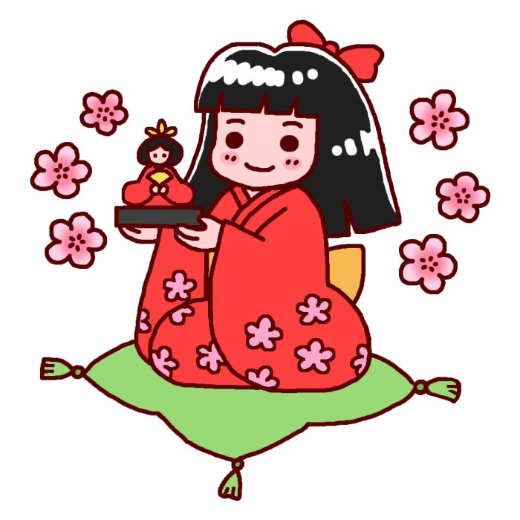
What do you eat on this Festival??

Slide 8
Lunch At school on girl’s festival

Slide 9
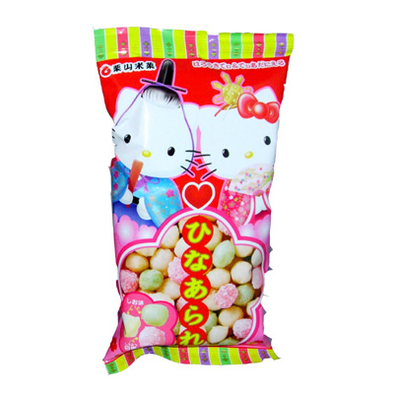
Hina-arare

Slide 12
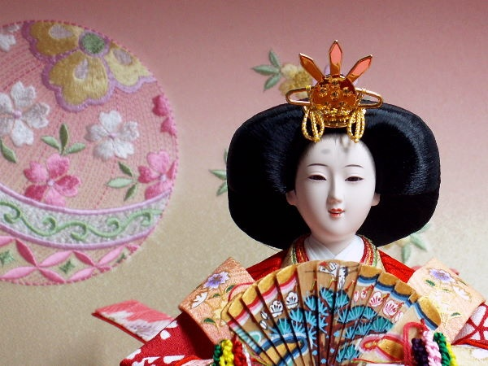
Hina-ningyou (Ornamental dolls)
Hina-Ningyou (Ornamental dolls) of today are different from traditional ones.
＊Characters
＊Animals

Slide 13
CAT dolls

Slide 14
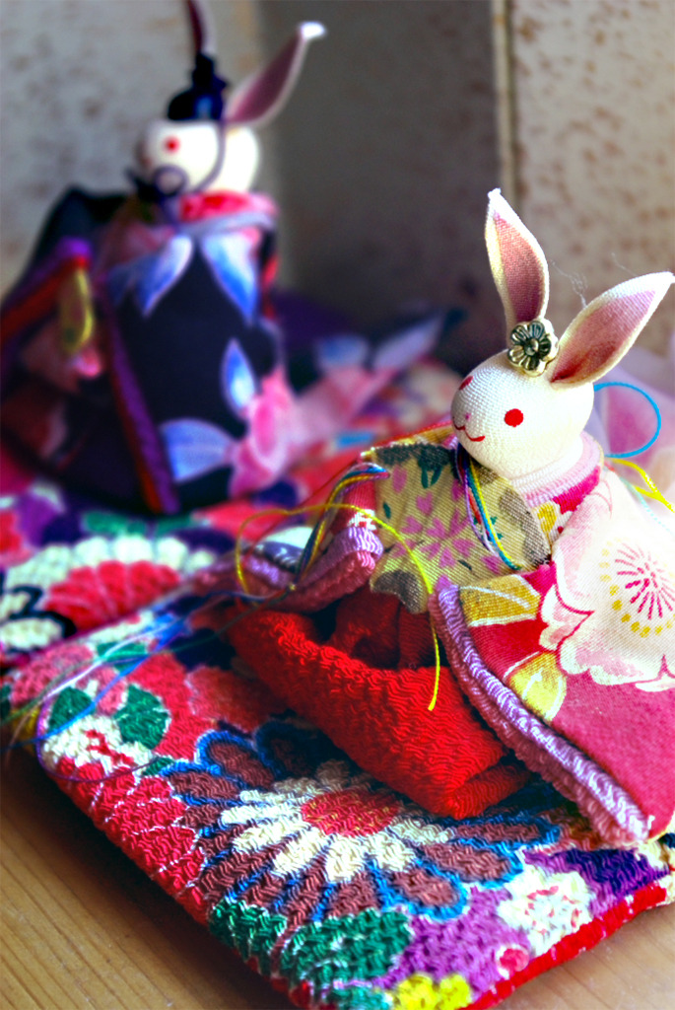
RABBIT Dolls

Slide 15
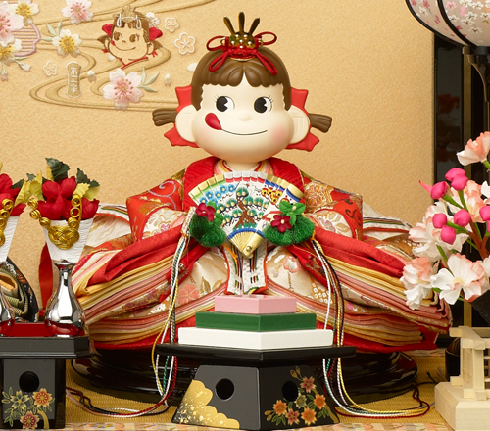

Slide 17
Choose the correct ending for the sentence.
Hinamatsuri is also known as
cherry blossom festival.
peach festival.

Slide 18
Choose the correct ending for the sentence.
Gils are given
(a) their mothers’ dolls.
(b) a new set of dolls each year.

Slide 19
Enjoy this
Girl’s festival!!

