Slide 1
Guess What?

Slide 2
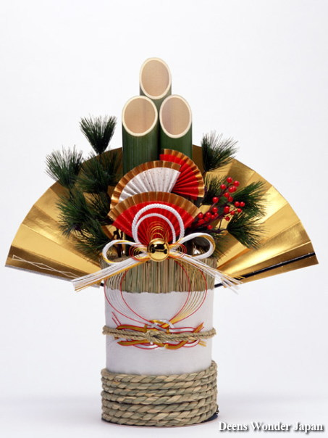
Kadomatsu is a traditional Japanese decoration of the New Year placed in pairs in front of homes to welcome ancestral spirits or kami of the harvest. They are placed after Christmas until January 7 and are considered temporary housing for kami.

Slide 3
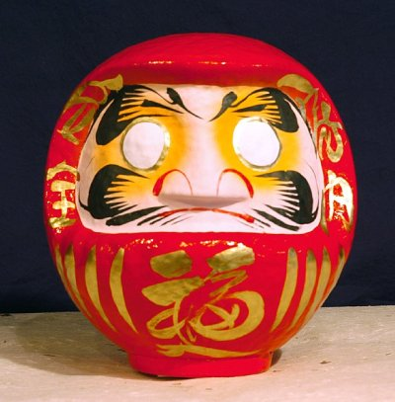
Daruma is a traditional handmade Japanese wishing doll that keeps us focused on achieving our goals. Daruma dolls are representations of the historical Indian priest Bodhidarma, a sage who traveled throughout Japan and China in the 5th or 6th century.

Slide 4
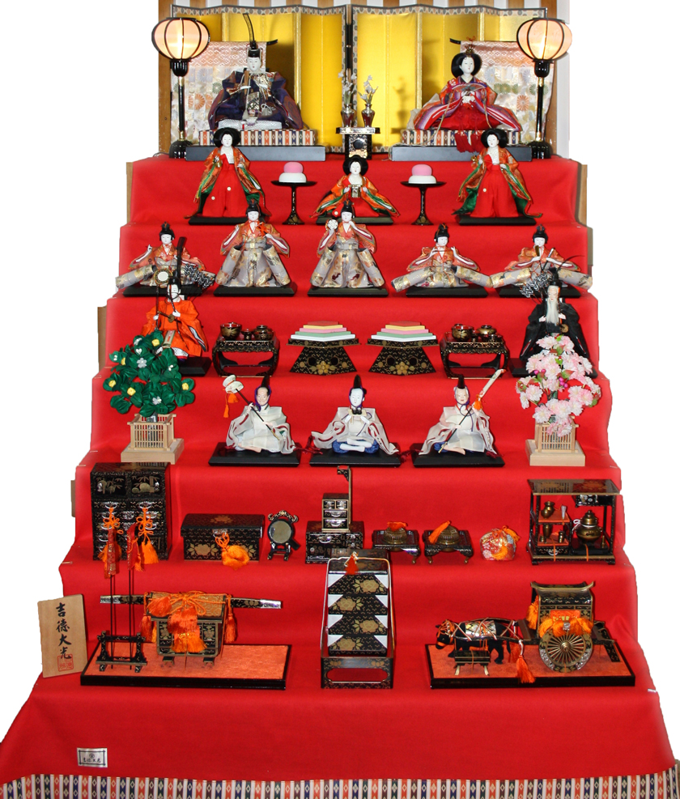
Hinamatsuri also called Doll's Day or Girls' Day, is a special day in Japan. Hinamatsuri is celebrated each year on March 3. Platforms covered with a red carpet are used to display a set of ornamental dolls (hina-ningyō) representing the Emperor, Empress, attendants, and musicians in traditional court dress of the Heian period.

Slide 5
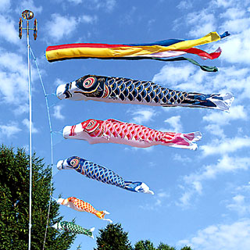
Koinobori are carp-shaped wind socks traditionally flown in Japan to celebrate Children's Day on May 5. Landscapes across Japan are decorated with koinobori from April to early May, in honor of sons for a good future and in the hope that they will grow up healthy and strong.

Slide 6
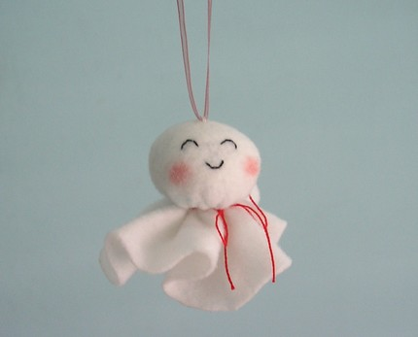
Teru Teru Bouzu is a little traditional handmade doll made of white paper or cloth that Japanese farmers began hanging outside of their window by a string. This amulet is supposed to have magical powers to bring good weather and to stop or prevent a rainy day.

Slide 7
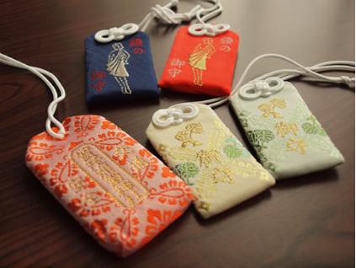
Omamori are Japanese amulets commonly sold at religious sites and dedicated to particular Shinto deities as well as Buddhist figures, and may serve to provide various forms of luck or protection.

Slide 8
Excellent!

