Slide 1
日本の動物の鳴き声
Animals in Japan

Slide 2
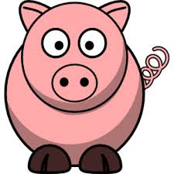
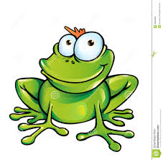
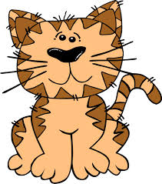
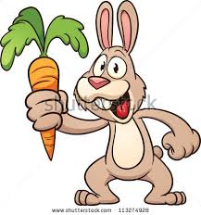
What do they say in Aus?
Dog?
Cat?
Frog?
Pig?
Rabbit?
Boing
Boing
Oink Oink
Ribbit Ribbit
Meow Meow
Woof Woof

Slide 3
What do they say in 日本?
- Pig = Buta ぶた
- Rabbit = Usagi うさぎ
Dog = Inu いぬ
Cat = Neko ねこ
Frog = Kaeru かえる
Pyon Pyon
Buu Buu
Kero Kero
Nya Nya
Wan Wan
ピョンピョン
ブウブウ
ケロケロ
ニャニャ
ワンワン

Slide 4
Old mcdonald
Old McDonald had a farm
Eeiieeiioo
On that farm he had a _______.
Eeiieeiioo.
With a ___ ___ here and a ___ ___ There
Here a ___ there a ___ everywhere a ___ ___
Old McDonald had a farm
Eeiieeiioo.
Makku jiisan no makiba de
Eeiieeiioo
Katteru no wa ______ de su
Eeiieeiioo
___, ____, ___
(animal) ___, ____, ___
Achimo kochimo doko de mo___, ____
Eeiieeiioo

Slide 5
Makku jiisan no makiba de
Eeiieeiioo
Katteru no wa ______ de su
Eeiieeiioo
___, ____, ___
(animal) ___, ____, ___
Achimo kochimo doko de mo___, ____
Makku jiisan no makiba de Eeiieeiioo
Notes:
https://www.youtube.com/watch?v=SZg4kly7E0I

