Slide 1
DATES
MONTHS, DAYS OF THE MONTH, DAYS OF THE WEEK

Slide 2
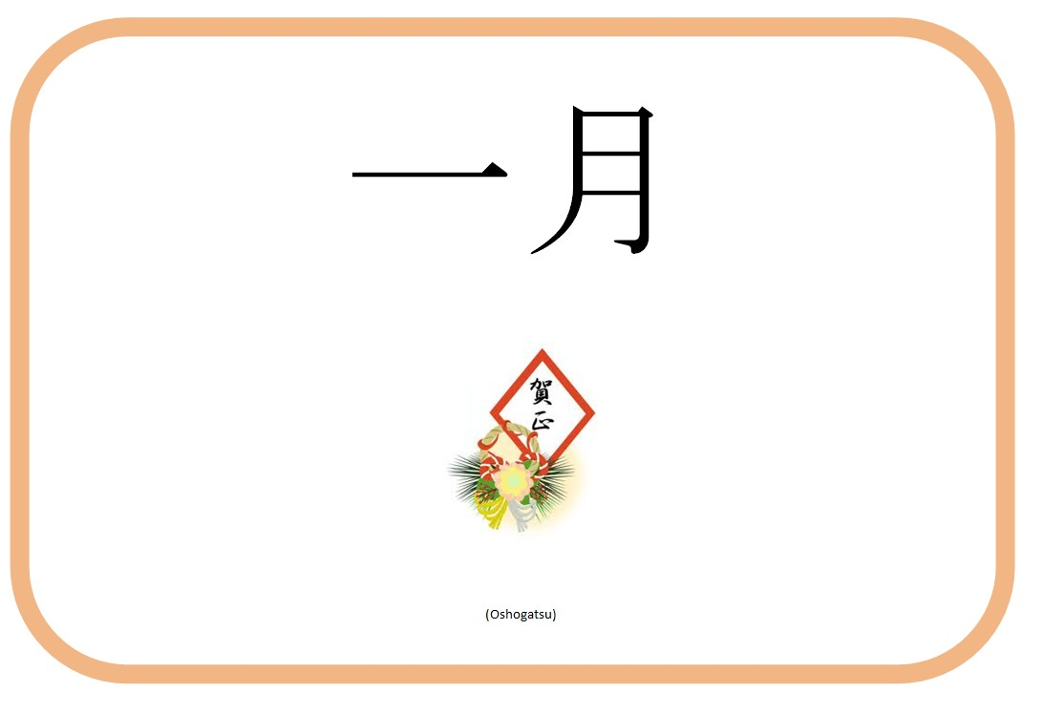
Ichi-Gatsu

Slide 3
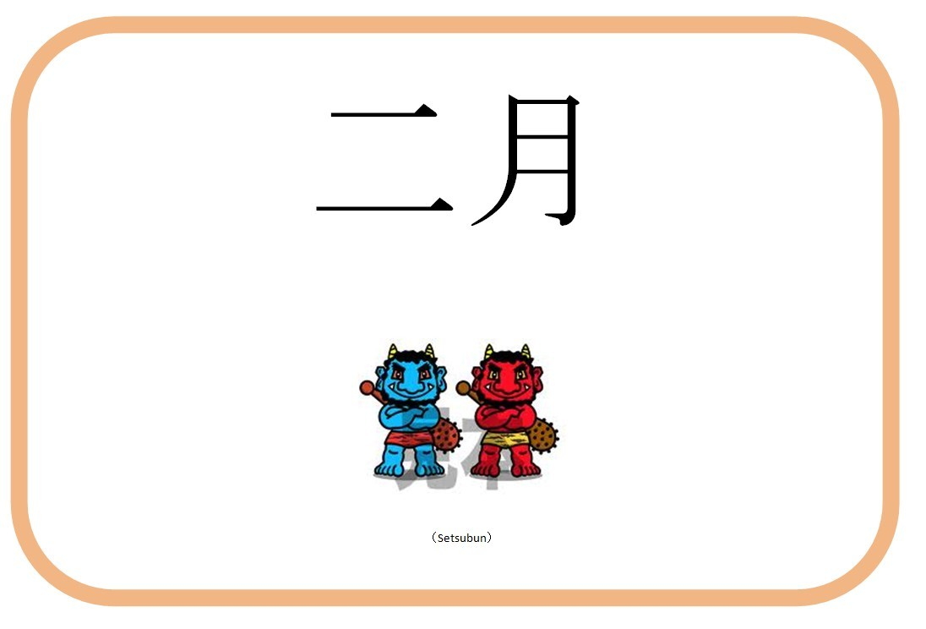
ni-Gatsu

Slide 4
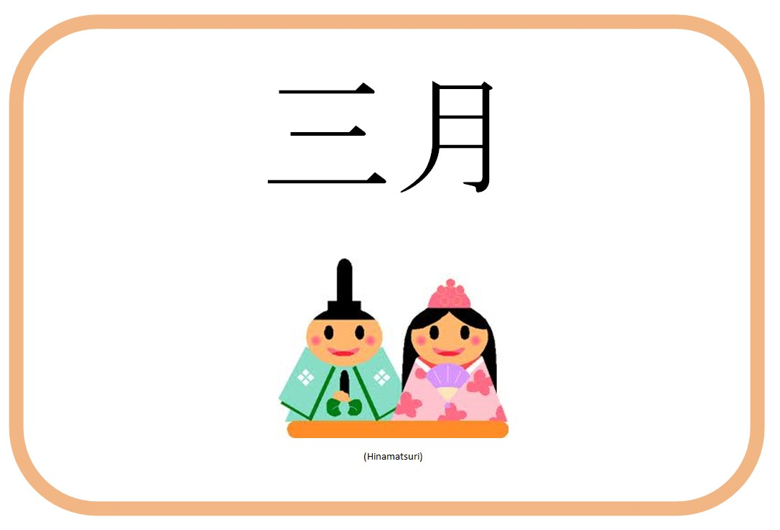
san-Gatsu

Slide 5
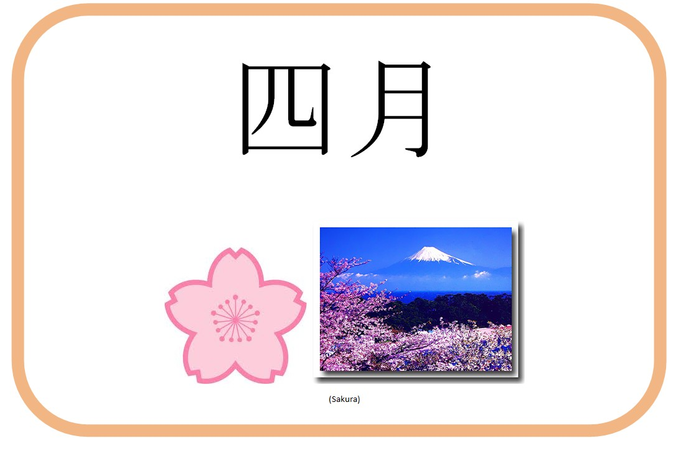
shi-Gatsu

Slide 6
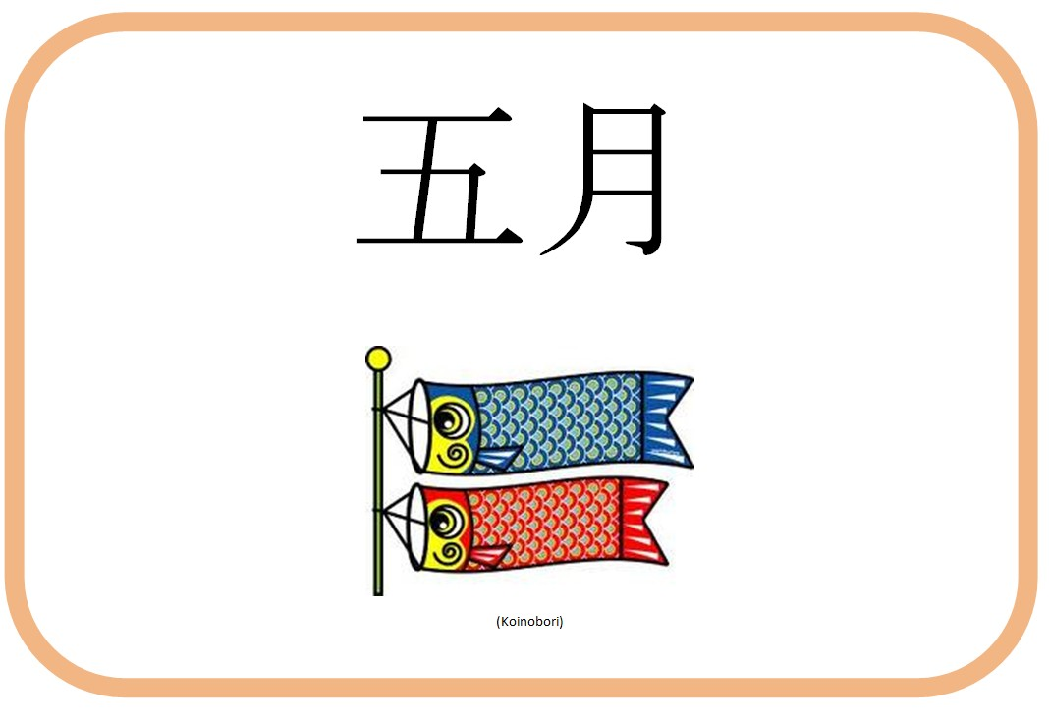
go-Gatsu

Slide 7
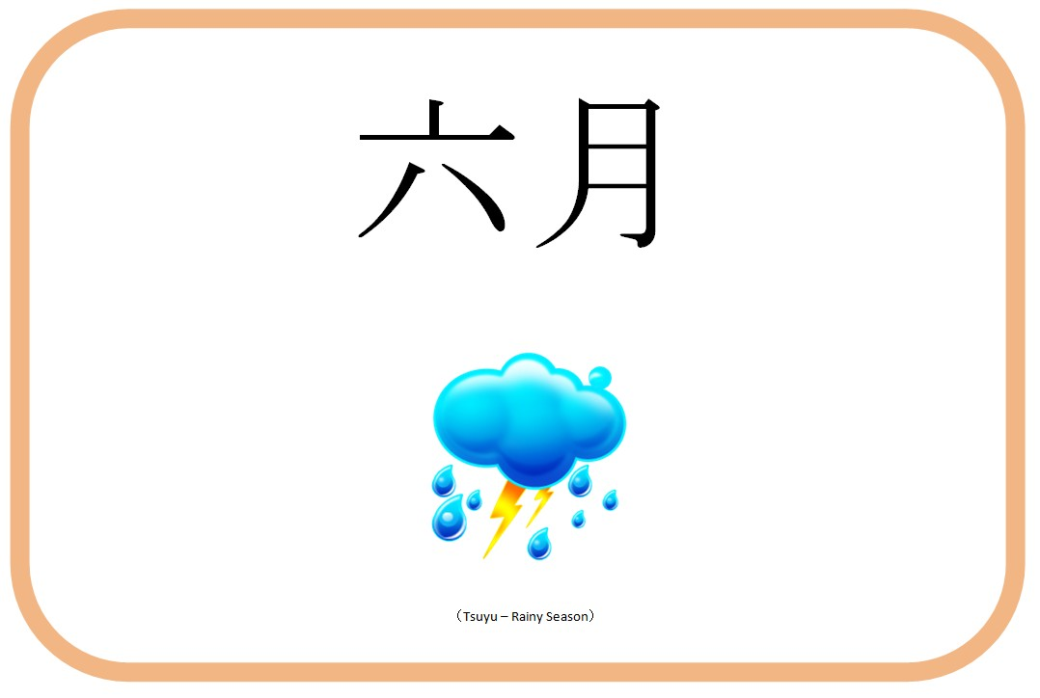
roku-Gatsu

Slide 8
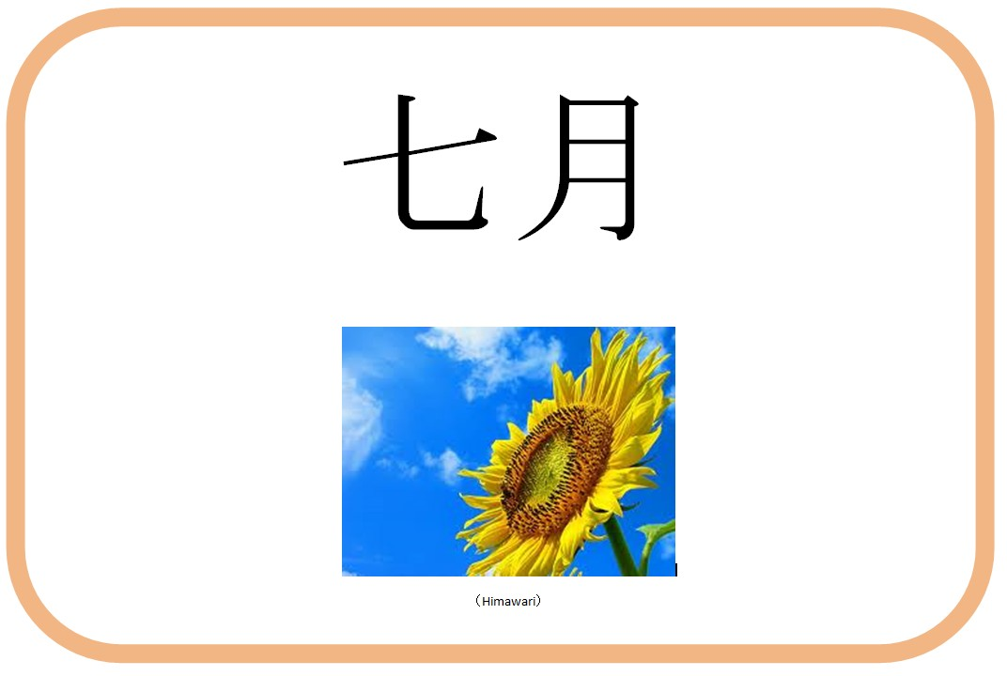
shichi-Gatsu

Slide 9
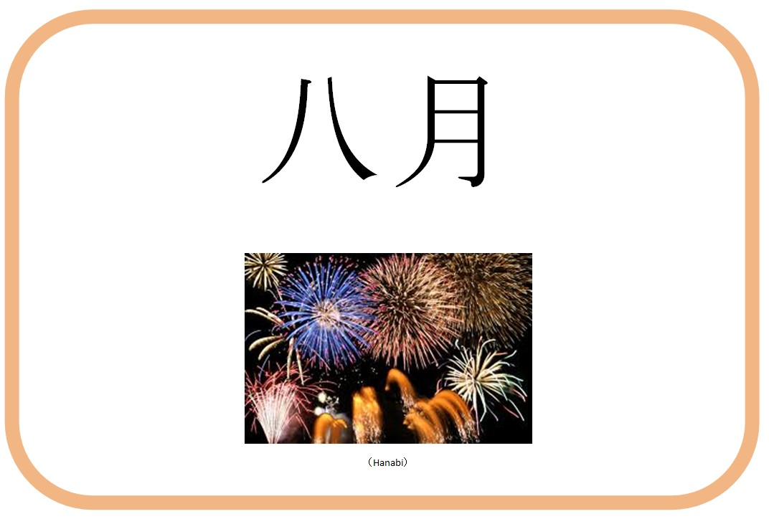
hachi-Gatsu

Slide 10
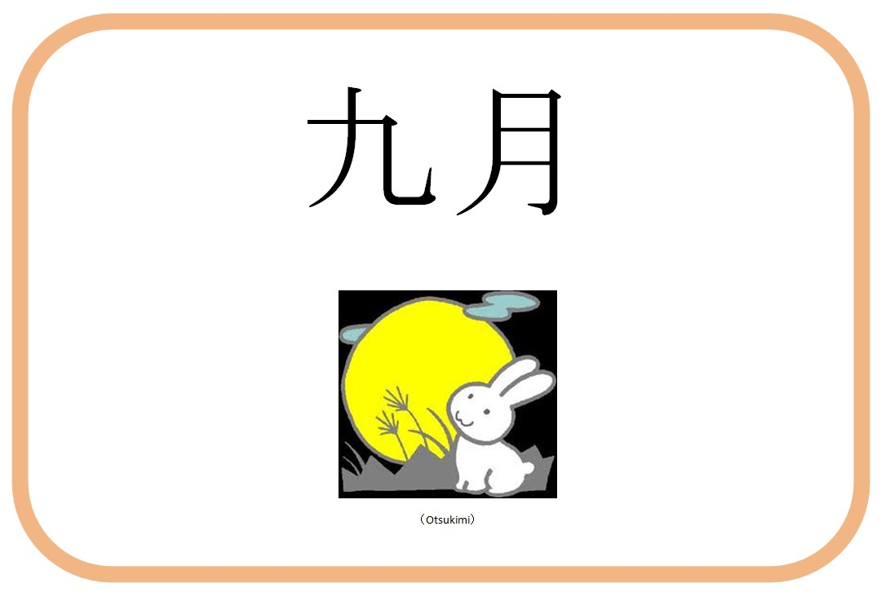
ku-Gatsu

Slide 11
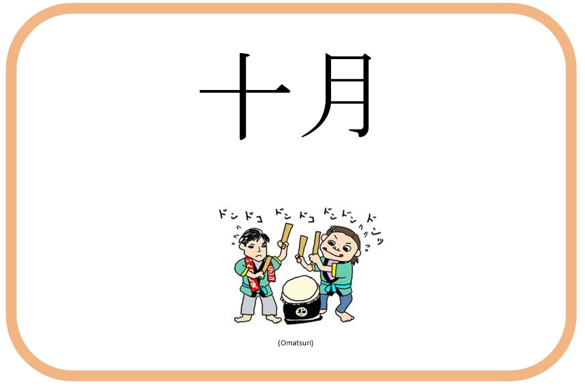
jū-Gatsu

Slide 12
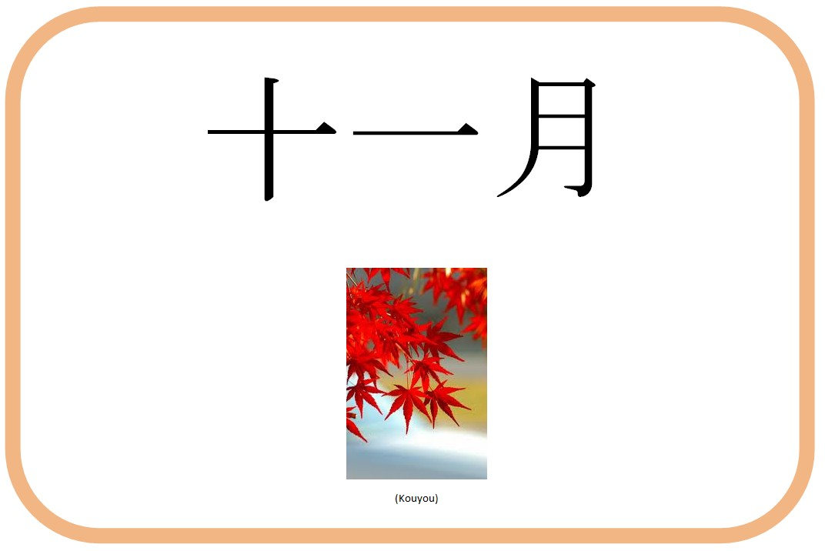
Jū Ichi-Gatsu

Slide 13
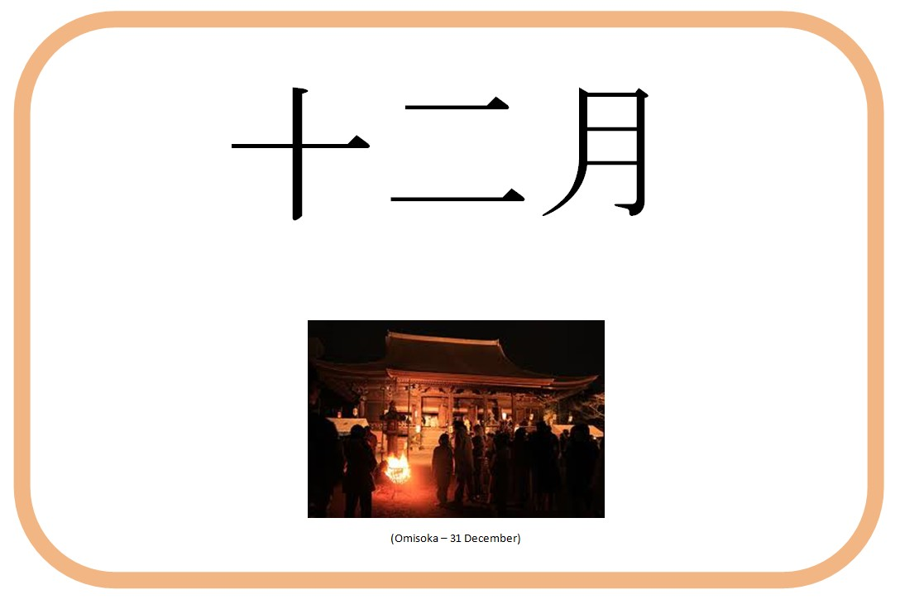
Jū ni-Gatsu

Slide 14
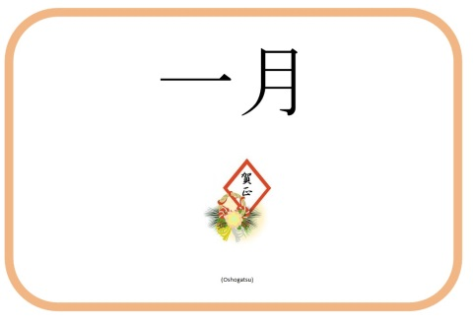

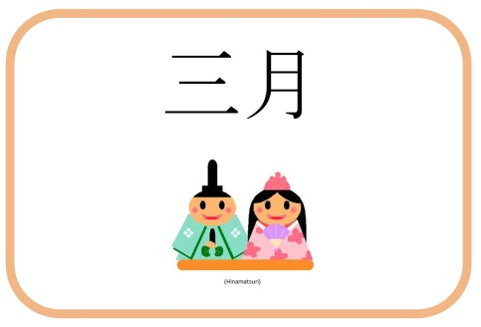

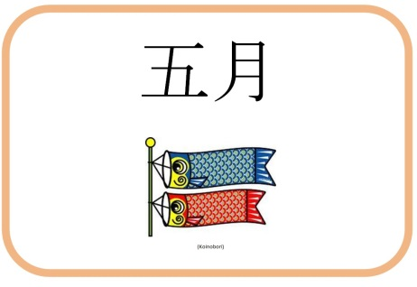
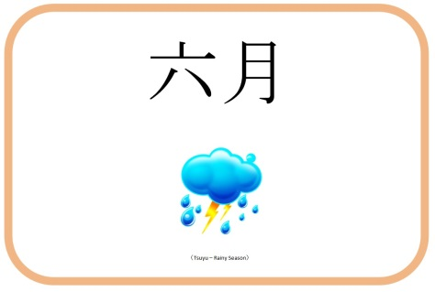
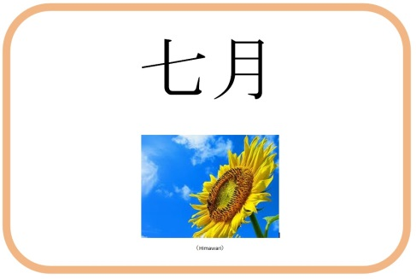

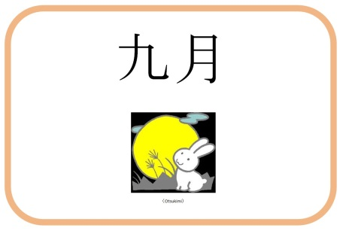
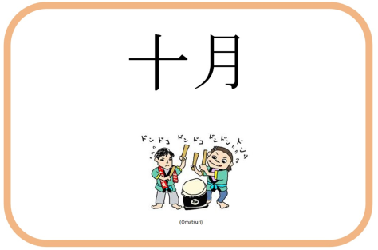
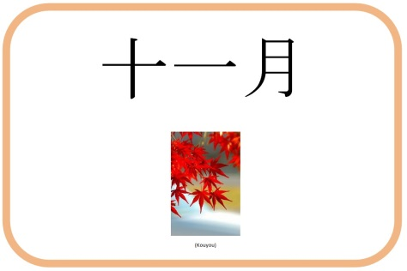


Slide 15
Months Summary
English | Japanese
January | Ichi gatsu
February | Ni gatsu
March | San gatsu
April | Shi gatsu
May | Go gatsu
June | Roku gatsu
English | Japanese
July | Shichi gatsu
August | Hachi gatsu
September | Kyu gatsu
October | Jū gatsu
November | Jū ichi gatsu
December | Jū ni gatsu

Slide 16
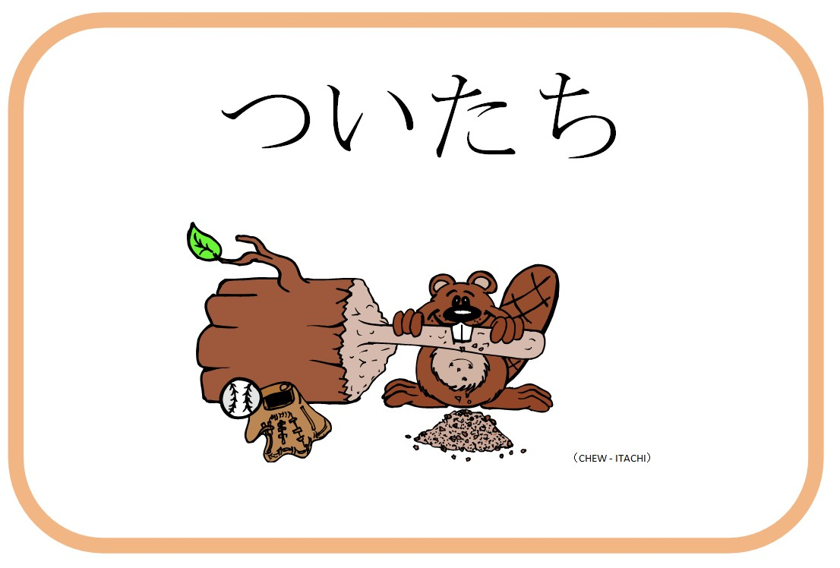
tsuitachi

Slide 17
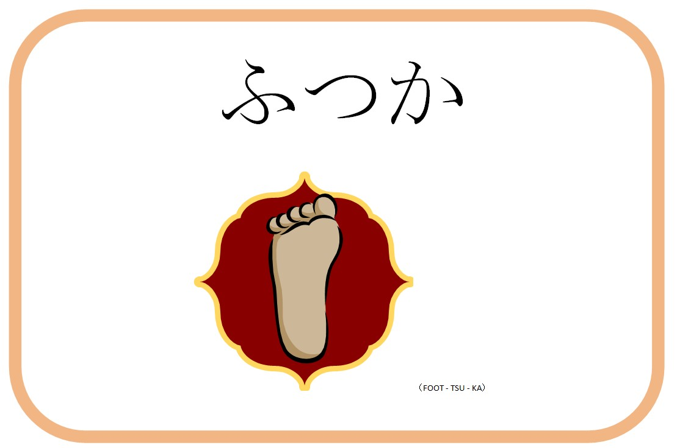
futsuka

Slide 18
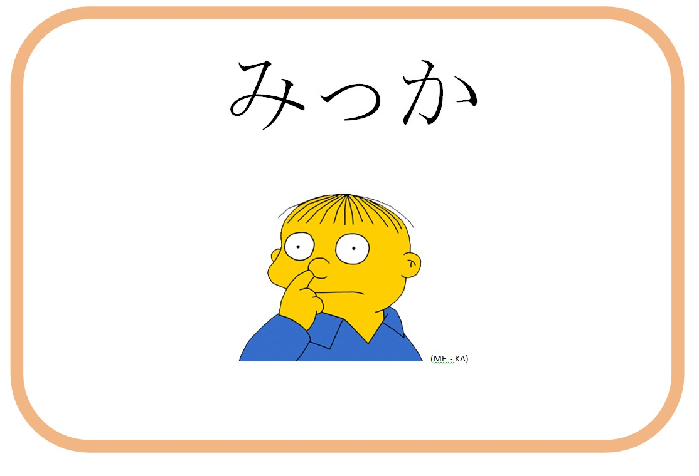
mikka

Slide 19
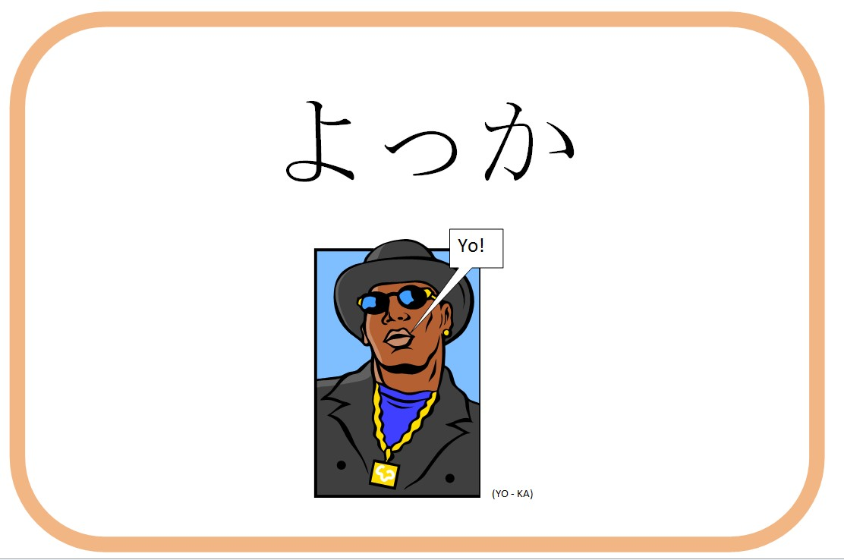
yokka

Slide 20
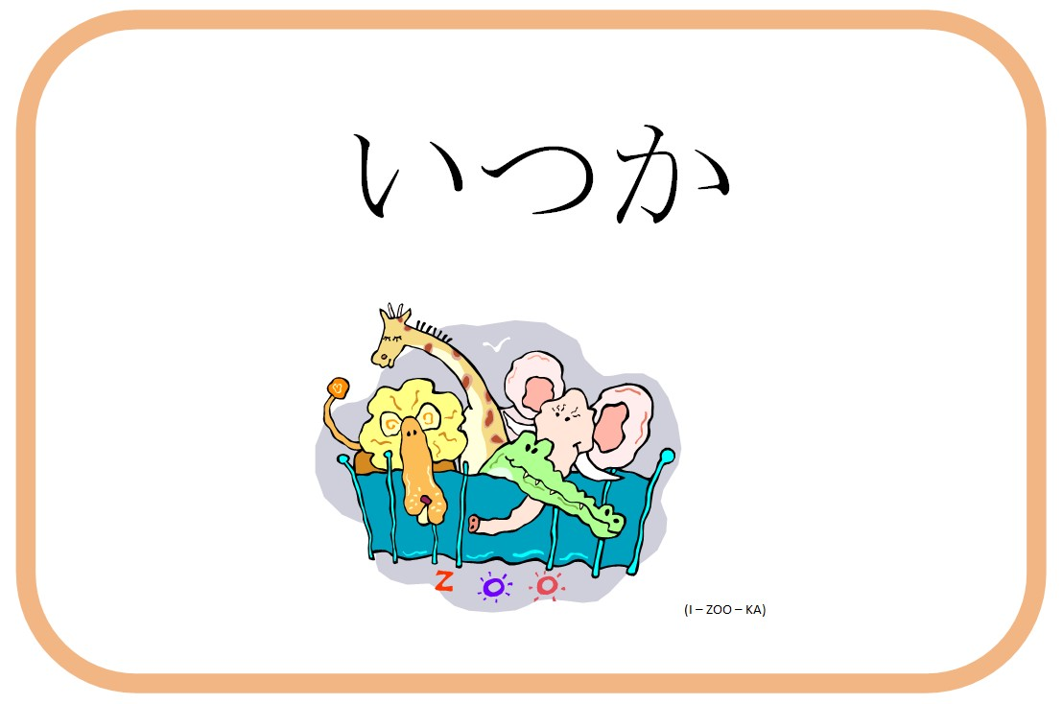
itsuka

Slide 21
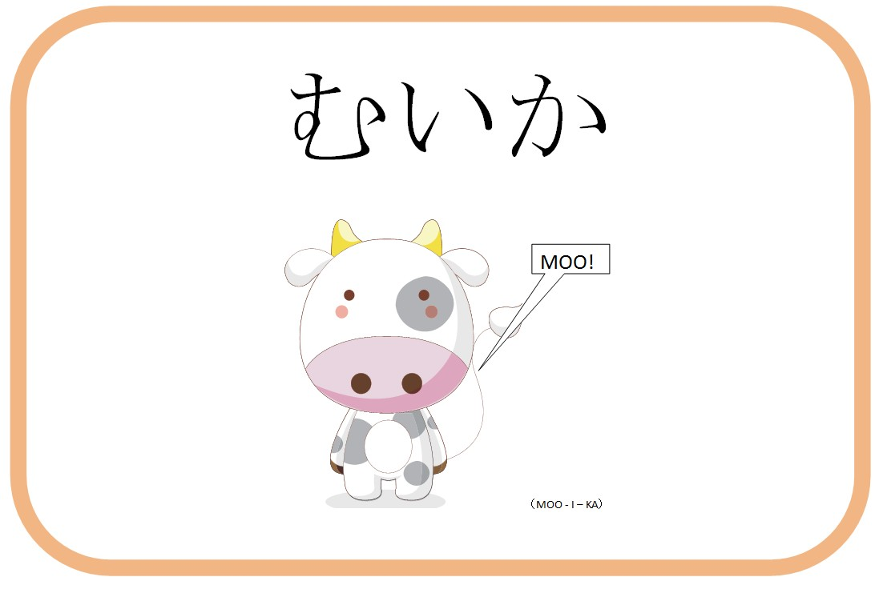
muika

Slide 22
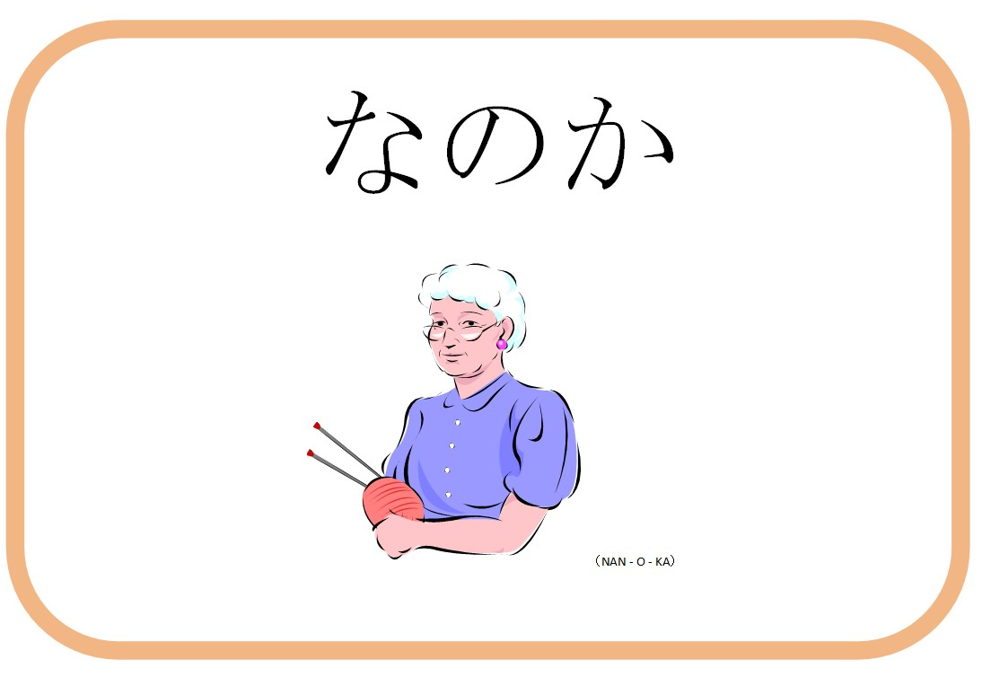
nanoka

Slide 23
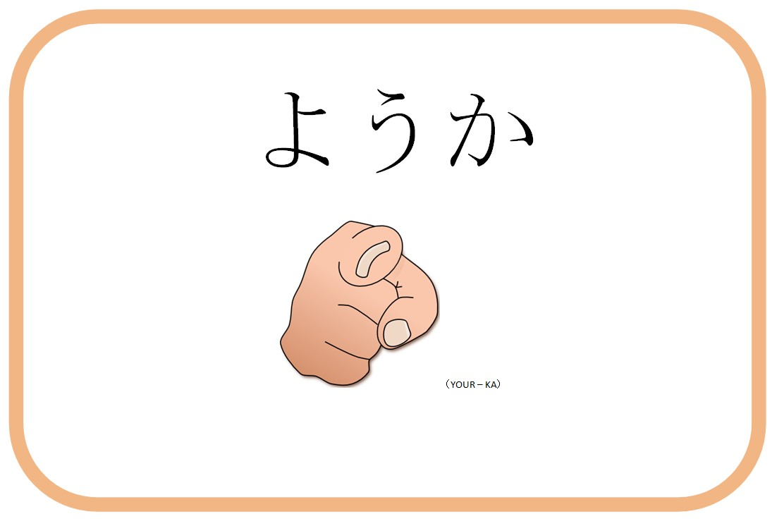
yōka

Slide 24
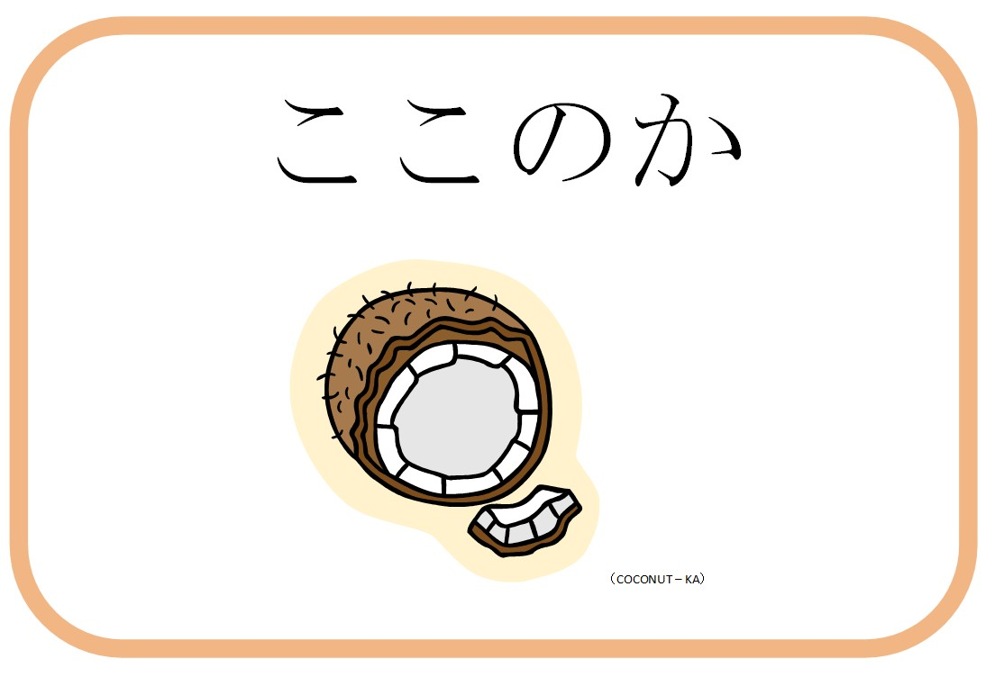
kokonoka

Slide 25
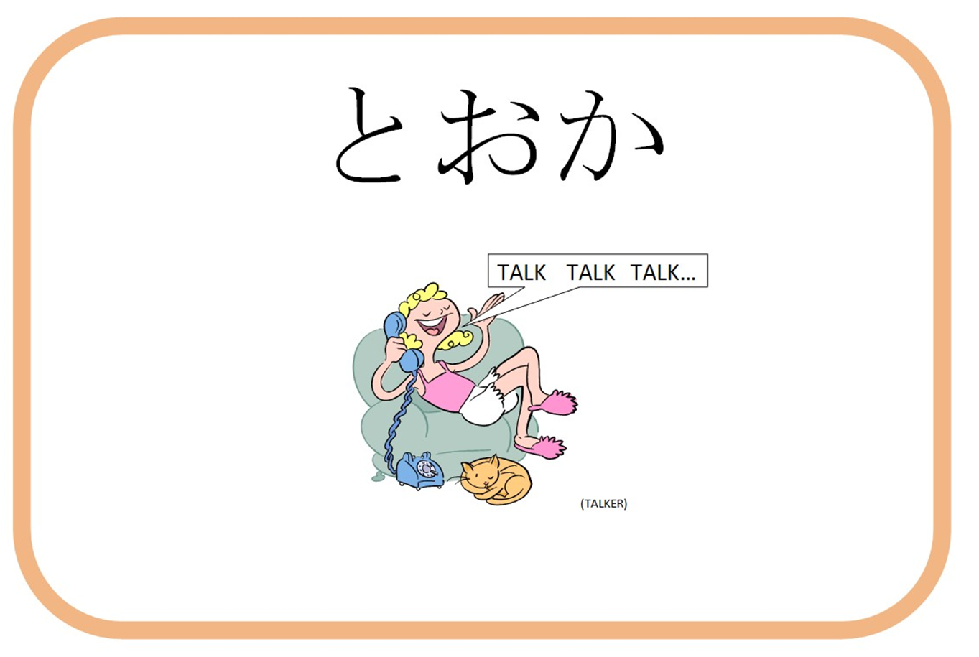
tōka

Slide 26


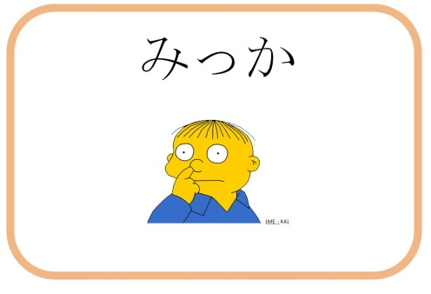

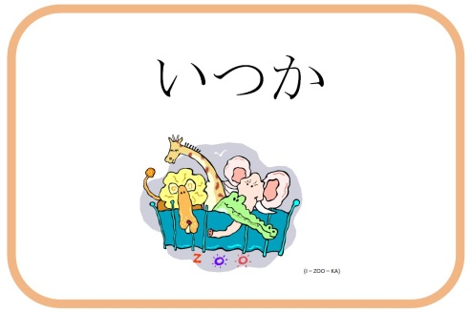
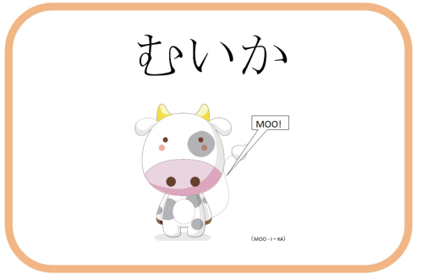





Slide 27

DAYS OF THE MONTH SUMMARY
English | Japanese
First | Tsuitachi
Second | Futsuka
Third | Mikka
Fourth | Yokka
Fifth | Itsuka
Sixth | Muika
Seventh | Nanoka
Eighth | Yōka
Nineth | Kokonoka
Tenth | Tōka
After the tenth day:
Number + nichi
Eg. 15th – jūgo nichi
23rd- nijūsan nichi
Exceptions:
14th – jūyokka
20th – hatsuka
24th- nijūyokka

Slide 28
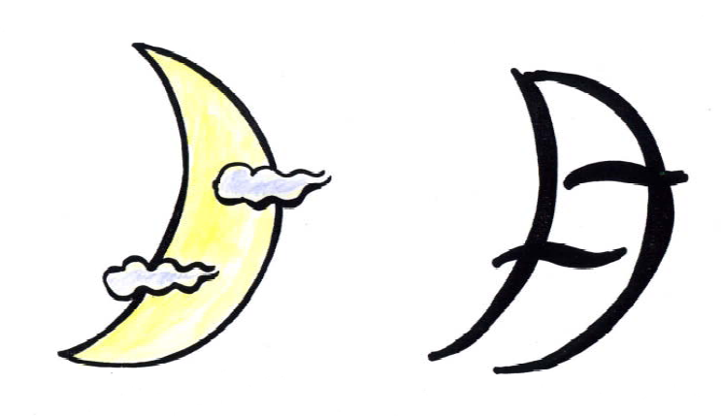
Getsuyōbi げつようび
MONDAY

Slide 29
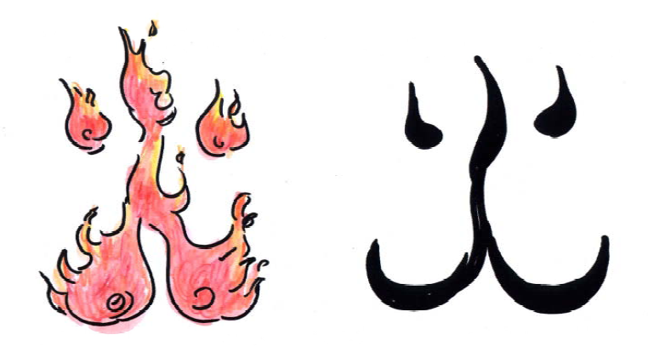
KAyōbi かようび
TUESDAY

Slide 30
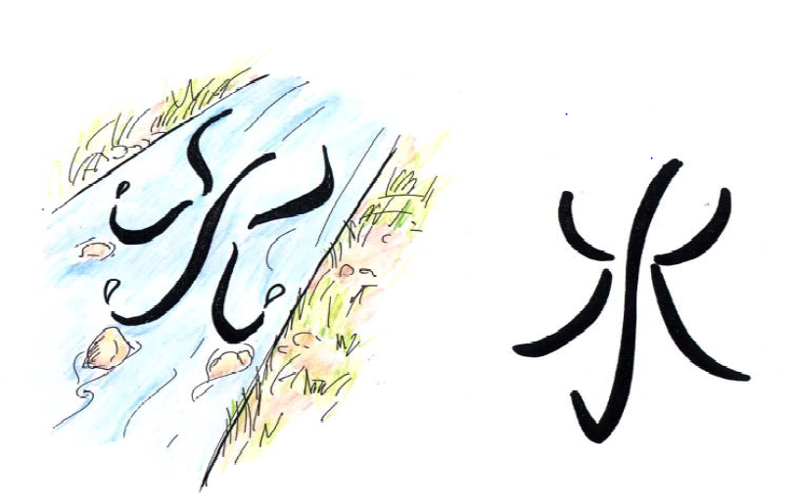
SUIyōbi すいようび
WEDNESDAY

Slide 31
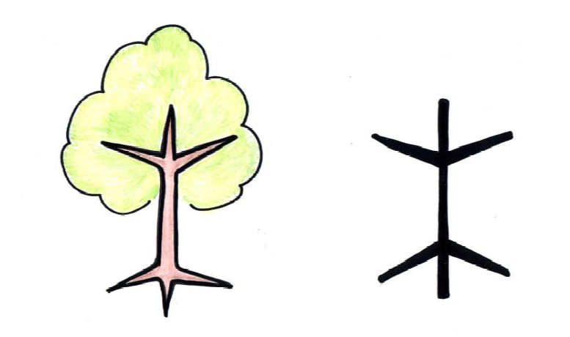
MOKUyōbi もくようび
THURSDAY

Slide 32
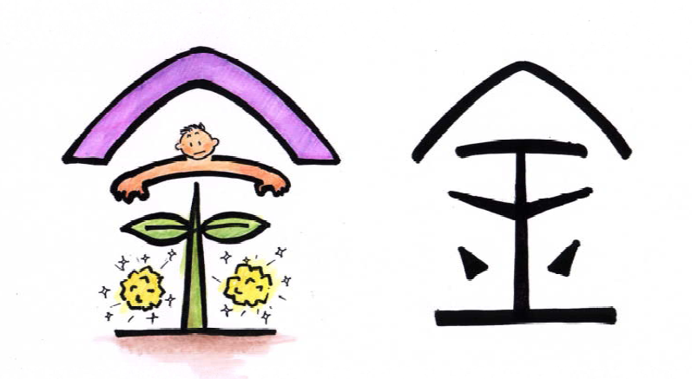
KINyōbi きんようび
FRIDAY

Slide 33
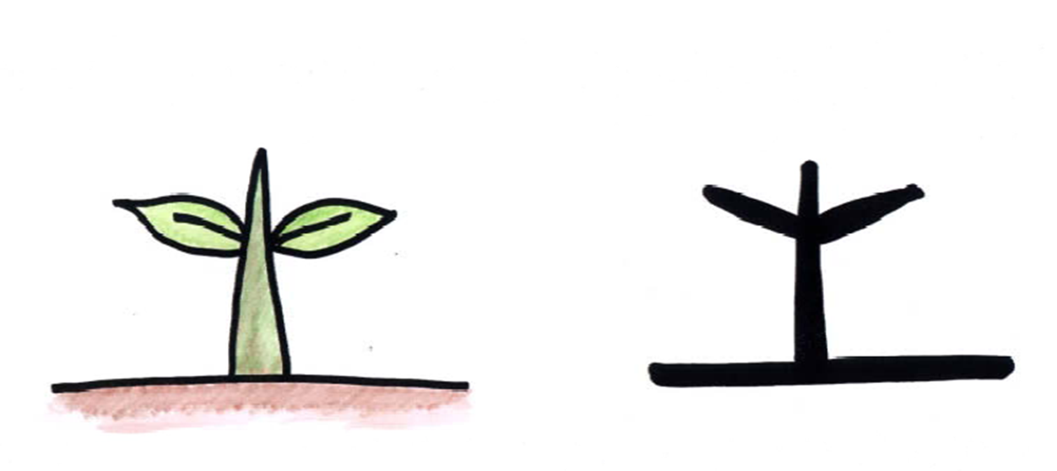
DOyōbi どようび
SATURDAY

Slide 34
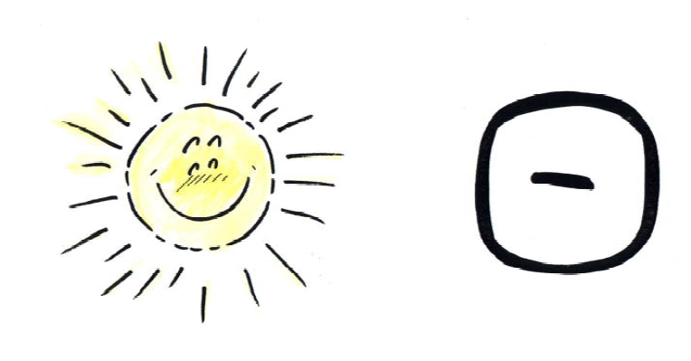
NICHIyōbi にちようび
SUNDAY

Slide 35








Slide 36
DAYS of the week SUMMARY
English | Japanese
Monday | Getsuyōbi
Tuesday | Kayōbi
Wednesday | Suiyōbi
Thursday | Mokuyōbi
Friday | Kinyōbi
Saturday | Doyōbi
Sunday | Nichiyōbi

